Slide 1

DEPARTMENT OF CSE (ARTIFICIAL INTELLIGENCE AND MACHINE LEARNING) ACADEMIC YEAR 2025 - 2026 SEMESTER III ARTIFICIAL INTELLIGENCE LABORATORY MINI PROJECT REVIEW AI QUIZ MASTER USING NAÏVE BAYES
REGISTER NUMBER | 2117240030007
NAME | Anjali C
YEAR | II
SECTION | A
FACULTY IN-CHARGE | Mrs. M. Divya

Slide 2
PROBLEM STATEMENT
Overview: Artificial Intelligence enables machines to mimic human reasoning, understanding, and learning. One interesting educational application of AI is in developing intelligent quiz systems that can evaluate user answers beyond simple text matching.
Problem Statement: To develop an AI-based quiz master that accepts text answers from users and classifies them as correct or incorrect using the Naive Bayes probabilistic model.
Expected Result: A functional text-based quiz system that evaluates user input accurately using probability-based classification.
Possibilities: 1.Expanding the system for multiple topics and difficulty levels. 2.Integrating natural language understanding for descriptive answers. 3.Adding speech-based answering using speech recognition.

Slide 3
THEORETICAL BACKGROUND
Theoretical Background: Naive Bayes is a probabilistic model derived from Bayes’ Theorem. It predicts the likelihood of a class based on given evidence (features). It assumes independence between words in a text, making it simple yet effective for text classification tasks. Formula: P(C∣X)= P(X∣C)×P(C)/ P(X)
Literature Survey:
McCallum & Nigam (1998) – Text classification with Naive Bayes models.
Raschka (2015) – Practical Python implementation of Naive Bayes.
Scikit-learn (2024) – Efficient implementation for machine learning tasks.
GeeksforGeeks (2021) – Tutorials on text classification using Naive Bayes..
Algorithm Explanation:
Collect sample correct and incorrect answers for each question.Convert text into numerical form using TF–IDF Vectorizer.
Train the Naive Bayes model on these examples.
Accept the user’s answer as input and transform it using the same vectorizer.
Predict whether the answer is Correct or Incorrect based on probability.
Display feedback and update the quiz score.

Slide 4
IMPLEMENTATION AND CODE
Link to code in Git-hub Repository
List | Git-hub Repository Links
Implementation of Code Link | https://github.com/AnjaliChakravarthi/AI-Quiz-Master/blob/main/ai_quiz_master_nb.py
Word Document Report Link | https://github.com/AnjaliChakravarthi/AI-Quiz-Master/blob/main/AI%20REPORT_ANJALI.docx
PPT Link | https://github.com/AnjaliChakravarthi/AI-Quiz-Master/blob/main/AI_PPT_ANJALI.pptx

Slide 5
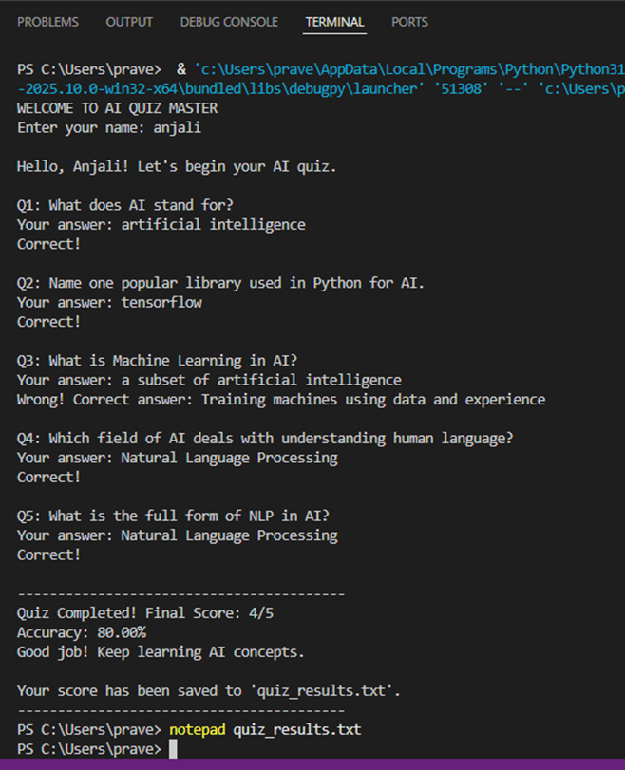
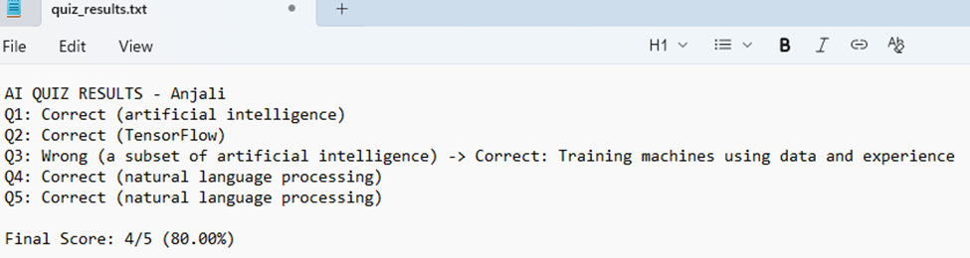
OUTPUT AND RESULTS

Slide 6
OUTPUT AND RESULTS
Explanation:
The program presents questions, receives user input, and uses Naive Bayes to evaluate correctness. It shows feedback, calculates total score, and saves the result in a text file. Results:
Successfully implemented a text-based quiz system using Naive Bayes classification.
Demonstrates probabilistic text analysis.
Accurately identifies correct answers for factual questions.
Future Enhancements:
Integrate semantic models (Word2Vec/BERT) for deeper language understanding.
Add GUI with Tkinter or Streamlit for better user interaction.
Maintain a database of questions and analytics for progress tracking.Deploy as a web-based AI quiz platform for adaptive learning.

Slide 7
REFERENCES
McCallum, A. & Nigam, K. (1998). A Comparison of Event Models for Naive Bayes Text Classification.
Raschka, S. (2015). Python Machine Learning. Packt Publishing.
Scikit-learn Documentation – https://scikit-learn.org
GeeksforGeeks (2021). Text Classification using Naive Bayes in Python.
Towards Data Science (2022). Understanding Naive Bayes for NLP Tasks.

