Slide 1
PRESENTATION TITLE
Home Loan Space
18-03-2023

Slide 2
TEXT LAYOUT 1
Agenda
Data Science Lifecycle​
Project Overview​
Process Overview
Data
Analysis
Modeling
Model Evaluation
Recommendations

Slide 3
TEXT LAYOUT 1
Data Science Lifecycle
Business Understanding
Data Understanding
Data Preparation
Modelling
Evaluation
Deployment

Slide 4
TEXT LAYOUT 1
Project Overview
Business Problem: The current home loan applications require loan officers to process manually, which takes 2 to 3 days to make the decision and notified outcome to the applicant.
Business Objective: To improve the manual process and reduce the amount of application processing time
Hypothesis: Based on historical data we can use machine learning to predict the loan status of a potential borrower such that the time taken for them to receive their respective statuses is reduced significantly.

Slide 5

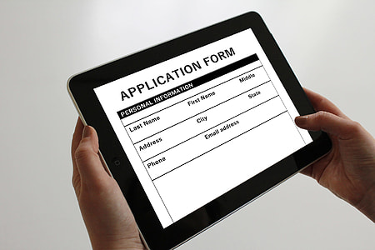


TEXT LAYOUT 1
Process Overview
Applicant
An applicant can apply on any device by filling his/her information (Gender, Marital Status, Income etc.). Upon completion the machine learning model will be triggered to make a predict (based on historical data that it has been trained). The prediction will appear on the device as Accept or Decline on the same device within few seconds

Slide 6
TEXT LAYOUT 1
Data
The number of historical data records: 614
The number of new data records: 367
The number of columns: 13
The number of numerical columns: 5
The number of categorical columns: 8
Target/Loan Status – Y(422) and N(192)

Slide 7
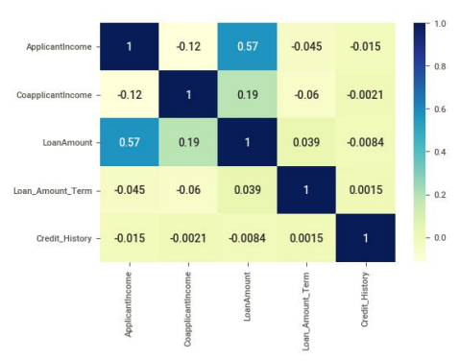
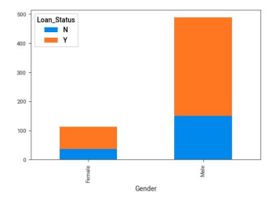
Analysis

Slide 8
TEXT LAYOUT 1
Modeling
One machine learning model trained and AutoML used as well.
-Bespoke model required preprocessing
-AutoML did not
-Results fairly similar

Slide 9

TEXT LAYOUT 1
Model Evaluation
- where accuracy is the sum of all the correct predictions made by the model over all predictions made.

Slide 10
TEXT LAYOUT 1
Recommendations
Bespoke ML > AutoML
We understand/know exactly what went in, how it went in and what algorithm was used to achieve the objective
Less time training (works in our favour if we train and predict in real time – maybe not applicable in this use case)
AutoML is best used as a baseline model.

