Slide 1
Property Analysis

Slide 2
Project Overview
Role: data scientist at Airbnb
Project Description: a start-up that lists properties on behalf of Airbnb hosts.
Data Description:
dataset airbnb_listings_information.csv includes the details for a sample of historic Airbnb listings for London.
data_dictionary_airbnb.xlsx data dictionary describing the fields within the dataset.
Problem Statement:
The firm intends to use a model to advise their clients on how to set a competitive price for their first listing on Airbnb. The model must predict the expected price of a new listing using at least the features of the property itself (including location and amenities) and listing parameters (e.g. min nights, accommodates and availabilities).
Objective:
To prepare a model to advise the clients to set competitive price for their first listing on Airbnb based on the features of the property (including location and amenities) and listing parameters (e.g. min nights, accommodates and availabilities).

Slide 3


Project Flow
Training Data
airbnb_listings_information.csv
airbnb_listings_information_processed.csv
Model Evaluation
Data preprocessing
Feature Handling
Data Modeling
Save Best Model
Testing Data
Deploy Save Model

Slide 4
Data Cleaning
Plot histogram and Boxplot to data distribution representation and detect Outliers values in data
Find Duplicates and Missing records in data.
The Dataset has total 76606 records includes the details for a sample of historic Airbnb listings for London data with 19 features
we use Winsorize Method and make our upper and lower limits for data our new maximum and minimum points.

Slide 5
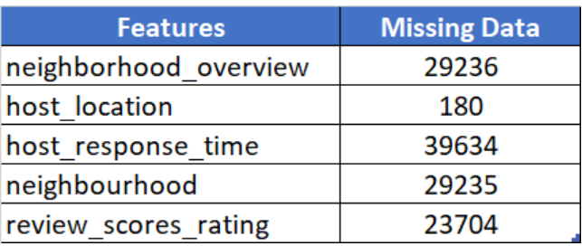
Data Acquisition
The Dataset has total 76606 records includes the details for a sample of historic Airbnb listings for London data with 19 features ('neighborhood_overview', 'host_name', 'host_location', 'host_about','host_response_time', 'host_verifications', 'neighbourhood','property_type', 'room_type', 'amenities', 'host_is_superhost','accommodates', 'bedrooms', 'beds', 'price', 'minimum_nights','number_of_reviews', 'review_scores_rating', 'instant_bookable’).
After removing redundant index, host_name and host_about, there is 17 features.
Where we explore 251 data records has duplicated values and handle this redundancy by remove duplicate data.
Handled missing data filling by 0 for review_scores_rating, by 'No Overview' for neighborhood_overview, host_location record by 'Other', by 'unknown' for host_response_time,by 'Other' for neighbourhood

Slide 6
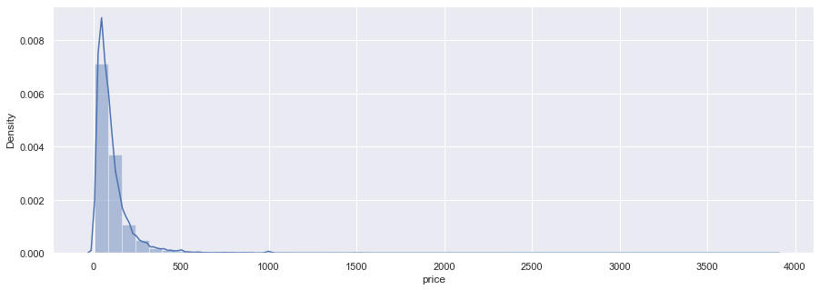
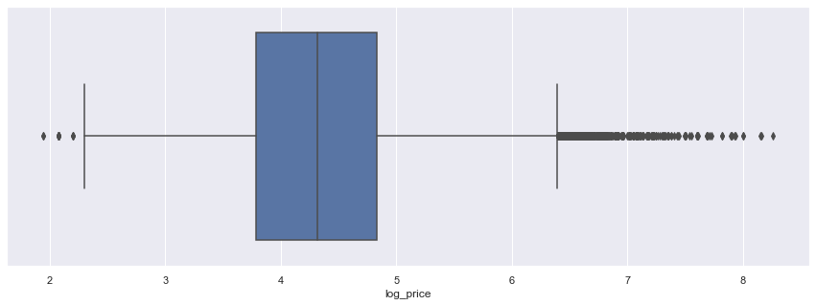
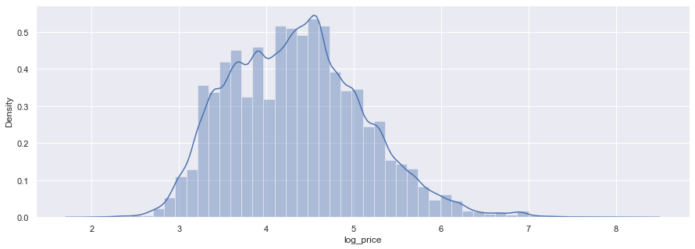
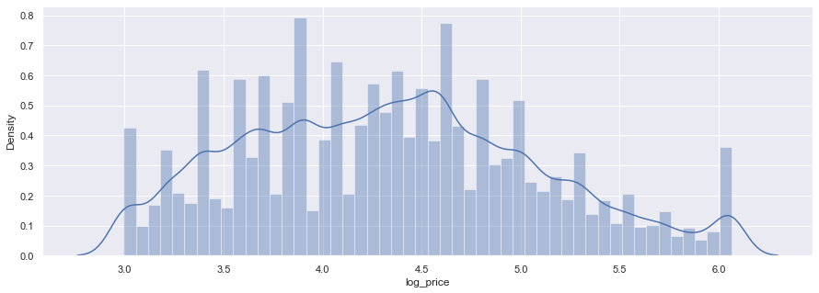
Property Price
The prices for the listings in the dataset are greatly skewed to the right as shown below. This causes a non-linear relationship between the price and features.
Detect Outliers in Price
We take the natural logarithm of the price to make the effective relationship non-linear, while still preserving the linear model.
After Handling Outliers

Slide 7
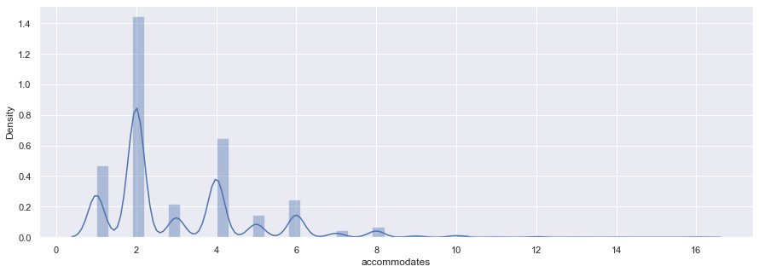
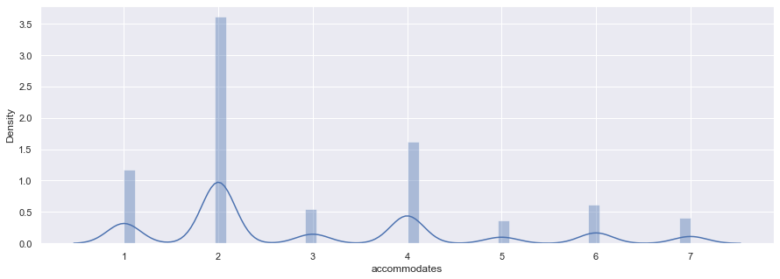
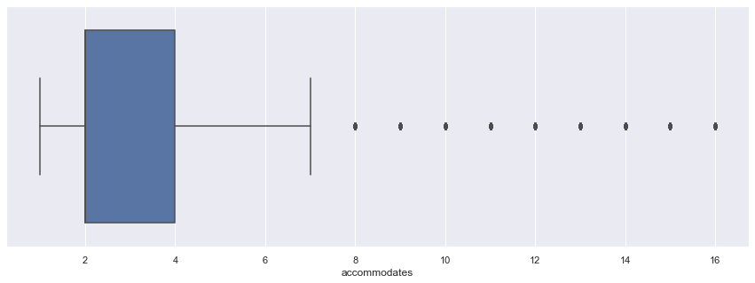
accommodates

Slide 8
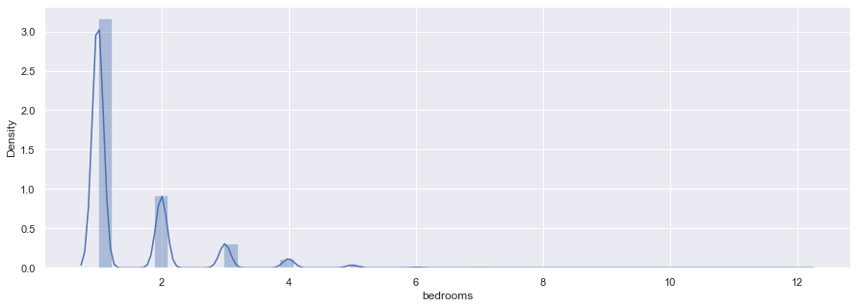
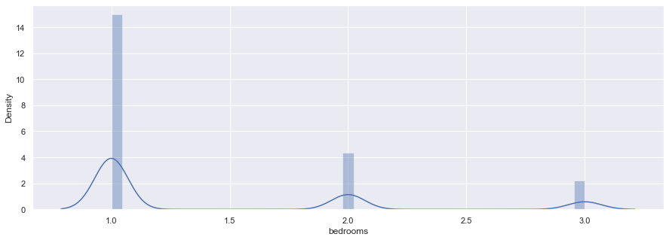
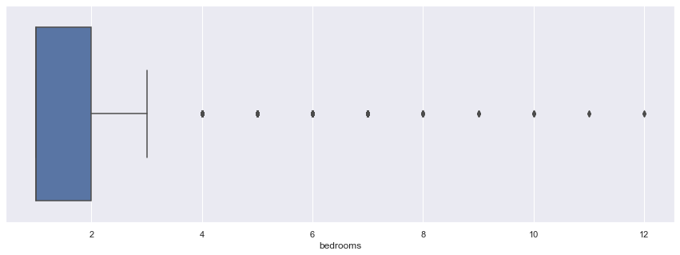
Bedrooms

Slide 9
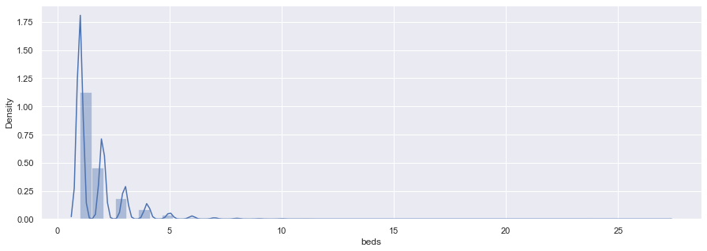
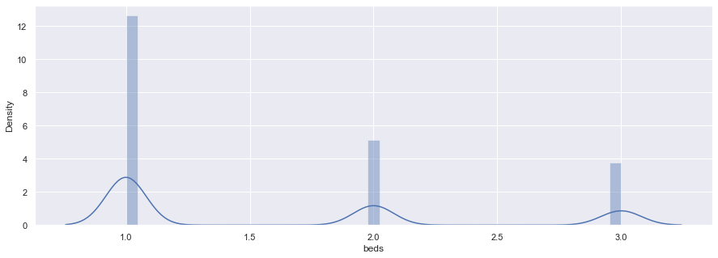
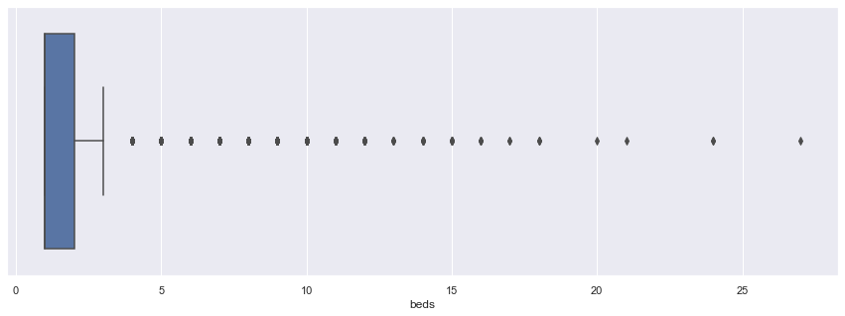
Beds

Slide 10
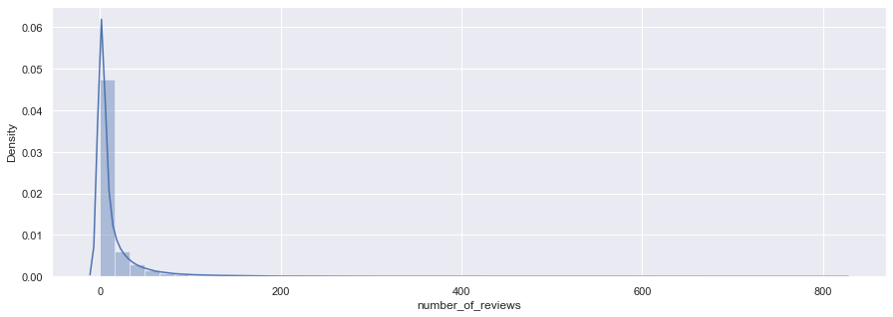
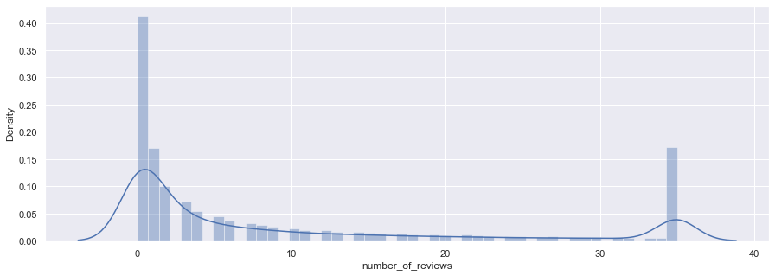
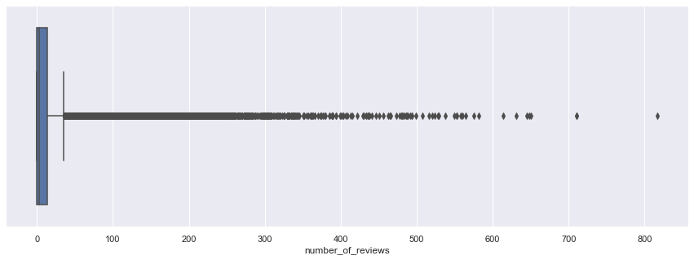
Number of Reviews

Slide 11
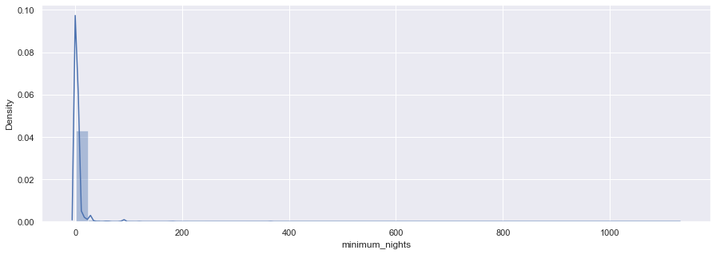
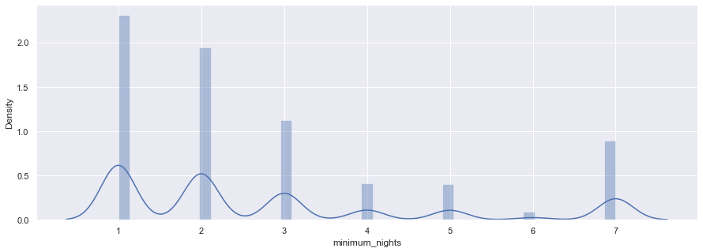
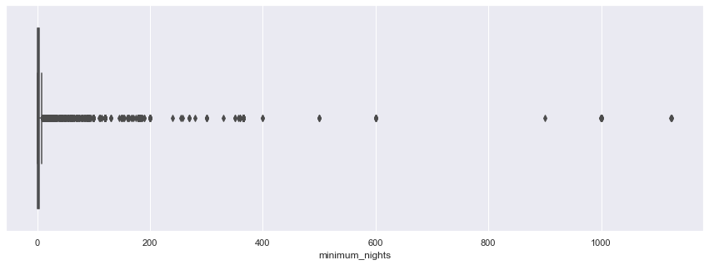
Minimum Nights

Slide 12
Initial Findings
75438 properties 'price' are between range 0-500 GBP. However, Prices are greatly skewed to the right. This causes a non-linear relationship between the price and features. We take the natural logarithm of the price to make the effective relationship non-linear, while still preserving the linear model. After taking price log we detect the outliers and handle outliers using winsorize method and set new limits.
According to the Data Distribution and the boxplot, we explored the 'accommodates' has some outliers (e.g., 8 to 16). Because the property records are less with the range of 8-16 people as compared to other accommodates count.
1-3 'bedrooms' properties are highly available as compared to 4 or more than 'bedrooms' properties. With the 1-3 'beds' properties are highly available as compared to 4 or more than 'beds' properties same case as 'bedrooms'. Bedrooms and Beds features has same impact on the model. Therefore, we can choose one.
property host allows for 1 to 240 'minimum_nights' stay. Whereas 32.16% host allows for 1 and 27.15% host allows for 2 minimum_nights stay.
28.79% of host has 0 number_of_reviews. However, different host has different number_of_reviews.

Slide 13
Feature Engineering
We extracted number of nearby location from neighborhood_overview using Natural Language Processing.
Host Location Status by country and city from host_location. According to the dataset 70.37% Host lives in United Kingdom. Where, 59.30% of Native Host lives in London.
host_verifications_status from host_verifications. 99.90% of Host accounts are not Verified
Property_Location from neighbourhood.
Extracted Number of amentity, Entertainment, Kitchen and dining, Internet and office, Bathroom, Bedroom and laundry, safety, Facilities, Heating and cooling from amenities.
price per bedrooms using following formula:
price_per_room = price / bedrooms
Property from property_type. 65.56% of properities are available in apartment type. Where, 63.93% of the properties are entire apartment, 35.51% properties has private room available.
After Feature Engineering data has 32 features.

Slide 14
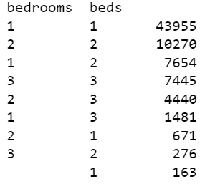
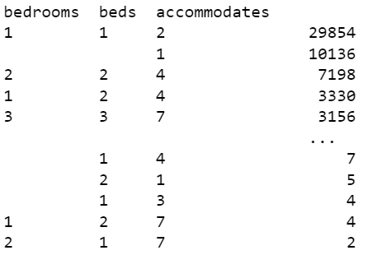
Exploratory Data Analysis
host_is_superhost feature is not impactful for property price change.
beds available in bedroom in property:
beds available in bedroom in property and allowed accommodates:

Slide 15
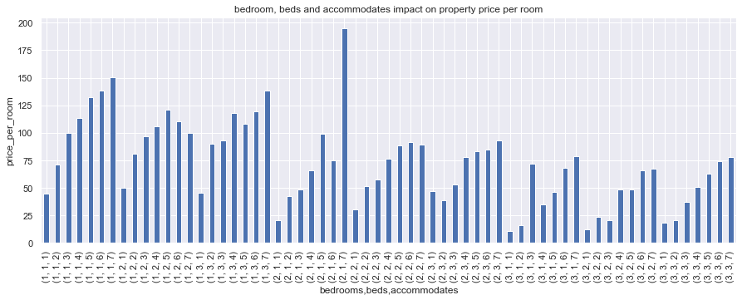
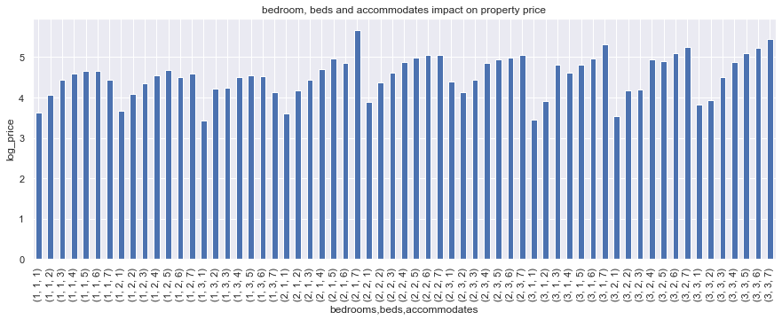
bedroom, beds and accommodates impact on property price

Slide 16
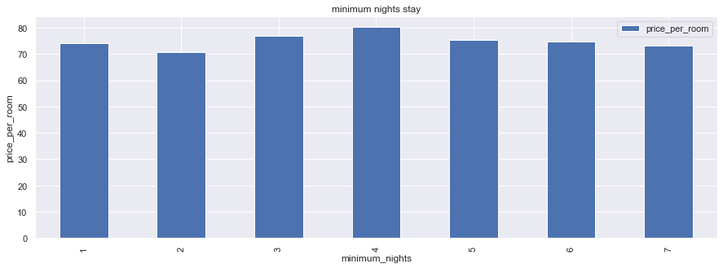
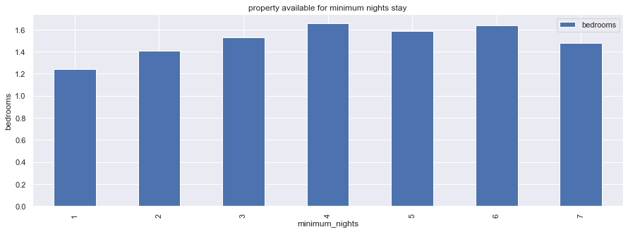
Minimum Nights Stay

Slide 17
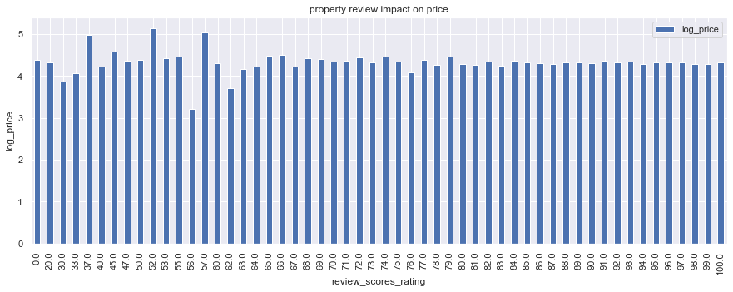
Review Scores Rating Impact On Price

Slide 18
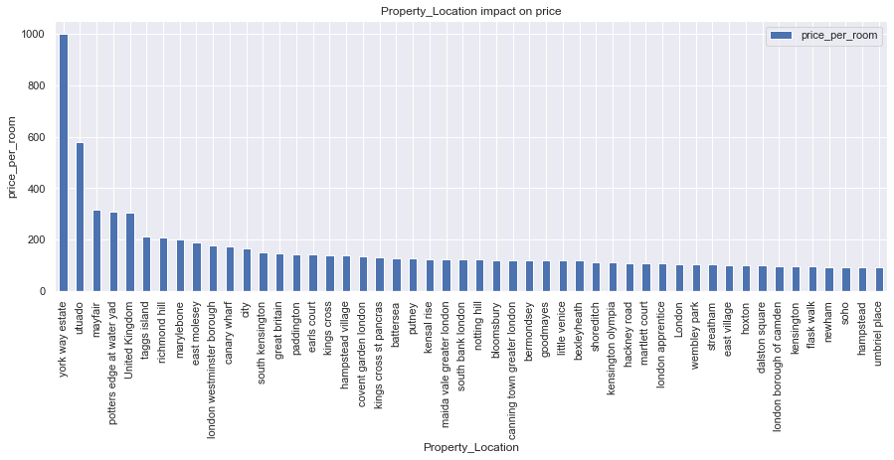
The Location Of The Property Impact On Price

Slide 19
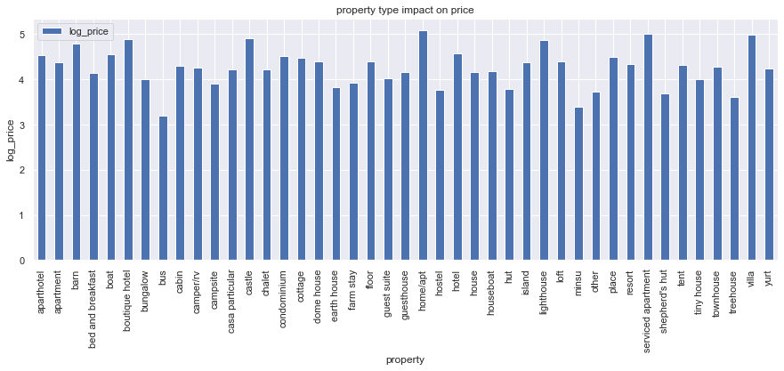
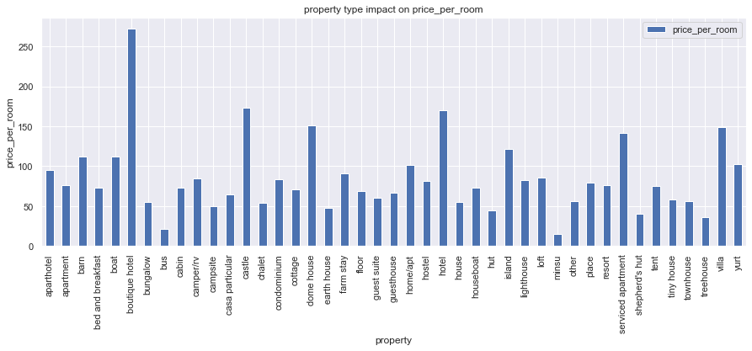
The Type Of Property Impact On Price

Slide 20
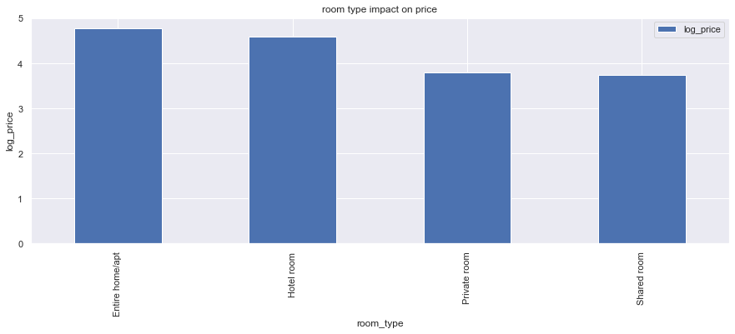
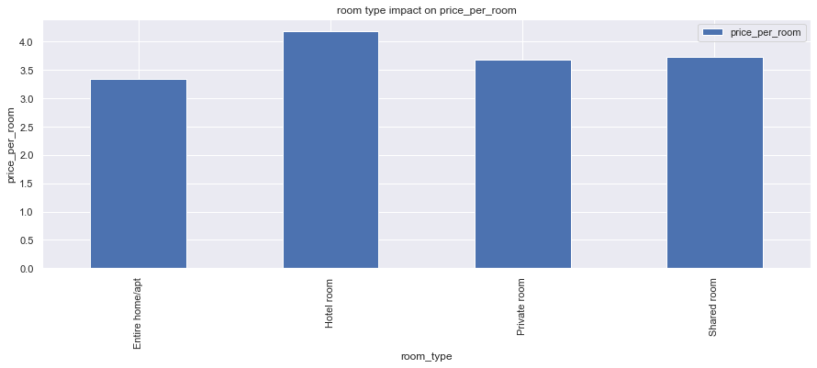
The Type Of Room Impact On Price

Slide 21
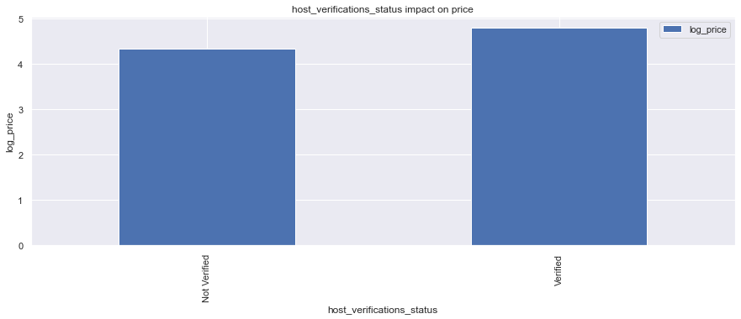
Host Verification Impact On Price

Slide 22
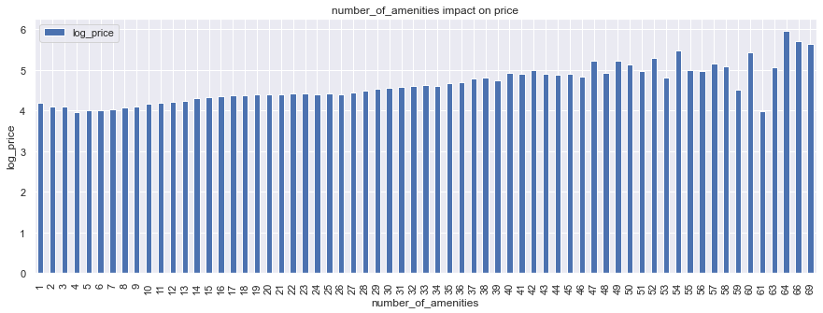
Number Of Amenities Impact On Property Price

Slide 23
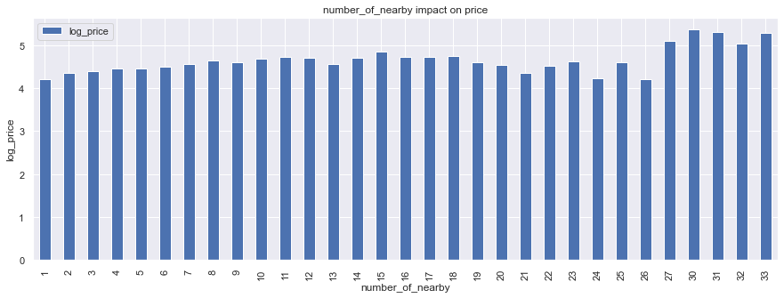
Number Of Nearby Impact On Property Price

Slide 24
EDA Conclusion
Properties are available in all types. However, Most properties has 1 bedroom and if we increased number of bedrooms property’s price decreased.
Minimum Night stay does not provide variance on price. However, 4 Night stay is popular.
21.93% of host achieved 100% reviews. However, 07.30% of host has 1 review recorded.
63.80% of host allows instant bookings.
Property Location has high impact on property price. Where, barn, boutique hotel, castle, home/apt, lighthouse, serviced apartment and villa has high prices and boutique hotel, castle has costly rooms. 'york way estate' is a location with the highest price of the property.
Entire Apartment or house has high price property as compared to other. Whereas Hotel rooms are costly rooms.
Verified Host has high priced property.
When host provides the greater number of amenities, the price of property is increases as well.
68.87% host provides Entertainment, 93.60% Kitchen and dining, 97.14% Internet and office, 86.71% Bathroom, 93.63% Bedroom and laundry, 66.46% safety, 91.69% Facilities, 94.26% Heating and cooling.
The nearby location is effective for property prices.

Slide 25
Define Target
Feature Handling
Feature Selection
Cross Validation
Data Scaling

Slide 26
Approach
Define Target:
- Prediction Type: forecasting
- Target Variable: log_price
Feature Handling:
Data Encoding for Property_Location, property using label encoding. Then applied dummy encoding on data. After encoding we got 37 features in data.
Feature Selection:
check correlation between features and eliminated 'bedrooms','Internet and office','Facilities','minimum_nights'. Then Lasso Regression for dimensionality reeducation. After we got 31 final features.
Cross Validation:
Split data into training and testing dataset.
Data Scaling:
Scaled dataset using Standard Scaler.

Slide 27
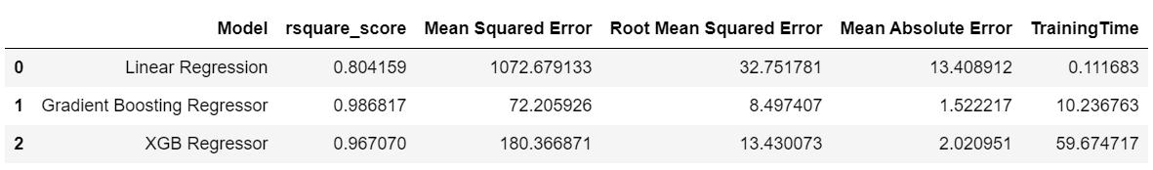
Model Performance
Conclusion
The Gradient Boosting Regressor Model rsquare_score is highest, and Root Mean Squared Error is lowest as compared to another model. Therefore, Gradient Boosting Regressor Model is the best model based on performance comparisons.

Slide 28
Future Improvements
Include List of nearby location and convert into an array of all the individual location with one-hot (True, False) representations.
Extract nearest facilities as well from neighborhood_overview.
Extract host characteristics from host_about.
Expand host_verifications and convert into an array of all the individual location with one-hot (True, False) representations.

Slide 29
Thank You

