Slide 1

<Client’s Name or Logo Here>
<<Client’s Name or Logo Here>>
Client Business Review
Presented to:
Presented by:
© 2019-2026 TeamLogic, Inc. All rights reserved. Business Confidential
Notes:
The purpose of a Client Business Review:
Discuss technical insight to support the growth and development of your company.
Summarize the IT management of your human capital and the network they use to stay productive in their use of technology.
Review important metrics detailing historical performance according to TeamLogic IT’s service agreement and how these metrics impact your business.
Provide recommendations to improve the support and services provided by TeamLogic IT.
Align near-term goals you may have to enhance the use of technology.

Slide 2
Agenda
Industry Trends
Services Review
Open Technical Items
Strategic Initiatives
Implementation Timeline
  Budget Summary
Reports
  Management Summary Report of Technical Infrastructure
  Completed Ticket Performance by Issue Type
  Other applicable reports

Slide 3
Industry Trends
Add technology trends that are applicable to the customer’s industry and how that impacts their use of your managed IT services solution…
  Consider using ChatGPT or MS Copilot to conduct research to help populate this slide.
  Topics may include Shadow AI, MDR, insurance requirements, compliance updates, end of life/support for industry specific SaaS and tools.
Notes:
Role: Act as an MSP executive briefing a <<insert industry here>> company’s CEO, COO, and CFO during a Client Business Review.
Objective: Translate industry-specific technology trends into business risk, financial impact, and executive decisions, showing where managed IT reduces exposure and enables scale.
Task: Identify 3 industry-specific technology trends leadership must address in the next 12–24 months (e.g., shadow AI/SaaS, cyber risk & MDR, cyber insurance, regulatory obligations, end-of-life systems).
Insights: Ask me three questions one at a time to gain further insights.
Output Rules:
▪One executive slide
▪Max 3 bullets, ≤20 words each
Each bullet must state:
▪The trend and the business or financial risk
▪Why managed IT oversight is needed
▪Tone: executive, factual, forward-looking
▪No marketing language
▪No technical jargon
Client website: <<insert website here>>

Slide 4
Service Review

Slide 5
Current Management and Maintenance
XX Workstations and Laptops
XX Physical Servers
XX Virtual Servers
XX Location(s)
XX Users
Based on a technical review of the last six months, all segments of TeamLogic IT services offering have been {insert your opinion}.
TeamLogic IT reports show improvements in the areas of endpoint management, infrastructure management, and network security.

Slide 6
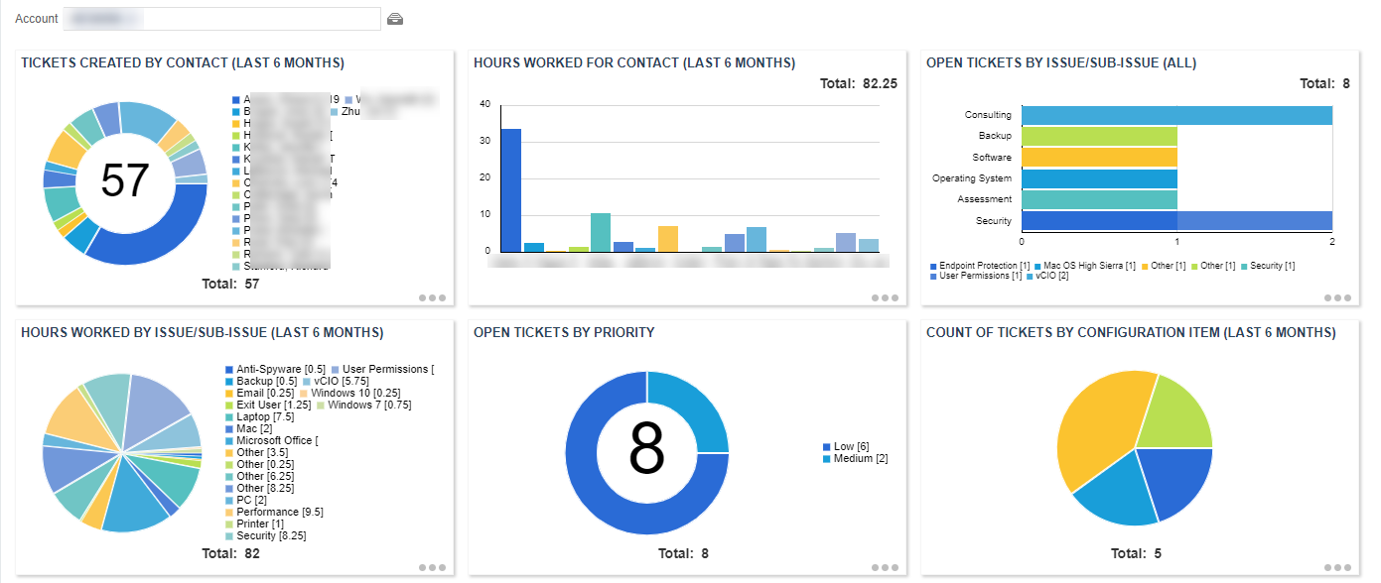
Customer Success Dashboard
Observations
Your “talk track” here (i.e., recent increase of password reset requests: recommend password manager)
Your “talk track” here (i.e., recent increase of cyber threats blocked: recommend MDR)
Your “talk track” here (i.e., office connectivity issues: recommend Wi-Fi or VPN solution)
Notes:
Role: You are an MSP executive presenting a client business review.
Task: Analyze the attached Ticket Export report for a client business review meeting that explains service performance in business terms the client cares about.
Insights: Ask me three questions one at a time to gain further insights.
Guidelines:
▪Headline: One sentence summarizing overall service performance
▪Key Observations: 3–5 bullets on meaningful trends or patterns
▪Client Impact: 2–3 bullets explaining effects on productivity, risk, or user experience
Rules:
▪Client-friendly language; no internal MSP jargon
▪Focus on outcomes, not ticket mechanics
▪Be transparent and confident
▪Fit all content on one slide
Formatting:
▪Bullet points exactly as shown on the slide
▪No internal commentary or technical detail

Slide 7
Management Summary Report
Key Takeaways
1 | Overall IT Health Is Strong — Core Controls Are Working Overall environment health score: 98%, indicating a well-managed and stable IT. Patch coverage and antivirus protection are both at 100%, eliminating two of the most common vectors for cyber incidents. Server availability is 100%, demonstrating high reliability for critical systems.
2 | Security Posture Is Solid, but Encryption Gaps Create Avoidable Risk Endpoint encryption is strong on laptops (41 of 47) but inconsistent on desktops (3 of 5) and absent on core Windows servers (0 of 3). You’re well protected against external threats, but internal data protection—especially on servers—is the next maturity step. Closing these gaps reduces exposure in the event of device loss, breach, or audit.
3 | Proactive Management Is Reducing Noise — Now It’s Time to Optimize The environment is stable, not stagnant. Automation is keeping things clean, but targeted optimization—storage management and alert tuning—will prevent future disruptions and improve user experience.
Notes:
Role: You are an MSP executive presenting a client business review.
Task: Create exactly three executive-level key takeaways from the Ninja Management Executive Summary for a Client Business Review.
▪For each takeaway start with a clear, decisive headline that states the conclusion
▪Follow with 1–2 plain-language sentences that:
oExplain what the data means
oHighlight one strength and one improvement opportunity
oTie directly to business impact (risk, cost, reliability, productivity, or security)
Insights: Ask me three questions one at a time to gain further insights.
Guidelines:
▪Business outcomes first, technology second
▪No technical jargon, tools, or metrics
▪Frame gaps as next-step maturity improvements
▪Assume the environment is well managed
▪Tone: Executive, confident, consultative
Formatting:
▪Numbered 1–3
▪Headline first, short paragraph below
▪Slide-ready with no rewriting

Slide 8
Recent Accomplishments
List recent accomplishments with details to describe how this benefited the client and their use of technology to improve their business.

Slide 9
CX Metrics
What we’re hearing from your team:
“Insert survey comments here”
“Insert survey comments here”
“Insert survey comments here”
    Net Promoter Score
    (NPS)
88
97
97
    Customer Satisfaction
    (CSAT)
    Product Quality
    (PQUAL)

Slide 10
Open Technical Items

Slide 11
Current Project Review
M365 Migration
Network Upgrade
ABC Company is in the middle/phase of the project.
This includes {brief explanation here}.
The project should be completed before the end of July 202x.

Slide 12
Devices Under Management
Recommended for Upgrade
List specific devices that may need to be replaced including an explanation why (i.e., end of support/end of life), the hours needed to complete the work, and the cost of any new licenses or hardware enhancements.

Slide 13
Devices Under Management
Recommended for Upgrade
List specific devices that may need to be upgraded including an explanation why, the hours needed to complete the work, and the cost of any new licenses or hardware enhancements.

Slide 14
Cybersecurity
Provide specific observations or vulnerabilities here. Examples provided.
Legacy Infrastructure: Core systems rely on outdated hardware and on-premise servers, limiting agility and scalability.
  Recommendation: Transition to a hybrid or cloud-first architecture to improve flexibility and support future growth.
Security Gaps: No centralized monitoring; compliance gaps increase cyber risk exposure.
  Recommendation: Implement a layered security strategy and schedule quarterly vulnerability assessments. Adopt Managed Detection and Response (MDR).
Underutilized Tools: Low adoption of security awareness training and education.
  Recommendation: Launch a structured user training and adoption campaign to improve cybersecurity awareness training through phishing simulations, policies, and course completion.

Slide 15
Backup / Business Continuity
Provide specific observations or vulnerabilities here. Examples provided.
Incomplete Backup Coverage: Critical applications and databases are not included in current backups.
  Recommendation: Expand backup scope and validate coverage quarterly.
No Offsite Replication: Backups stored only locally create a single point of failure.
  Recommendation: Implement offsite or cloud-based replication for geographic redundancy.
Missing Disaster Recovery Plan: No formal, tested DR plan exists for outage scenarios.
  Recommendation: Develop and test a comprehensive DR plan with defined RTO/RPO objectives.

Slide 16
Strategic Initiatives

Slide 17
Scheduled Projects
Server Replacement > Migration to Cloud Solution
Access Points to Enhance Wi-Fi Connectivity
Estimated start date for project is August 202x.

Slide 18
Recommended Services
This section is your opportunity to recommend additional services to expand this client’s managed services offering.
Cloud Computing Technology
Cybersecurity Essentials
Recommended Additional Cybersecurity
  Endpoint + Cloud Protection (MDR) – Device and Cloud Security Monitoring
  Secure Access Service Edge + Network Data Loss Prevention – Secure Login and Permission Management
  Mobile Device Management (MDM) – Secure Access on Mobile Devices
  Penetration Testing – Security Testing
  SIEM / SOC and Threat Hunting – Cyber Attach Detection
Other

Slide 19
Near-Term Priorities
AI Enablement and Adoption
Endpoint + Cloud Protection (MDR) - Device and Cloud Security Monitoring
Mobile Device Management (MDM) – Secure Access on Mobile Devices

Slide 20

AI Essentials
Business AI Discovery
Readiness Scan
Data Governance
AI Acceptable Use Policy
Licensed AI Productivity
Sensitive Data Monitoring
AI End-User Training

Slide 21
Implementation Timeline

Slide 22
Budget and Timeline
Recommendation | Budget / Quote | Timeline
Firewall and network security configurations | $ | Q1
New device installation, setup, and configuration | $ | Quote acceptance / as needed
Telephony (VOIP) configurations | $ | Q2
Cloud migration | $ | Q3

Slide 23
Thank you for our continued partnership!
We build our business on referrals. If you know of someone who has technology concerns, please let them know about us. We’d like to help.

