Slide 1
SOA PROGRAMMING AND MICROSERVICES (24SDCS03)
MediAssist - AI Powered Hospital Appointment System
Team Members:
Anjali Kasarla - 2420030170
Vinusha Muppala - 2420030212
M Lakshmi Abhista - 2420030743
Under the Esteemed Guidance of:
Dr. Neelima Gogineni

Slide 2
Contents
Problem Statement
Objectives
Literature Survey
Research Gap
Innovation & Creativity
Novelty
Feasibility
Project Plan
Proposed Architecture/Methodology
Datasets & Technology Stack
References

Slide 3
PROBLEM STATEMENT
Problem Statement
Traditional hospital management systems are often centralized, making them difficult to scale, maintain, and integrate with different hospital departments.
Our project aims to develop a secure and scalable Hospital Management System using Service-Oriented Architecture (SOA) and Microservices Architecture.
The system manages:
Patient registration and information
Doctor management
Appointment booking
Billing operations
Secure user authentication
Notifications for important events
The architecture enables independent services, better scalability, and secure communication.

Slide 4
OBJECTIVES
Objectives
The main objectives of the proposed system are:
To develop a Hospital Management System using SOA and Microservices
To provide independent services for Patients, Doctors, Appointments, and Billing
To implement RESTful APIs for service communication
To provide centralized routing using an API Gateway
To implement Service Discovery using Eureka
To secure the application using Spring Security and JWT
To use Kafka for event-driven notifications
To ensure data management using Spring Data JPA and MySQL
To perform unit and integration testing
To automate build and testing using CI/CD

Slide 5
LITERATURE SURVEY
SOA and Microservices: Improve scalability, flexibility, and maintainability in healthcare systems.
Healthcare Interoperability: Standards like HL7 FHIR enable secure data exchange between departments.
Hospital Management Systems: Existing studies focus on patient management, appointments, billing, and authentication.
Research Gap: Need for a secure, scalable, and easily integrated hospital management system using microservices.

Slide 6


RESEARCH GAP
Existing systems may have limitations such as:
Tightly coupled modules
Limited independent scalability
Difficulty in deploying individual modules
Lack of flexible service discovery
Limited event-driven communication
Security challenges in distributed systems
Our Approach
The proposed system addresses these gaps using:
Microservices + Eureka + API Gateway + JWT Security + Kafka
This provides a more modular, secure, and scalable hospital management solution.
Limited Emotion-Aware Evaluation
Persistent Human Bias
No Multimodal Scoring

Slide 7
INNOVATION & CREATIVITY
Innovation & Creativity
The proposed system combines modern technologies to improve hospital operations.
Key Innovations:
Independent Microservices for different hospital departments
Service Discovery for dynamic communication between services
API Gateway as a single entry point
JWT-based Authentication for secure access
Role-Based Authorization for Admin, Doctor, and Patient
Kafka-based Event Notifications
Database-per-Service approach
Scalable service instances for handling increased requests
Example Innovation:
Appointment Booked → Kafka Event → Notification Service
This allows services to communicate asynchronously without tight coupling.

Slide 8
NOVALITY
Novelty of the Proposed System
The novelty of the project lies in combining hospital management functionality with a modern distributed architecture.
Key novel aspects:
Migration from a traditional centralized system to Microservices
Separate services for major hospital operations
Dynamic service registration using Eureka
Centralized API access through Spring Cloud Gateway
Event-driven communication using Kafka
Secure APIs using JWT and Spring Security
Independent databases for better service autonomy
CI/CD automation for reliable development and deployment

Slide 9
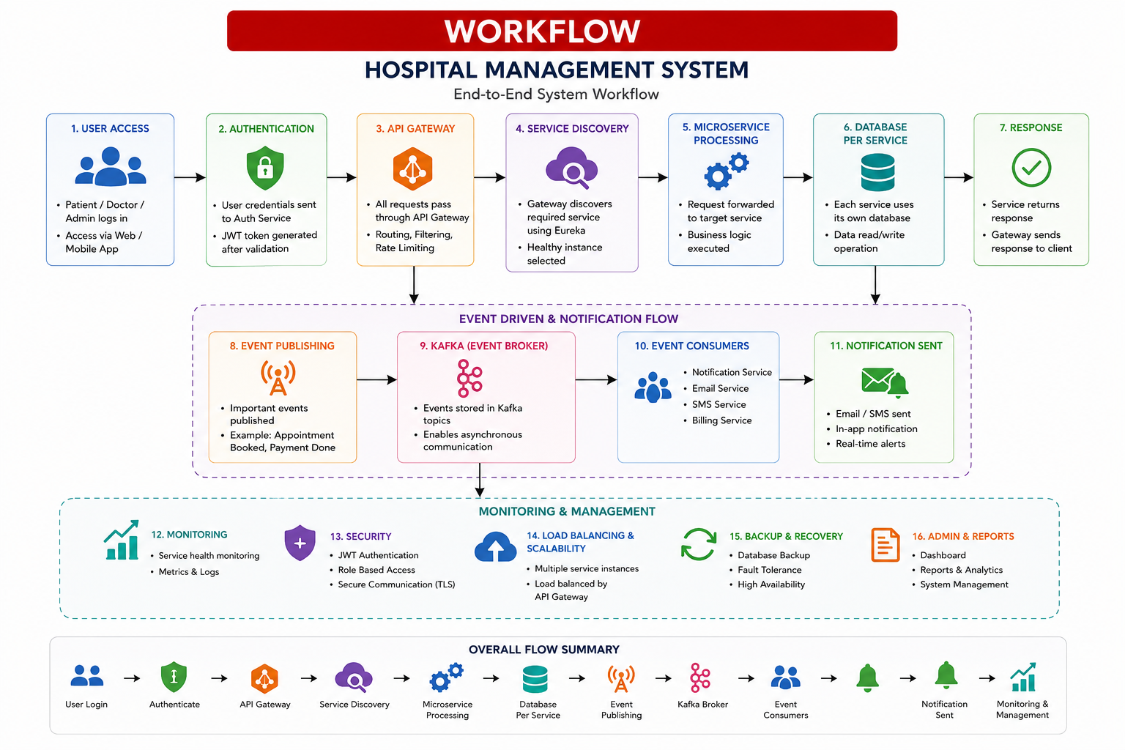
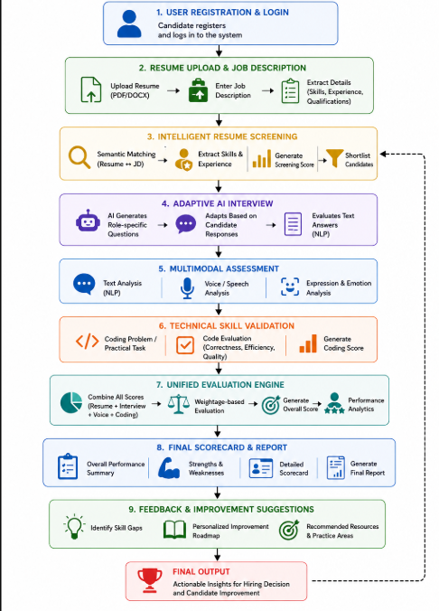
PROPOSED ARCHITECTURE/METHODOLOGY
Workflow:
1.User Registration & Login
2.Resume & Job Description Upload
3.Intelligent Resume Screening
4.Adaptive AI Interview
5.Speech-to-Text & Multimodal Analysis
6.Technical Coding Assessment
7.Final Hiring Recommendation / Improvement Roadmap

Slide 10
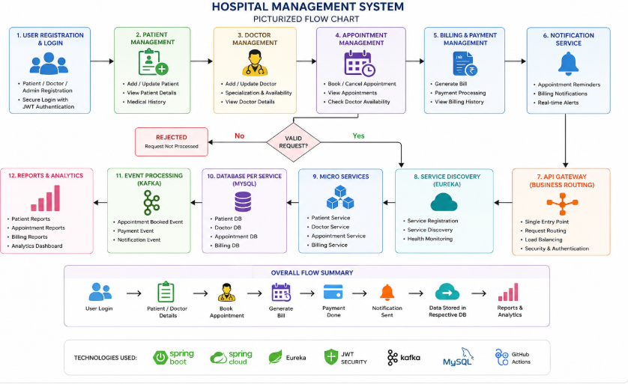
FEASIBILITY ANALYSIS

Slide 11
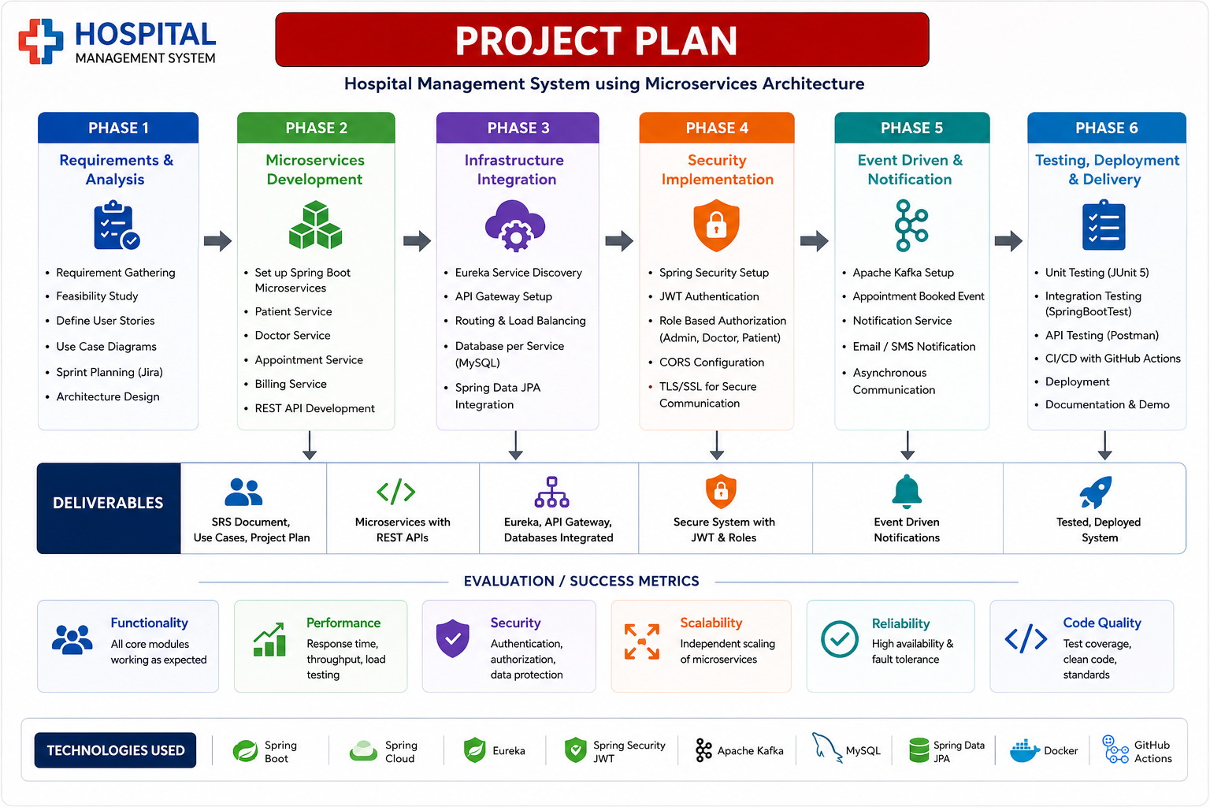
PROJECT PLAN
PHASE 2
PHASE 3
PHASE 4
Data & Resume
NLP & Coding
System & Testing
• Whisper Integration
• Speech → Text
• Emotion Analysis
• Audio Processing
• BERT Answer Scoring
• Semantic Matching
• Coding Assessment
• Test-Case Grading
• Dashboard Integration
• Final Report Gen.
• Full Pipeline Testing
• Deployment
MATCHING
VOICE
EVALUATION
DELIVERY
Evaluation Metrics
Resume Matching
Speech-to-Text
Answer Evaluation
Emotion Analysis
Coding Assessment
Similarity / Match Score
Transcription Accuracy
Semantic / Relevance Score
Classification Performance
Test Cases Passed / Accuracy

Slide 12
Thankyou

