Slide 1
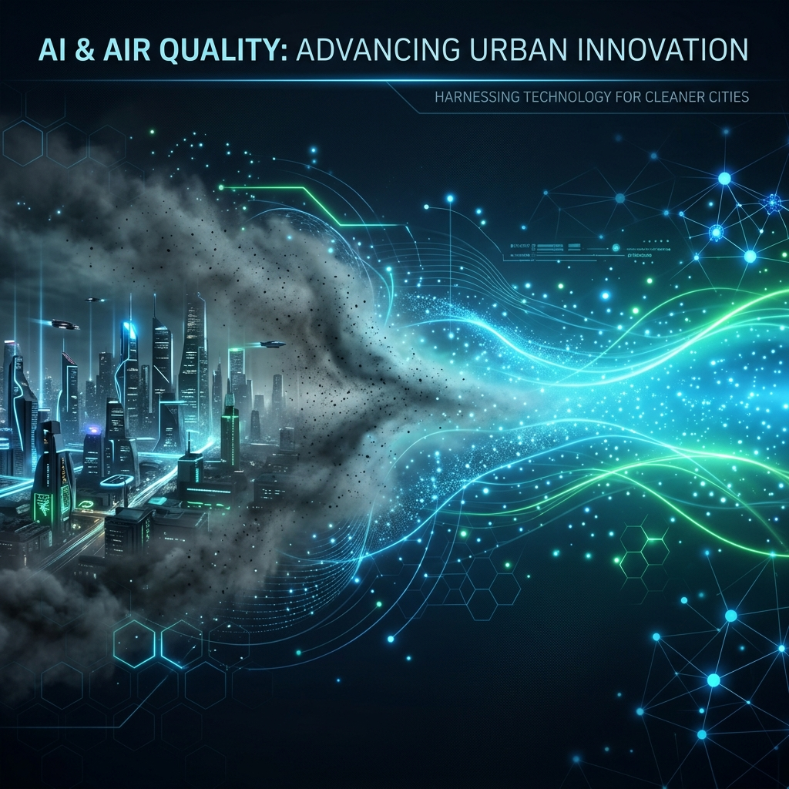
AQI Predictor Pro
Empowering Citizens with Actionable Air Quality Insights

Slide 2
The Silent Crisis
Millions are affected by air pollution, yet environmental data remains difficult to understand.
Technical metrics (PM2.5, NO2, AQI numbers) fail to answer basic human questions: 'Is it safe to go outside today?'
Existing platforms are built for scientists, not for everyday citizens.

Slide 3
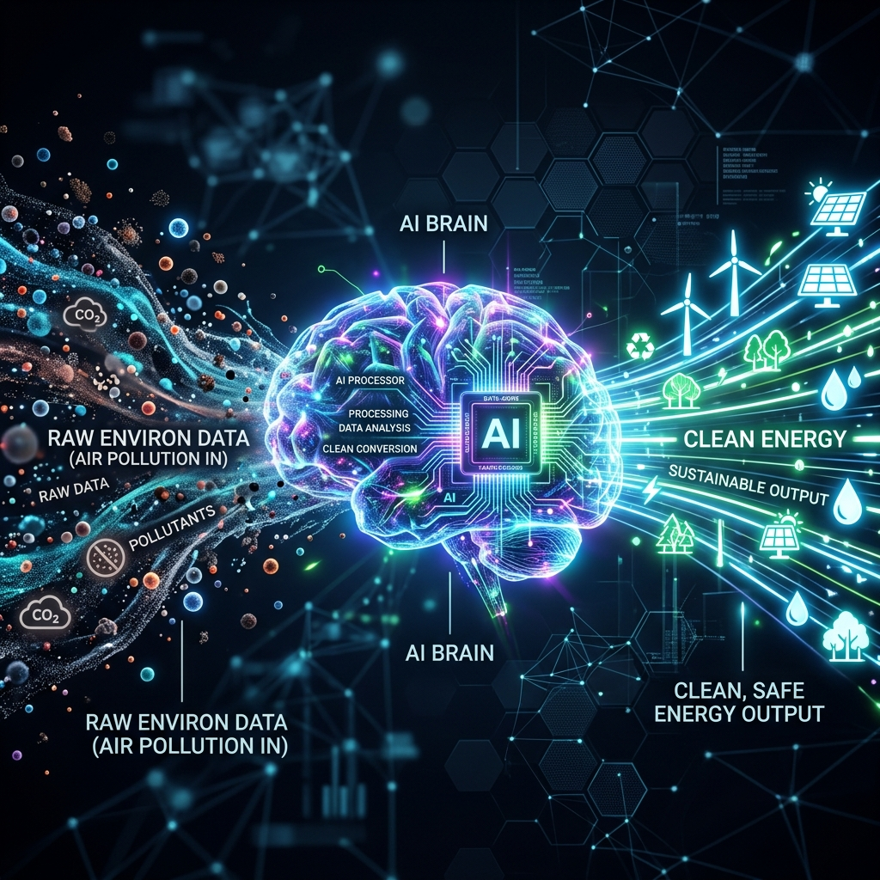
Introducing AQI Predictor Pro
Bridges the gap between raw scientific data and everyday health.
Uses Machine Learning to predict accurate Air Quality Index (AQI) based on 6 key pollutants.

Slide 4
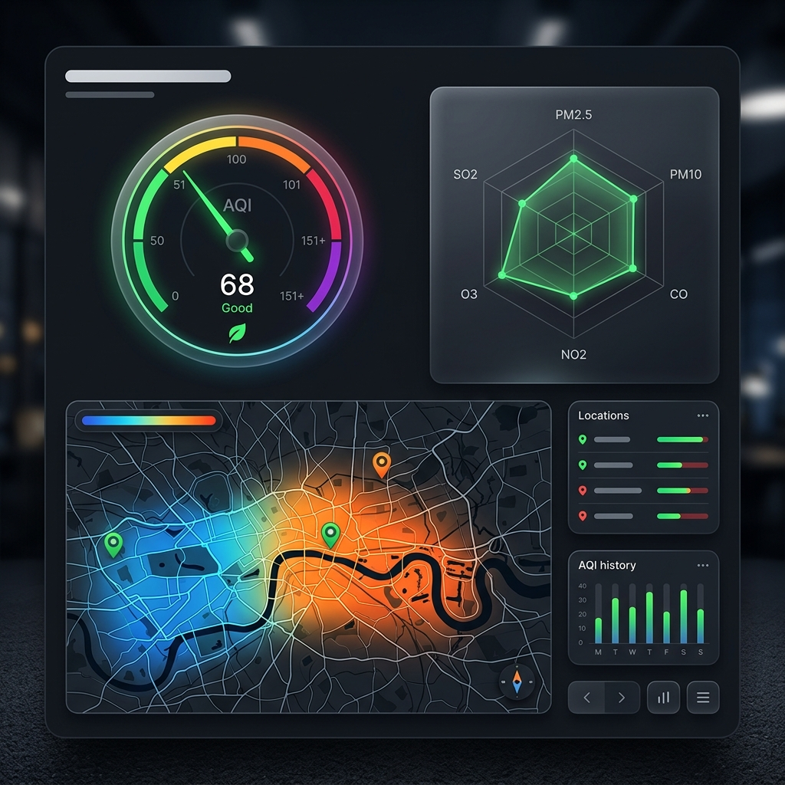
Visualizing the Impact

Slide 5
Key Features
ML-Powered Prediction: Evaluates PM2.5, PM10, NO2, SO2, CO, and O3.
Plain-Language Advisory: Symptom trackers and time-of-day guidance.
Group-Specific Alerts: Tailored advice for children, elderly, and asthma patients.
City Heat Sink Map: Mapping of temperature, humidity, and pollution hotspots.

Slide 6
Technology Stack
Frontend/UI: Streamlit (Python)
Machine Learning: Scikit-Learn
Data Visualization: Plotly Graph Objects
Styling: Custom CSS for a premium feel

