Slide 1
“Predicting Mental Stress Levels and Analyzing Human Behavior Using Machine Learning”
Guided By: Presented By :
Prof .V R. Dhawale Anjali Mali
Mitali Mahajan
Dhanashri Zend
Date: 11-04-2025
S.E Civil
Savitribai Phule Pune University
(2022-2023)

Slide 2
Abstract: Machine Learning for Mental Health
Abstract: Mental stress is a pervasive issue affecting individuals worldwide, leading to severe consequences on physical and mental well-being. This study proposes a machine learning-based approach to predict mental stress levels and analyze human behavior, using physiological signals, self- reported stress levels, and behavioral data, our model employs supervised and unsupervised learning techniques to identify patterns and correlations. Experimental results demonstrate high accuracy in stress level prediction and insightful behavioral clustering. This research contributes to the development of personalized stress management systems, enabling early intervention and improved mental health outcomes.
Keywords—- Mental Stress Detection, Machine Learning, Human Behavior Analysis, Artificial Intelligence, Human Computer Interaction, Healthcare Technology, Human Factors, Stress, Physiological measurement

Slide 3
Introduction: Addressing Mental Stress with Machine Learning
Problem Focus:
The study addresses the global impact of mental stress on physical and mental health, emphasizing the need for early detection and intervention.
Proposed Solution:
machine learning-based framework is developed using physiological signals and behavioral patterns to predict stress levels accurately
Methodology:
The approach leverages supervised learning techniques to detect patterns and correlations, alongside behavioral clustering for deeper analysis
Outcome & Significance:
The model achieves high prediction accuracy and provides actionable insights, contributing to personalized stress management and advancements in healthcare technology

Slide 4
Research Methodology: Data Collection and Preprocessing
Data Collection
Survey Design & Participants: Data was collected via online and offline surveys from individuals aged 18–50, focusing on stress levels, lifestyle factors, and coping mechanisms.
2. Ethics & Data Handling: Survey questions were based on established frameworks, responses were recorded in Excel, and ethical guidelines were followed with informed consent and confidentiality assured.
Data Preprocessing
Data Cleaning: Irrelevant columns like 'Name' and 'Timestamp' were removed, and categorical data (e.g., stress frequency, screen time) was mapped to numeric values for model compatibility.
2. Encoding & Imputation: Label Encoding was used for categorical features, and missing values were handled using the Simple Imputer with median replacement to maintain data integrity.

Slide 5
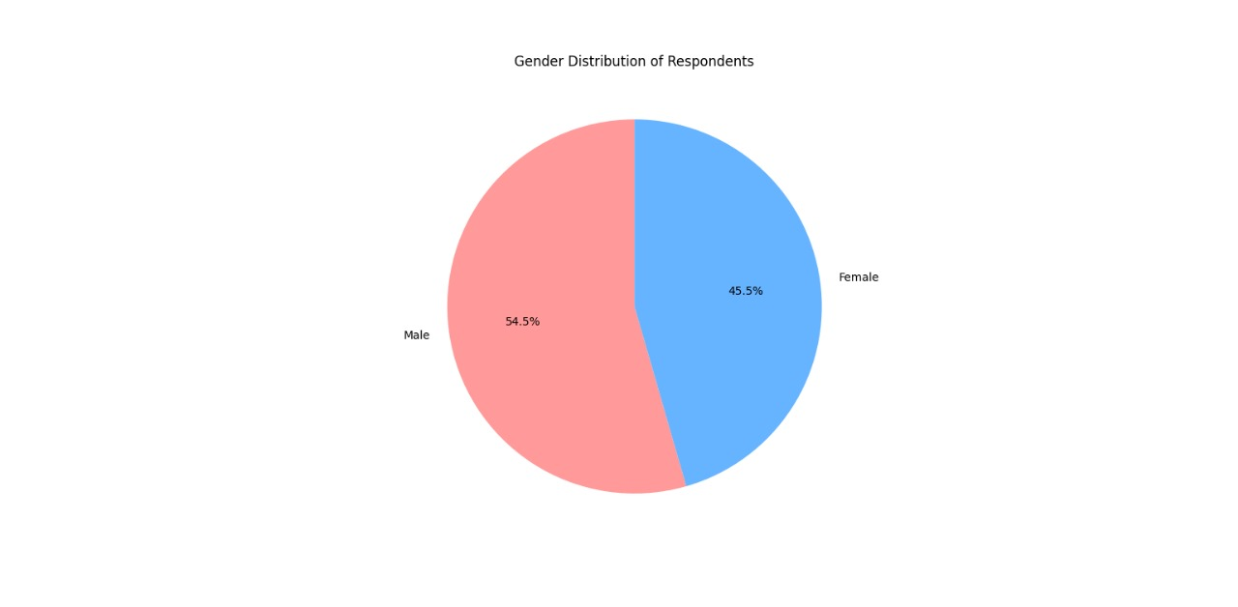
Research Methodology: Data Collection and Preprocessing

Slide 6
Feature Engineering and Scaling
Feature Selection :
Key features such as stress frequency, gender, screen time, and coping mechanisms were retained for training based on their significance in stress prediction as supported by prior studies.
Feature Scaling :
Feature Scaling: All selected features were normalized using Standard Scaler to ensure uniform contribution of each feature during training.
Data Splitting :
The preprocessed dataset was divided into a training set (80%) and a testing set (20%) to assess the model’s ability to generalize to unseen data.
Model Training :
Multiple regression models were trained to predict stress frequency based on selected features.
These included:
Linear Regression
Decision Tree Regressor
Random Forest Regressor
Gradient Boosting Regressor
Support Vector Regressor
K-Nearest Neighbors Regressor

Slide 7
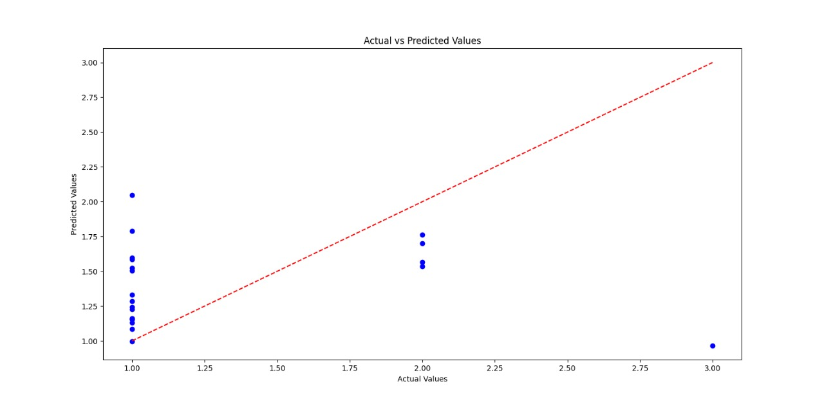
Visualization of Results
Actual vs Predicted (Linear Regression):
Actual vs Predicted (Linear Regression): A scatter plot was generated to visually compare the actual and predicted stress values

Slide 8
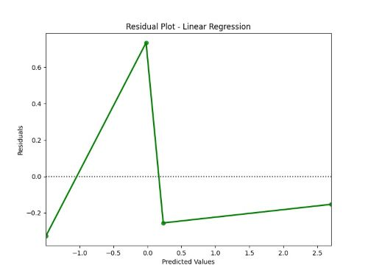
Visualization of Results
Residual Plot (Linear Regression):
Residual Plot (Linear Regression): Residual errors were plotted to evaluate the goodness-of-fit and identify any patterns in prediction errors.

Slide 9
Observations: Model Performance and Stress Factors
Model Performance :Random Forest Regressor was the most accurate with the lowest MSE of 0.1838.
Other models ranked: Gradient Boosting (0.2032), SVR (0.2348), Decision Tree (0.25), KNN (0.30), and Linear Regression performed worst with a high MSE of 3.4468, indicating poor fit.
Limitations of Linear Regression: The model struggled especially with actual stress level = 1, showing a wide spread in predictions. An outlier at actual value 3 was significantly underpredicted. Residual plots revealed non-random error patterns, indicating that linear regression fails to capture the non-linear nature of the data
Coping Mechanisms vs Stress :People with higher stress levels reported more frequent use of coping mechanisms such as social interaction, exercise, and relaxation techniques. This suggests a proactive response in individuals with higher stress.
Screen Time and Stress:Screen Time and Stress A weak positive correlation (0.14) was found between screen time and stress frequency. Prolonged screen use, especially over 6 hours, is associated with increased stress, though the relationship isn’t strong.
Gender-Based Stress Trends:Gender-Based Stress Trends Females reported higher emotional and personal stress. Males experienced stress more due to work or physical factors, possibly reflecting societal roles or gender-based stress response differences.
Visual Insights & Recommendations
Heatmaps and scatter plots showed patterns missed by simple models. Suggest exploring non-linear models like Random Forest or Gradient Boosting for better predictions. Incorporate psychological, lifestyle, and behavioral features for holistic modeling.

Slide 10
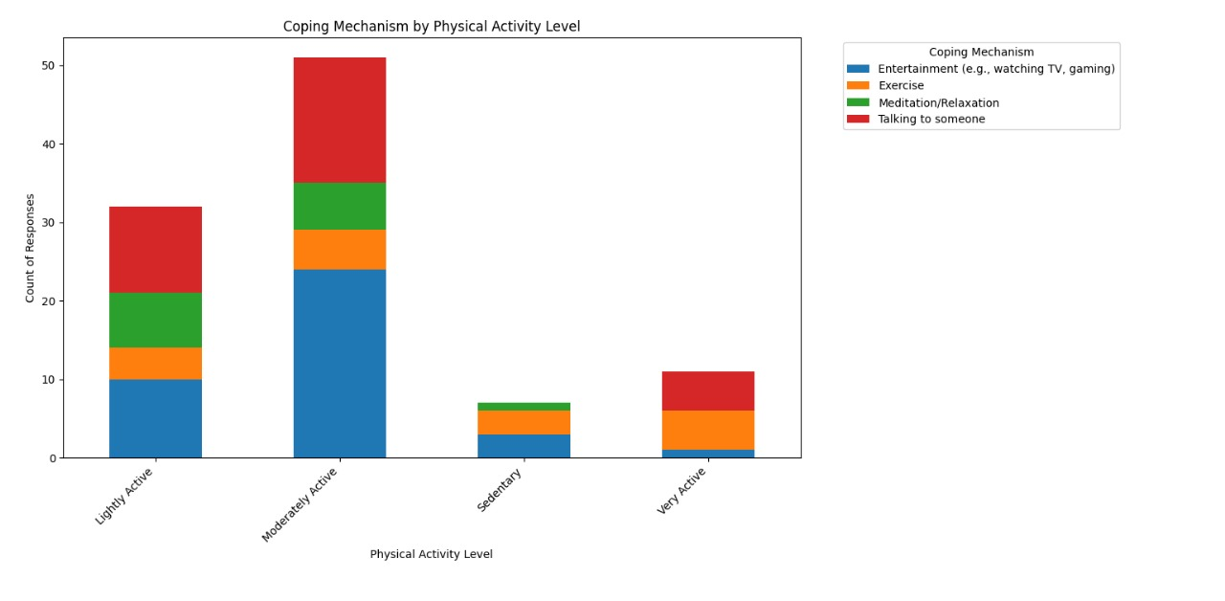
Observations: Model Performance and Stress Factors

Slide 11
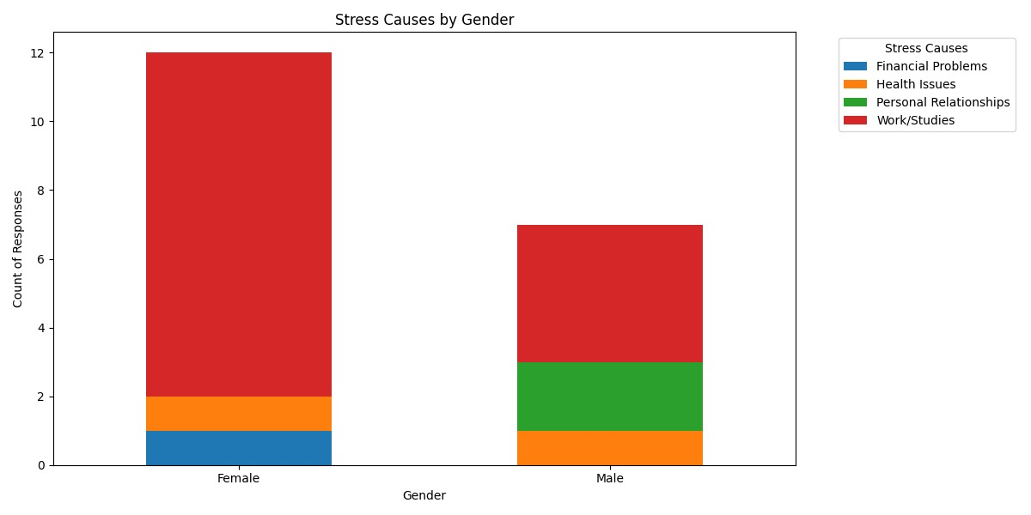
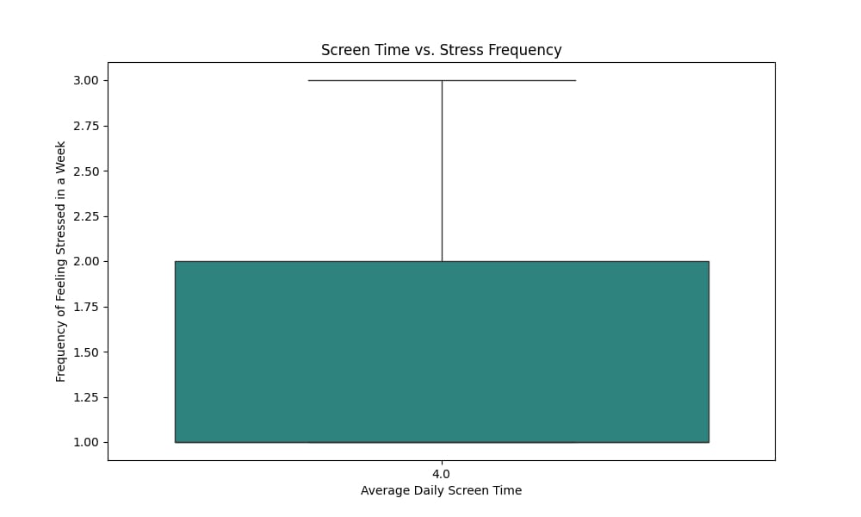
Observations: Model Performance and Stress Factors

Slide 12
CONCLUSION
Effective Stress Prediction through Machine Learning
The study showcased the effectiveness of machine learning models—especially the Random Forest Regressor (MSE: 0.1838)—in accurately predicting mental stress levels using behavioral and lifestyle data from participants. This supports the development of personalized stress management strategies and early intervention tools
Broader Impact on Mental Health and Technology
The research emphasizes the critical role of ML in mental health care, enabling tailored solutions and offering a strong foundation for future innovations in healthcare technology and human-computer interaction to improve global mental well-being

Slide 13
REFERENCES
1. X. Zhang et al., "Improved diagnostic accuracy using SVM and RF techniques on clinical records," J. Healthc. Technol., vol. 2020, 2020.
2. A. Dubey et al., "Enhanced treatment prediction using SVM with patient datasets," Int. J. Med. Inform., vol. 2019, 2019.
3. M. Papini et al., "Effective risk prediction using logistic regression on survey data," Behav. Sci. Res., vol. 2018, 2018.
4. M. Subhani et al., "Higher detection accuracy in stress detection using logistic regression on physiological signals," J. Stress Res., vol. 2017, 2017.
5. R. Radheshamjee and P. Kinariwala, "Efficient stress classification using Naïve Bayes and SVM for Twitter sentiment analysis," Soc. Media Anal. J., vol. 2020, 2020.
6. K. Thota and P. Dharun, "Varied accuracy across features in a professional stress study using LR and KNN on professional questionnaires," J. Occup. Health, vol. 2020, 2020.
7. S. Padmaha, "Binary stress assessment effectiveness using fitness tracker data analyzed by LR," Wearable Technol. Health J., vol. 2021, 2021.

Slide 14
THANK YOU
Anjali Mali
Mitali Mahajan
Dhanashri Zend

