Slide 1



DataGuru.com
Driving your business decisions
9th Oct 2018
Archana Soni Anjali Mangal Christie Lafrance
Slide: 1

Slide 2


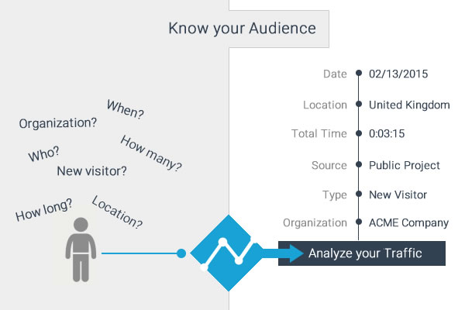
Web Traffic Analysis: Motivation and Introduction
Find MQLs !!!
H0:
Marketing & Business Unit heads has 20% conversion expectation. (Translate to 18 customers)
Data Package is more popular out of 3 services
Slide: 2
Notes:
MQL: Most Qualified Lead’s
Company has a new business unit and investing in cloud services (subscription model) for few of its traditional licensed suits on premise products.
Business Unit has launched 3 of its data-cloud services : Data Logging, Data packaging and SDK
In Beta /Trial phase to almost 100 Companies . The trial period is about 60 days.
While the trial is going on the engineering team has instrumented the click stream telemetry in the services. They have tried Google analytics /Mixpanel in previous launches. But for these new services they have chosen Fullstory www.fullstory.com .
The tool gives us info on pageviews, click paths, and heat maps as a proxy for user engagement,

Slide 3





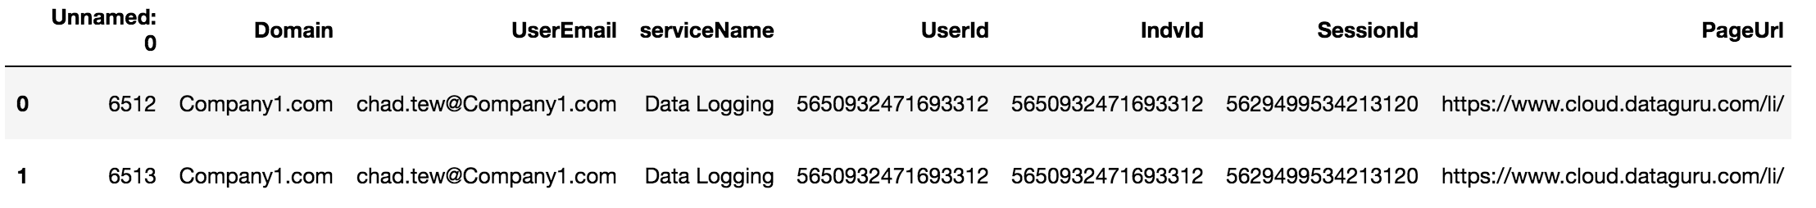
API Request Process
LIST Request
2018-09-07 - 2018-09-27
GET Request
Structured Data in CSV shape (753495, 34)
Jsonify Raw
Data
Slide: 3

Slide 4




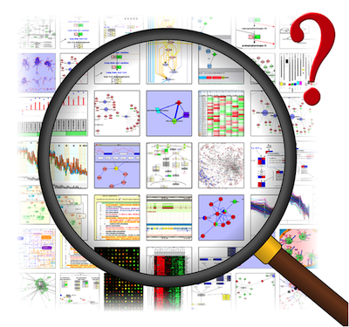
Data Preparation
Read
Combined_data.cvs
Securing on
premise
data
Main_customers.csv
Shape (711158,36)
Cleaning
&
Filtering
Shape (71286,16)
external_customers.csv
Exploratory
Data Analysis
(EDA)
Insights,
Reports,
Visuals Graphs
What Got Masked:
Services
URLs
Dropped Columns
Company Names
What Got Cleaned/Filtered:
Unwanted Columns
No email/Duplicate Rows
Renamed Columns
Services of study
Slide: 4

Slide 5
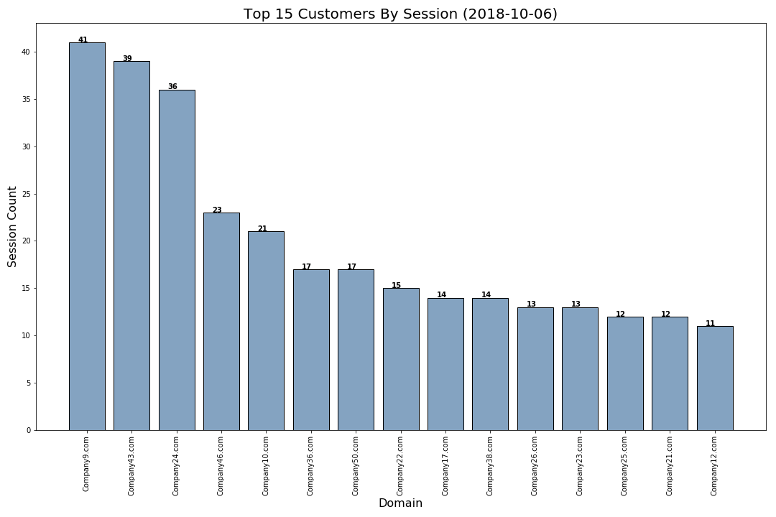
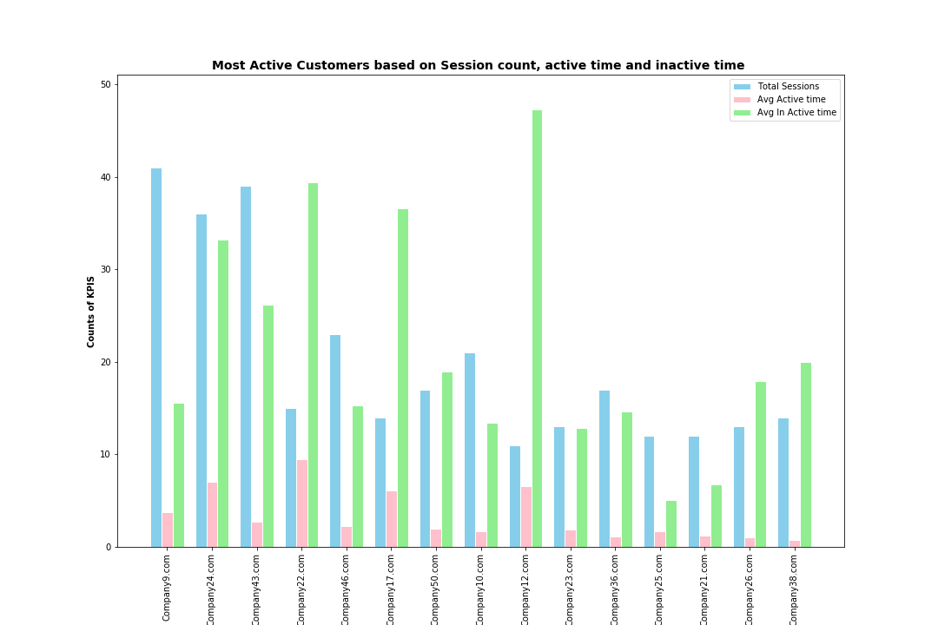
Customers Overall Session Count Vs Customers Active/Inactive Time On Session
Top 15 Customers by Session Count out of 88
Company9, Company43, Company24 have created maximum sessions with count of 41, 39, 36
The active time spend is not proportionate to the number of sessions created by the top three companies.
Most active customers are Company24, Company8, Company22, Company17
Company38 has is least active or has recently come to site while this customer has 14 sessions.
Slide: 5

Slide 6
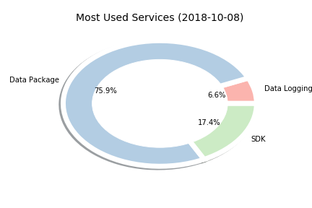
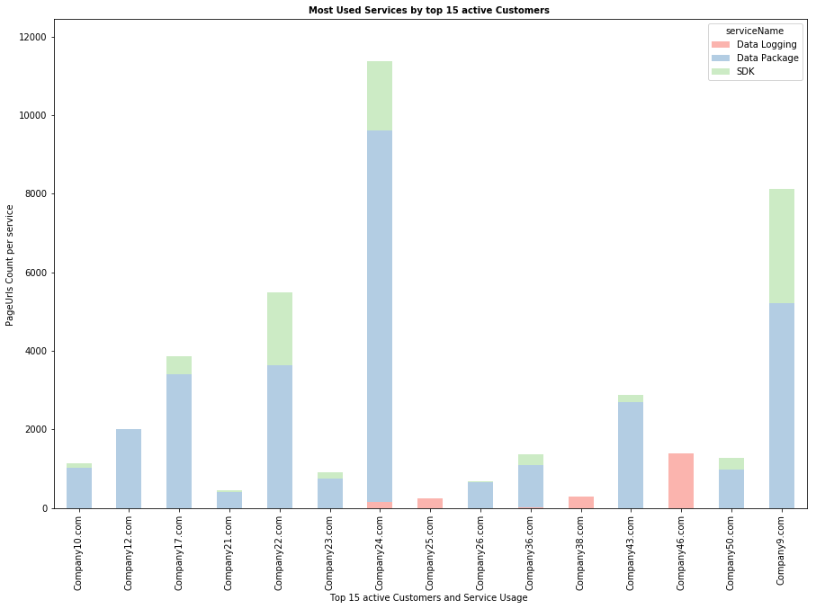
Data Package Is Most Popular Service Overall As Well As Among Active Customers
Most Popular Service Overall
Popular Services Among Active Customers
Slide: 6

Slide 7
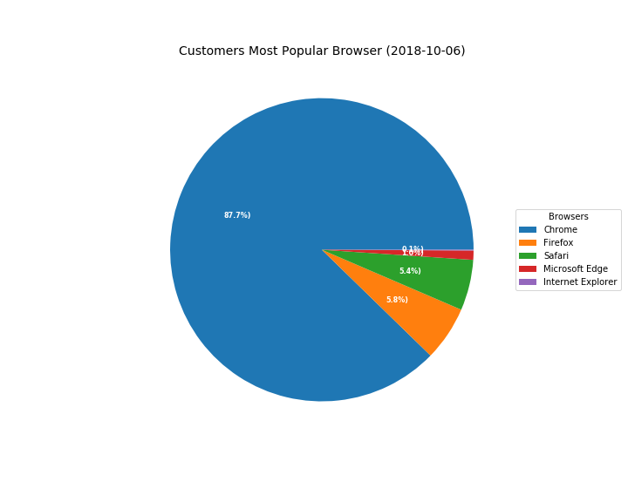
With 87.7% (47279 users), it can be undoubtedly deduced that customers prefer Chrome browser over others
Most Popular Browser
Slide: 7

Slide 8
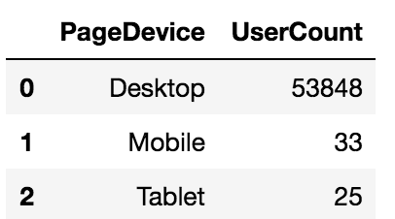
Most popular device among customers is Desktop (53848 Users) with 99% user base using our services through Desktop.
Most Popular Devices
Slide: 8

Slide 9
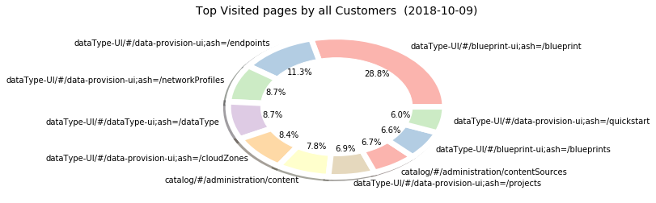
dataType-UI/#/blueprint-ui;ash=/blueprint Is The Top Visited Page Overall with 8479 PageCount at 28.8%
Top Visited Page
Slide: 9

Slide 10
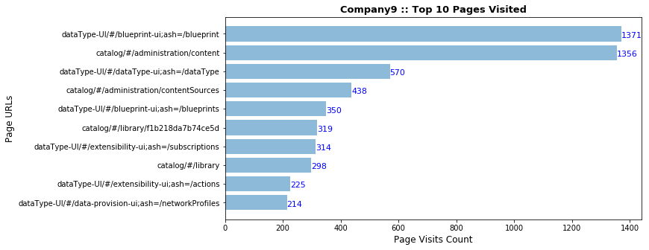
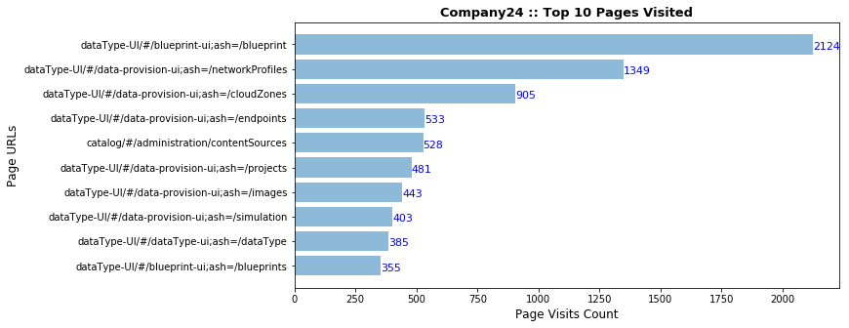
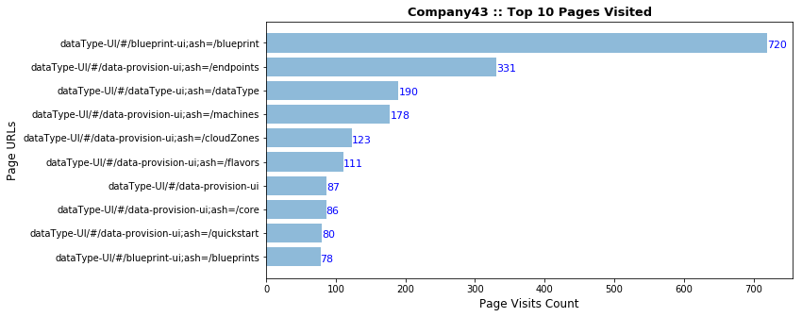
Top 10 Pages Visited by Our Top Active Customers. This data will be useful for our load and performance testing and future roadmap.
Top Visited Page By Active Customers
Slide: 10

Slide 11
AT A GLANCE
Customers: 88
Page Views: 71286
Active Customers: 42
Popular Browser
Popular Device
Top Visited Page
dataType-UI/#/blueprint-ui;ash=/blueprint
Slide: 11

Slide 12
Out of 88 customers we have 42 Active Customers, we can say the company is positively geared towards the expected goal of converting 18 customers by end of trial period. We show confidence on numbers in the both our hypothesis but cannot conclude yet till we acquire other related data and do more exploration on it.
Conclusion
H0:
Marketing & Business Unit heads has 20% conversion expectation. (Translate to 18 customers)
Data Package is more popular out of 3 services
Ha:
Less than 18 customers converted
Data Package is not popular
Slide: 12

Slide 13
From The Desk Of Analysis Team: Recommendations
Customers Session count matters, but the Average Active Time they spend on session is more definitive for being a potential.
“Data Package” is the most popular service, resources should be aligned and geared towards addressing any clarification/accessibility/issues etc. that may arise.
Company46, Company38, Company25 are solely using “Data Logging” Service, finding their use case to attract other customers who may have similar use cases can be explored.
dataType-UI/#/blueprint-ui;ash=/blueprint is the top visited page. Team should strive to keep this page optimized for user, effective load balancing be done, keep the page more engaging and seek required response on this page as required.
Align resources to handle Chrome and Desktop related issues on priority compared to other browsers or devices.
Slide: 13

Slide 14
Facts and Learnings
We have explored various libraries
configparser : Reading API, config file using
os : for checking and making data, img folders
logging : for logging errors and info on execution
2018-10-08 23:34:10,490 - __main__ - INFO - Starting downlaod of the Fullstory data exports
2018-10-08 23:34:10,490 - __main__ - INFO - Starting download for the bundle 1
Team has used List comprehension/Lambda, isin, list reduce, pivot, weightage rank, function etc. as our favorite tools
We explore new module for giving color effect to our charts:
palettable.colorbrewer.qualitative
Removed outliers
Slide: 14

Slide 15
Thank you!
We are now open for Q & A
Slide: 15

