Slide 1






DataGuru.com
Driving you business decisions
Archana Soni Anjali Mangal Christie Lafrance
9th Oct 2018

Slide 2


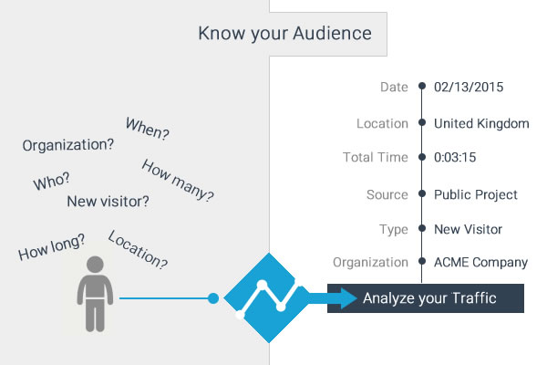
Web Traffic Analysis: Motivation and Introduction
Find MQLs !!!
H0:
Marketing & Business Unit heads has 20% conversion expectation. (Translate to 18 customers)
Notes:
Company has a new business unit and investing in cloud services (subscription model) for few of its traditional licensed suits on premise products.
Business Unit has launched 3 of its data-cloud services : Data Logging, Data packaging and SDK
In Beta /Trial phase to almost 100 Companies . The trial period is about 60 days.
While the trial is going on the engineering team has instrumented the click stream telemetry in the services. They have tried Google analytics /Mixpanel in previous launches. But for these new services they have chosen Fullstory www.fullstory.com .
The tool gives us info on pageviews, click paths, and heat maps as a proxy for user engagement,

Slide 3





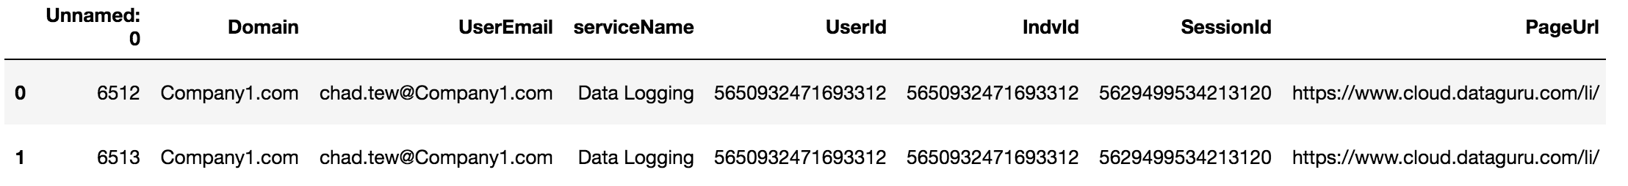
API Request Process
LIST Request
2018-09-07 - 2018-09-27
GET Request
Structured Data in CSV shape (753495, 34)
Jsonify Raw
Data

Slide 4





Data Preparation
Read
Combined_data.cvs
Securing on
premise
data
Main_customers.csv
Shape (711158,36)
Cleaning
&
Filtering
Shape (53906,16)
external_customers.csv
Exploratory
Data Analysis
(EDA)
Insights,
Reports,
Visuals Graphs
What Got Masked:
Services
URLs
Dropped Columns
Company Names
What Got Cleaned/Filtered:
Unwanted Columns
No email/Duplicate Rows
Renamed Columns
Services of study
Notes:
Read CSV Combined_data.cvs is the combined data of two bundles.
We apply below masking:
What we are masking:
Dropping rows with extra services we don’t care they were part of some POC
Size of data before dropping servcies (753495, 35)
Size of data after dropping servcies (711158, 35)
Masking Services
Size of data (711158, 35)
Masking sensitive URLs
Size of data (711158, 35)
Dropping columns that are not required
number of columns before :35
number of columns After :34
3. We apply below cleaning and filters to data post masking:
What we are cleaning:
Dropped column Unname 0 :
number of columns before :36
number of columns After :35
Adding Domain Column
Shape of exports read from CSV : (711158, 36)
3. Drop rows that do not have email and remove all email rows of internal folks
1. Shape of dataframe after dropping internal users : (78291, 36)
4. Set uppercase and lower case email and remove duplicates to avoid double counting
5. Dropping unwanted columns.
1.Shape of dataframe after dropping extra columns: (78291, 15)
6. Renaming columns to have better understanding
7. Three Services in all we have ['Data Logging', 'SDK', 'Data Package’]
8. Masking company names
4. LoadExternalDataAndWork:
1. Adding new normalized column PageUrl_Norm
2. Answer active users or company by unique session ID count
3. Total Active Customers 39 and Top 15 customer by session count. (groupby(["Domain"])['UserId'].nunique())
4. Graph plotted for Top 15 Customer by Session Count
5. Average Session Time Per Company: PageInactiveTime = PageDuration – PageActiveDuration and then :
groupby(["Domain","UserEmail", "UserId"]).head(1).reset_index(drop=True)
6. Merging above two data set and then Activecustomer Score: by using Dense Rank and allocating weights to find weightage rank
7. df = 'Domain', 'SessionCount', 'AverageSessionTime (Mins)', 'AverageActiveSessionTime (Mins)', 'AverageInActiveSessionTime (Mins)','ActiveCustomer_score’
8. 'AverageSessionTime (Mins)', 'AverageActiveSessionTime (Mins)', 'AverageInActiveSessionTime (Mins)’ cols are /1000/60 to find average session time per
Company in seconds
9. KPI’s stacked bar plotted: Most Active Customers based on Session count, active time and inactive time
5. Now we want to see top used Services overall:
6. Pie Chart plotted for seeing which is the top service used overall

Slide 5
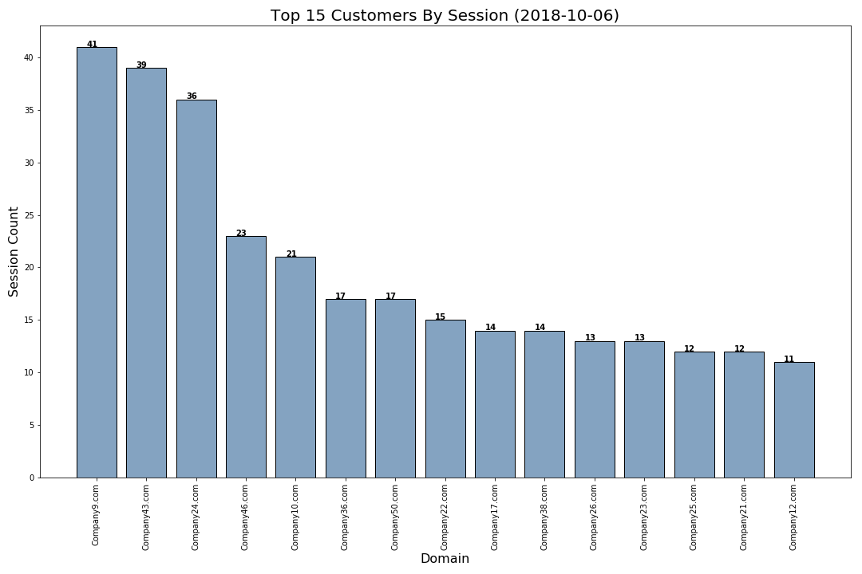
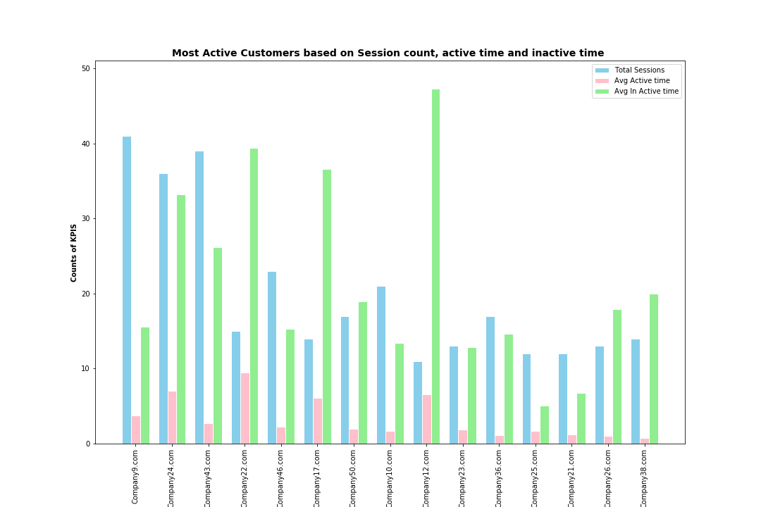
Top 15 Customers by Session Count out of 88
Company9, Company43, Company24 have created maximum sessions with count 41, 39, 36
The active time spend is not proportionate to the number of sessions created by the top three companies.
Most active customers are Company24, Company8, Company22, Company17, while
Company38 has is least active or has recently come to site while this customer has 14 sessions.

Slide 6
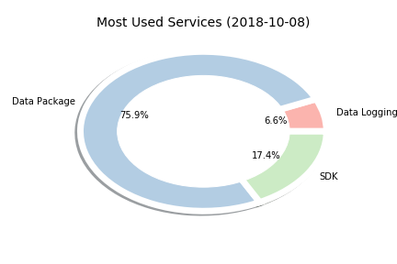
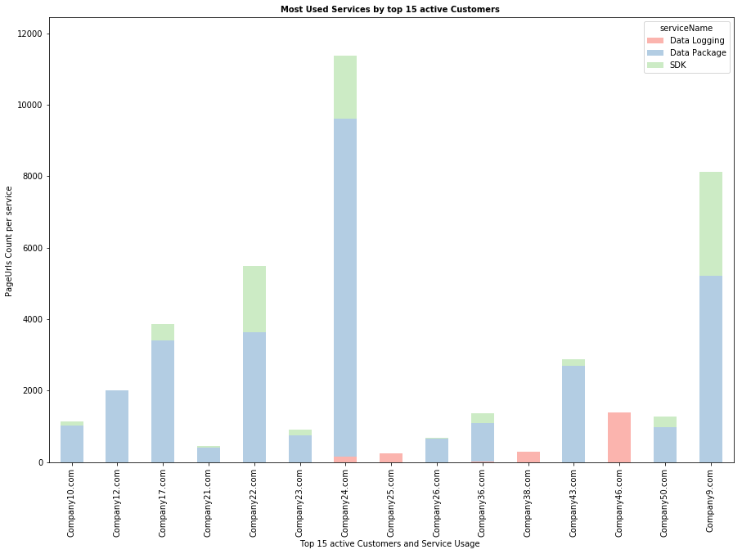
Data Package is most Popular Service Overall as well as among Active Customers

Slide 7
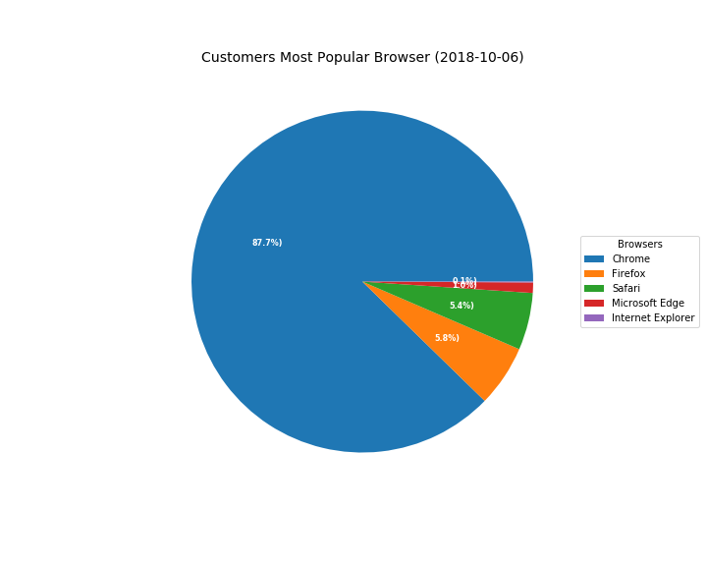
With 87.7% (47279 users), it can be undoubtedly deduced that customers prefer Chrome browser over others

Slide 8
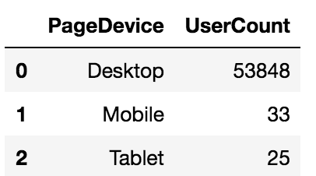
Most Popular Devices among customers is Desktop (53848 Users) which is 99% user base is using our services through Desktop.

Slide 9
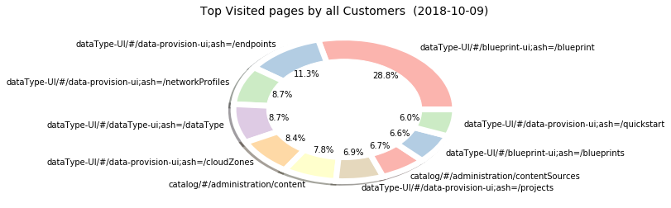
dataType-UI/#/blueprint-ui;ash=/blueprint Is The Top Visited Page Overall with 8479 PageCount at 28.8%

Slide 10
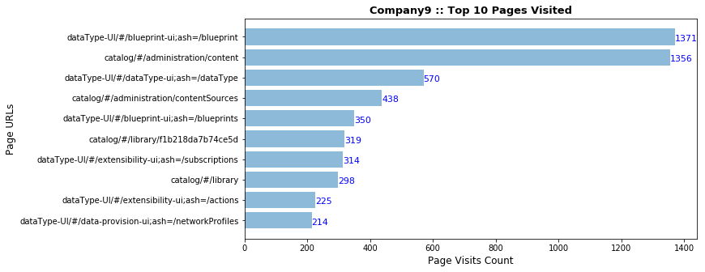
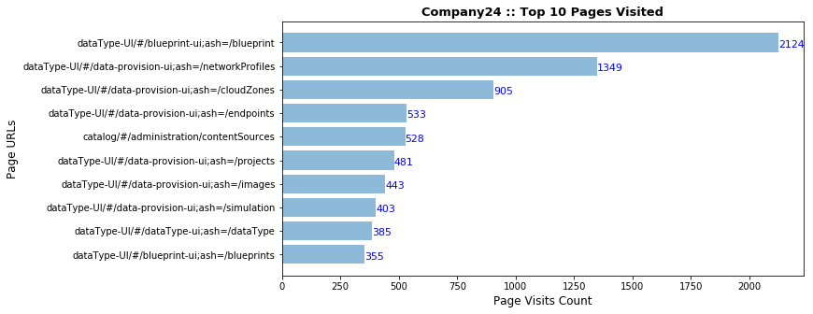
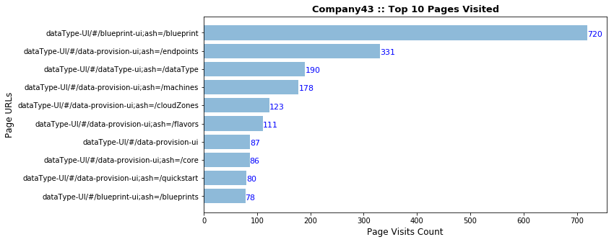
Top 10 Pages Visited by Our Top Active Customers. This data will be useful for our load and performance testing and future roadmap.

Slide 11
AT A GLANCE
Customers: 88
Page Views: 53906
Active Customers: 42
Popular Browser
Popular Device
Top Visited Page
dataType-UI/#/blueprint-ui;ash=/blueprint

Slide 12
Out of 88 customers we have 42 Active Customers, we can say the company is positively geared towards the expected goal of converting 18 customers by end of trial period.
Conclusion
H0:
Marketing & Business Unit heads has 20% conversion expectation. (Translate to 18 customers)
Ha:
Less than 18 customers converted

Slide 13
Facts and Learnings
We have explored various libraries
configparser : Reading API, config file using
os : for checking and making data, img folders
logging : for logging errors and info on execution
2018-10-08 23:34:10,490 - __main__ - INFO - Starting downlaod of the Fullstory data exports
2018-10-08 23:34:10,490 - __main__ - INFO - Starting download for the bundle 1
Team has used List comprehension/Lambda, isin, list reduce, weightage rank etc. as our favorite tools
We explore new library for giving color effect to our charts:
palettable.colorbrewer.qualitative
Removed outliers
And much more…

Slide 14
Thank you!
We are now open for Q & A
9th Oct 2018

