Slide 1
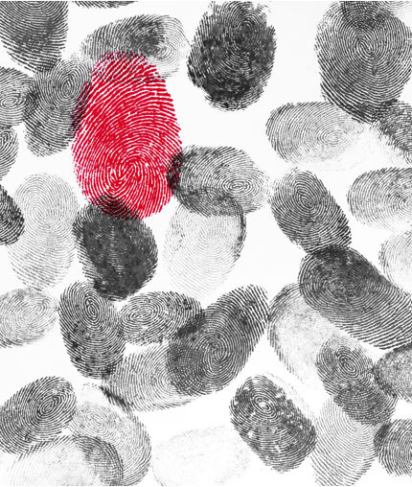
Fingerprint Matching and Verification Using SIFT Keypoints
Under the guidance of :
Prof. Dr.-Ing. Christof Jonietz
SRH Hochschule Heidelberg
Anjali Pankan
Matriculation Number: 11016821

Slide 2

WHY SIFT ?
Minutiae points - absence of sufficient minutiae features in partial images and altered images
Harris Corner Detector
Other algorithms assume that the two templates are approximately of the same size
Size of the image matters – SIFT is scale invariant.
Rotation invariant
Create comparatively large number of feature points

Slide 3
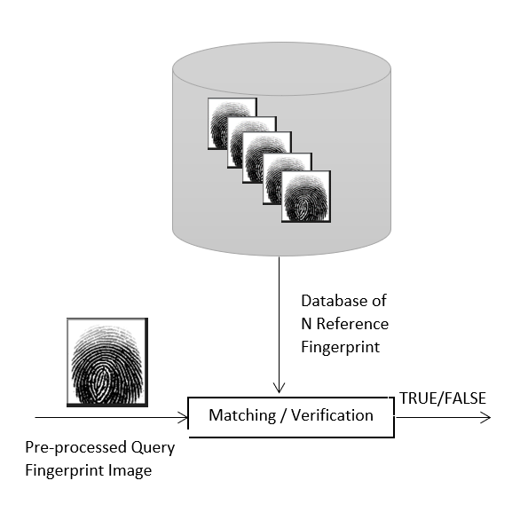

Steps

Slide 4

STEP:
Query Image as Input
Compare with each image from the Database
1

Slide 5
Detect keypoints using SIFT algorithm and compute the descriptors
STEP:
2
  detectAndCompute()
1
  Scale – space Extrema Detection
2
  Key-point Localization
3
  Orientation Assignment
4
  Key-point Descriptor

Slide 6
STEP
Find "good" matches
3
Brute-Force Matching
FLANN based matching
BFMatcher
FLANN

Slide 7
STEP
Find "good" matches : Distance Threshold
4
Higher Value - False positive
Lower value – Missing Good matches
Distance Threshold :120

Slide 8

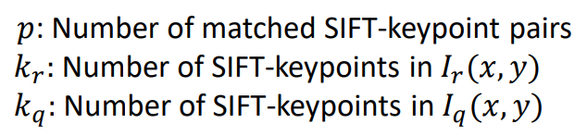
STEP
Determination of matching score based on good matches and keypoints
5

Slide 9
STEP
Decision of selection based on Decision threshold
DECISION_THRESHOLD = 0.1
6
Lower Value - False positive
Higher value – Missing right verification
7
Draw the "good" matches
cv::drawMatches()

Slide 10
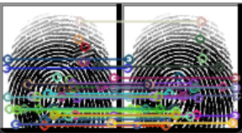
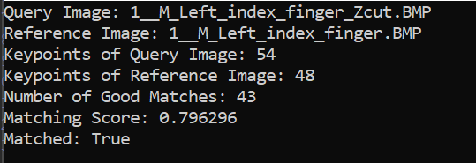
RESULTS
SUCCESSFUL CASE

Slide 11
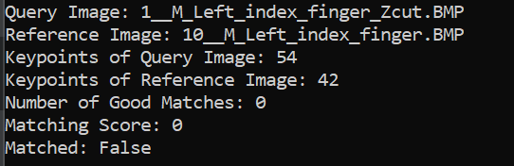
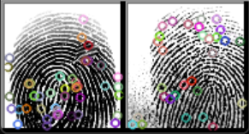
RESULTS
NON - SUCCESSFUL CASE

Slide 12
Easy = 100%
Medium = 98.96%
Hard = 94.73%
FINDINGS
Easy =658/299
td = 0.1 and distance 100
td = 0.05 and distance 150
Higher distance Value - False positive
Easy = 100%
Medium = 99.65%
Hard = 95.95%
td = 0.1 and distance 120
Easy = 497/299
Easy = 99.66%
td = 0.1 and distance 150
td = 0.2 and distance 100
10__M_Left_little_finger_Obl.BMP
Matching score: 0.160714
Higher distance Value - False positive
Higher td Value – Missing Good matches

Slide 13
Limitation faced even for td= 0.1 & distance =120
Altered Easy = 299/299 (100%)
Altered Medium = 290/291 (99.65%)
Altered Hard = 237/247 (95.95%)

Slide 14
DEMO

