Slide 1

Implementation of LMS FIR based Adaptive Filter for System
Identification
Under the guidance of :
Prof. Dr.-Ing. Christof Jonietz
SRH Hochschule Heidelberg
Anjali Pankan
Matriculation Number: 11016821

Slide 2
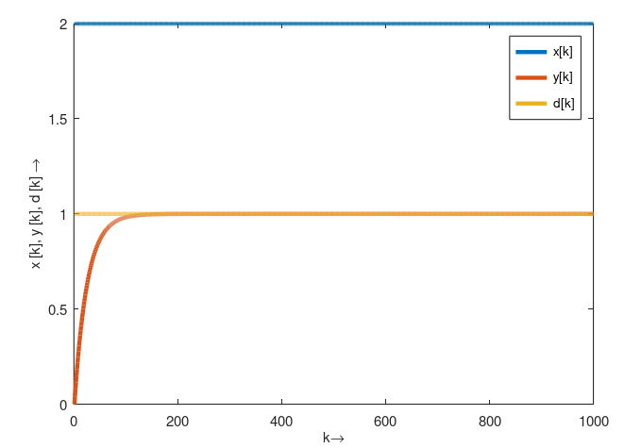
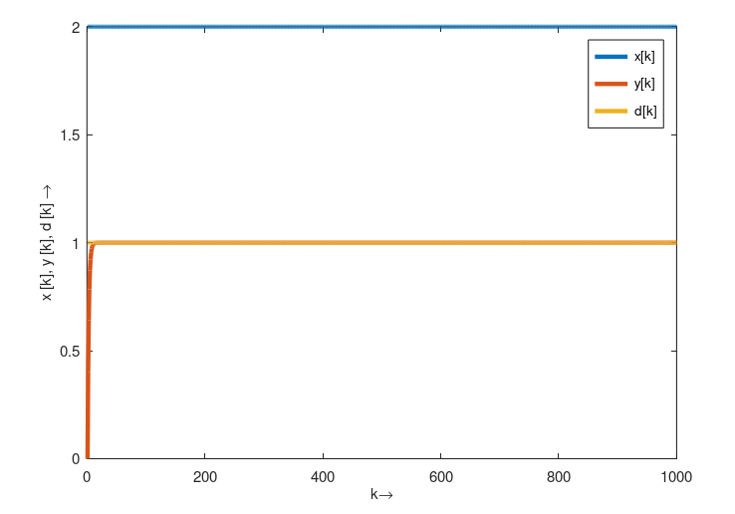
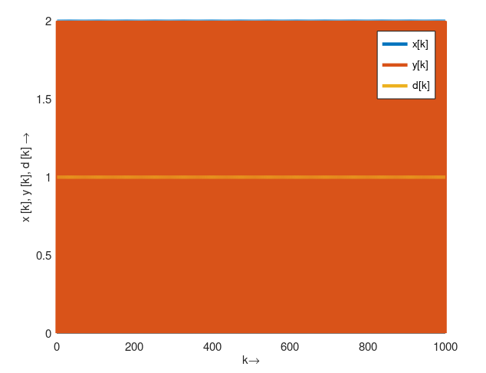
Task 01
LMS Algorithm
(μ) = 0.01
(μ) = 0.1
(μ) = 0.5
Μ -> Larger the step size causes a faster convergence but also a larger excess error
EXCESS ERROR : Wiener solution is approximated and not guaranteed
The convergence speed of LMS algorithm depends on the conditioning X (R) of the input and the step size µ. The LMS algorithm is therefore considered a rather 'slow' algorithm
Plot x[k], y[k] and d[k] for different step size

Slide 3
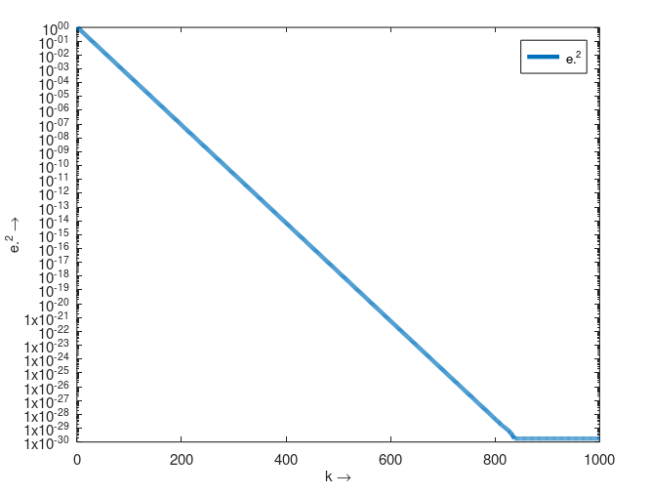
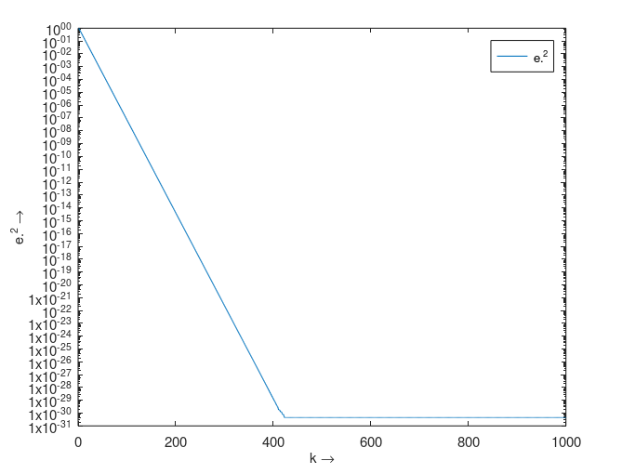
Task 02
LEARNING CURVE
Compare the Behavior of learning curve for N = 1 and N = 2
N = 1
N = 2
J = Jmin + Jex
If N increases, Jmin decreases (accuracy) and Jex (inaccuracy) increases
The number of weights N should therefore be kept as small as possible but large enough to meet the requirements of the applications.

Slide 4
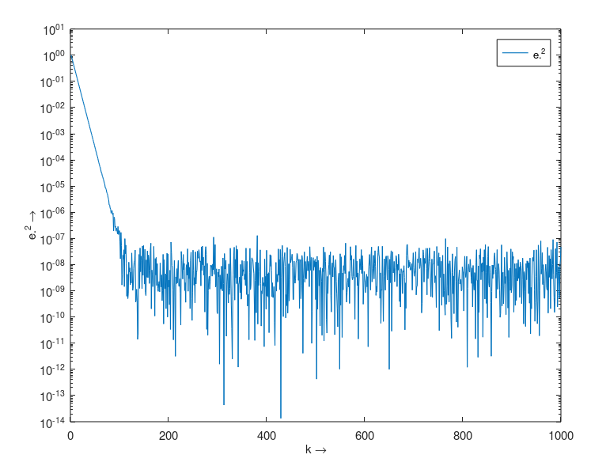
Task 02 :LEARNING CURVE
N = 2
Compare the learning curves with and without noise. Do the coefficients converge ?
YES!
For LMS an excess error Jex[k] > 0 remains for k → ∞ (gradient noise)
For the LMS algorithm, which is an approximation of the gradient method, we can at most expect to get close to Jmin (gradient noise).
N = 2

Slide 5
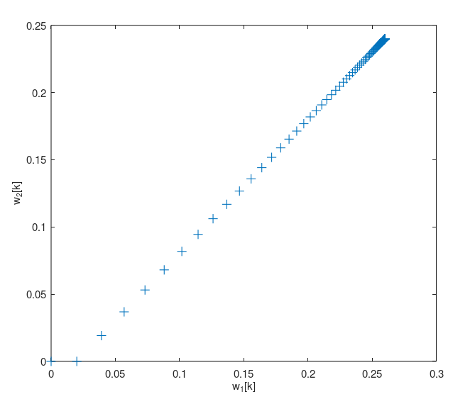
Task 02
Learning Curve
Filter Vector Coefficients
w_1 = 0.26
w_2 = 0.24

Slide 6
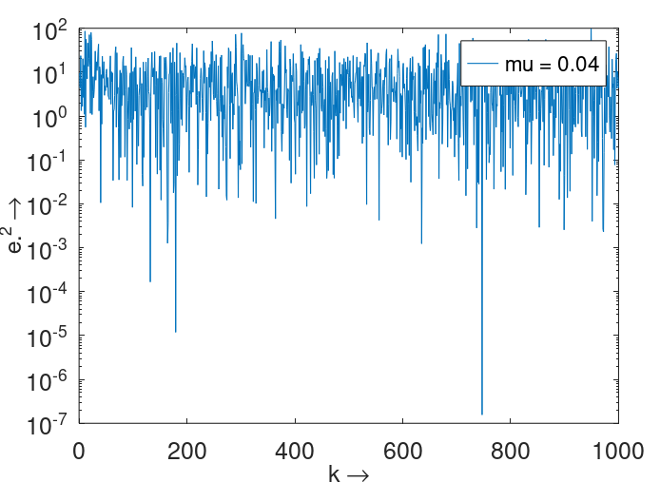
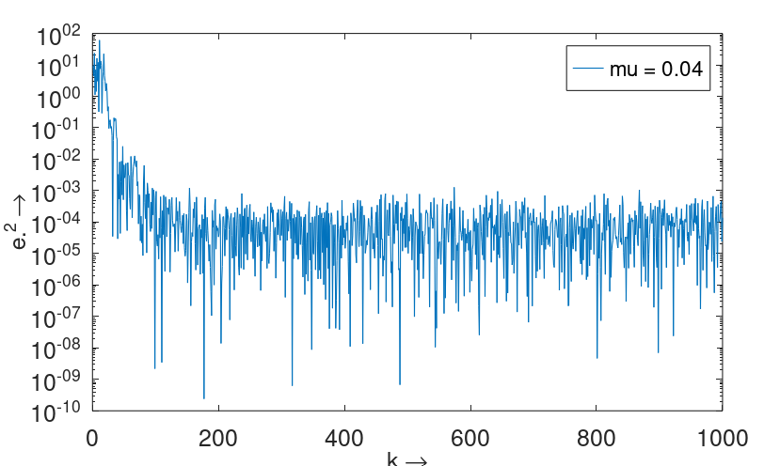
Task 03
System Identification
Determine the optimal length N
N = 2
N should therefore be kept as small as possible but large enough to meet the requirements of the applications.
N = 4

Slide 7
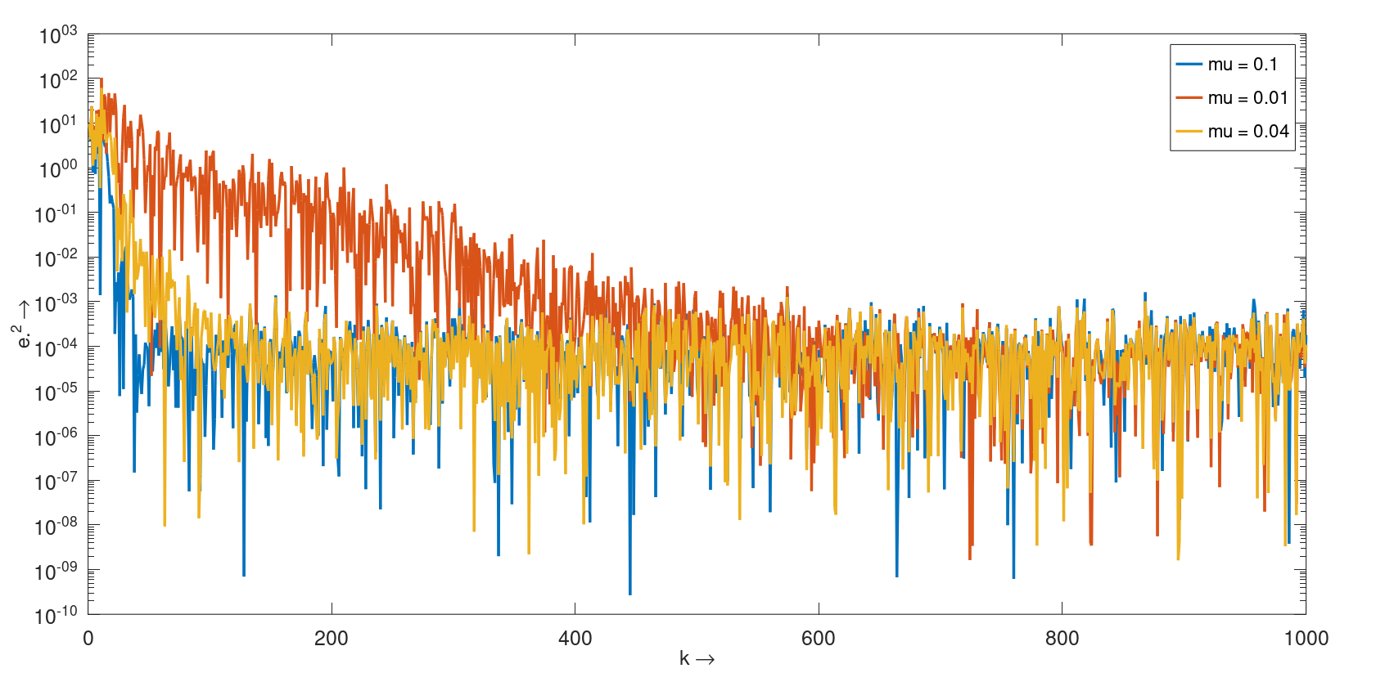
Task 03
System Identification
Determine the optimal step size

Slide 8
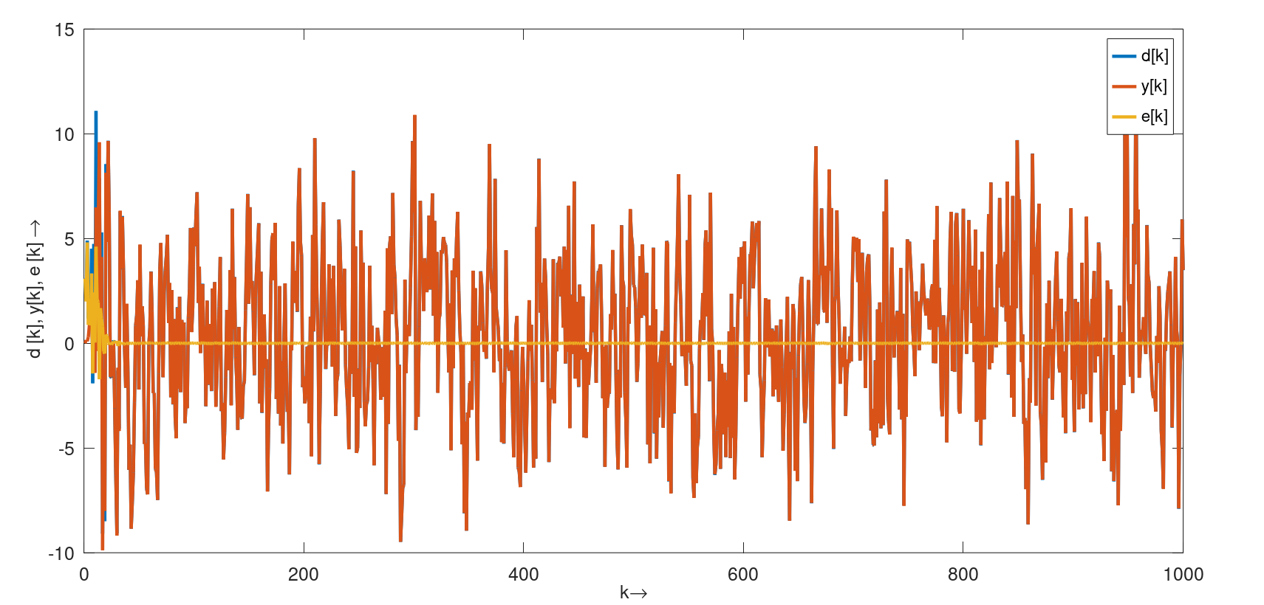
Task 3
System Identification

Slide 9
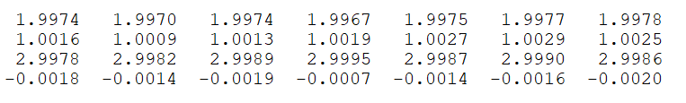
Show the filter coefficients wi, i=1..N,
Task 03
System Identification

Slide 10
DEMO

