Slide 1
Multi-Agent Reinforcement Learning for MultiRobot Intelligent Fixture Planning
Presented by:
P. Anjalidevi (y21cs136)
P. Bharath Chandra Seshu (y21cs134)
T. Dileep Chakravarthi (y21cs178)

Slide 2
Contents
Title
Abstract
Existing Techniques
Limitations
Proposed Technique
Algorithms
Module description
Implementation
Test cases
Results
Conclusion

Slide 3
Title
Decision Making for Multi-Robot Fixture Planning Using Multi-Agent Reinforcement Learning
Multi-Agent Reinforcement Learning (MARL) :involves multiple agents learning and making decisions in an environment while interacting with each other .The system learns from simulations, using feedback to improve its decision-making over time.
Multi-Robot Fixture Planning involves coordinating multiple robots to efficiently work together in tasks like assembling or manufacturing, using shared tools or fixtures.
Teaching multiple robots to plan and decide how to position their fixtures for manufacturing tasks like drilling, using Multi-Agent Reinforcement Learning

Slide 4
Abstract
Within the realm of flexible manufacturing, fixture layout planning allows manufacturers to rapidly deploy optimal fixturing plans that can reduce surface deformation that leads to crack propagation in components during manufacturing tasks. The role of fixture layout planning has evolved from being per formed by experienced engineers to computational methods due to the number of possible configurations for components. Current optimisation methods commonly fall into sub-optimal positions due to the existence of local optima, with data-driven machine learning techniques relying on costly to collect labelled training data. In this paper, we present a framework for multi-agent reinforcement learning with team decision theory to find optimal f ixturing plans for manufacturing tasks. We demonstrate our approach on two representative aerospace components with complex geometries across a set of drilling tasks, illustrating the capabilities of our method; we will compare this against state of the art methods to showcase our method’s improvement at f inding optimal fixturing plans with 3 times the improvement in deformation control within tolerance bounds.

Slide 5
Existing Techniques
Optimization methods:
CBR and RBR methods
Particle swarm optimization
Supervised Learning Method
Reinforcement Learning Method with single agent

Slide 6
Limitations For Existing Techniques
optimization methods often get stuck in "okay" solutions rather than the best ones. They are prone to finding sub-optimal solutions due to local optima
Supervised Learning Method needs a lot of labeled training data, which is expensive to collect.
Single-agent reinforcement learning approaches are slow and inefficient for real-world multi-agent systems.

Slide 7
Proposed Technique Multi-Agent Reinforcement Learning (MARL)
To clear limitations of existing systems the prosed technique is multi-agent reinforcement learning (a way for multiple AI "agents" to learn by trial and error) combined with Team decision theory (a way to make group decisions efficiently). This framework helps find the best fixture layouts for manufacturing tasks without needing a lot of pre-collected data. It can find the best way to hold the parts while reducing bending or deformation by three times more efficient. Overcomes local optima issues by enabling global optimization through cooperative agents.

Slide 8
Algorithms
Nash-Q learning: allows agents to build a policy that are capable of mitigating uncertainty in complex games and reducing the amount of data collection is required for training, this makes our approach most appropriate for determining optimal robotic fixture placement
Gaussian Reward Function: The project utilizes a Gaussian Reward Function to evaluate the quality of each fixture's action. This function assigns higher rewards to actions that result in minimal deformation

Slide 9
Multi-Layer Perceptron (MLP)
Deals with the space complexity issue of the base Nash-Q algorithm by removing the complexity completely with a neural network.
4) Finite Element Analysis
Accurate Deformation Measurement: FEA calculates deformation in x and z directions at a high resolution, helping the system understand how drilling affects the component's shape.
Reward Function Calculation: The deformation data from FEA is used in a Gaussian reward function, guiding the Multi-Agent Reinforcement Learning (MARL) system to find fixture positions that minimize deformation.

Slide 10
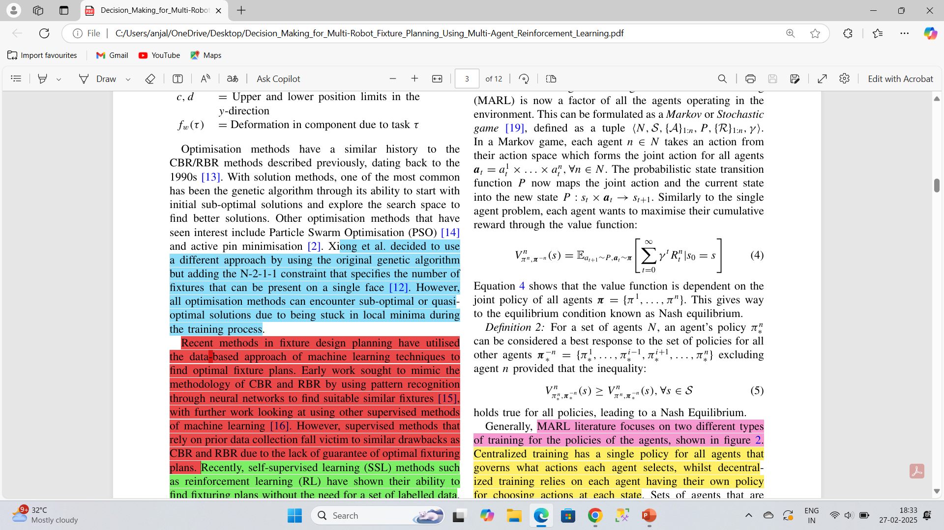
Module description
Markov Decision Process For Multi Agent Operating Environment
Tuple ⟨N,S,{A}1:n, P,{R}1:n,γ⟩. In a Markov game, each agent n ∈ N takes an action from their action space which forms the joint action for all agents.
N agents perform JOINT ACTION, the state transition function P now maps the joint action and the current state into the new state P : st × at → st+1.
Each agent want to maximize their reward through value function

Slide 11
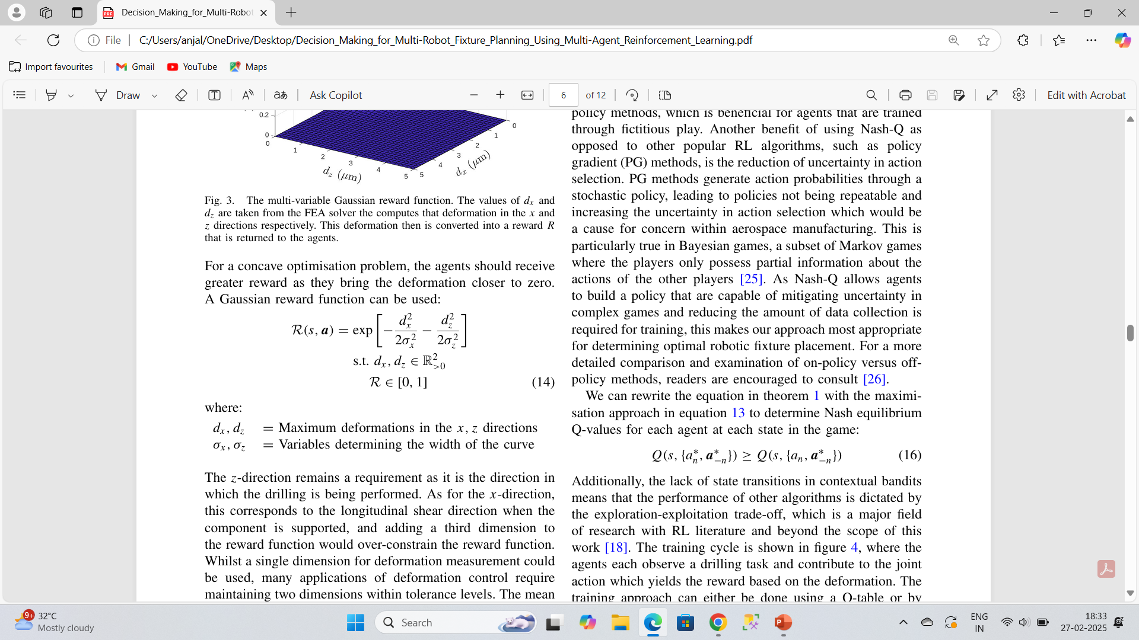
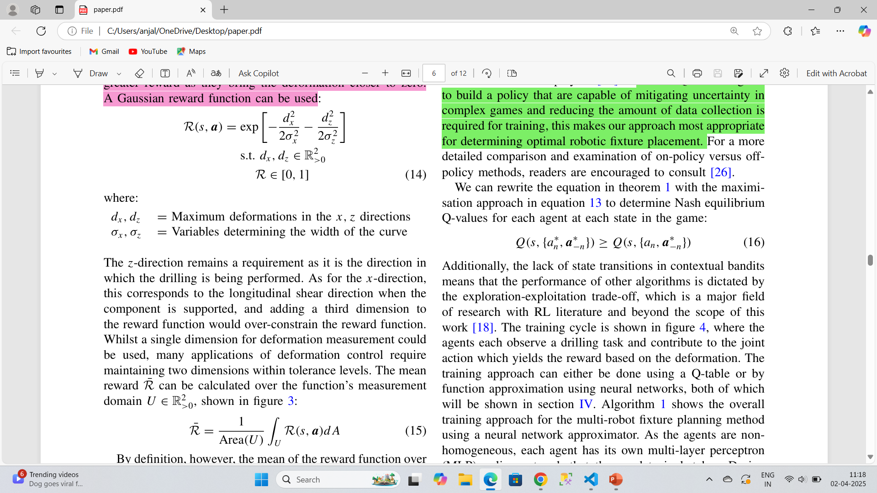
the agents should receive greater reward as they bring the deformation closer to zero. A Gaussian reward function can be used to calculate the reward
The agent (MARLAgent) updates its Q-values using the Q-learning formula:

Slide 12
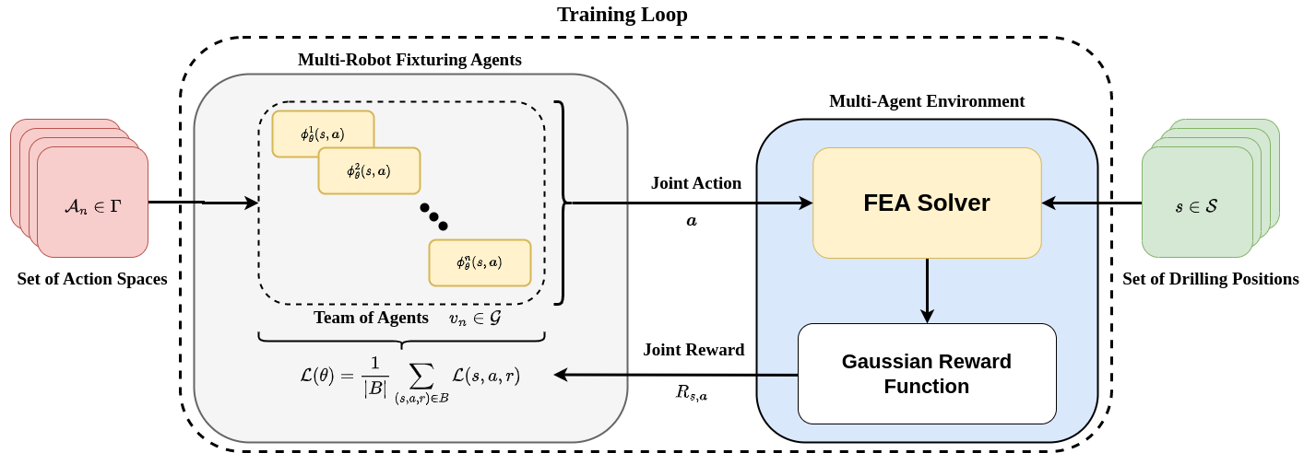

Slide 13
Training Loop for Multi-robot Fixturing Agents in A Multi-agent Environment.
The process starts with the robots selecting actions from a Set of Action Spaces (An ∈ Γ ) These actions are determined by each agent's Policy Network (ϕθ(s,a)), which learns and improves over time. The team of agents (vn ∈ G) works together to choose a Joint Action that is then tested in the FEA Solver. The FEA Solver simulates the physical effects of the joint action on the workpiece using Finite Element Analysis (FEA). Based on the simulation results, a Gaussian Reward Function calculates a Joint Reward (Rs,a) which evaluates how well the action minimized deformation. The agents then update their policy networks using the calculated loss function L(θ), helping them learn the best strategies. This loop continues until the agents maximize the rewards, ensuring stability and precision at the Set of Drilling Positions (s∈S).

Slide 14
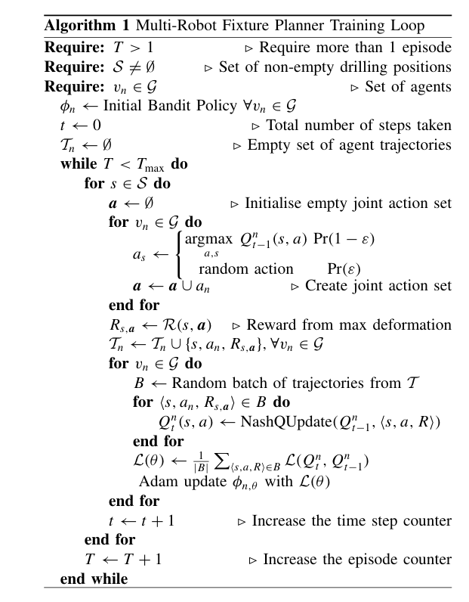
Training loop for Multi robot fixture planning using Nash Q-learning and Gaussian reward function

Slide 15
Implementation
Input
Component characteristics are constant
NUM_STATES = 500
NUM_EPISODES = 100
BATCH_SIZE = 32
EPS_START = 0.9
EPS_END = 0.05
EPS_DECAY = 3500
ALPHA = 0.8
TAU = 0.005
LR = 1e-4

Slide 16
Environment Setup (Cuboid Env )
the drilling environment, where the agents must decide optimal fixture placements to minimize deformation.
Reset : Randomly selects where to place the fixtures. Resets the strain map (sets deformation to zero).
Take an action : Agents pick new fixture locations (action). The environment simulates deformation and gives a reward. Higher reward = less deformation (better fixture placement). The task ends immediately after one step (done = True )

Slide 17
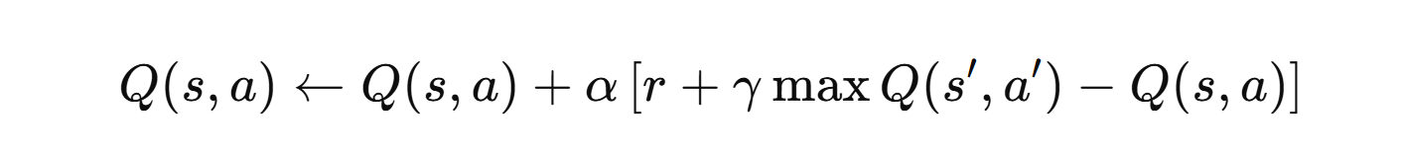
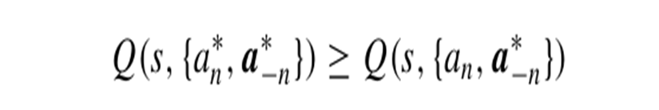
Q-Learning Agent (MARL Agent)
Picking an Action
Early on: It randomly chooses actions (explores different fixture placements).
Later: It chooses the best action based on what it has learned (exploits).
Learning from Experience
After taking an action, the agent gets a reward.
It updates its Q-values using Equation:
As it updates Q-values, it learns which placements minimize deformation the most.

Slide 18
Visualization & Analysis
The code generates multiple plots to analyze training performance:
Step vs. Reward (plot_step_vs_step_reward):
Shows how reward improves over training steps.
Episode vs. Return (plot_episode_vs_return):
Tracks overall learning progress.
Episode vs. Regret (plot_episode_vs_regret):
Regret decreases as the agents learn.
3D Equilibrium Plot (plot_3d_equilibrium):
Displays a multi-agent game equilibrium.
Violin Plot (plot_violin):
Shows distribution of deformation percentages.
Fixture Utilization Trend (plot_fixture_utilization_trend):
Illustrates how frequently different fixtures are used.

Slide 19
Test cases
Multi-Agent Reinforcement Learning (MARL) was tested in real-world scenarios involving the positioning of various components, such as parts of a bus, a fan, and a door. In these scenarios, the parts are secured using fixtures within a controlled cuboid environment. The MARL system was designed to optimize the placement and securing of these components, ensuring stability and less deformation while drilling

Slide 20
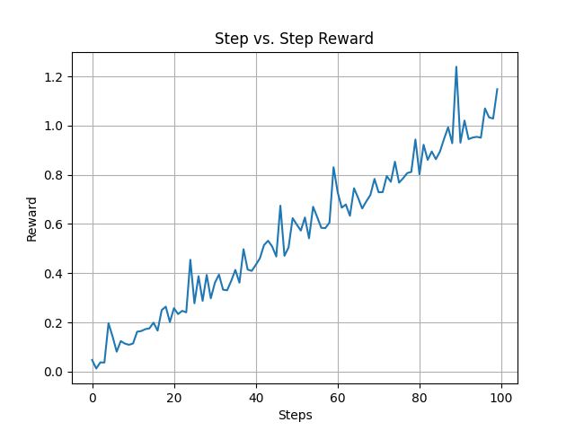
Results Step vs. Reward (plot_step_vs_step_reward): Shows how reward improves over training steps.

Slide 21
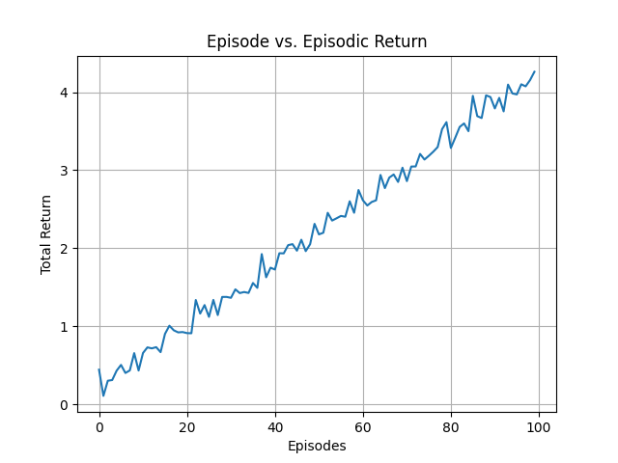
Episode vs. Return (plot_episode_vs_return): Tracks overall learning progress.

Slide 22
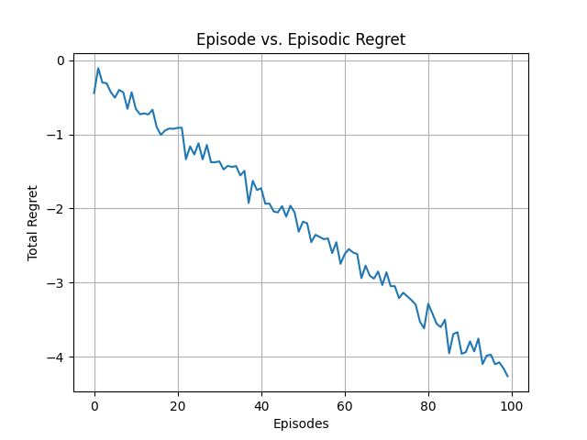
Episode vs. Regret (plot_episode_vs_regret): Regret decreases as the agents learn.

Slide 23
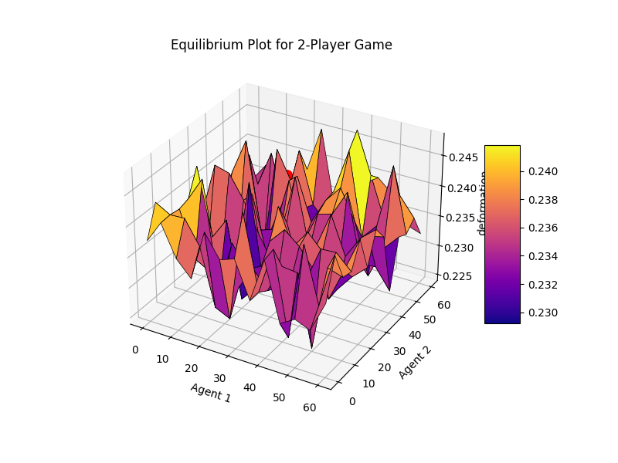

Slide 24
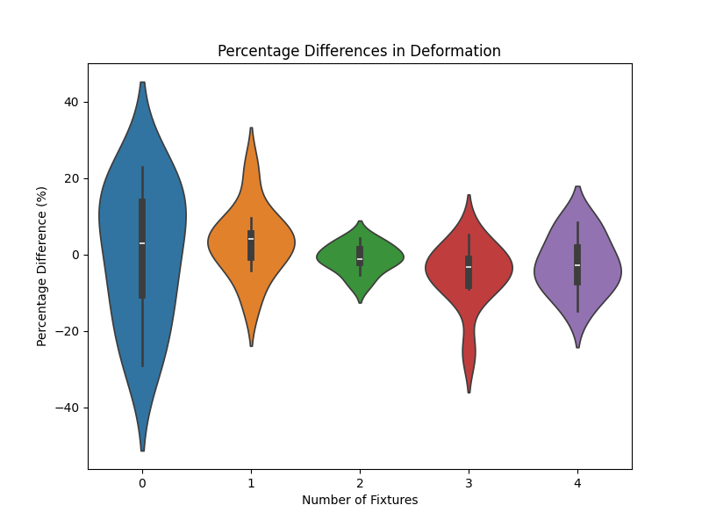
Violin Plot (plot_violin): Shows distribution of deformation percentages

Slide 25
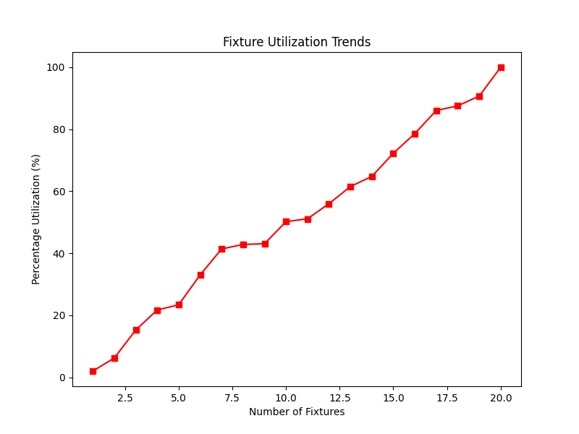
Fixture Utilization Trend (plot_fixture_utilization_trend): Illustrates how frequently different fixtures are used

Slide 26
Conclusion
Multi-Agent Reinforcement Learning (MARL) system to optimize fixture placement for drilling tasks, aiming to minimize deformation. Each agent uses deep Q-learning to learn the best positions by continuously updating Q-values based on rewards. Over time, the agents improve their decision-making through an exploration-exploitation strategy, leading to increased total rewards and reduced regret. The system's performance is visualized using various plots, showcasing how fixture arrangements impact deformation. This approach enhances automated manufacturing, allowing robotic fixtures to intelligently adjust positions without human intervention, improving drilling precision and efficiency.

