Slide 1
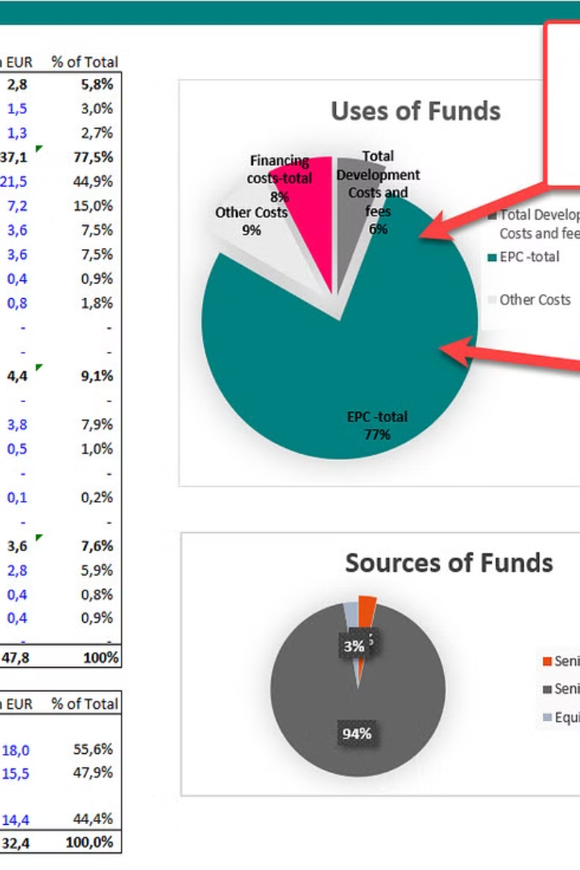


Project Bootcamp Program
by Rajani Gupta

Slide 2
Domain: Finance
Project: Bank loan of customers
Dataset Type: Excel Data
Dataset Size: Each Excel file has 39k+ records

Slide 3
Datasets: Finance_1 & Finance_2
Finance_1
(.xlsx)
Finance_2
(.xlsx)

Slide 5
Key Performance Indicator
●Year wise loan amount Stats
●Grade and sub grade wise revol_bal
●Total Payment for Verified Status Vs Total Payment for Non Verified Status
●State wise and last_credit_pull_d wise loan status
●Home ownership Vs last payment date stats

Slide 6
Thank You

