Slide 1
Real Time Attendance System
Made By:
Anjali Rana (102017095): CSE5
Saurabh Thakur(102017183): CSE8
Harishankar Kumar(102003066): COE3
Naman Khurana(102017099): CSE5

Slide 2
Steps:
Feature Extraction using Gabor
Then Compressing the output feature vector using LDA based on PCA
Use Nearest domain classifier for face recognition classification

Slide 3
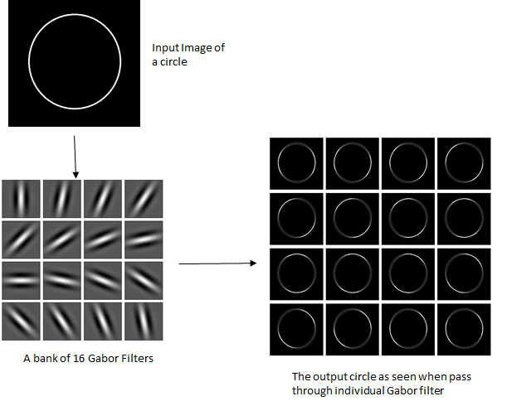
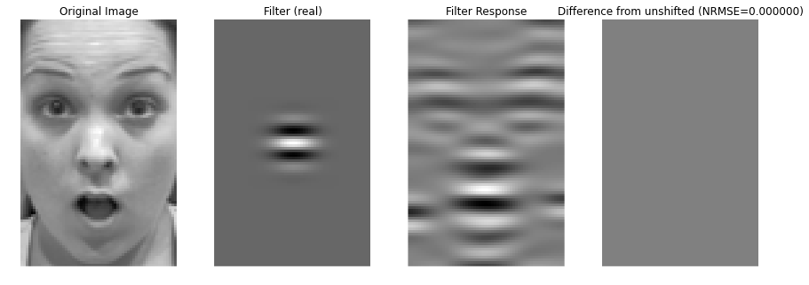
Gabor Wavelet Transform
Gabor filter, named after Dennis Gabor, is a linear filter used for texture analysis.
Gabor filter (or wavelet transform) is used to capture facial features aligned at specific angles!

Slide 4

Gabor kernel definition of wavelet transform:
Where
x̅ = (x, y) is a spatial domain variable
k̅ j = frequency vector that determines the scale and direction of the Gabor kernel.

Slide 5
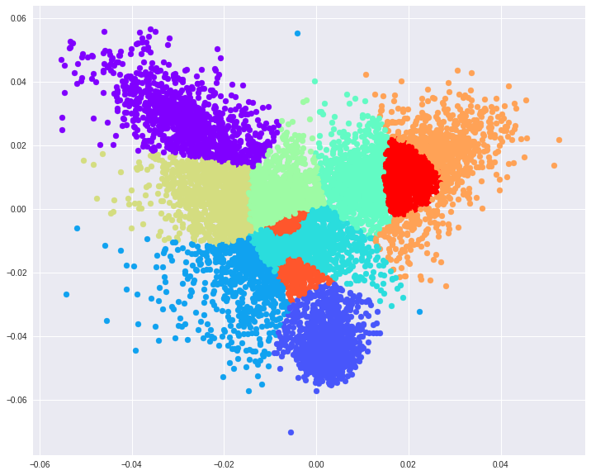
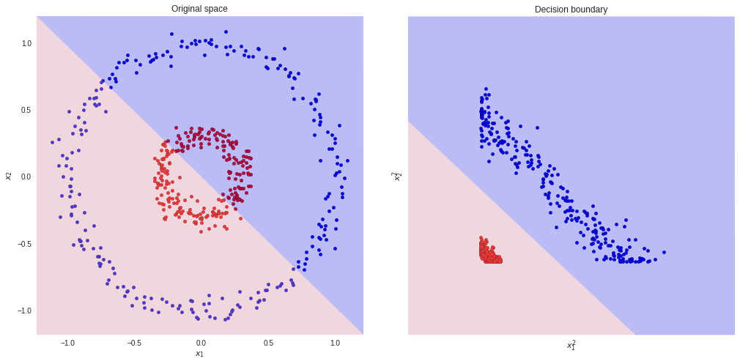
Fisher’s Linear Discriminant Analysis (LDA)
LDA finds vector such that the separation between classes is maximum and separation inside classes is minimum!
Ie aggregating facial features of person together and making sure it is far away from other students facial data.
Multiple Classes
LDA

Slide 6

Fisher Discriminant Criteria
where
φ is any n – dimensional column vector
Sb is the inter-class separation matrix
Sw is the intra-class separation matrix

Slide 7

Use Nearest domain classifier for face recognition classification
Let Fk°, k = 1,2,…….., L be the average of the training samples of class φk after PCA or LDA transformation
where
δ is judged as the distance

Slide 8
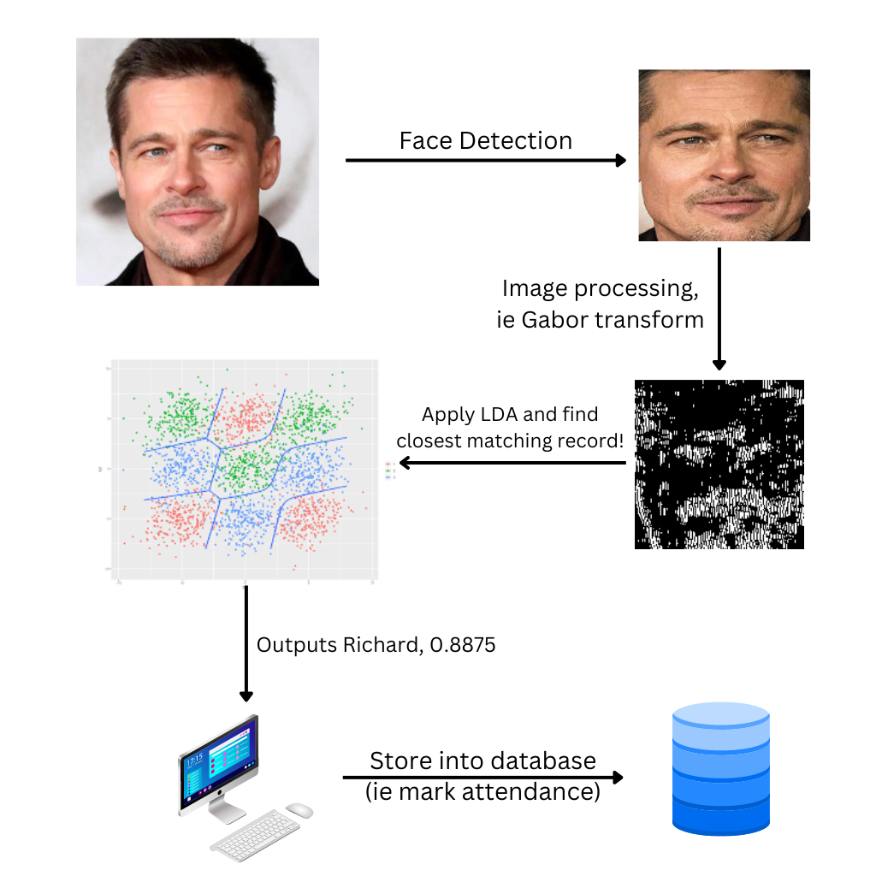
Assembling everything!

Slide 9
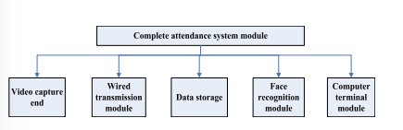
Complete Module

Slide 10
Conclusion
The attendance system realizes the expected attendance results through face recognition technology with the help of computer, which fully reflects the feasibility design of the overall algorithm.

Slide 11
Thank you !!

