Slide 1

Team details:
NAME | USN | ROLL NO
Anjali Savalkar | 01fe22bcs196 | 140
Daneshwari M | 01fe22bcs253 | 152
Prerana Deshpande | 01fe22bcs246 | 150
Subrahmanya H | 01fe22bcs278

Slide 2
Application Functionalities
Our e-commerce application provides essential features for a seamless online shopping experience. Below are the core functionalities we are implementing:
User Authentication : Secure login and registration system for customers.
Product Listing and Browsing : Users can view all available products with details such as name, price, image, and description.
Add to Cart : Customers can add products to their cart from the product listing or individual product pages.
Remove from Cart : Users can view items in their cart and remove unwanted items.
Cart Value Calculation : Automatically calculates and displays the total value of items in the cart.
Admin Panel : Admins can add new products to the system.

Slide 3
Cloud Service Provider: Render
We have selected Render as our cloud service provider due to its simplicity, scalability, and cost-effectiveness for hosting modern web applications.
Why Render?
Full-Stack Support: Easily deploy both frontend (React, HTML/CSS/JS) and backend (Node.js, Express) apps.
Free Tier Available: Ideal for student projects with free hosting options for web services and databases.
🧩 Services Used in Our Project
Web Services: Hosting the Node.js + Express backend API.
Static Sites: Deploying the frontend (HTML/CSS/JS or React).
PostgreSQL Database: Managing user credentials, product data, and cart data

Slide 4
Cloud Architecture
i) Deployment Model – Public Cloud
We are using a Public Cloud Deployment Model via Render.com.
Resources such as servers, databases, and hosting environments are owned and operated by Render.
Our application is accessible over the internet by any user, making it ideal for e-commerce.
Benefits of Public Cloud:
Cost-effective for small to medium projects
Easy to set up and scale
No maintenance overhead

Slide 5
ii) Service Model – PaaS (Platform as a Service)
Render provides PaaS, allowing us to focus on development without managing infrastructure.
It handles hosting, deployment, scaling, and backend configurations.
We only write code – Render handles the rest!
PaaS Advantages:
Fast deployment and continuous integration (CI/CD)
Built-in database and storage solutions
Supports full-stack apps (frontend + backend)

Slide 6
Deployment Steps
1. Create a Render Account
Signed up for a free account at Render.com.
Connected GitHub repository for CI/CD deployment.
2. Deploy Frontend (Static Site)
Chose "Static Site" option on Render.
Linked GitHub repo containing HTML, CSS, and JavaScript files.
Selected build command and publish directory.
Render deployed the frontend with a live URL.

Slide 7
3. Deploy Backend (Web Service)
Created a "Web Service" for our Node.js + Express backend.
Set up environment variables (e.g., DB credentials).
Auto-deployment enabled from GitHub branch.

Slide 8
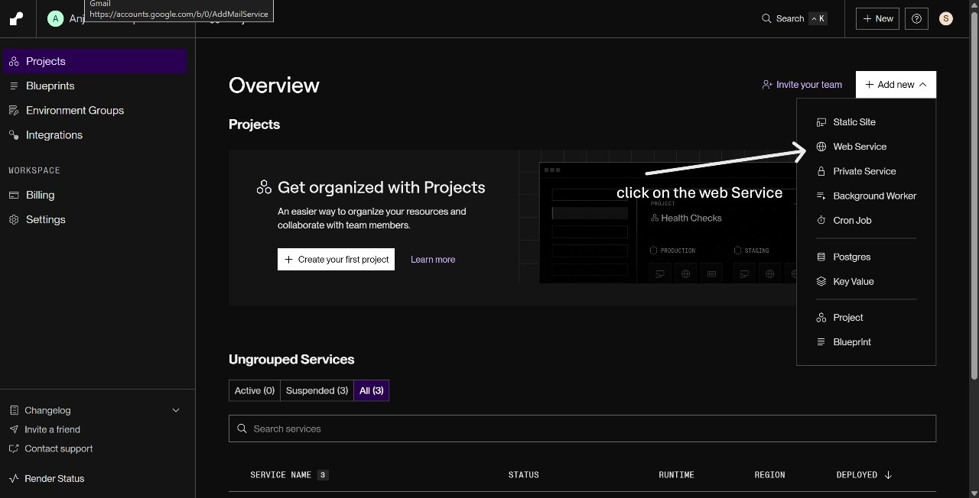

Slide 9
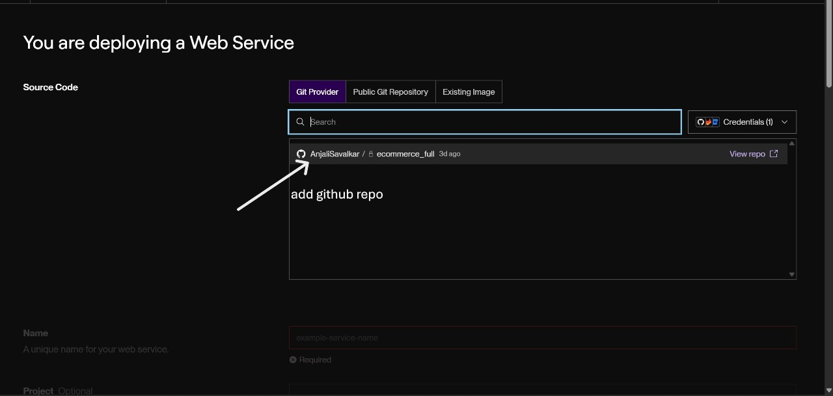

Slide 10
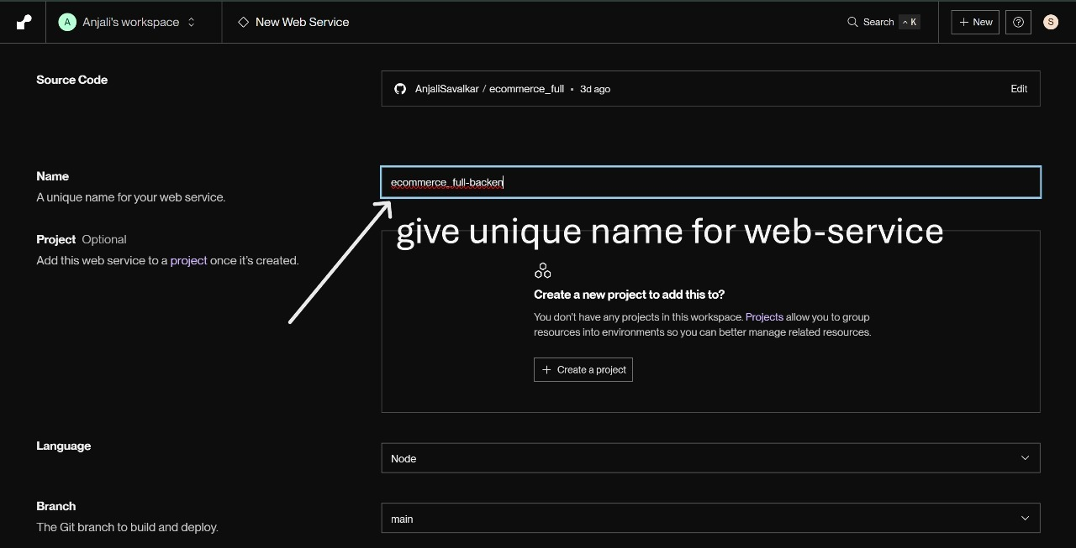

Slide 11
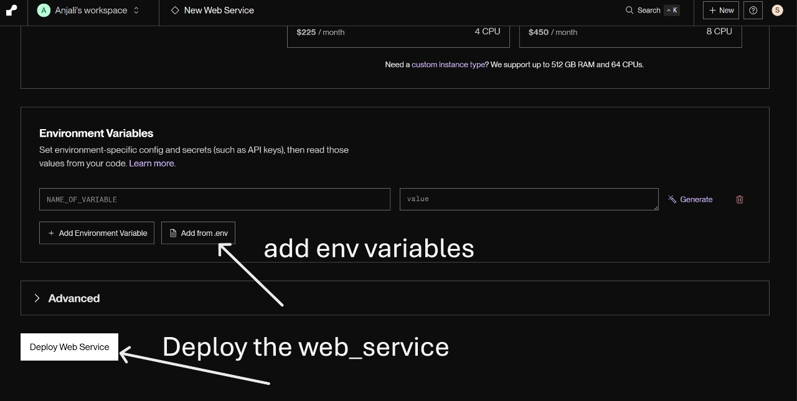

Slide 12
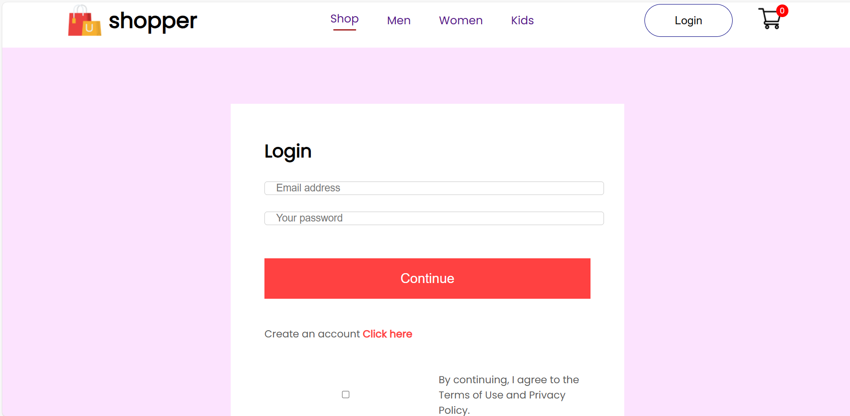
Hosted Website Images

Slide 13
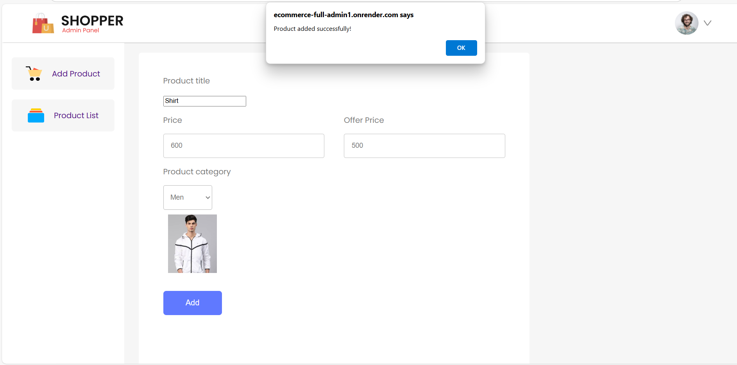

Slide 14
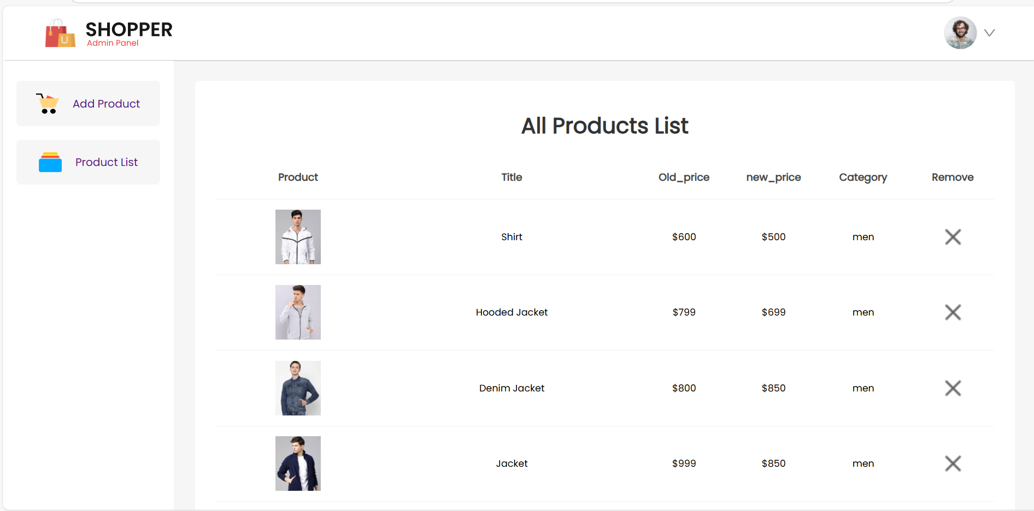

Slide 15
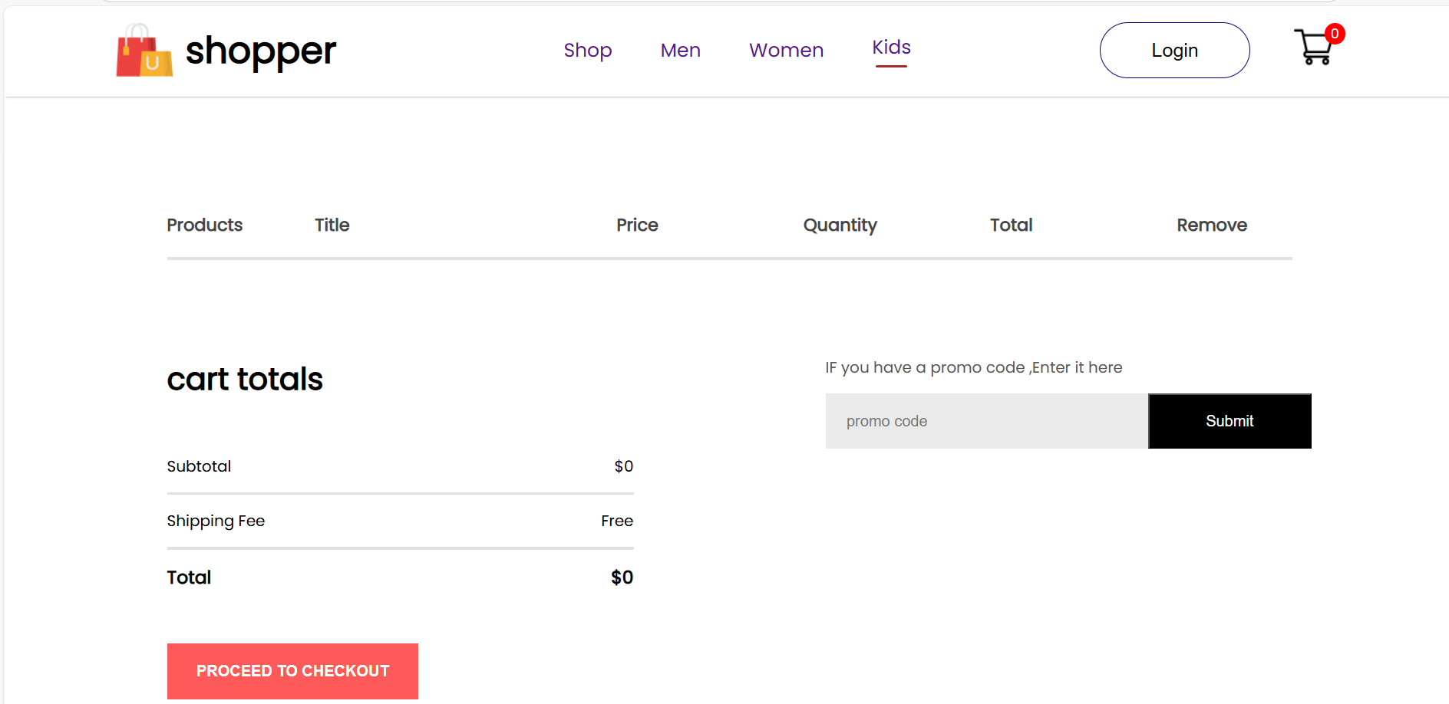

Slide 16
THANK YOU

