Slide 1

Project Title -Seasonal Agriculture Performance Analysis
Student Name- Anjali Prempratap Sharma
College Name- Shree Swaminarayan Institute of Technology
AICTE STU ID : STU6a218cce54df81780583630

Slide 2

PROBLEM STATEMENT
Agricultural activities are influenced by seasonal variations in environmental conditions, farming practices, resource availability and market conditions. As a result, agricultural performance may differ from one season to another. However, raw agricultural data does not clearly explain how agricultural performance changes across seasons or what patterns can be observed in different seasonal conditions. The problem is to analyze the given agricultural dataset and investigate seasonal differences in agricultural performance by identifying meaningful patterns, trends, relationships and variations within the available data.

Slide 3
Seasonal Agriculture Performance Analysis is a data analysis project that examines agricultural performance across different seasons, crops, regions, farming practices, and environmental conditions. The project uses the provided agricultural dataset to identify seasonal variations in yield, production, water usage, profitability, and disease/pest risk. Through data cleaning, statistical analysis, and visualization, meaningful patterns and relationships are identified to support evidence-based agricultural planning and decision-making.
PROJECT DESCRIPTION

Slide 4

WHO ARE THE END USERS?
Farmers
Agricultural Advisors
Government Agriculture Departments
Agricultural Researchers & Data Analysts
Resource Management Teams

Slide 5

Technology Used
🐍 Python – Main programming language for data analysis
🐼 Pandas – Data loading, cleaning, transformation, and analysis
🔢 NumPy – Numerical and statistical operations
📊 Matplotlib – Data visualization and graphical analysis
📈 Seaborn – Statistical visualizations and relationship analysis
📓 Google Colab – Development and execution environment
📁 CSV Dataset – Provided agricultural dataset used for analysis

Slide 6
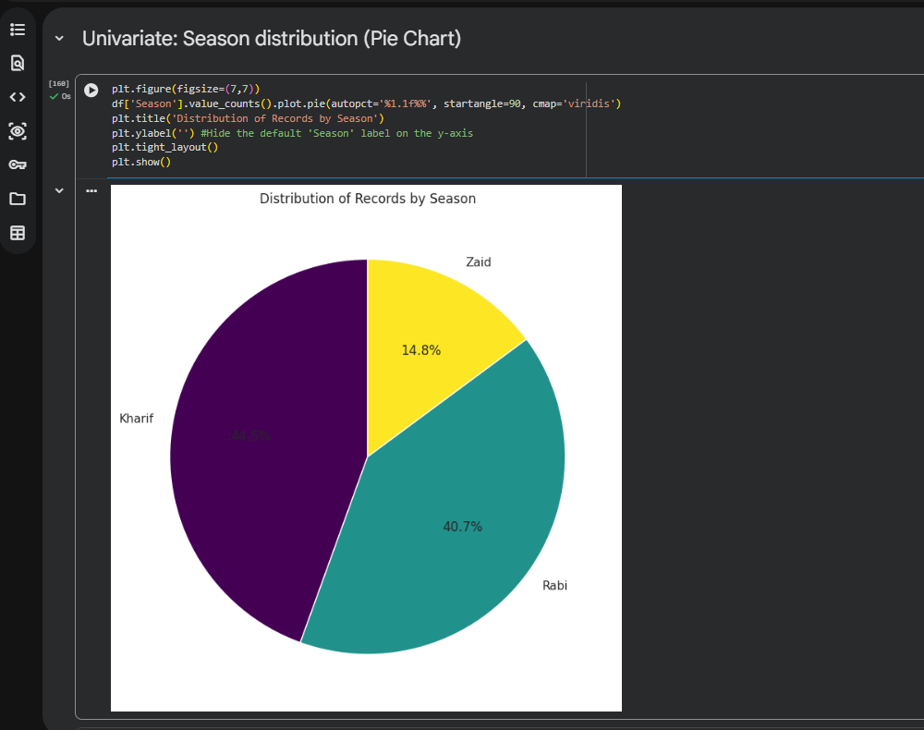
RESULTS
[Add screen shots of your code ]

Slide 7
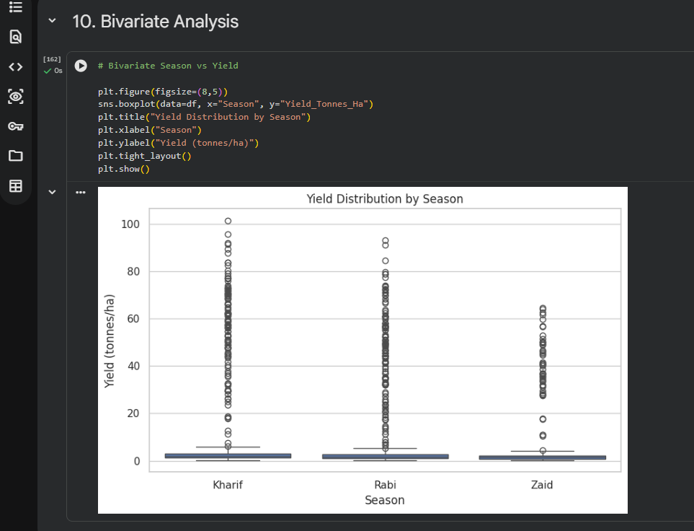
RESULTS
[Add screen shots of your code ]

Slide 8
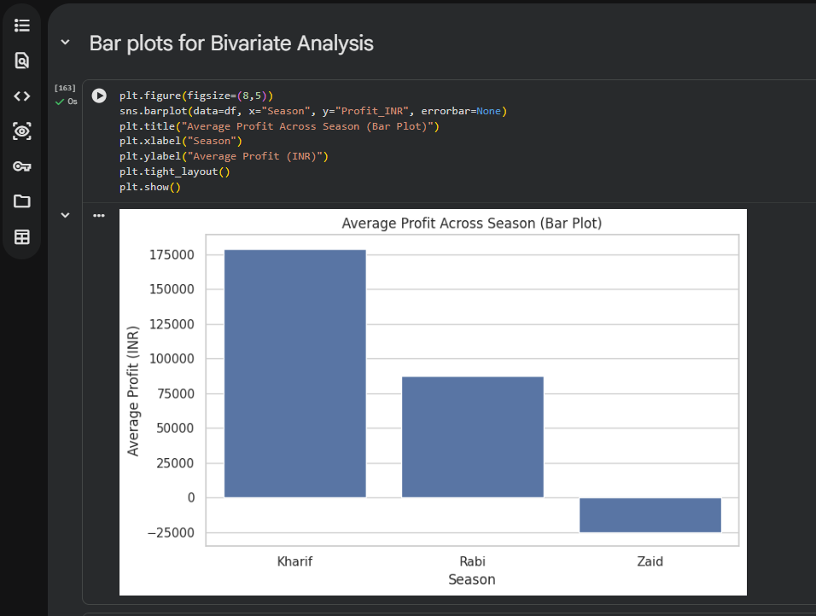
RESULTS
[Add screen shots of your code ]

Slide 9
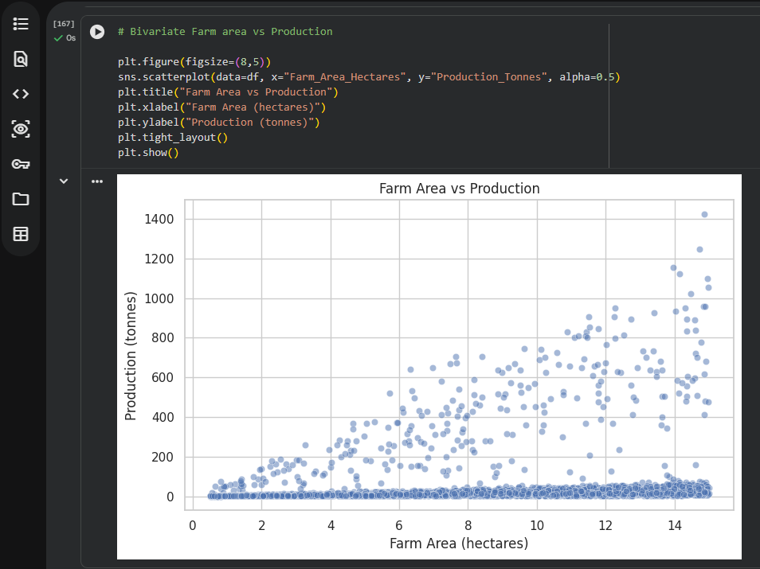
RESULTS
[Add screen shots of your code ]

Slide 10
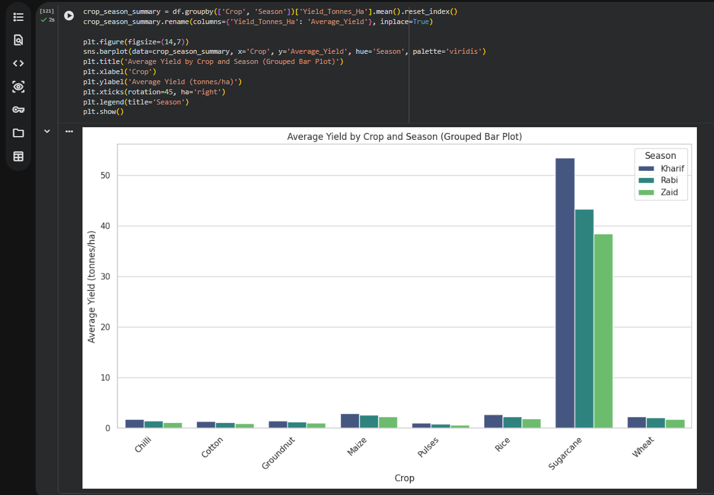
RESULTS

Slide 11
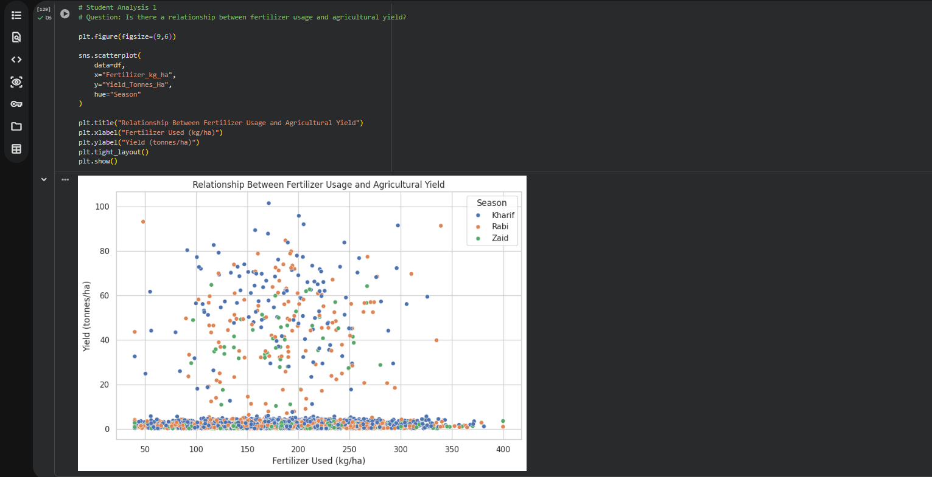
RESULTS

Slide 12
Future scope
• AI-Based Crop Yield Prediction – Predict future crop yield using historical and environmental data. • Smart Crop Recommendation – Recommend suitable crops based on season, soil, rainfall, and resource availability. • Weather-Based Risk Prediction – Predict the impact of weather conditions on crop performance. • Disease & Pest Early Warning – Provide early alerts for seasons with higher disease and pest risks. • Regional Analysis – Extend the analysis to different geographical regions and farming conditions. • Real-Time Agricultural Dashboard – Integrate live weather, soil, and crop data for continuous monitoring. • Resource Optimization – Develop AI-driven recommendations for efficient water, fertilizer, and irrigation usage.

Slide 13
GitHub Link
https://github.com/AnjaliSharma070/Seasonal-Agriculture-Performance-Analysis.git

Slide 14
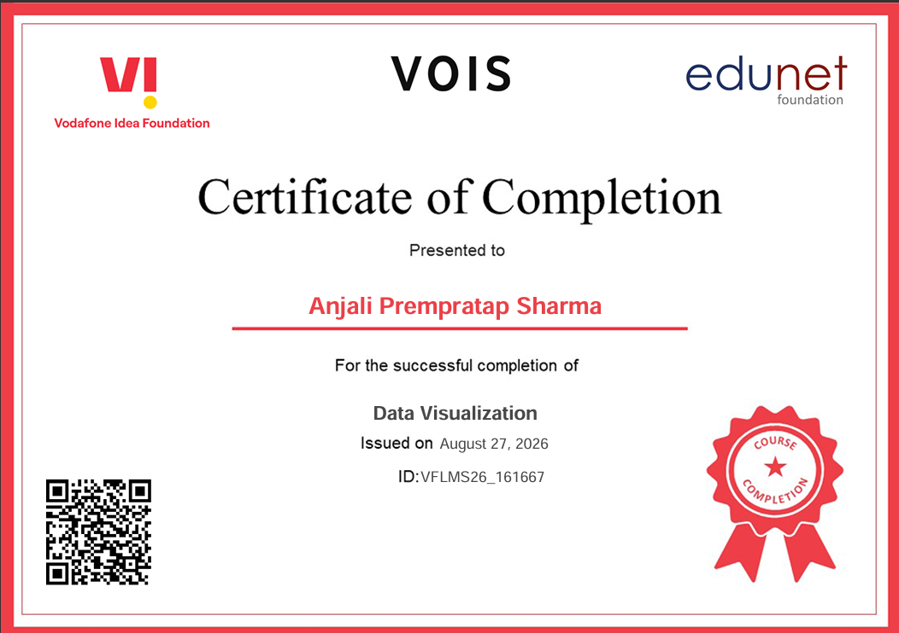
VOIS Course completion certificate - Course name- Data Visualization

Slide 15
Thank you
.
.

