Slide 1


http://127.0.0.1:8000/
Home
Dashboard
About us
Getting started
Login
Welcome To Future
CSC 289 Capstone project
Programming & Information Sciences Department
Spring 2021
Get Started

Slide 2
http://127.0.0.1:8000/aboutus
Home
Dashboard
About us
Getting started
Login
Team Members
Industry Mentor(s)
William Calhoun
Executive Director - Software Engineering
Jeremiah Thomas
Scrum Master
IHS Markit
COMPUTER PROGRAMMING AND DEVELOPMENT
Stuart Watson
Product Owner
IHS Markit
DATA SCIENCE AND PROGRAMMING SUPPORT SERVICES
Mike Fitzpatrick
Software Developer
Anjali Sharma
Developer
DATA SCIENCE AND PROGRAMMING SUPPORT SERVICES
Instructor
Elmehdi Mnajli
Developer
DATA SCIENCE AND PROGRAMMING SUPPORT SERVICES
Susan Rizzo
Wake Technical Community College
Kai McGregor
Developer
Computer Programming & Information Sciences
COMPUTER PROGRAMMING AND DEVELOPMENT

Slide 3
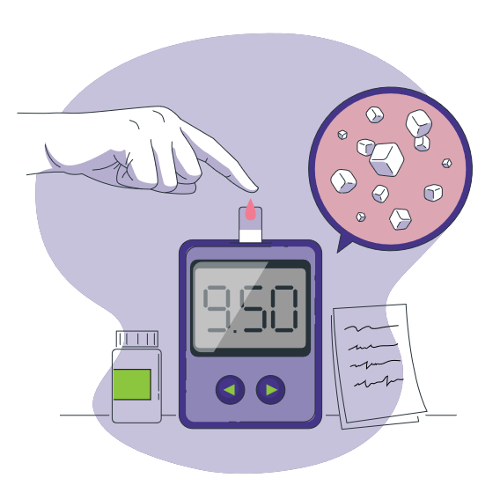
http://127.0.0.1:8000/aboutus
Home
Dashboard
About us
Getting started
Login
Project Description
Team 6 will be creating GlucoCheck, a program to track glucose and insulin levels.
This program will offer a secure, web-based, DB-backed UI for users to create an account,
log in, and input health data. Users will be able to visualize this data, as well as receive
different dietary recommendations based upon it.

Slide 4
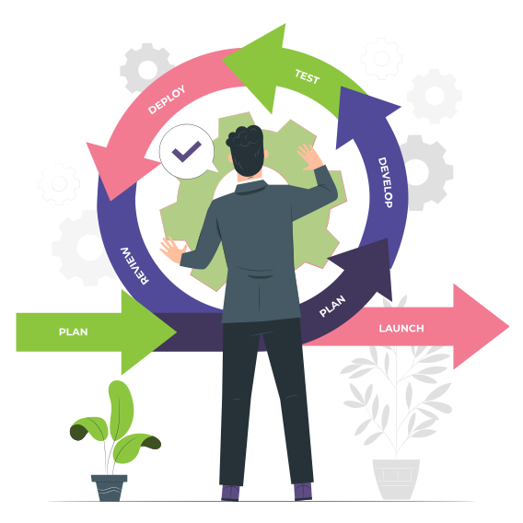
Home
http://127.0.0.1:8000/gettingstarted
Dashboard
About us
Getting started
Login
Product Vision Statement
GlucoCheck
​
For diabetics and their caregivers.​
Who need help monitoring, tracking, and managing blood sugar levels​
and stopping dietary glucose spikes.​
The program GlucoCheck.​
Is a simple, easy to use and clear web-based personal logbook.​
That allows even non-professionals to log in from anywhere, ​
Input insulin and glucose levels, visualize the changes over time, get reminders,​
and receive dietary recommendations.​
Unlike competitors, such as Omnipod and Medtronic, which focus heavily ​
on bolus doses and medical intervention to manage diabetes.​
Our product also offers lifestyle changes and USDA/FDA approved meal ideas​
for controlling blood sugar spikes with a more holistic approach ​
that treats the whole person.​

Slide 5

http://127.0.0.1:8000/outline
Home
Dashboard
About us
Getting started
Login
Product Outline
Sprint 1 - Set up a compliant, secure website that allows users to signup and login to the app
Sprint 2 - Add data entry and visualization to the app and make sure the experience is accessible, clear, and robust
Sprint 3 - Provide better data input, dietary advice, and more general polish to the user to aid in differentiation and customer retention

Slide 6
Home
http://127.0.0.1:8000/
Dashboard
About us
Getting started
LOGIN
Let’s start demo
Get Started

Slide 7

Home
http://127.0.0.1:8000/
Dashboard
About us
Getting started
LOGIN
Welcome Back!
Are there any Questions

