Slide 1

Get Going With Git
A practical guide to understand the git concepts and make contribution to your first open-source project
1 / 67

Slide 2
About me
Hello, everyone. Welcome to today's session.
I am Divya Bhushan.
I am a Technical Writer at Visual BI Solutions.
I have 12+ years of IT experience in Linux/Unix Administration, Database Administration, and Technical Documentation.
Apart from my job, I contribute to open source. I have contributed to Kubernetes and Water Monitoring System which is part of GirlScript Summer of Code, Rails Girls Summer of Code.
Let’s begin today’s session.

Slide 3

Sigh of relief !!!
It is developed to ease your task of maintaining, storing and tracking every version of your change.
Just concentrate on your project and let Git manage the rest for you.
Never lose your work again !
Quickly undo and fix your mistakes :)
Git is not another programming language that you need to learn.
3 / 67

Slide 4
Objective
Git terminology
Architecture
How to Install, configure and use Git
Get to know the basic commands
Git workflow
Publish on GitHub
Contribute to an open-source project
4 / 67

Slide 5
Visualize the complete Git workflow
5 / 67

Slide 6


GITHUB
Compare and create PR
UPSTREAM
ORIGIN
git remote add upstream
git fetch upstream
git checkout master
git rebase upstream/master
git
Yes
resolve
git push
git clone
conflicts
No
git rebase --continue
LOCAL
Local Repo
HEAD
git commit
git add
git checkout -b branch
New Branch
6 / 67

Slide 7


Slide 8
Prerequisites
Basic knowledge of any Operating System
Good to have a familiarity writing basic terminal commands
Git version: 2.27.0
Create a GitHub account
Text editor: Visual Studio Code(or any editor of your choice)
Demo setup:
Operating System: macOS Catalina
Git version: 2.27.0
Visual Studio Code: 1.46.1
7 / 67

Slide 9
Course Modules
Module 1: Introduction to Git
Module 2: Install and Initialize git repo
Module 3: Work locally with git
Module 4: Branching and Merging
Module 5: Collaboration
8 / 67
Notes:
This tutorial will help you to:
Understand the basic concepts and commands to quickly get you started with git.
Install, configure and initialize a git repository.
Know the basic commands that are required to add and maintain your project code files into Git VCS.
Master the technique of branching and merging in Git
Share and publish your work on a cloud hosted server such as GitHub, Bitbucket or GitLab.
This remote sharing enables multiple contributors to synchronize and work together.

Slide 10
Module 1: Introduction To Git
Module 1: Introduction to Git
Module 2: Install and Initialize git repo
Module 3: Work locally with git
Module 4: Branching and Merging
Module 5: Collaboration
9 / 67
Notes:
Let’s jump right in !!!

Slide 11
Module 1: Introduction to Git
Module 1: Introduction to Git
Module 1: Introduction to Git
Need for a (VCS)
Types of VCS
Merits of Git
10 / 67

Slide 12
Module 1.1: Need for a Version Control System
Module 1: Introduction to Git
Module 1: Introduction to Git
Need for a (VCS)
Types of VCS
Merits of Git
11 / 67

Slide 13
1.1 What is a VCS and why do we need it
A VCS (Version Control System) is a software to store, track, and share your data
Few popular VCS like CVS, SVN, BitKeeper, ClearCase and Perforce were developed for the purpose of:
Backup and restore (time travel)
Track ownership
Work in isolation (branching)
Collaborate or merge your work with your peers using remote sharing
Continuous Integration and development (deployment) of the code
12 / 67
Notes:
We tend to constantly update and save different versions of our work.
If you are a sole contributor with just bunch of files, you can save them on your personal machine.
However, the real challenge begins, when the same files have to be accessed from different locations and from an uncommon network.
In addition, when you have many contributors editing the files simultaneously the need for a better source code management software arises.
Not just that we also like to go back in time and see the changes we made.
So this implies, that we :
a. want to keep a history of how our data evolved over a period of time
b. Get a last known good copy of our data
c. Want to share our work with others.
This is exactly what a good VCS does for us.
Backup and restore (time travel) - To save your entire project and be able to restore to an earlier version in case you want to fix any mistakes, and revert an older state of the project
Track ownership - To track who made what changes, when and why
Work in isolation (branching) - To write an independent piece of data or fix a bug, while not disturbing the current state of the project

Slide 14
Module 1.2: Types of VCS
Module 1: Introduction to Git
Module 1: Introduction to Git
Need for a (VCS)
Merits of Git
Types of VCS
13 / 67
Notes:
A VCS is typically classified as a Centralized VCS or a De-centralized VCS.

Slide 15
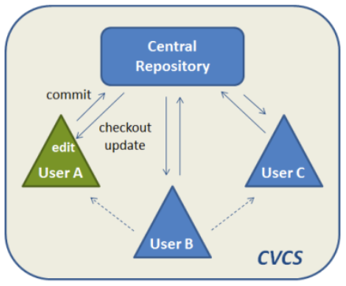
Centralized VCS
Each developer’s change must go into the main trunk before it can be seen by others
14 / 67
Notes:
In such a setup developers clone the central repository, edit and publish their work back on the central hub.
Each developer’s change must go into the main trunk before it can be seen by others.
Major overlap and re-work occur if more than one developer works and change the same piece of code at the same time.
The lack of data sharing among the developers is a drawback in this layout.
There is also a dependency on other’s work.

Slide 16
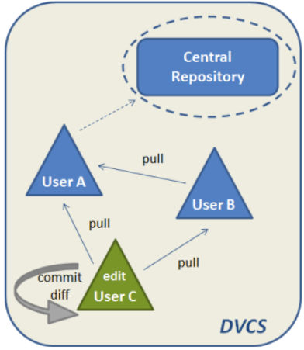

De-centralized or Distributed VCS
In a Distributed VCS (DVCS) :
Each user has a personal copy of the entire repository.
Users choose when to publish the changes.
Users share work among each other.
Git is a Distributed VCS
15 / 67
Notes:
Users can also share pre-published work with each other in advance.
This help them to contribute, merge and test the features before pushing the work to the main repository.
In this layout, it is important that the users stay in synch with the remote repository.
This synching up is done by a periodic fetch and pull request from the remote repo.
All developers must synch up their local repo before they start to edit their local copy of the main repository.

Slide 17
Module 1.3: Merits of Git
Module 1: Introduction to Git
Module 1: Introduction to Git
Need for a (VCS)
Types of VCS
Merits of Git
16 / 67
Notes:
Awesome CI/CD pipelines
Builds automatically super fast

Slide 18
1.3 Merits of Git
Distributed architecture
Speed = Most of the operations are local (data store and data fetch)
Data Integrity
Easy branching and merging
Collaboration
17 / 67
Notes:
Distributed architecture: Git can be configured to be used as both a centralized and a Distributed VCS
Distributed nature of Git allows more flexibility in terms of
Speed
Data Integrity: Every data is checked summed as an object with a unique Hexadecimal id.
.gitignore
Any minor change in the source code or the filesystem creates a new object id.
Thus two different data will never have the same id.
Your data is secure = Data change -> changes the object id
Easy Branching and merging:
Git supports parallel development
Creating a new branch is just issuing a simple command and you get a new test environment to play with
You can easily merge your changes with the main code and discard the branch later
Collaboration
You can easily connect your local repo to a remote repository.
You do so by placing a remote reference link from your local repo
Git allows you to choose different strategies to accept merges from different contributors

Slide 19
Summary: Module 1: Introduction to Git
What we learnt so far?
VCS is a software to store, manage and track data changes
Git is a distributed VCS with its unique features such as distributed architecture, speed, data integrity, easy branching and merging and collaboration strategy.
18 / 67
Notes:
Pause - doubt
Hands - on

Slide 20
Module 2: Install, Configure, and Initialize git repo
Module 1: Introduction to Git
Module 2: Install and Initialize git repo
Module 3: Working locally with git
Module 4: Branching and Merging
Module 5: Collaboration
Install Git
Configure
Initialize local repo
19 / 67

Slide 21
Module 2.1: Install Git
Module 1: Introduction to Git
Module 2: Install, Configure, and Initialize
Install Git
Configure
Initialize a git repository
20 / 67

Slide 22

2.1: Install Git
Go to https://git-scm.com/downloads
Download the Git software for your Operating System
Go to terminal and check the git version installed:
git version
21 / 67
Notes:
CRUD = Create, Read/Retrieve, Update/Modify, Delete

Slide 23
Demo
22 / 67

Slide 24
Module 2.2: Configure Git
Module 1: Introduction to Git
Module 2: Install, Configure, and Initialize
Install Git
Configure
Initialize a git repository
23 / 67

Slide 25
2.2: Git configurations
#Set your github username
#Set your github email id
#View the configuration settings
git config --global user.name 'yourname'
git config --global user.email 'youremail@domain'
git config --global list
24 / 67
Notes:
There are more
Alias

Slide 26
Demo
25 / 67

Slide 27
Module 2.3: Initialize a git repository
Module 1: Introduction to Git
Module 2: Install, Configure, and Initialize
Install Git
Configure
Initialize a git repository
26 / 67

Slide 28
2.3: Initialize a Git repository
#Create a new project on your machine
#Change directory to ‘git-demo’
#Initialize a git repository
mkdir git-demo
cd git-demo
git init .
27 / 67

Slide 29
Demo
28 / 67

Slide 30
Summary: Module 2: Install, Configure, and Initialize git repo
What did we learn?
How to Install Git
Set global configuration settings
Create a new git repository
29 / 67

Slide 31
Module 3: Work locally with Git
Module 1: Introduction to Git
Module 2: Install and Initialize git repo
Module 3: Work locally with git
Module 4: Branching and Merging
Module 5: Collaboration
Git workflow & architecture
Add/modify data
Stage
Commit
30 / 67
Notes:
Let’s jump right in !!!

Slide 32
Module 3.1: Git workflow and architecture
Module 1: Introduction to Git
Module 3: Work locally with Git
Git workflow and architecture
Add/modify data
Stage
Commit
31 / 67

Slide 33
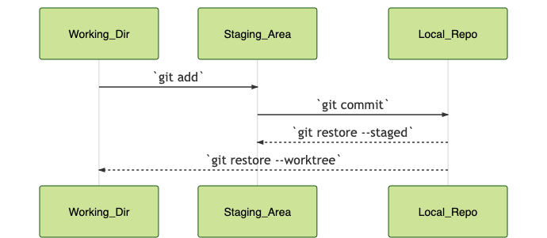
3.1: Git workflow and git architecture
The basic operations in any project:
CRUD data functions: Create, Read, Update, Delete
Add to Staging Area
Commit to Local Repo
The 3-tier architecture
32 / 67

Slide 34
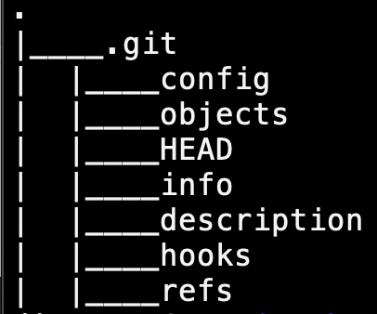
Explore the project file structure
Git architecture resembles the filesystem of Linux OS.
All of its database objects are stored as metadata in a hidden folder - .git.
33 / 67
Notes:
When you first create a new project on the local disk, a .git directory is placed with all the objects metadata inside it.

Slide 35
Module 3.2: Add/modify data
Module 1: Introduction to Git
Module 3: Work locally with Git
Git workflow and architecture
Add data
Stage
Commit
34 / 67

Slide 36
Working Directory
WORKING DIR | STAGING AREA | LOCAL REPO
#!/bin/sh
35 / 67
Notes:
Data added for the first time resides in the Working directory.
This is a local copy of the original project.

Slide 37
Module 3.3: Stage
Module 1: Introduction to Git
Module 3: Work locally with Git
Git workflow and architecture
Add data
Stage
Commit
36 / 67

Slide 38
Staging Area
WORKING DIR | STAGING AREA | LOCAL REPO
#!/bin/sh
#!/bin/sh
git add
37 / 67
Notes:
Once you modify data in the working directory, you must add the snapshot of the current state of the project to the Staging Area.
Also called an “Index”.
This is a middle layer that gives a quick preview of the project snapshot that you are about to commit.

Slide 39
Module 3.4: Commit
Module 1: Introduction to Git
Module 3: Work locally with Git
Git workflow and architecture
Add data
Stage
Commit
38 / 67

Slide 40
Local Repository
WORKING DIR | STAGING AREA | LOCAL REPO
#!/bin/sh
#!/bin/sh
#!/bin/sh
git add
git commit
39 / 67
Notes:
After you review and confirm the changes, commit the changes to Local Repository.
A commit is the latest snapshot (state) of a project.
Congratulations !!!

Slide 41
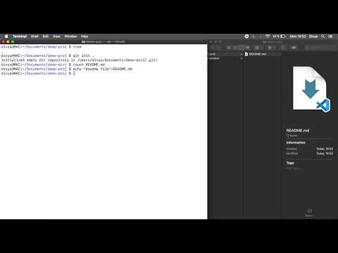
Module 3: Work locally with Git - Demo
40 / 67

Slide 42
Modify file in the Working directory
WORKING DIR | STAGING AREA | LOCAL REPO
#!/bin/sh
main()
{
}
#!/bin/sh
#!/bin/sh
41 / 67

Slide 43
Add modified file to the Staging area
WORKING DIR | STAGING AREA | LOCAL REPO
#!/bin/sh
main()
{
}
#!/bin/sh
main()
{
}
#!/bin/sh
git add
42 / 67

Slide 44
Commit the modified file to the Local repo
WORKING DIR | STAGING AREA | LOCAL REPO
#!/bin/sh
main()
{
}
#!/bin/sh
main()
{
}
#!/bin/sh
main()
{
}
git add
git commit
43 / 67

Slide 45
Summary of git workflow commands
Add new file
Stage the file
View the status
Commit the snapshot
View the log
echo “#Readme file” > README.md
git add .
git status
git commit -m ‘Initial commit’
git log
44 / 67

Slide 46
Module 4: Branching and Merging
Module 1: Introduction to Git
Module 2: Install and Initialize git repo
Module 3: Work locally with git
Module 4: Branching and Merging
Module 5: Collaboration
What is a branch
Create a branch
Merge branches
45 / 67
Notes:
Let’s jump right in !!!

Slide 47
Module 4.1: What is a Branch?
Module 1: Introduction to Git
Module 4: Branching and Merging
What is a Branch?
Create a Branch
Merge the branch
46 / 67

Slide 48
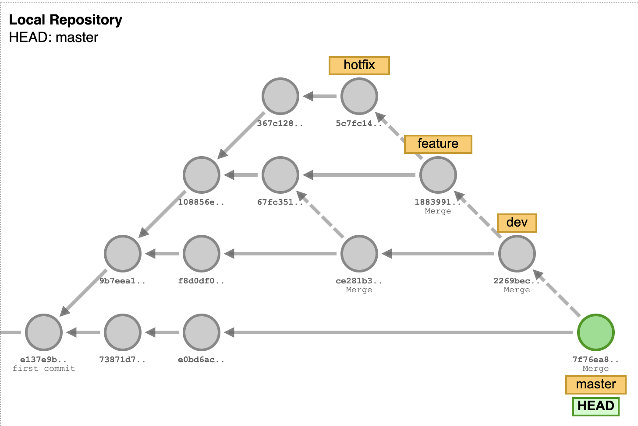
Module 4.1: What is a Branch?
A branch is a parallel independent line of development
A replica environment for your source code
You create and work in branches to
Isolate your work to create a new feature or bug-fix
47 / 67
Notes:
HEAD is a pointer reference to the latest snapshot of the project.
HEAD always refers to the commit on the checked out branch.
HEAD moves ahead along with the commits.

Slide 49
Module 4.2: Create a branch
Visualize and learn here:
https://git-school.github.io/visualizing-git/#free
git commit
git commit
Git branch dev
Git commit
Git checkout dev
Git commit
Git commit
Git branch feature
Git checkout feature
Git commit
Git commit
Git checkout dev
Git merge feature
Git checkout master
Git merge dev
48 / 67
Notes:
Git branch

Slide 50
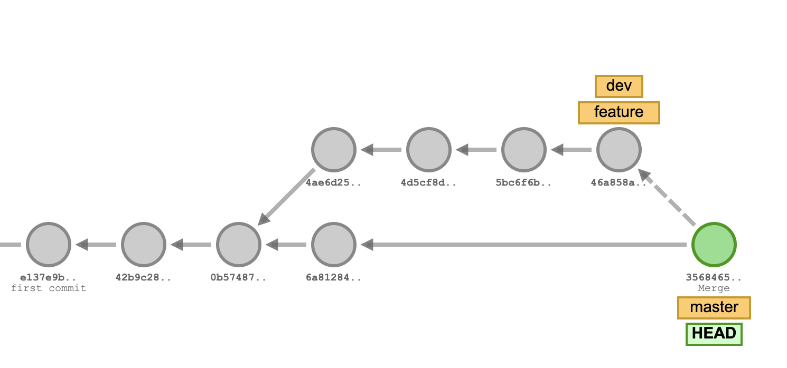
Module 4.2: Create a branch
Visualize and learn here:
https://git-school.github.io/visualizing-git/#free
git commit
git commit
Git branch dev
Git commit
Git checkout dev
Git commit
Git commit
Git branch feature
Git checkout feature
Git commit
Git commit
Git checkout dev
Git merge feature
Git checkout master
Git merge dev
48 / 67
Notes:
Git branch

Slide 51
Easy branching and merging
New feature development or bugfix in isolation
Frequent code check-ins with synchronous merged work
Easy to track changes
No last-minute conflict chaos
CI/CD pipeline practice
49 / 67
Notes:
Developers are encouraged to unit test their features and merge frequently with the main code.
Each one can work on multiple branches and merge n-number of times in a day.
This avoids last-minute merge conflicts and keeps every code development in synch with the main development.
Analyzing the history logs, it’s easier to track which change was introduced by whom.
Also, continuous integration, testing, and deployment of the code promote CI/CD practice.

Slide 52
Module 4: Summarize commands
git branch <branch_name>
git commit
git checkout <branch>
git merge <branch>
50 / 67

Slide 53
Module 5: Collaboration
Module 1: Introduction to Git
Module 2: Install and Initialize git repo
Module 3: Work locally with git
Module 4: Branching and Merging
Module 5: Collaboration
What is a Remote?
Clone a Remote
Make local commits
Push to a Remote
51 / 67

Slide 54
Module 5: Collaboration
Module 1: Introduction to Git
Module 2: Install and Initialize git repo
Module 3: Work locally with git
Module 4: Branching and Merging
Module 5: Collaboration
What is a Remote?
Clone a Remote repo
Make local commits
Push to the Remote
52 / 67
Notes:
Let’s jump right in !!!

Slide 55
Module 5.1: What is a Remote?
Module 1: Introduction to Git
Module 5: Collaboration
What is a Remote?
Clone a Remote repo
Make local commits
Push to the Remote
53 / 67

Slide 56
Module 5.2: Clone a Remote Repo
Module 1: Introduction to Git
Module 5: Collaboration
What is a Remote?
Clone a Remote repo
Make local commits
Push to the Remote
54 / 67
Notes:
Git clone https://github.com/divyabhushan/git-webinar.git
Local copy of the remote repo
Creates a remote pointer reference - origin
Git remote
Git remote -v

Slide 57
Module 5.3: Make local commits
Module 1: Introduction to Git
Module 5: Collaboration
What is a Remote?
Clone a Remote repo
Make local commits
Push to the Remote
55 / 67
Notes:
Vim README.md - modify
Git add .
git commit
git log
Recap of git workflow

Slide 58
Module 5.4: Push to the remote
Module 1: Introduction to Git
Module 5: Collaboration
What is a Remote?
Clone a Remote repo
Make local commits
Push to the Remote
56 / 67

Slide 59
Module 5.4: Push to the remote
git push
git push projA
git push projA master_local:master
57 / 67
Notes:
git push
git push origin
git push origin master:master
Video
My demo VS code

Slide 60
Module 5: Collaboration Summary visualize
Module 1: Introduction to Git
58 / 67

Slide 61
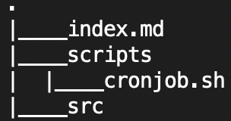
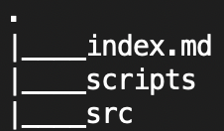

REMOTE
LOCAL
WORKING DIR | STAGING AREA | LOCAL REPO
 |  | .
git clone
59 / 67

Slide 62
REMOTE
LOCAL
WORKING DIR | STAGING AREA | LOCAL REPO
 |  | .
git clone
60 / 67

Slide 63
REMOTE
LOCAL
WORKING DIR | STAGING AREA | LOCAL REPO
 |  | .
git clone
61 / 67

Slide 64
REMOTE
LOCAL
LOCAL REPO
.
git clone
git push
62 / 67
Notes:
After you review and confirm the changes, you are now ready to commit your changes to the “git local repository”.
When you decide to publish your work, you add a remote repository reference to an external hub such as a cloud, or a project server.
In that case there will be a 4th layer called the “remote repository”, wherein you would push your changes from “local repository” to the “remote repository”.
Also to stay in synch you would “pull” changes from “remote” to “local” repository.

Slide 65
Real-time Open-source contribution
Fork -> https://github.com/divyabhushan/git-webinar
Clone
Edit
Commit
Push
Create a PR
Wait for approval
Your changes merged and published
63 / 67

Slide 66
Congratulations !!!
You have kick started your journey in the world of open source.
65 / 67

Slide 67
Thank you :)
You have reached the end of this session.
This is just a beginning of Git
Where to reach me
LInkedin
GitHub
66 / 67

