Slide 1
V-Card
INTRODUCTION PROBLEM STATEMENT PROPOSED SYSTEM MODULES PROJECT PLAN CONCLUSION OUTPUT THANKS
ANJALI SURESH KUMAR C
MCA, Semester VI Department of Computer Application
Government Engineering College, Thrissur
V-Card
11 de abril de 20221 / 9

Slide 2
INTRODUCTION
INTRODUCTION PROBLEM STATEMENT PROPOSED SYSTEM MODULES PROJECT PLAN CONCLUSION OUTPUT THANKS
V-Card is an Ecommerce Business Application to support Entrepreneurs and Customers for selling and ordering products.
This project aims to provide an efficient and useful platform to Entrepreneurs and Customers for their needs.
V-Card
11 de abril de 20222 / 9

Slide 3
PROBLEM STATEMENT
INTRODUCTION PROBLEM STATEMENT PROPOSED SYSTEM MODULES PROJECT PLAN CONCLUSION OUTPUT THANKS
Provides an easy way to sell products to a large customer base.
Customers can order available products from a shop using visiting card.
V-Card
11 de abril de 20223 / 9

Slide 4
PROPOSED SYSTEM
INTRODUCTION PROBLEM STATEMENT PROPOSED SYSTEM MODULES PROJECT PLAN CONCLUSION OUTPUT THANKS
The objective of this project is to make the business process easier by creating effective business application.
The project consist of four different modules.
V-Card
11 de abril de 20224 / 9

Slide 5
MODULES
INTRODUCTION PROBLEM STATEMENT PROPOSED SYSTEM MODULES PROJECT PLAN CONCLUSION OUTPUT THANKS
Admin - All activities in this application are managed by Admin.
Entrepreneur - Generate QR code and can add products. Can rate a manufacturer and send feedback to admin.
Customer - Scan QR code, View product details and can order products. Can rate a shop and send feedback to admin.
Manufacturer - Add product details
V-Card
11 de abril de 20225 / 9

Slide 6
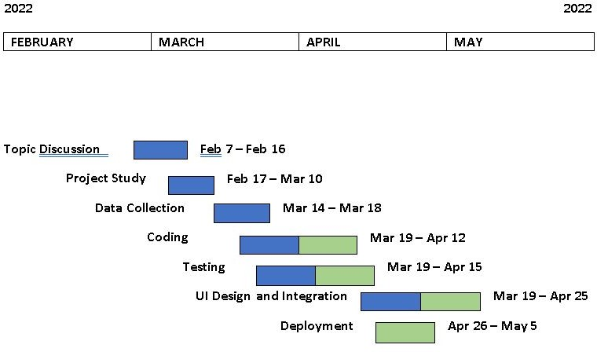
PROJECT PLAN
INTRODUCTION PROBLEM STATEMENT PROPOSED SYSTEM MODULES PROJECT PLAN CONCLUSION OUTPUT THANKS
V-Card
11 de abril de 20226 / 9

Slide 7
CONCLUSION
INTRODUCTION PROBLEM STATEMENT PROPOSED SYSTEM MODULES PROJECT PLAN CONCLUSION OUTPUT THANKS
The E-commerce Business Application named V-Card is an effective and useful platform for business process for both Customers and Entrepreneurs.
This Business Application will support both Customers and Entrepreneurs to buy and order products.
Customers can consume time by using this application.
V-Card
11 de abril de 20227 / 9

Slide 8
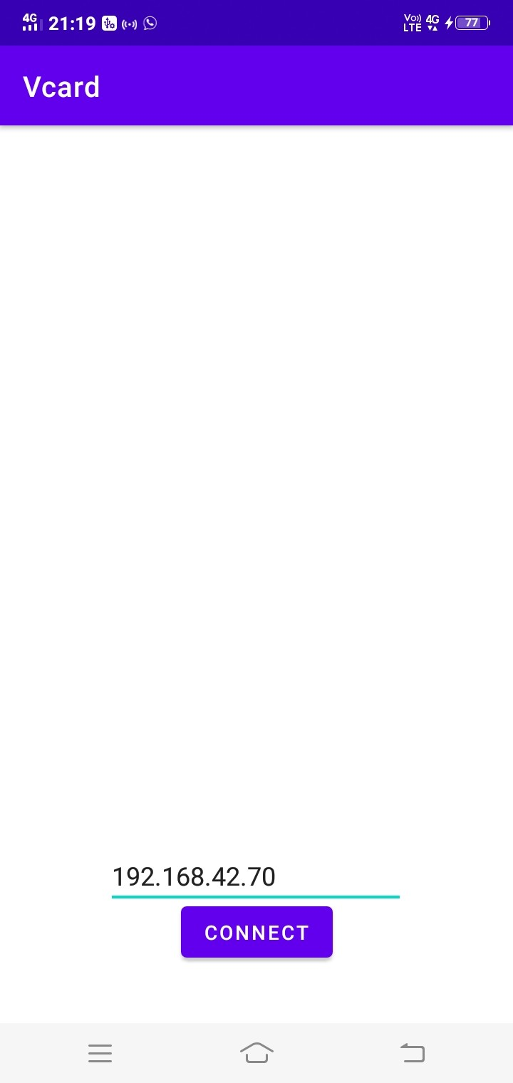
OUTPUT
INTRODUCTION PROBLEM STATEMENT PROPOSED SYSTEM MODULES PROJECT PLAN CONCLUSION OUTPUT THANKS
8/ 9
V-Card

Slide 9

INTRODUCTION PROBLEM STATEMENT PROPOSED SYSTEM MODULES PROJECT PLAN CONCLUSION OUTPUT THANKS
8/ 9
V-Card

Slide 10
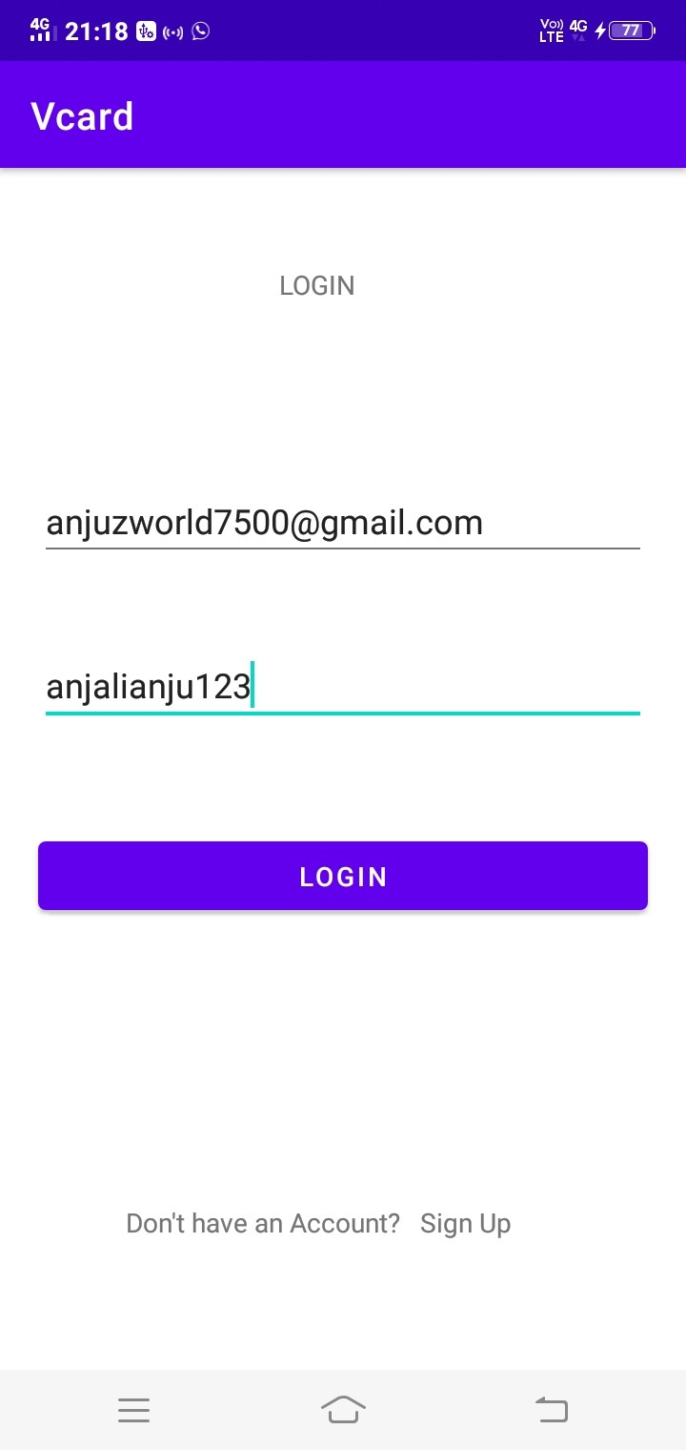
INTRODUCTION PROBLEM STATEMENT PROPOSED SYSTEM MODULES PROJECT PLAN CONCLUSION OUTPUT THANKS
8/ 9
V-Card

Slide 11
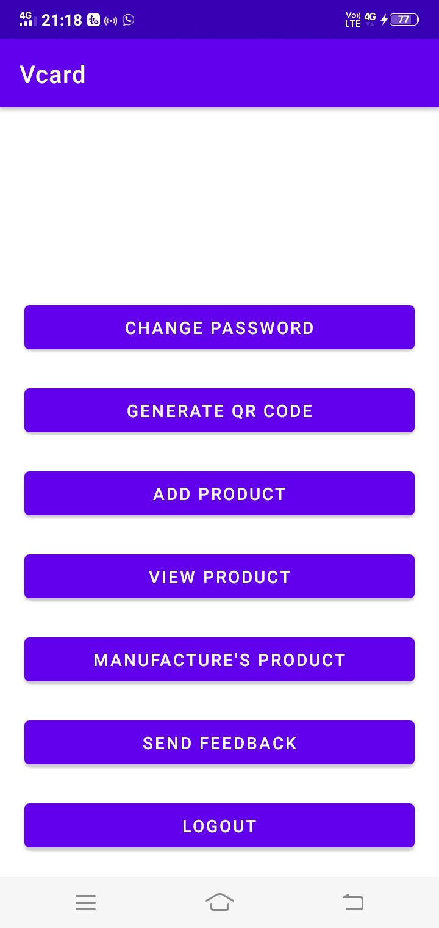
INTRODUCTION PROBLEM STATEMENT PROPOSED SYSTEM MODULES PROJECT PLAN CONCLUSION OUTPUT THANKS
8/ 9
V-Card

Slide 12
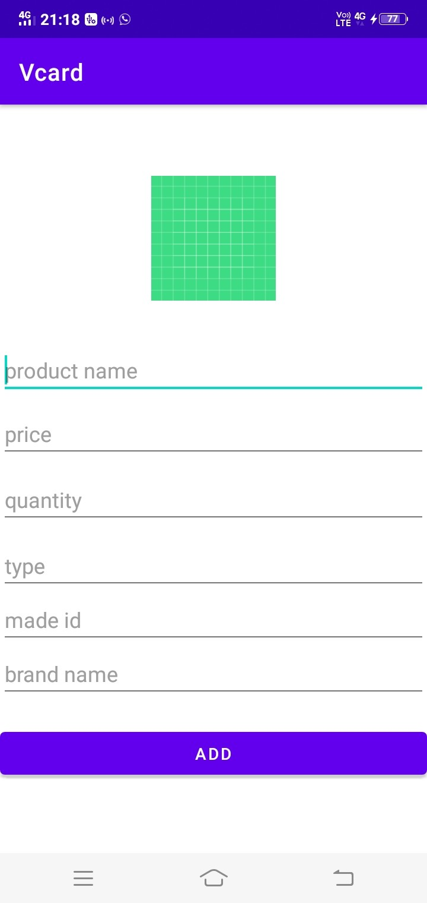
INTRODUCTION PROBLEM STATEMENT PROPOSED SYSTEM MODULES PROJECT PLAN CONCLUSION OUTPUT THANKS
8/ 9
V-Card

Slide 13
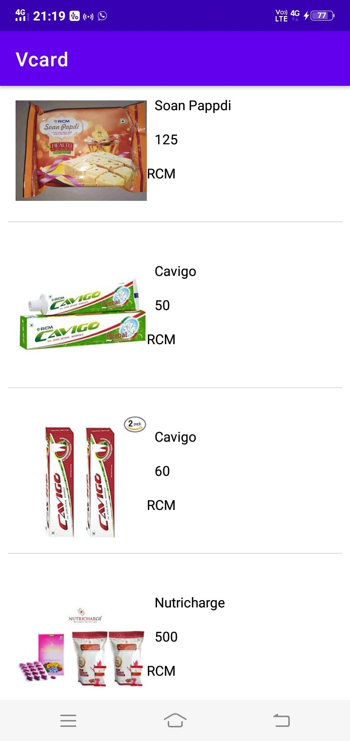
INTRODUCTION PROBLEM STATEMENT PROPOSED SYSTEM MODULES PROJECT PLAN CONCLUSION OUTPUT THANKS
8/ 9
V-Card

Slide 14
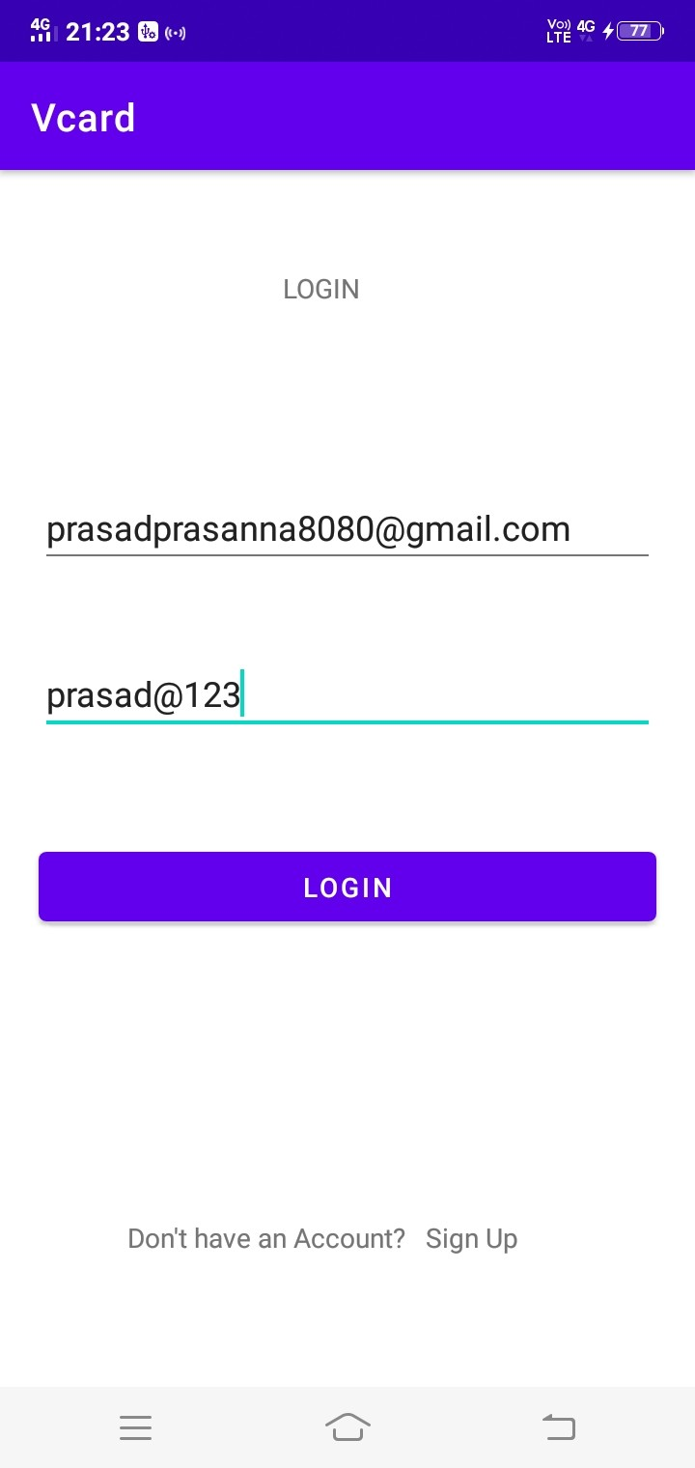
INTRODUCTION PROBLEM STATEMENT PROPOSED SYSTEM MODULES PROJECT PLAN CONCLUSION OUTPUT THANKS
8/ 9
V-Card

Slide 15
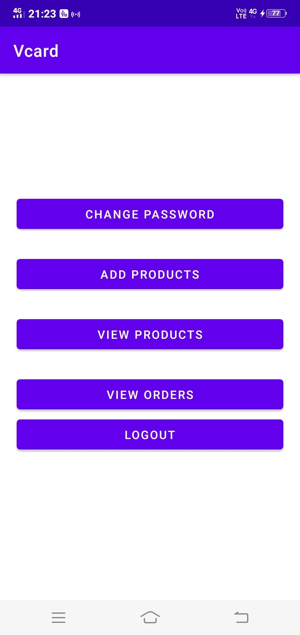
INTRODUCTION PROBLEM STATEMENT PROPOSED SYSTEM MODULES PROJECT PLAN CONCLUSION OUTPUT THANKS
8/ 9
V-Card

Slide 16
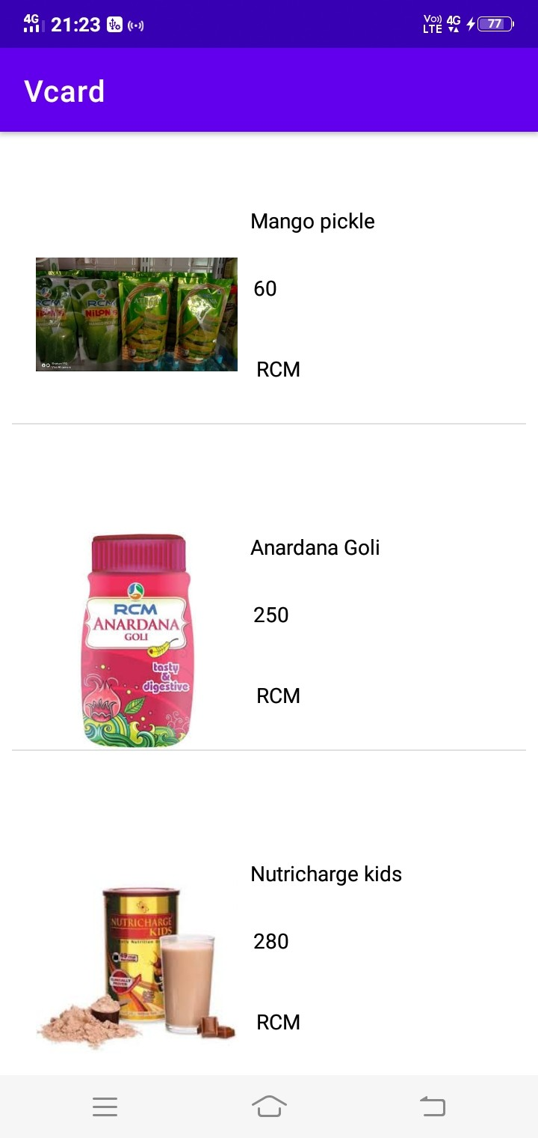
INTRODUCTION PROBLEM STATEMENT PROPOSED SYSTEM MODULES PROJECT PLAN CONCLUSION OUTPUT THANKS
8/ 9
V-Card

Slide 17
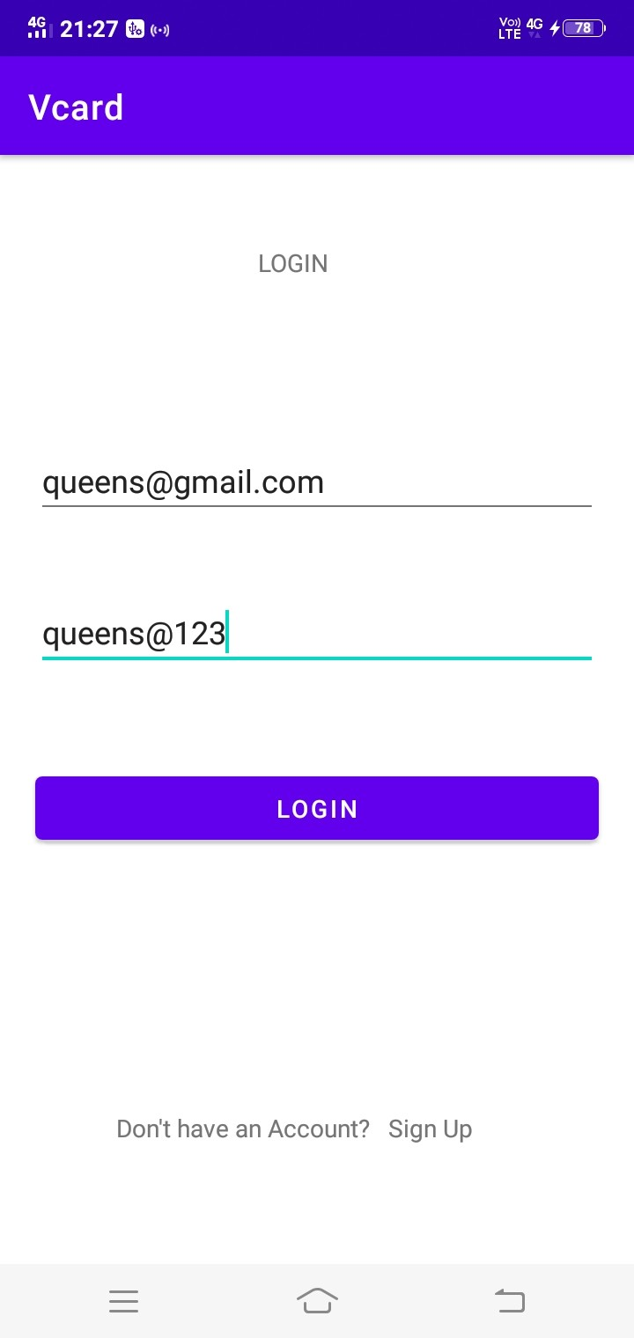
INTRODUCTION PROBLEM STATEMENT PROPOSED SYSTEM MODULES PROJECT PLAN CONCLUSION OUTPUT THANKS
8/ 9
V-Card

Slide 18
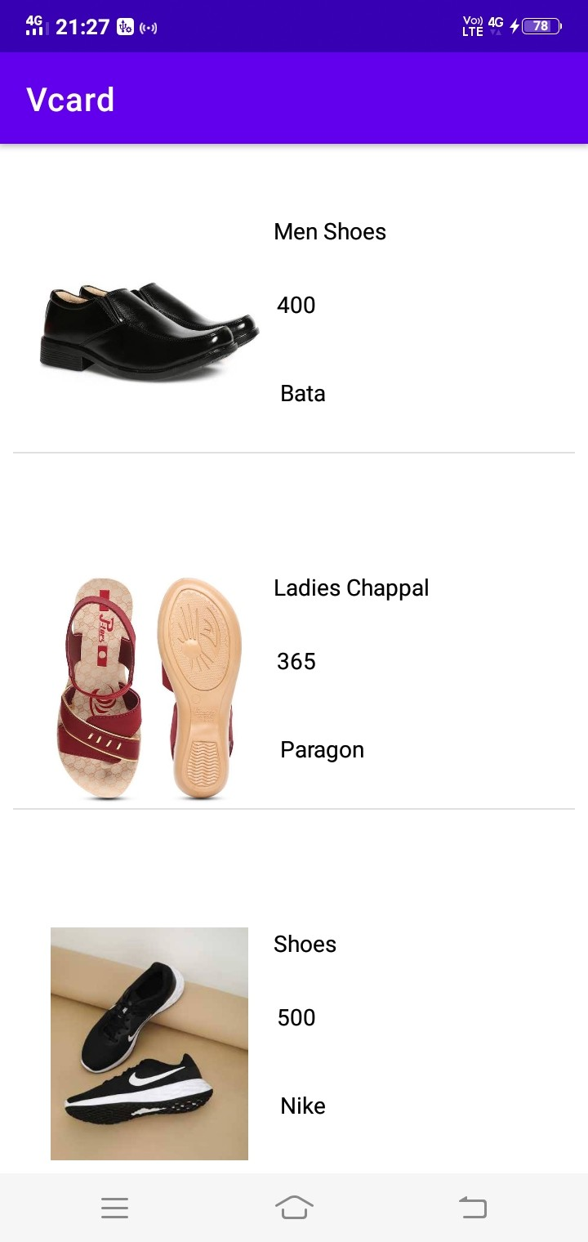
INTRODUCTION PROBLEM STATEMENT PROPOSED SYSTEM MODULES PROJECT PLAN CONCLUSION OUTPUT THANKS
8/ 9
V-Card

Slide 19
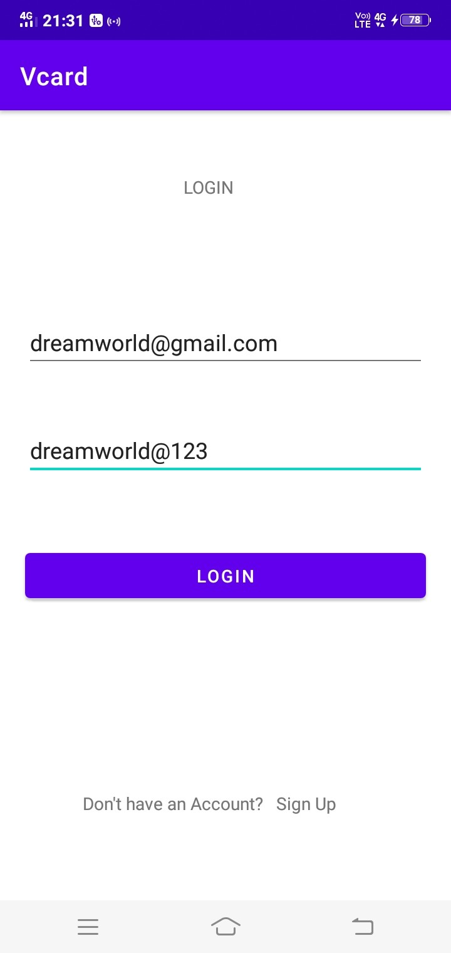
INTRODUCTION PROBLEM STATEMENT PROPOSED SYSTEM MODULES PROJECT PLAN CONCLUSION OUTPUT THANKS
8/ 9
V-Card

Slide 20
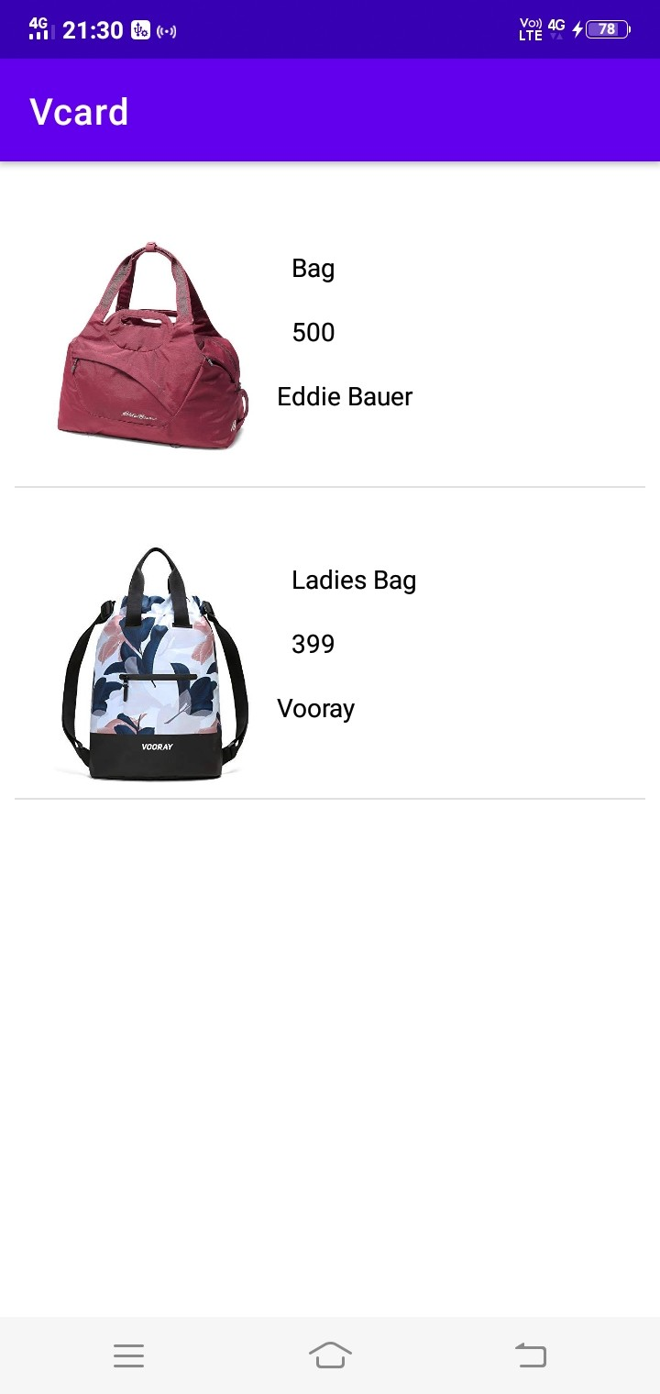
INTRODUCTION PROBLEM STATEMENT PROPOSED SYSTEM MODULES PROJECT PLAN CONCLUSION OUTPUT THANKS
8/ 9
V-Card

Slide 21
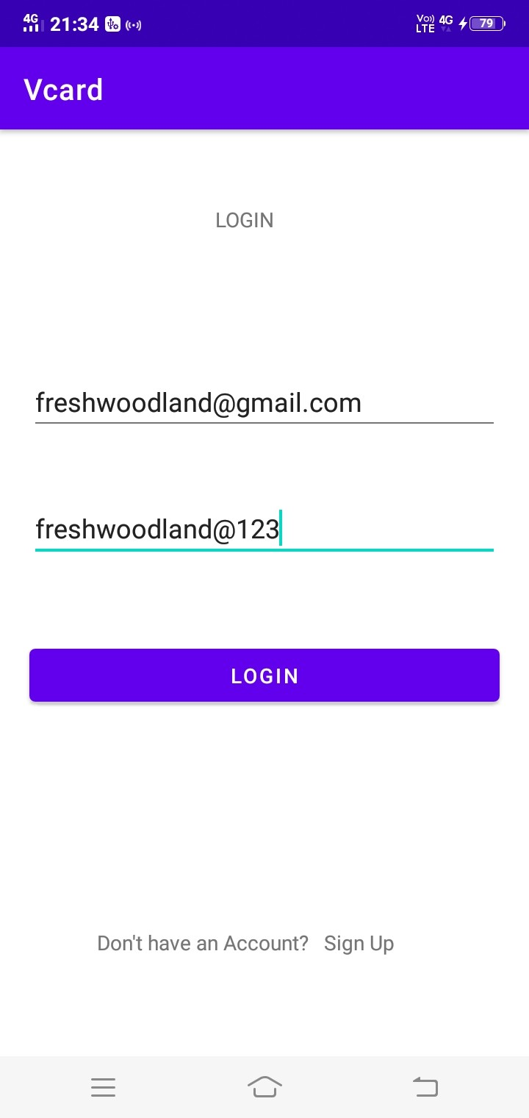
INTRODUCTION PROBLEM STATEMENT PROPOSED SYSTEM MODULES PROJECT PLAN CONCLUSION OUTPUT THANKS
8/ 9
V-Card

Slide 22
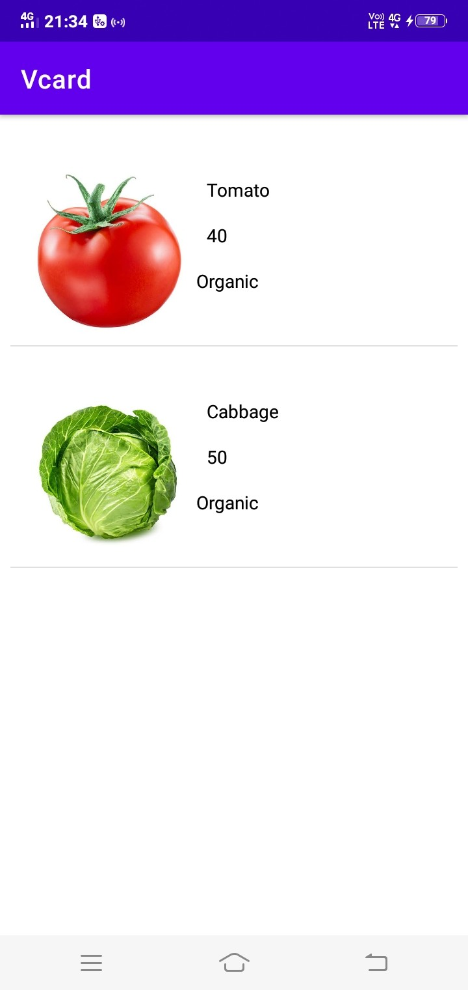
INTRODUCTION PROBLEM STATEMENT PROPOSED SYSTEM MODULES PROJECT PLAN CONCLUSION OUTPUT THANKS
8/ 9
V-Card

Slide 23
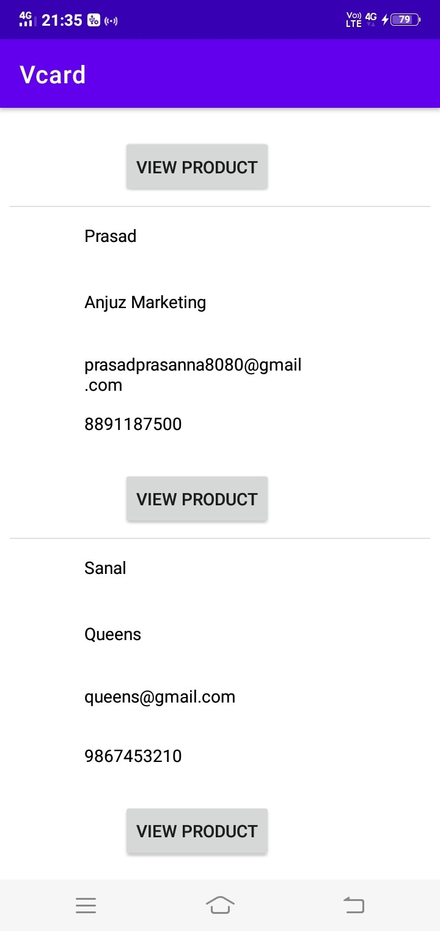
INTRODUCTION PROBLEM STATEMENT PROPOSED SYSTEM MODULES PROJECT PLAN CONCLUSION OUTPUT THANKS
8/ 9
V-Card

Slide 24
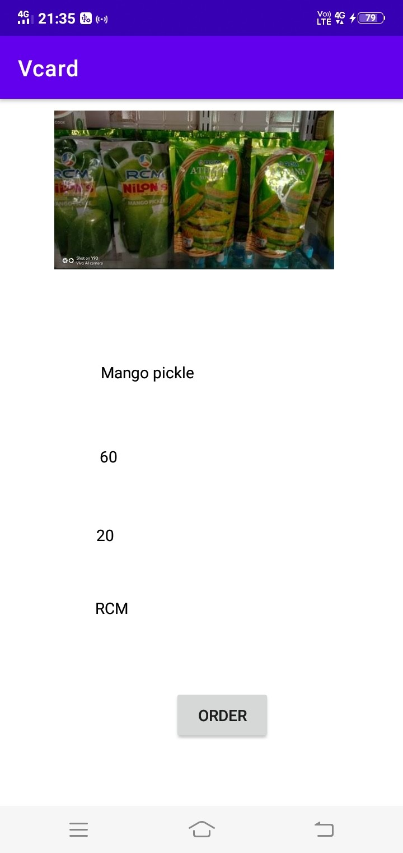
INTRODUCTION PROBLEM STATEMENT PROPOSED SYSTEM MODULES PROJECT PLAN CONCLUSION OUTPUT THANKS
8/ 9
V-Card

Slide 25
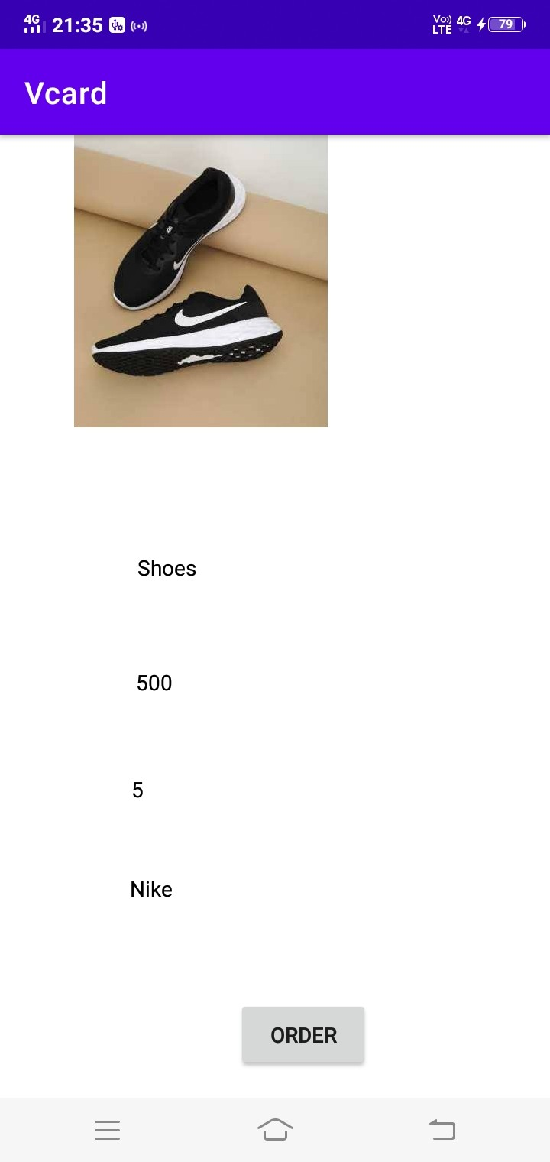
INTRODUCTION PROBLEM STATEMENT PROPOSED SYSTEM MODULES PROJECT PLAN CONCLUSION OUTPUT THANKS
8/ 9
V-Card

Slide 26
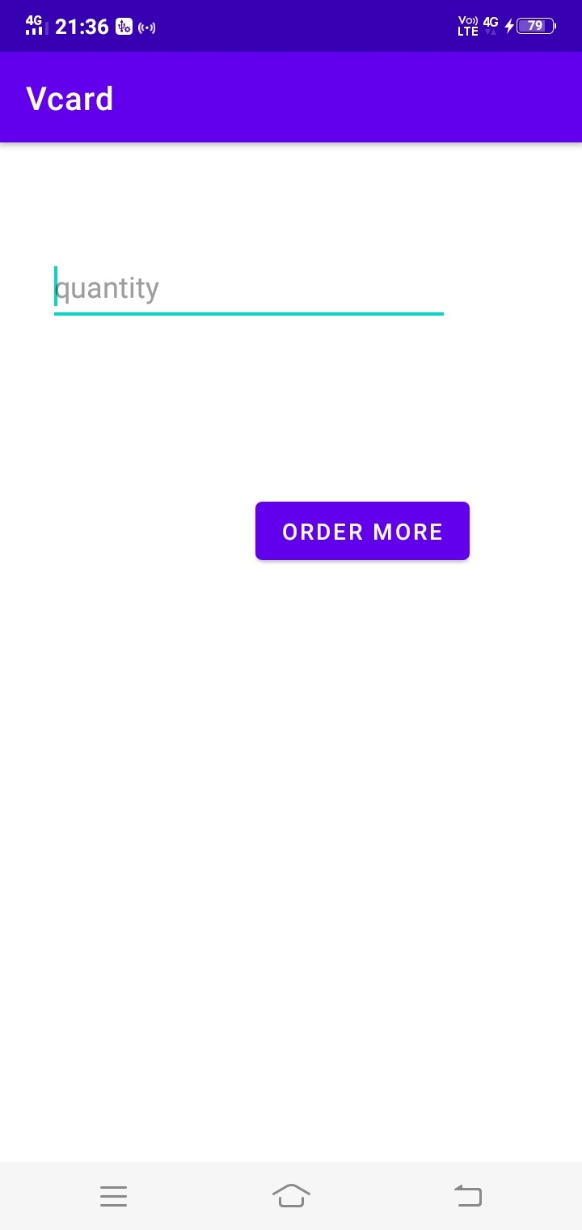
INTRODUCTION PROBLEM STATEMENT PROPOSED SYSTEM MODULES PROJECT PLAN CONCLUSION OUTPUT THANKS
8/ 9
V-Card

Slide 27
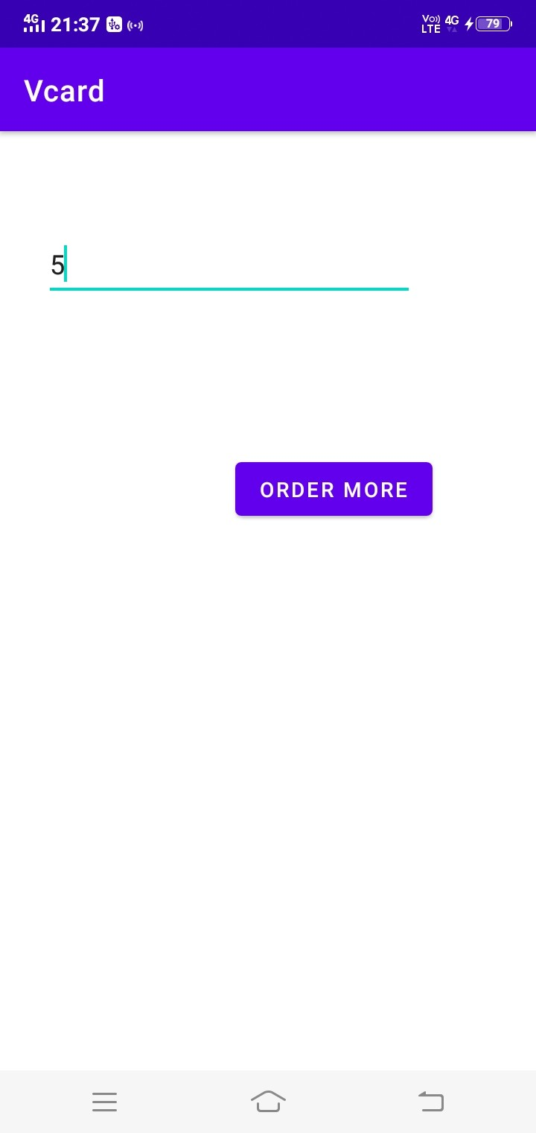
INTRODUCTION PROBLEM STATEMENT PROPOSED SYSTEM MODULES PROJECT PLAN CONCLUSION OUTPUT THANKS
9/ 9
V-Card
11 de abril de 20229 / 9

Slide 28

THANKS
INTRODUCTION PROBLEM STATEMENT PROPOSED SYSTEM MODULES PROJECT PLAN CONCLUSION OUTPUT THANKS
9/ 9
V-Card
11 de abril de 20229 / 9

