Slide 1
V-Card
Guided By:
Jibin Thomas
Assistant Professor
MCA Department
Presented By:
Anjali Suresh Kumar C
TCR19MCA006

Slide 2


Introduction

Slide 3
V-Card is an Ecommerce Business Application to support Entrepreneurs and Customers for selling and ordering products.
This project aims to provide an efficient and useful platform to Entrepreneurs and Customers for their needs.

Slide 4


Problem Statement

Slide 5
Provides an easy way to sell products to a large customer base. Customers can order available products from a shop by scanning QR code.

Slide 6

Proposed Solution

Slide 7
The objective of this project is to make the business process easier by creating effective business application.
The project consist of four different modules .

Slide 8
Requirement Specifications

Slide 9
Functional Requirement
Generate QR Code
Add Product Details
Scan QR Code
View Product Details
Order Products
Rating
Non Functional Requirement
User Friendly
Time Consuming
Secure

Slide 10
Architecture

Slide 11
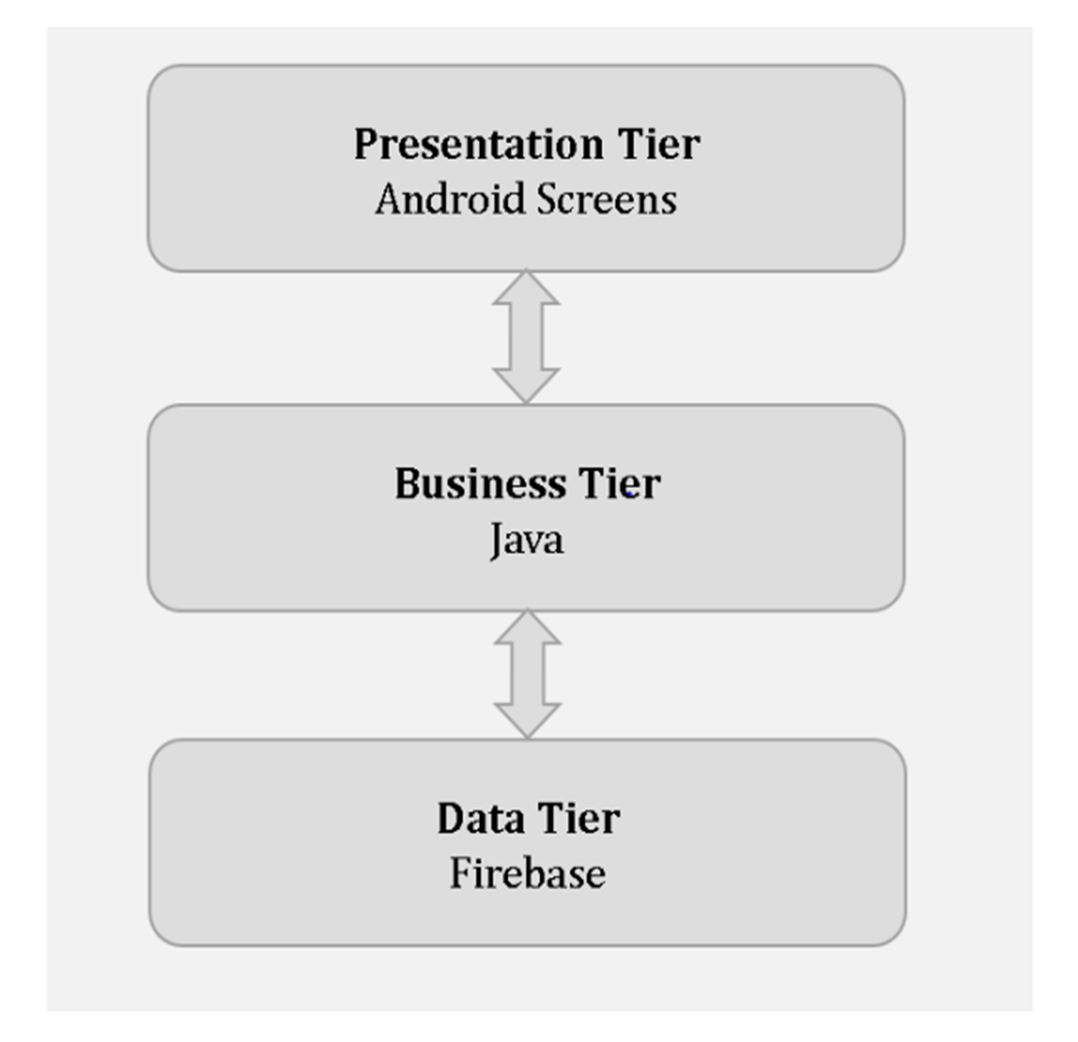
3 TIER ARCHITECTURE

Slide 12

Modules

Slide 13
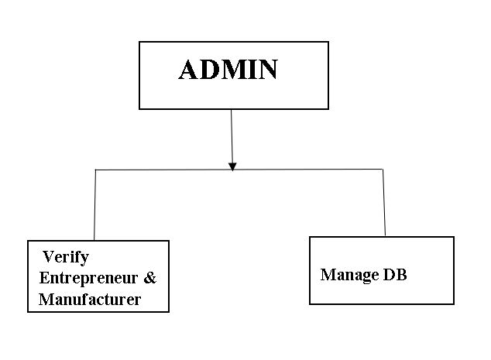
1.ADMIN
All activities in the application are managed by admin.

Slide 14
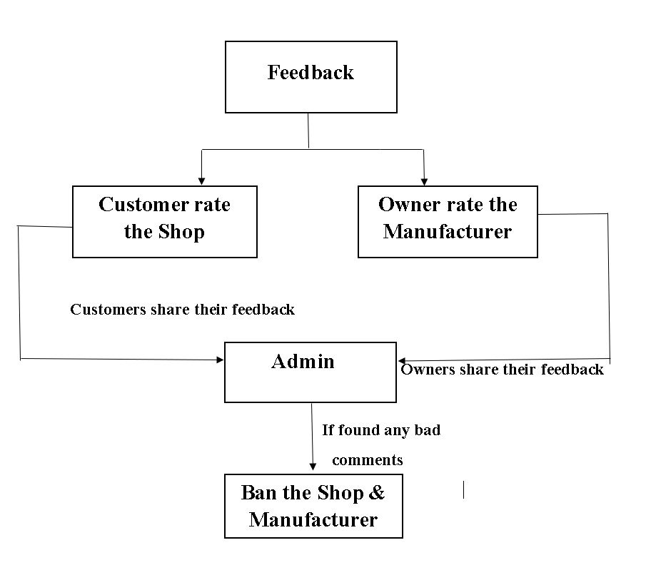
FEEDBACK
Customers can share their feedback to admin and Owners can also share their feedback to admin.

Slide 15
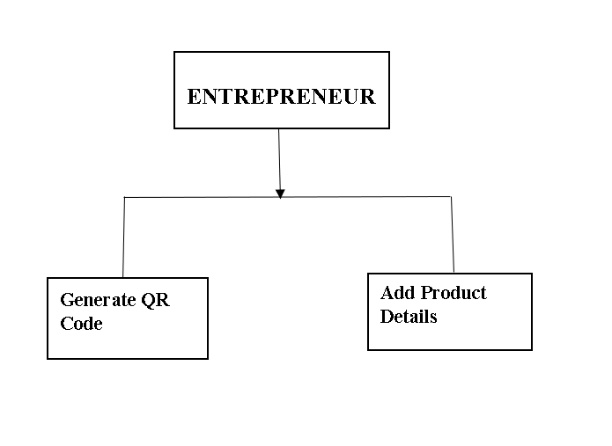
2.ENTREPRENEUR
Generate QR Code
Add Product Details

Slide 16
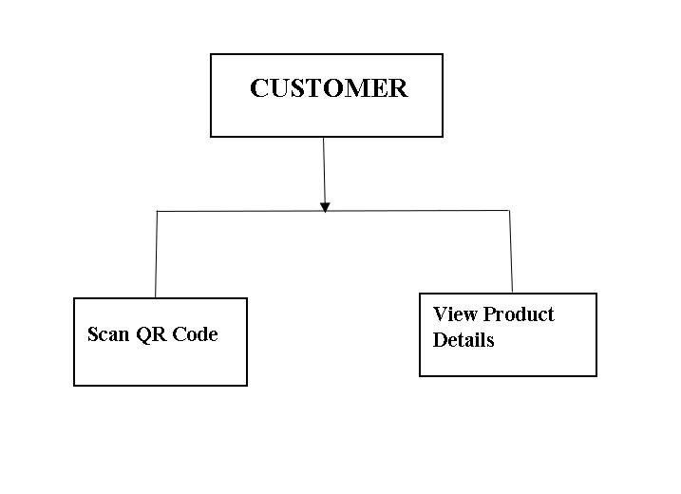
3.CUSTOMER
Scan QR Code
View Product Details

Slide 17
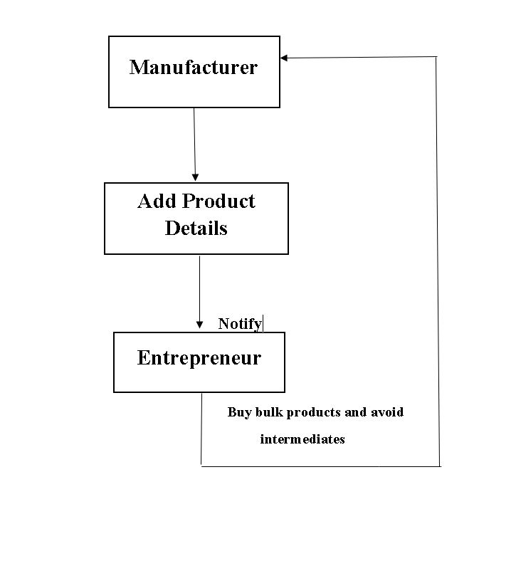
4.MANUFACTURER
Owners can directly buy bulk products from manufactures and avoid intermediates.

Slide 18
Project Plan

Slide 19
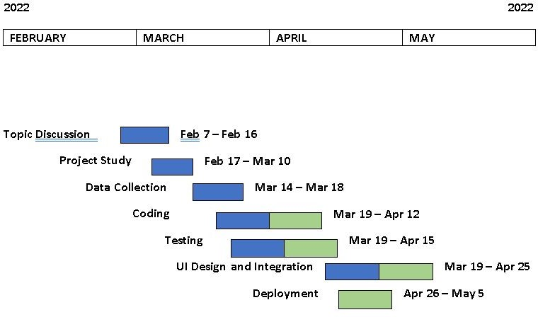

Slide 20


Conclusion

Slide 21
The Ecommerce Business Application named V- Card is an effective and useful platform for business process for both customers and Entrepreneurs.
This Business Application will support both Customers and Entrepreneurs to buy and order products.
Customers can consume time by using this application.

Slide 22



