Slide 1
Decision tree

Slide 2
Definition
A decision tree is a flowchart-like structure in which each internal node represents a "test" on an attribute , each branch represents the outcome of the test, and each leaf node represents a class label.
A decision tree consists of three types of nodes:
Decision nodes – typically represented by squares
Chance nodes – typically represented by circles
End nodes – typically represented by triangles

Slide 3
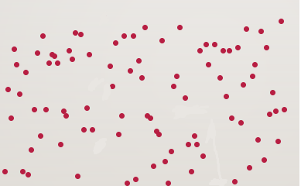




Decision tree intuition(1/2)
$$x_{2}$$
y
Split 1
$$x_{1}$$
190
Split 3
Split 2
$$x_{2}$$
170
Split 4
20
40
$$x_{1}$$

Slide 4






Decision tree intuition(2/2)
$$x_{1}<20$$
y
yes
no
$$x_{1}$$
$$x_{2}<190$$
$$x_{2}<170$$
$$x_{2}$$
yes
no
yes
no
$$x_{1}<40$$
300.5
63.7
1023
yes
no
-64.0
0.7

Slide 5

Steps involved
Importing the basic libraries

Slide 6
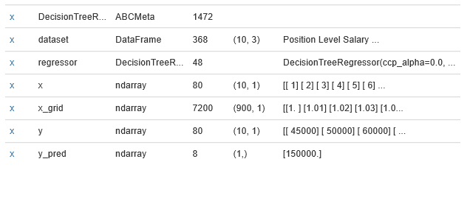
Importing data and splitting the X and Y variables

Slide 7
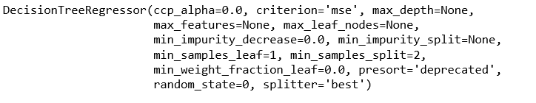
Fitting the decision tree model

Slide 8
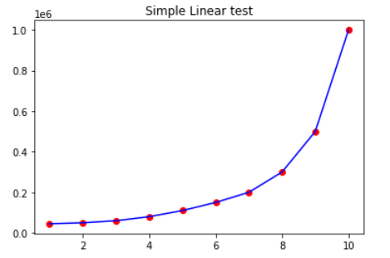
Predicting and representing data

Slide 9
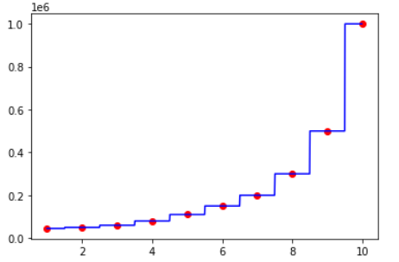
Precise representation

Slide 10
Thank you

