Slide 1
Data pre-processing in ML

Slide 2
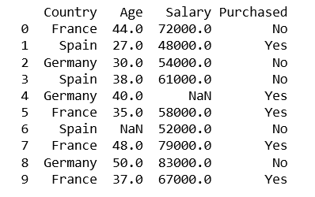
Data pre-processing
Data pre-processing is one of the most important steps when we create any ML model.
There are different data pre-processing tools and we use them depending upon the data set we have.
Our first implementation will be with all the tools.

Slide 3
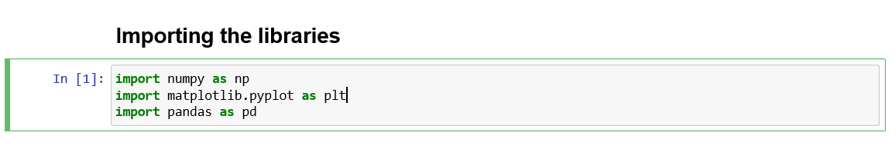
Importing libraries
These are the generic libraries which we are going to use in all the ML models.

Slide 4
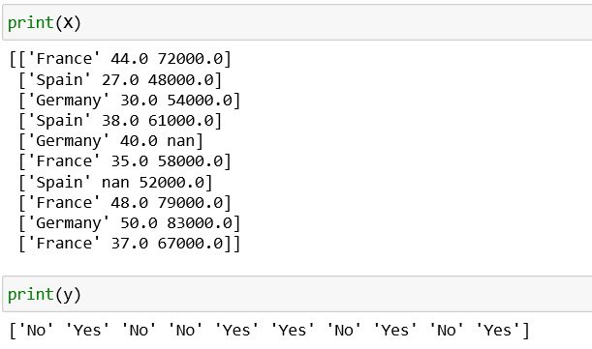
Importing data set
The next step in data pre-processing is to import you data set.
All the data set contains features and the dependent variable thus it is divided into the matrix of independent variable(features) and a vector of dependent variable.

Slide 5
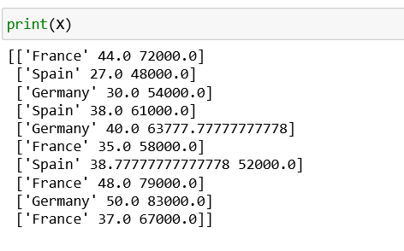
Taking care of missing data
The missing data in your data set can produce unwanted results therefore it is very important to take care of the missing data.
There are two ways to do it:
to ignore the missing data
To replace the missing the data

Slide 6
Encoding Categorial data(1/2)
Most of the time in our data set we have categorial data which is to encoded and converted into numerical values.
This will prevent the ML model from creating unnecessary co-relation between the features and the dependent variable.

Slide 7

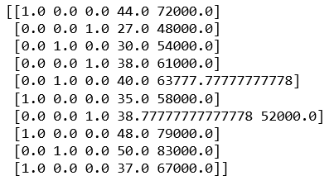

Encoding Categorial data(2/2)

Slide 8
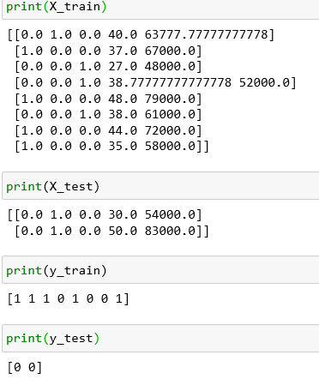
Splitting the data set into training set and test set
The data set from the previous steps is further divided into training set and test set.
The training set is the set on which you will train your ML model.
The test set is assumed as the future set on which you are going to test your model.

Slide 9
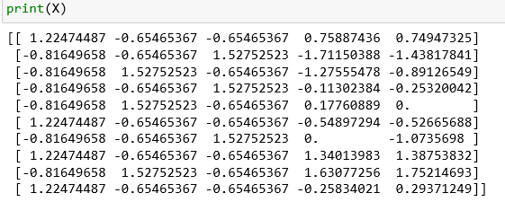
Feature scaling
Feature scaling is the process of scaling of our variables/features to take the same scale, and we do this to prevent one feature dominating the other.

Slide 10
Thank you

