Slide 1
Simple Linear regression

Slide 2
Simple linear regression
Co-efficient
Simple
Linear
Regression
y = a * x + b
Constant
Independent variable
Dependent variable

Slide 3
10k
30k
1 yr

Slide 4

Importing the libraries

Slide 5
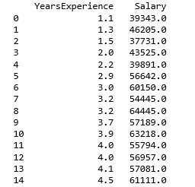
Importing the data set

Slide 6
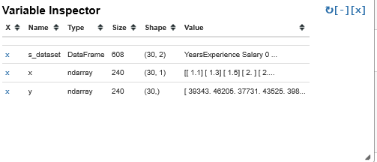
Separating independent and dependent variable

Slide 7
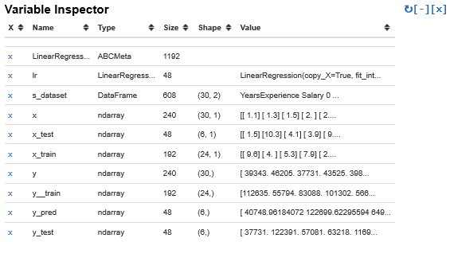
Splitting the previous data into train and test data and creating linear regression model

Slide 8
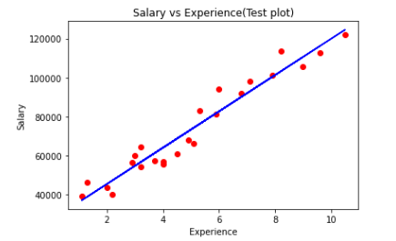
Plotting the train data

Slide 9
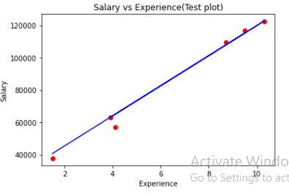
Plotting the test data

Slide 10
Thank you

