Slide 1
Refining Computer Sales Strategy through Statistical Analysis Project
BY ANJALI THOTA
Batch:- DA326S32

Slide 2
Problem Statement
The analyzing a dataset of computer purchases to understand the likelihood
of customers purchasing specific computer configurations and the
statistical properties of various aspects of the data.
The analysis involves calculating probabilities, performing hypothesis tests

Slide 3
Objectives For Analysis
Enhance Product Strategy and Sales Performance through Specification-Based Analysis.
Assessing Price Disparities Between Premium and Non-Premium Computers as compared to prices of both categories together.
Understanding Computer Price Trends Through Distribution Analysis
Analyzing Advertising Budget for Premium Computers.
Evaluating the Price Impact of CD Players on Computers

Slide 4
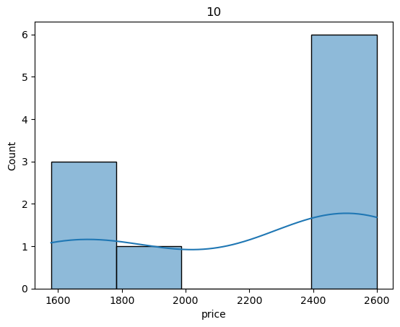
Low Peak: Around the price of between 1800 and 2000, with a count of 1.
High Peak: Around the price of between 2400 and 2600, with a count of 6.

Slide 5
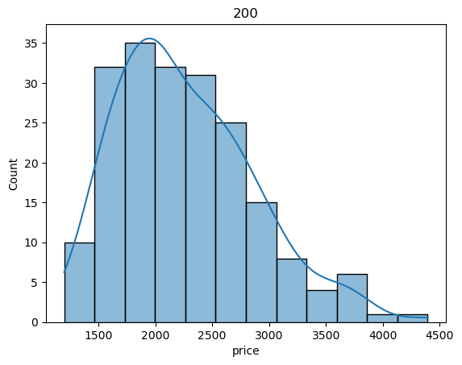
The highest concentration of data points are around the price range of 2000 to 2500.

Slide 6
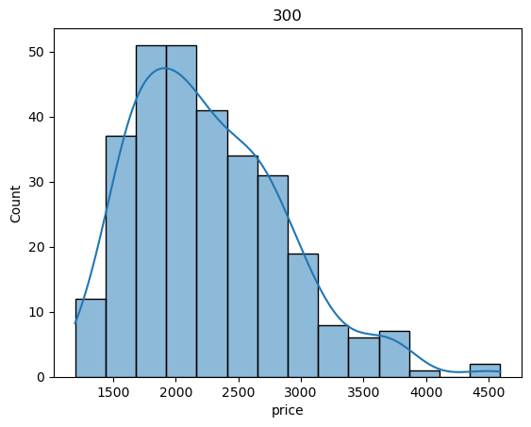
The highest concentration of data points is around the 2000-2500 price range, indicating that this is where most prices are clustered.

Slide 7
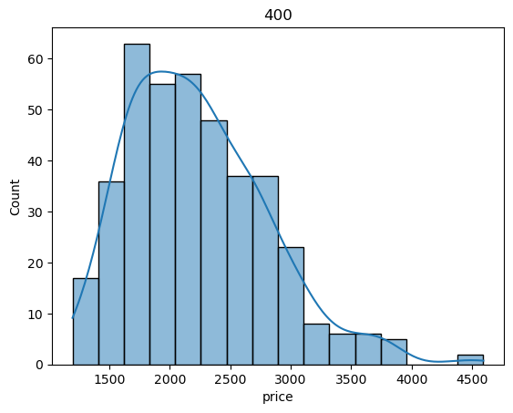
The count of prices around 1500-2500 is higher in this dataset, suggesting a higher concentration in this range.

Slide 8
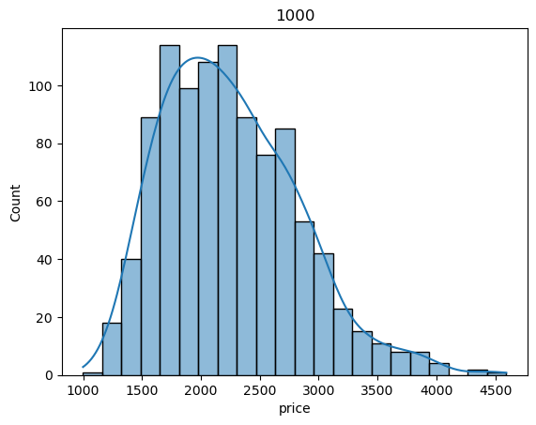
There is a gradual decline in the number of occurrences as the price increases beyond 2500, showing that higher prices are less common.

Slide 9
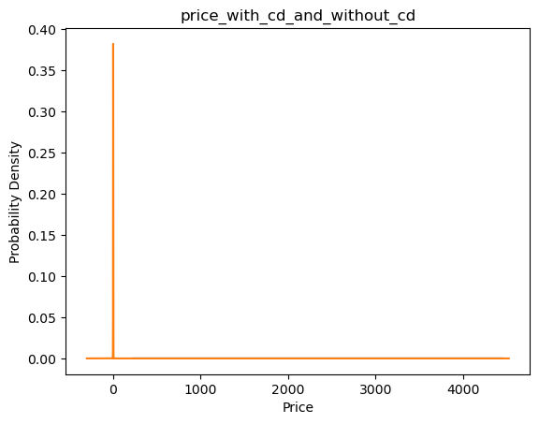
CD_WITH & WITHOUT_PRICE_COMPARSION AND DISPLACEMENT
The probability density of prices for both products with and without a CD is very low across all price points. The highest density appears to be around the $0 price point.

Slide 10
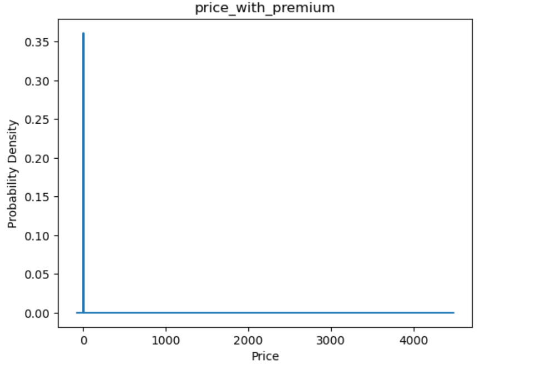
The distribution of prices for products with a premium. The graph reveals a clear concentration of prices at the lower end of the spectrum, with a sharp peak near the $0 mark

Slide 11
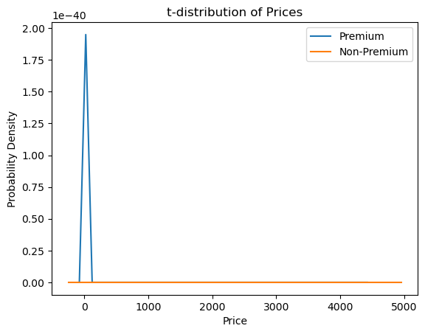
The distribution of premium prices is concentrated in the higher price range, while the distribution of non-premium prices is concentrated in the lower price range.

Slide 12
The probability density of prices for both products with and without a CD is very low across all price points. The highest density appears to be around the $0 price point. The distribution of prices for products with a premium. The graph reveals a clear concentration of prices at the lower end of the spectrum, with a sharp peak near the $0 mark. The distribution of premium prices is concentrated in the higher price range, while the distribution of non-premium prices is concentrated in the lower price range.
Conclusion

Slide 13
Sample_Size _ 10: -Low Peak: Around the price of between 1800 and 2000, with a count of 1.
High Peak: Around the price of between 2400 and 2600, with a count of 6.
Sample_Size_100:-The count of prices around 1500-2500 is higher in this dataset, suggesting a higher concentration in this range.
Sample_Size_200:-The highest concentration of data points is around the 2000-2500 price range, indicating that this is where most prices are clustered.
Sample_Size_300:-The count of prices around 1500-2500 is higher in this dataset, suggesting a higher concentration in this range.
Sample_Size_400:-The count of prices around 1500-2500 is higher in this dataset, suggesting a higher concentration in this range.
Sample_Size_1000:-There is a gradual decline in the number of occurrences as the price increases beyond 2500, showing that higher prices are less common.
Finall_Conclusion: When Increasing the Sample Size it’s Equally To The Normal Distibruation.

Slide 14
Business Conclusion:
The findings suggest that certain features ( CD, screen size) and product categories (premium vs. non-premium) significantly impact customer purchasing behavior and pricing strategies.
Companies can use these insights to tailor their offerings and pricing strategies to better meet customer preferences.

Slide 15
THANK YOU ALL

