Slide 1
Unveiling_Automobile_Sales_Trends
BY ANJALI THOTA
Batch:- DA326S32

Slide 2
Problem Statement:
The company is facing several challenges in its business operations that are impacting overall performance and profitability
Objectives For Analysis
Sales Analysis
Customer Segmentation
Sales Forecasting
Product Performance
Inventory Management
Order Fulfilment Analysis
Pricing Strategy

Slide 3
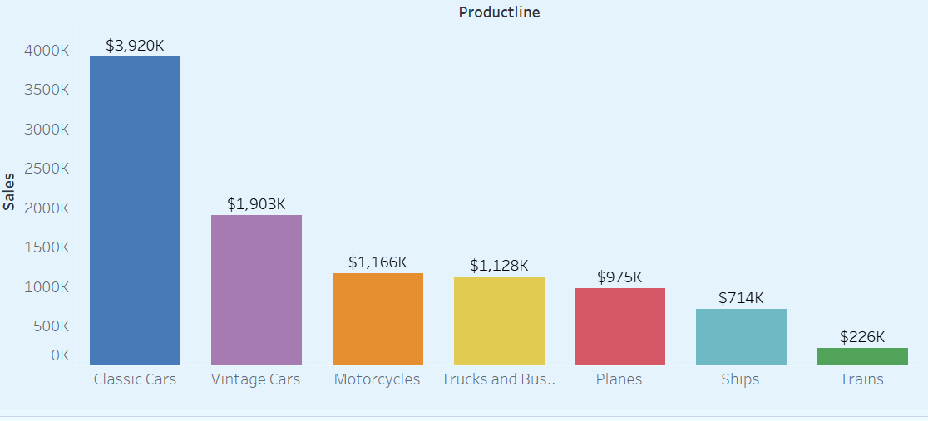
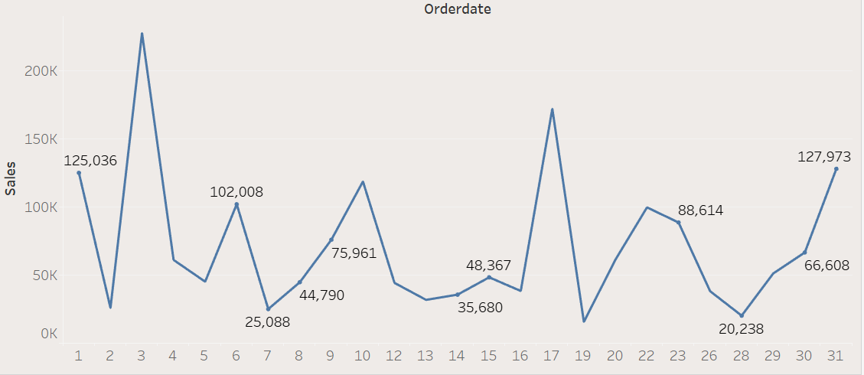
Sales Analysis
Classic Cars have the highest sales, totaling $3,920K.
Trains have the lowest sales at $226K.
Highest sales day is on the 31st with 127,973.
Lowest sales day is on the 26th with 20,238.

Slide 4
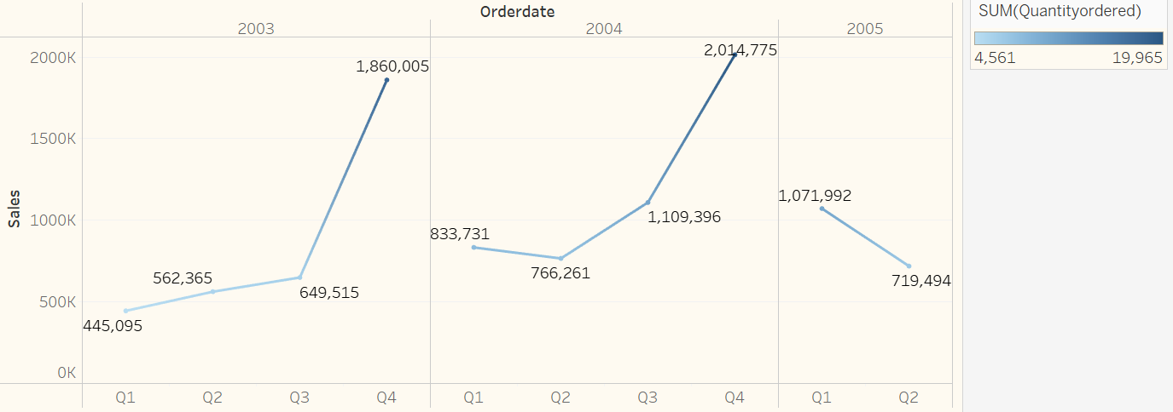
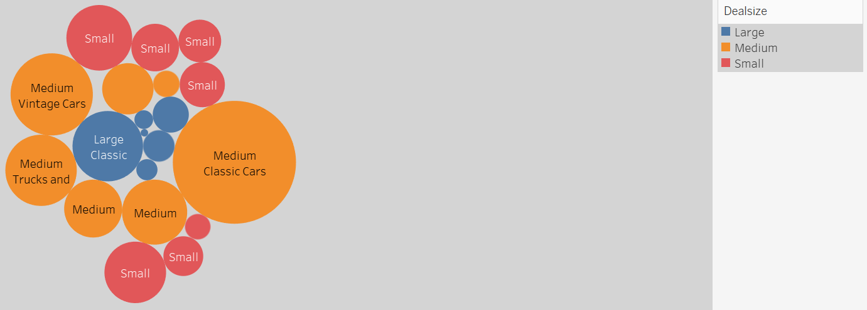
In 2003 "Q4" $1,860,005
Sales increased in Q1 to Q3, then showed a more spike in Q4.
.
circle "Medium Size" in the "Classic Cars" Having Most sales
circle "Medium Size" in the "Classic Cars" Having Most sales

Slide 5
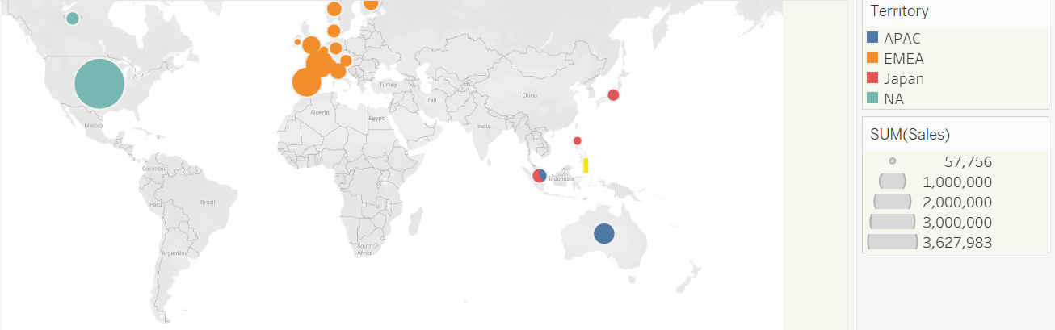
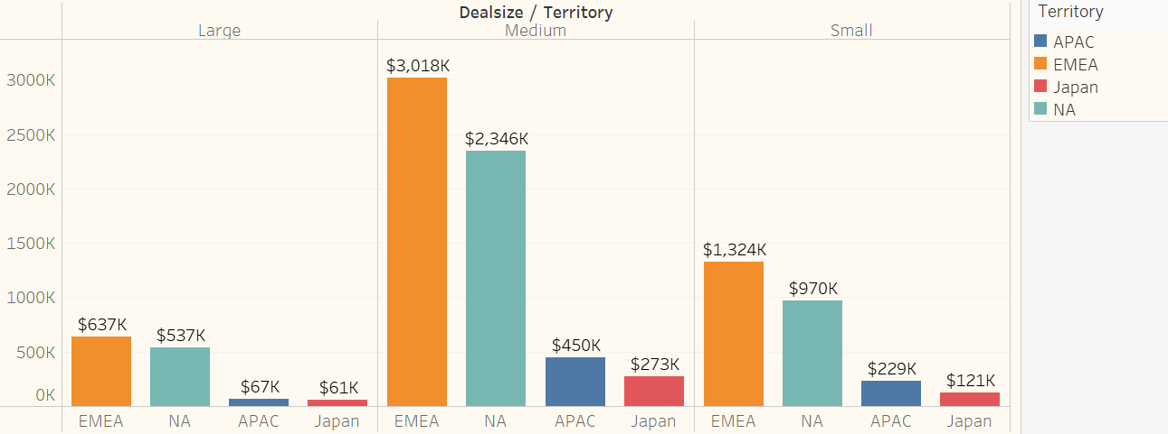
Customer Segmentation
"EMEA" to have the highest sales $3018k "Medium Size" in that category In All sizes (Large,Medimum,small,)
The sales into four regions "APAC" (Asia-Pacific),"EMEA" (Europe, Middle East, and Africa),"Japan", and "NA" (North America).
North America (NA) has the highest overall sales 3,627,983.

Slide 6
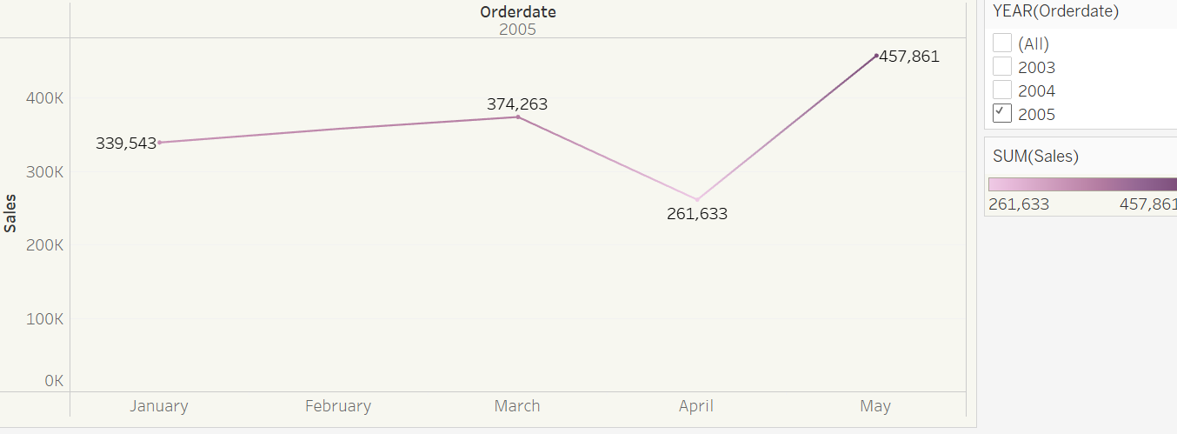
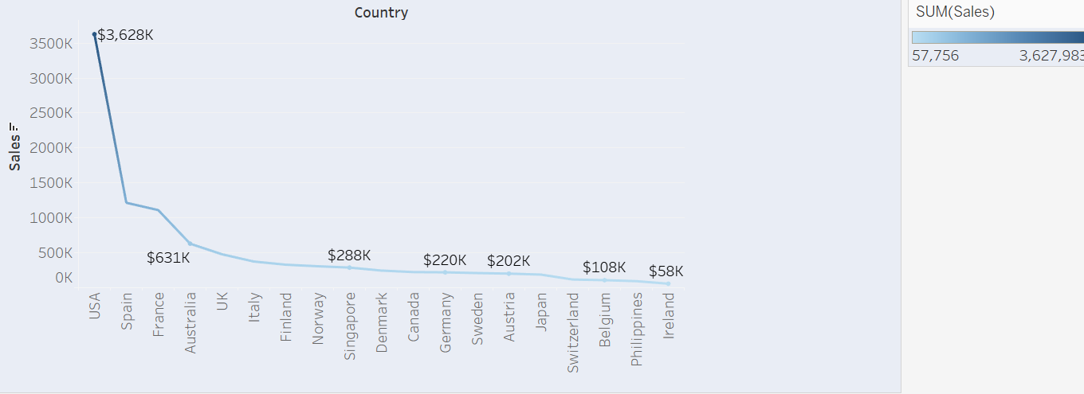
Sales Forecasting
The Maximum Sales of month is "May" 4,57,861 In the 2015 and Minimum Sales of Month "JANUARY" 3,39,543
The Maximum Sales of Country is "USA" $3628k In the 2015 and Minimum Sales of Country "Ireland" $58k

Slide 7
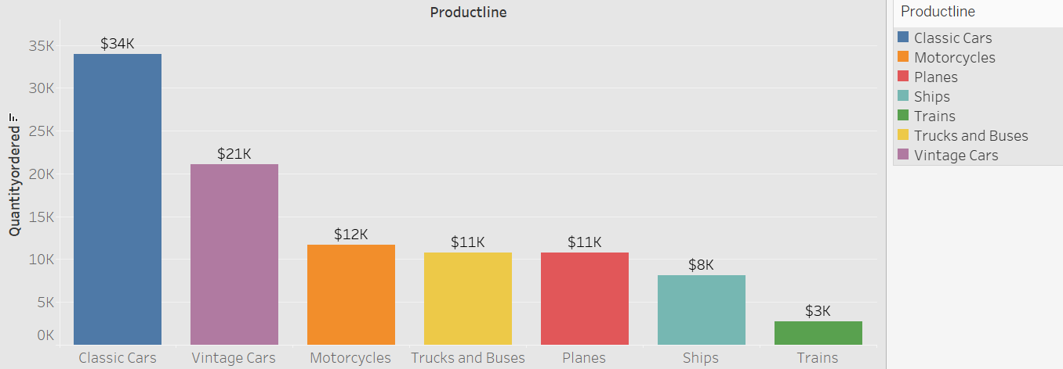
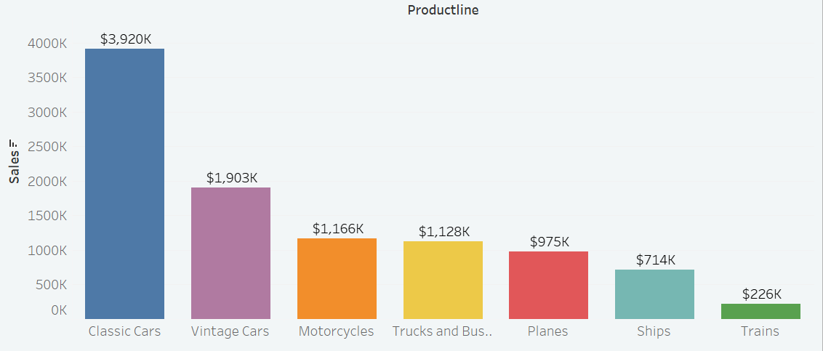
Product Performance
Product with the maximum quantity ordered $34k is Classic Cars and Minimum quantity ordered $3k with Trains.
Product with the maximum sales $3920k is Classic Cars and Minimum sales $226k with Trains.

Slide 8
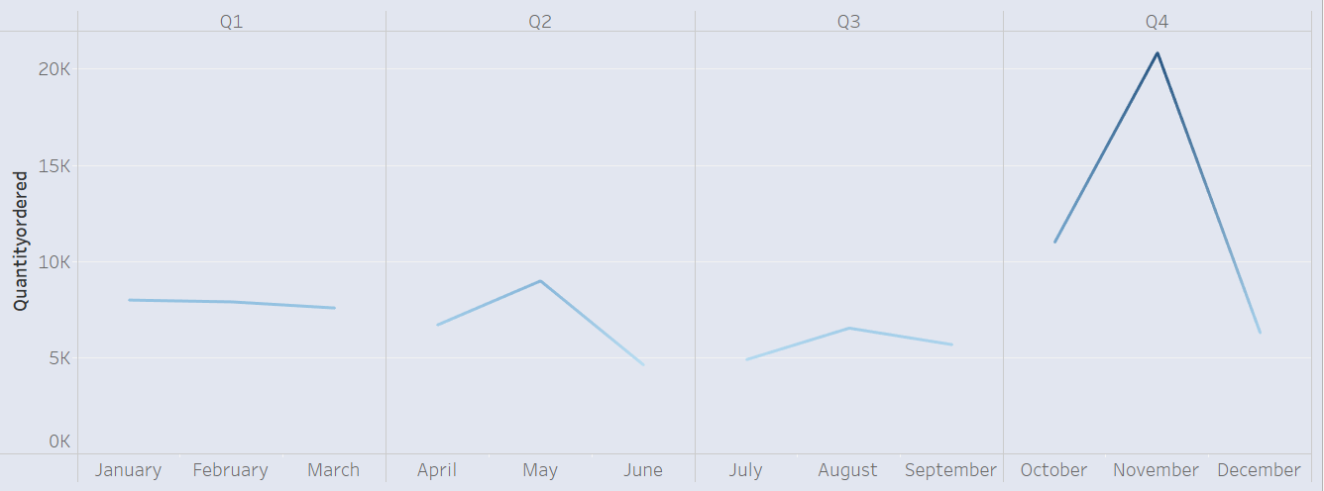
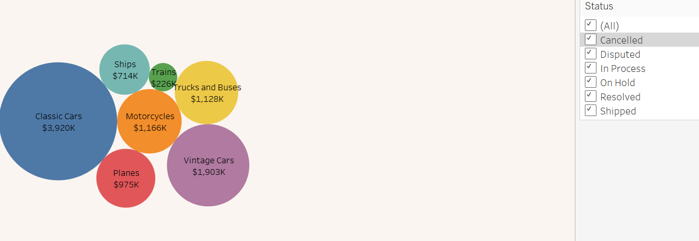
Inventory Management
In Q4 November Month having the ordered most.
The "Classic Cars" have the
highest total sales amount $3920k

Slide 9
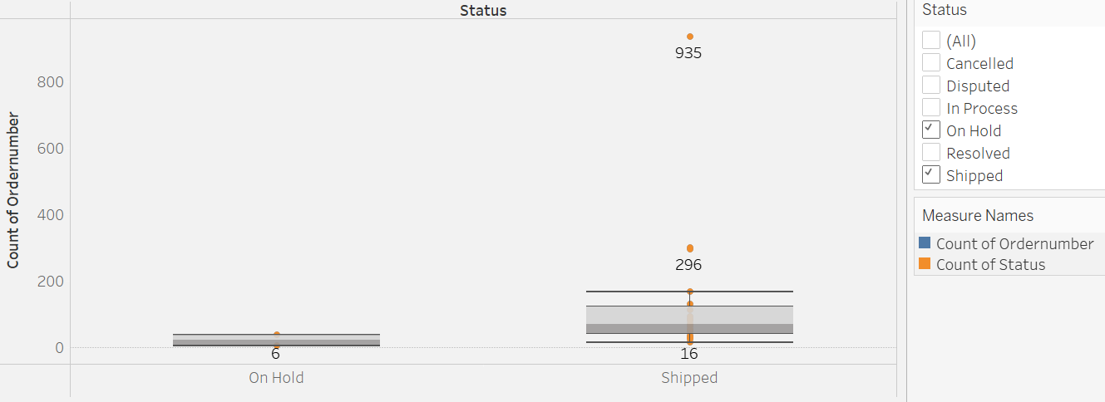
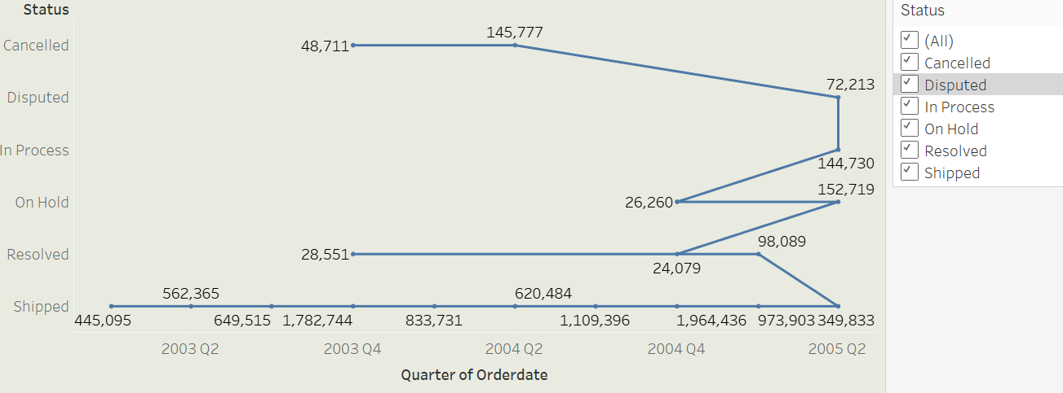
Order Fulfilment Analysis
The Status Shipped Having the more Count of ordered 935

Slide 10
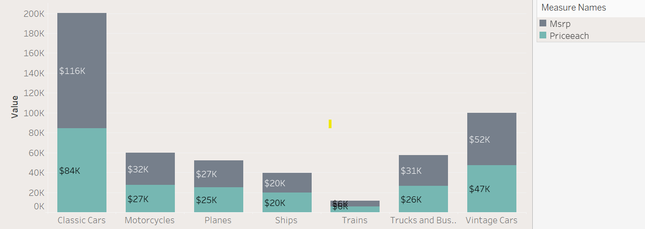
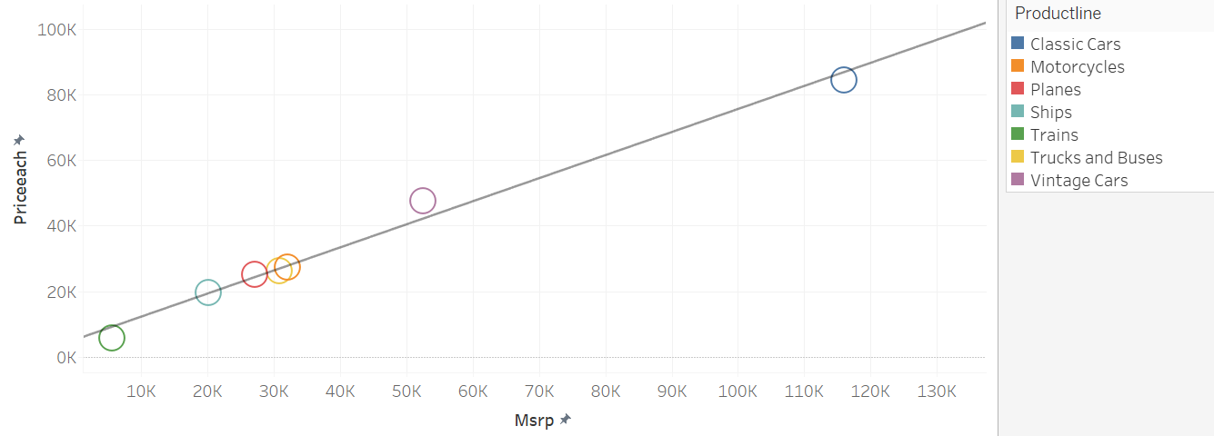
Pricing Strategy
The maximum sales of ProductLine classic cars Having Most "MSRP“ $116k and" Price Each $84k
scatter plot showing the relationship between the "MSRP" and" Price each "Different product lines.

Slide 11
Summarization
Highest sales day: 31st ($127,973).
Lowest sales day: 26th ($20,238).
Highest total sales: Classic Cars ($3,920K).
Lowest total sales: Trains ($226K).
Highest sales month: May ($457,861).
Lowest sales month: January ($339,543).
Highest sales: USA in 2015 ($3,628K).
Lowest sales: Ireland ($58K).
Highest quantity ordered: Classic Cars ($34K).
Lowest quantity ordered: Trains ($3K).
Highest order count: "Shipped" status in 2003 Q2.
Highest total sales month for Classic Cars: Q4, particularly November ($3,920K)

Slide 12
Conclusion
Daily Sales:
The highest sales day is the 31st, with sales totalling $127,973.
Product Line Performance:
Classic Cars have the highest total sales, reaching $3,920K.
Quarterly Sales Trends:
In 2005, sales decreased from Q1 ($1,071,992) to Q2 ($719,494).
Monthly Sales Trends in 2015:
May Month the highest sales, totall $457,861.
January Month the lowest sales, totall $339,543
Order and Shipping Trends:
The "Shipped" status had the highest count of orders, peaking in 2003 Q2.
Classic Cars had the highest total sales amount ($3,920K), with most orders placed in Q4, particularly in November.

Slide 13
Product Quantity and Sales:
Classic Cars had the highest quantity ordered ($34K) and the highest sales ($3,920K).
Trains had the lowest quantity ordered ($3K) and the lowest sales ($226K)
Pricing:
A scatter plot shows a strong relationship between MSRP and price for different product lines, with Classic Cars having the highest values for both.

Slide 14
THANK YOU

