Slide 1
Housing Hub A Society Coordination Platform
Presented By :
SHOEB SHAIKH
ROHAN GOILKAR
ANUJA KHUMKAR
HIMANSHU SINGH
ANJALI UDAWANT
250245920080
250245920072
250245920039
250245920033
250245920015

Slide 2
Content
Introduction
Problem Statement
Objectives
Diagrams -
Technology Stack
Future Scope
Conclusion
Use Case Diagram
ER Diagram
Class Diagram
Activity Diagrams
Data Flow Diagram

Slide 3

Introduction
Housing Hub, a Society Coordination System is a web-based platform designed to modernize and simplify residential society operations.
It addresses common issues such as outdated workflows, lack of transparency, and security concerns. And empowering residents and admin with smart tools for:
Notices & Announcements
Complaint Tracking & Visitor Logging
Amenity Reservations & Maintenance Billing

Slide 4
Problem Statement
Housing societies often face daily challenges such as Disorganized processes, delayed updates, hard-to-track complaints, Inconvenient amenity reservations, and unreliable visitor entry logs. These issues arise due to manual work, poor coordination, and lack of transparency. Housing Hub addresses them with automation, centralized access, and seamless resident engagement.

Slide 5
Objectives
Digitize manual society functions. (e.g., complaint logging, visitor entries)
Improve access to essential services for residents. (e.g., amenity booking, bill viewing)
Automate notifications and logs. (e.g., announcements, security gate logs)
Provide a unified platform for all users. (e.g., one portal for admins, residents, and guards)

Slide 6
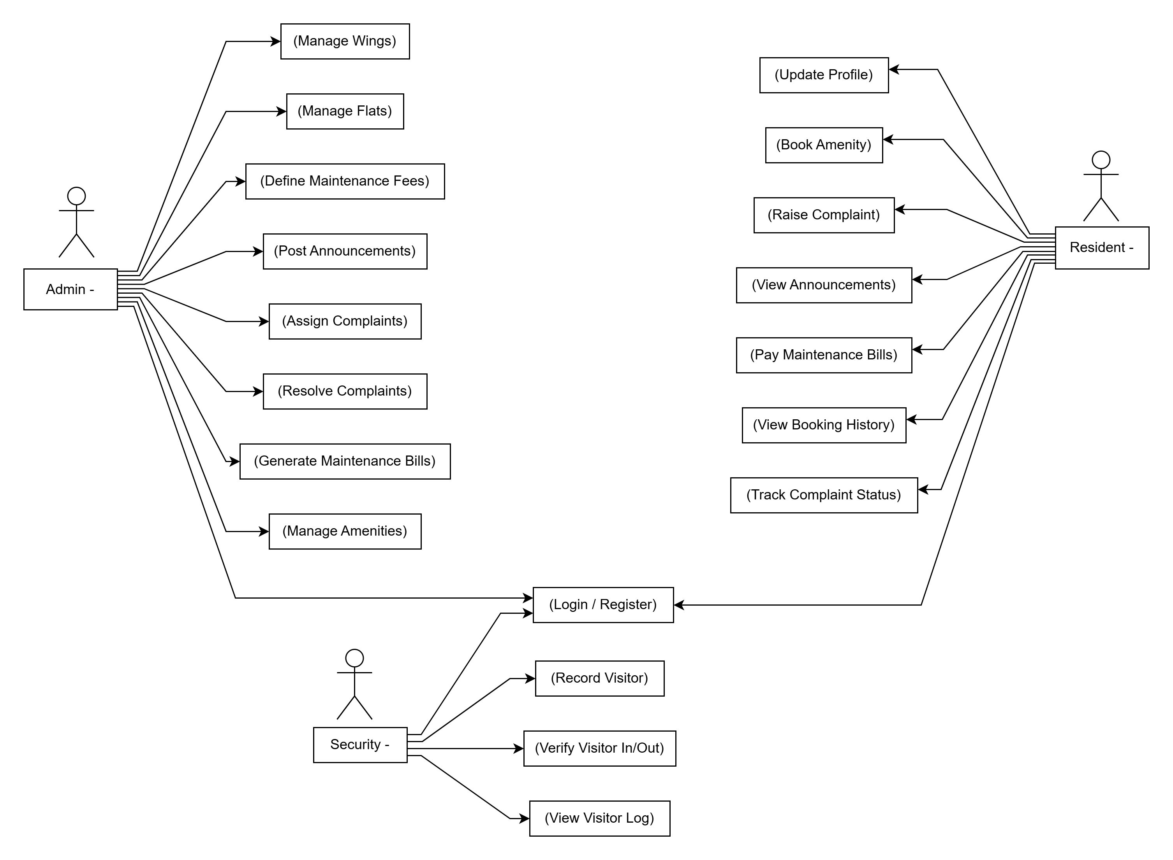
Use case diagram

Slide 7
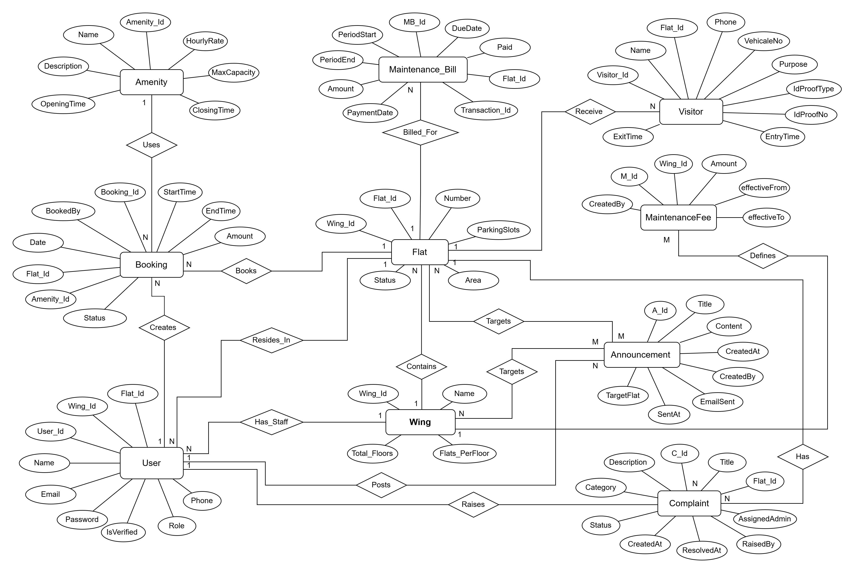
ER Diagram

Slide 8
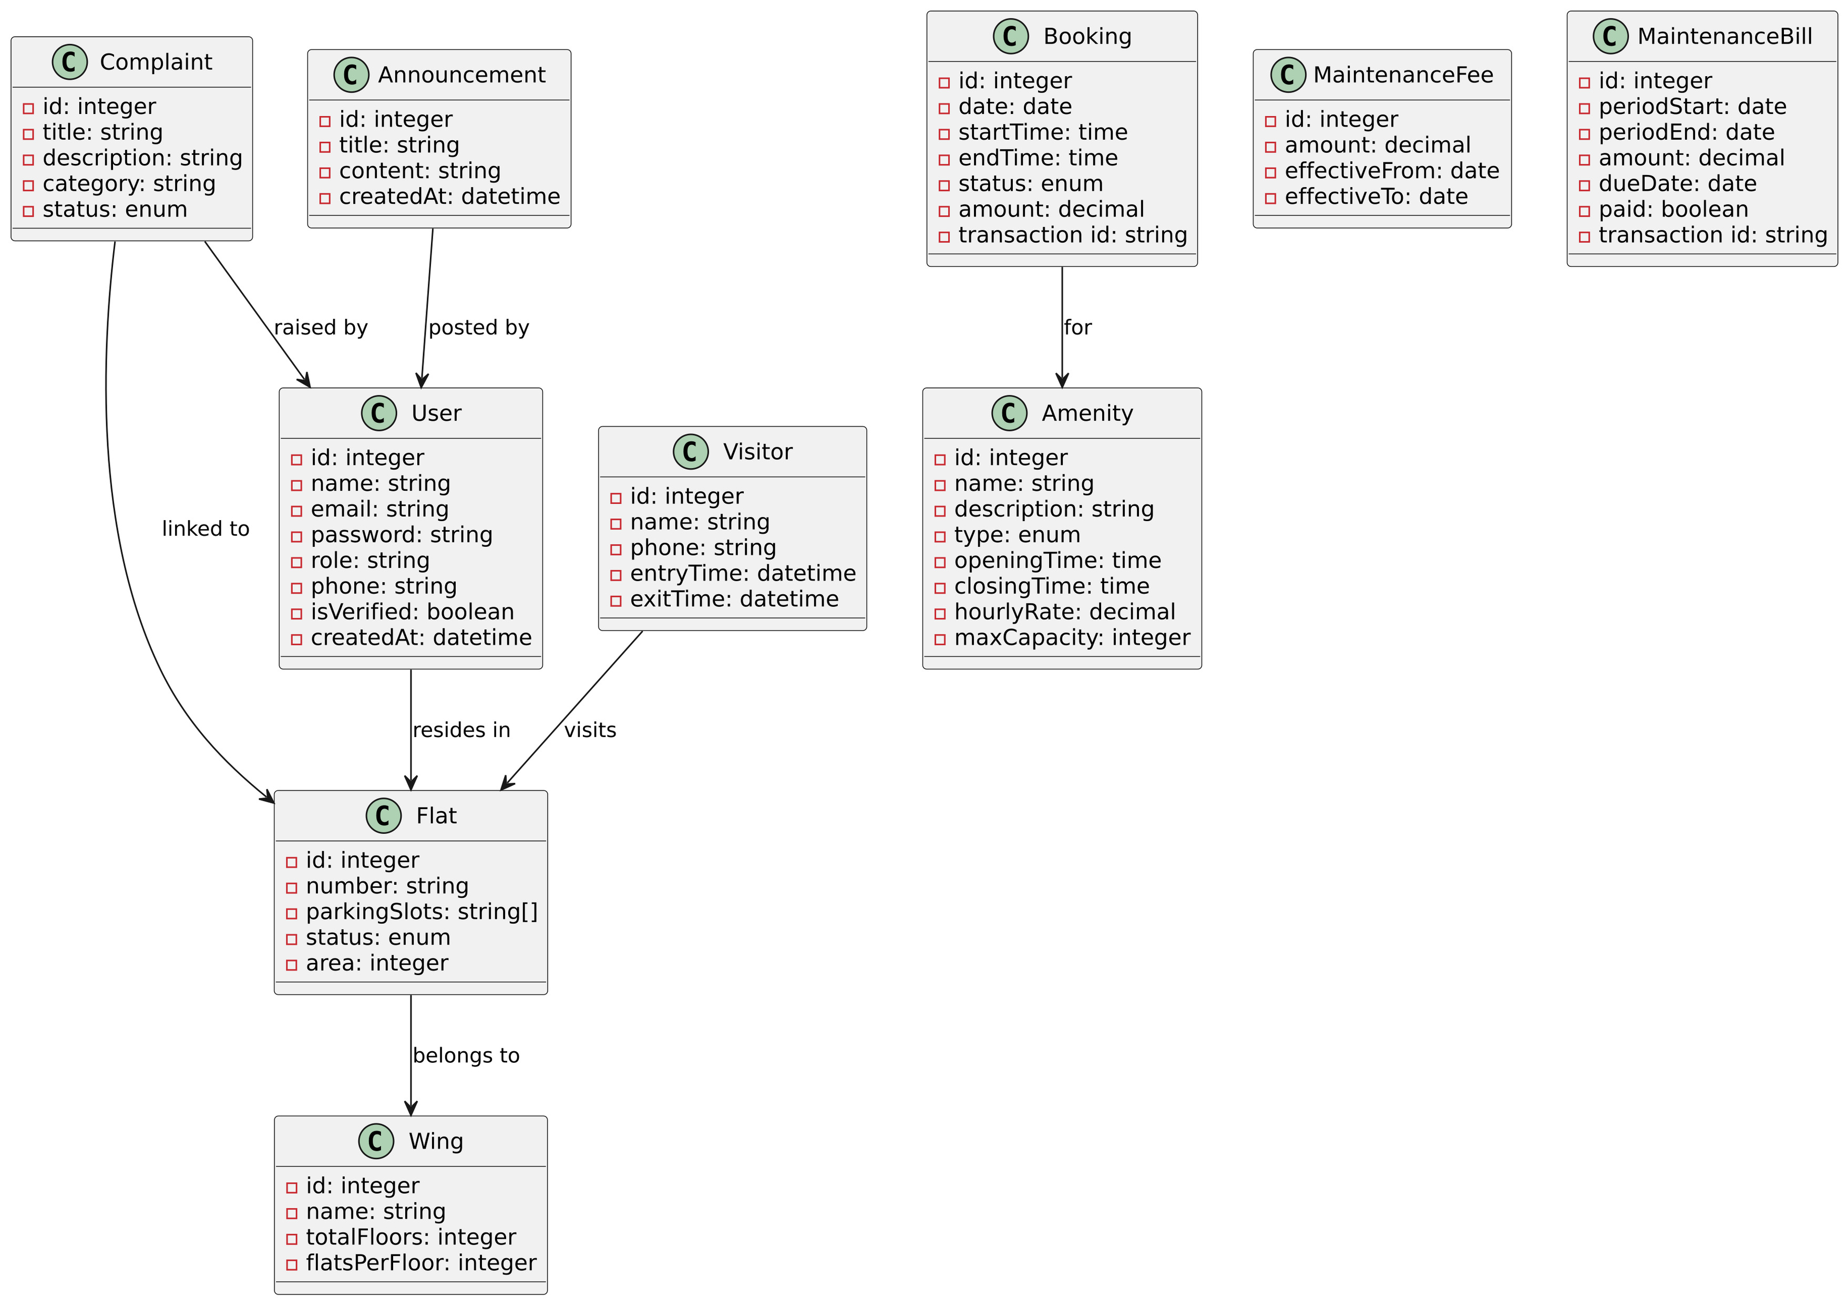
Class diagram

Slide 9
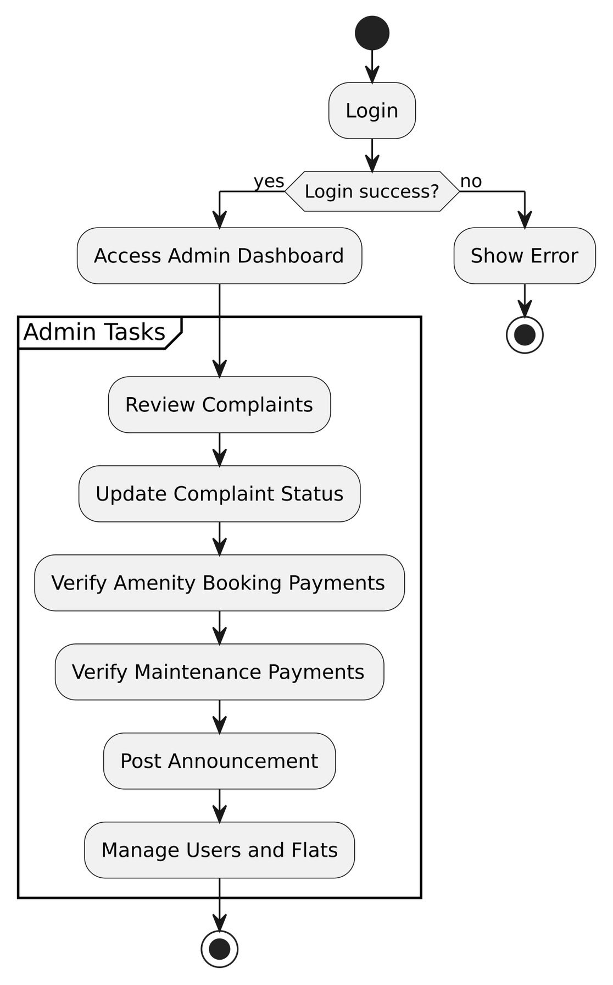
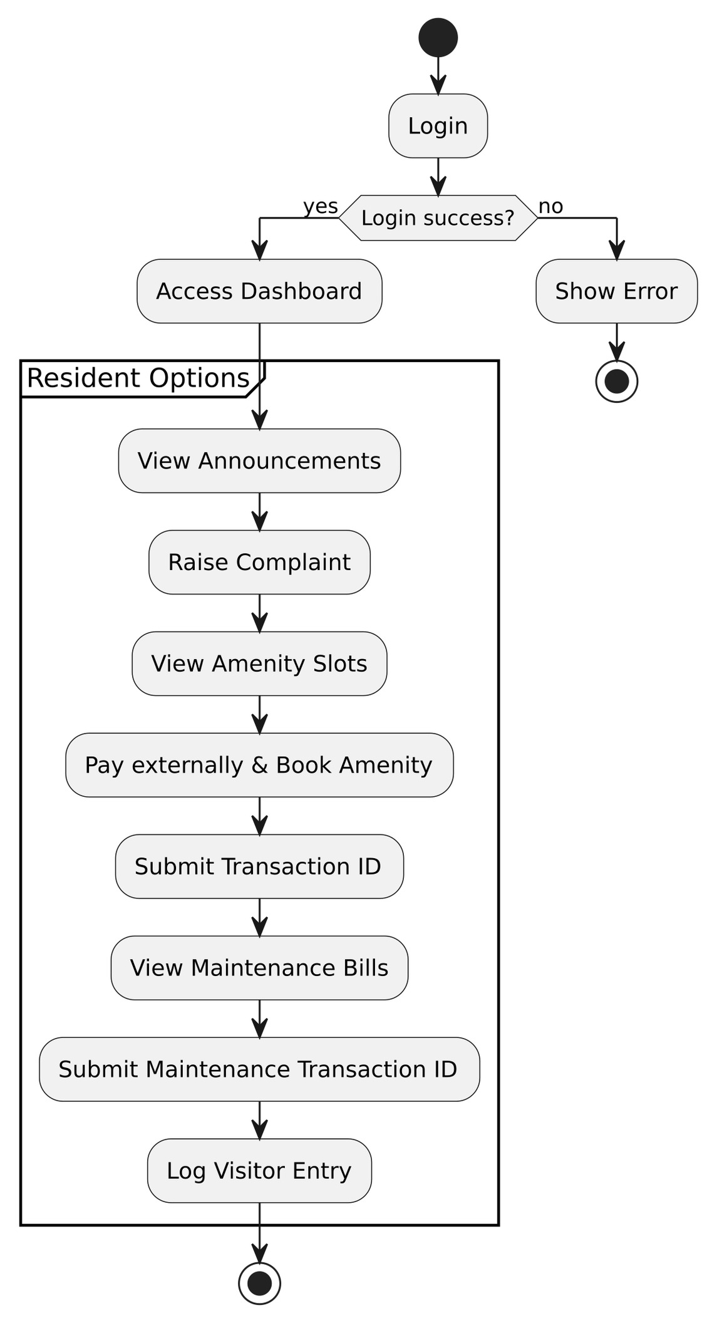
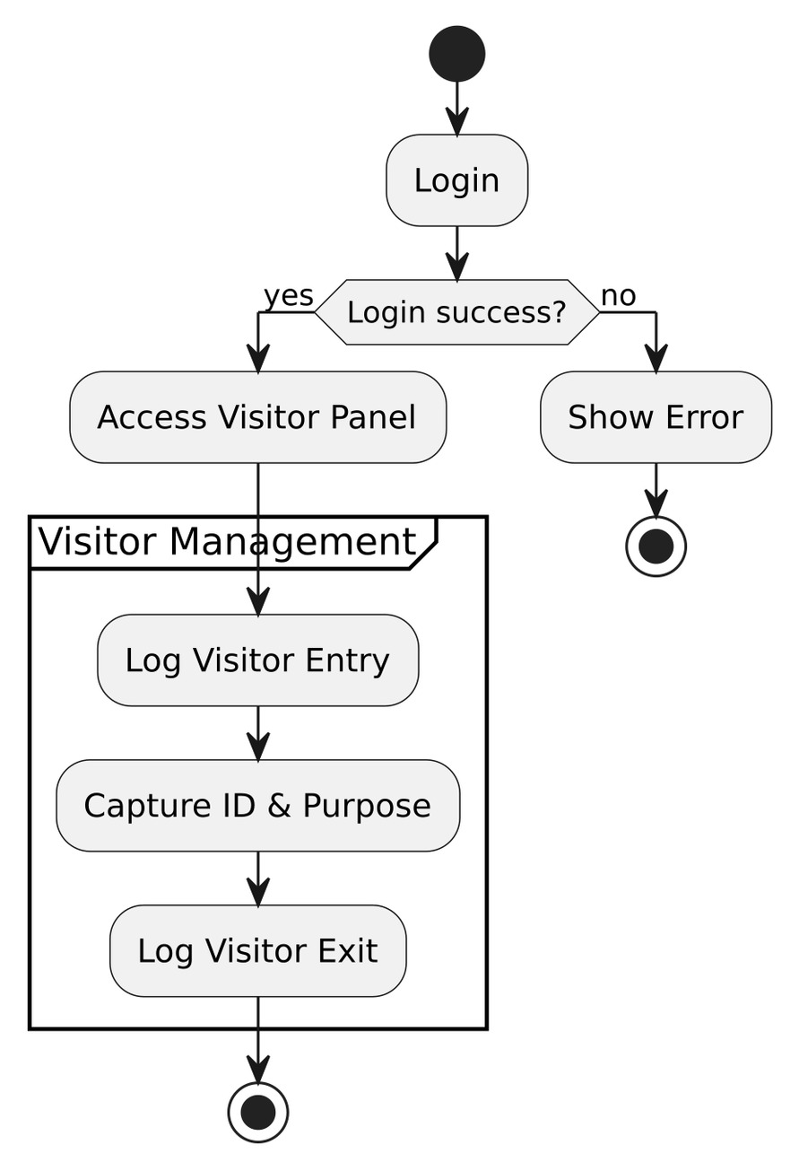
Activity Diagrams

Slide 10
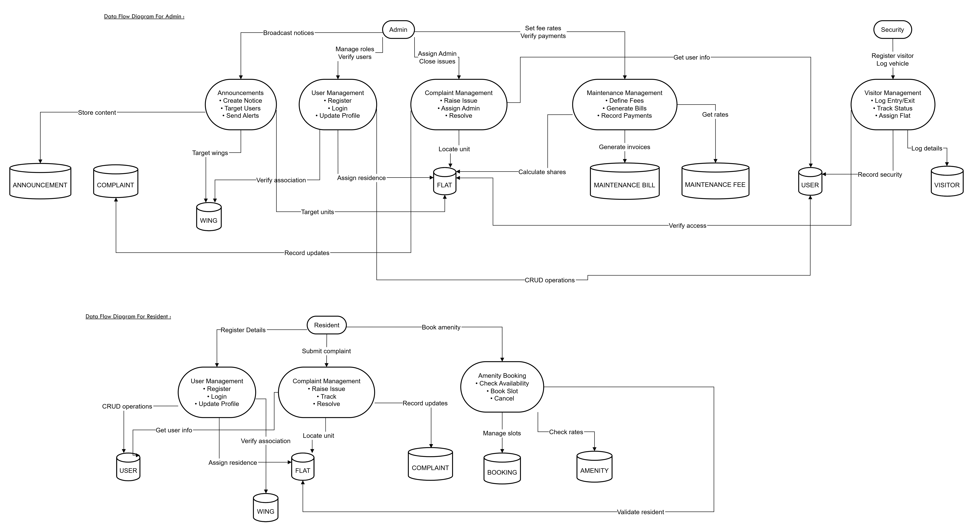
Flow Diagram

Slide 11
Technology Stack
Frontend:
React.js - Responsive, Interactive UI
HTML, CSS, JS
Backend:
Microsoft .NET Core (Business logic)
SendGrid API - Email Notifications
Database
Microsoft SQL Server
Cloud Platform & Hosting
AWS
Version Control
Git (GitHub)

Slide 12

Future Scope
Voting/Polling System: Allow society members to vote on important decisions or participate in polls.
Built-in Marketplace Feature: To allow residents to buy and sell items securely within the society.
Vendor Management: A module to manage service providers (plumbers, electricians, cleaners) and their schedules.

Slide 13
Conclusion
The Society Coordination System is a simple yet powerful platform designed to streamline and modernize everyday activities in residential societies. It helps improve efficiency, enhance the resident experience, and strengthen security. By replacing outdated methods with smart, digital tools, the system creates a more organized, transparent, and better living experience for everyone.

Slide 14
THANK YOU

