Slide 1

AstroSage Call Center Performance Analysis
Spreadsheet-Based Business Intelligence and Dashboard Project
Prepared by: Anjali Kapse
Notes:
1.7.2013
1
‹#›

Slide 2




Business Problem Statement
AstroSage faces critical operational and strategic challenges that require data-driven solutions:
Customer Satisfaction Improvement Opportunities
Operational Efficiency Challenges
Failed calls (1,214), incomplete calls (875), busy calls (1,270), and failed chats (7,256) represent operational bottlenecks requiring process optimization and workforce improvements.
Overall customer rating of 2.93 out of 5.0 indicates significant opportunities to enhance service quality and customer experience across all consultation channels.
Revenue Optimization Opportunities
Strategic Investment Decisions
Call consultations generate 78.72% of revenue while chat contributes 21.25%, presenting opportunities for service expansion and targeted business strategies.
Need to allocate resources strategically based on historical data to optimize peak-hour performance (6 AM - 4 PM), improve customer satisfaction, and maximize revenue growth.
Notes:
1.7.2013
2
‹#›

Slide 3



Dataset Overview & Methodology
Dataset at a Glance
Spreadsheet Functions & Tools Applied
28,027 total customer interactions across call and chat channels
35+ business attributes spanning customer interactions, ratings, sales, operational costs, consultation types, and guru performance metrics
Comprehensive data on customer satisfaction, revenue generation, and operational efficiency
Guru and user profile information for performance analysis
Pivot Tables for multi-dimensional analysis
SUM() for aggregation
COUNTA() for counting records
AVERAGE() for mean calculations (Average Daily Calls: 246.03 calculated using total interactions divided by available business dates)
COUNTUNIQUE() for distinct values
FILTER() for data segmentation
SORT() for data organization
CORREL() for correlation analysis
Column, Pie, Line, and Combo Charts for visualization
Interactive Dashboards with Slicers for performance monitoring
Data Cleaning & Preparation
Removed duplicates and trimmed whitespace
Standardized guru names and corrected inconsistencies
Handled missing values; validated data types
Notes:
1.7.2013
3
‹#›

Slide 4
Key Performance Indicators
28,027
₹214,065.90
Total Calls
Across all consultation categories
Total Sales
Revenue generated from all consultations
₹99,146.57
2.93
Operational Cost
Total operational expenses
Average Rating / 5.0
Customer satisfaction score
5,054
246.03
Repeat Callers
Returning customers
Average Daily Calls
Daily call volume average
Key Insights
Strong revenue base of ₹214K with operational costs of ₹99K, indicating healthy profit margins
Customer satisfaction at 2.93/5 indicates significant room for improvement through service optimization
5,054 repeat callers demonstrate customer loyalty despite satisfaction gaps, representing retention opportunity
Notes:
1.7.2013
4
‹#›

Slide 5
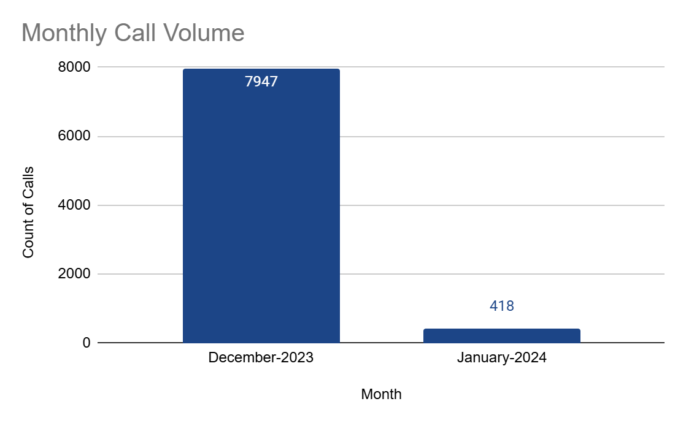
Monthly Call Volume Analysis
Key Insights
December-2023 recorded the highest call volume with 7,947 calls, accounting for the majority of total call activity.
January-2024 recorded the lowest call volume with only 418 calls, showing a significant decline compared to December-2023.
Call volume decreased by approximately 94.7% from December-2023 to January-2024 (7,947 to 418 calls).
The sharp drop in January-2024 suggests that the available data for January may represent only a partial month or a shorter reporting period.
Notes:
1.7.2013
5
‹#›

Slide 6
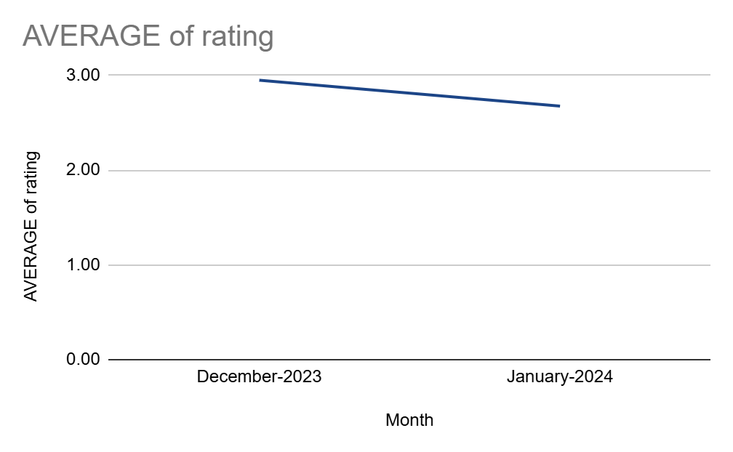
Customer Satisfaction Trend
Key Insights
December-2023 recorded the highest average customer satisfaction score of 2.95, while January-2024 recorded the lowest at 2.68.
The average customer satisfaction score declined by 0.27 points from December-2023 to January-2024.
The overall average customer satisfaction score across the analyzed period was 2.93, indicating a generally consistent customer rating trend.
Although customer satisfaction decreased in January-2024, the difference between the two months was relatively small (0.27 points), suggesting only a moderate change in average ratings.
Key Insights
Customer satisfaction declined 9% from December (2.95) to January (2.68), indicating seasonal variations and service quality challenges that require continuous monitoring.
The downward trend requires continuous monitoring and service quality improvements to prevent further customer attrition and maintain business performance.
Regular satisfaction tracking and targeted service improvements are critical for maintaining customer loyalty and supporting long-term business growth.
Notes:
1.7.2013
6
‹#›

Slide 7
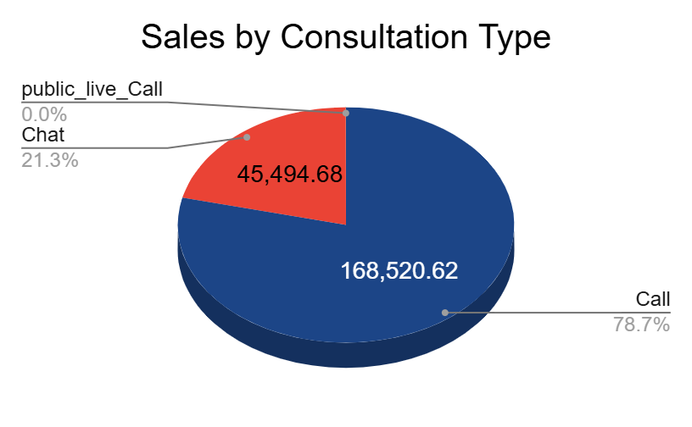
Sales by Consultation Type
Key Insights
Call consultations generated the highest share of revenue, contributing 78.72% of total sales, making them the primary revenue source.
Chat consultations accounted for 21.25% of total sales, making them the second-largest contributor to revenue.
Public Live Call contributed only 0.02% of total sales, indicating minimal revenue generation during the analyzed period.
Complementary consultations generated no measurable revenue (0%), as they were offered free of charge or had no billable transactions.
Key Insights
Call consultations generate 78.72% of total revenue (₹168.5K), establishing them as the primary revenue driver for AstroSage's business model.
Chat consultations contribute 21.25% of revenue, presenting significant opportunities for service expansion and targeted business strategies to increase market share.
Revenue distribution across consultation types should guide strategic investment priorities and resource allocation decisions.
Notes:
1.7.2013
7
‹#›

Slide 8
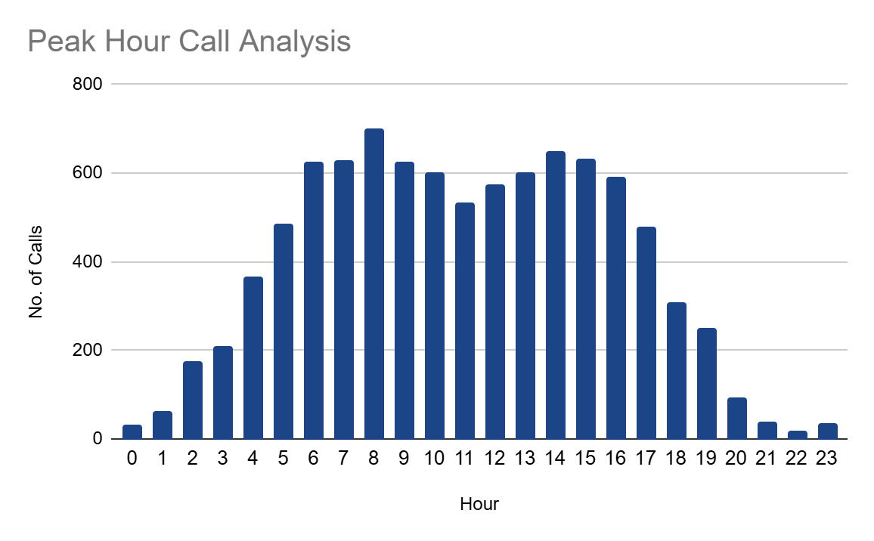
Peak Hour Call Analysis
Key Insights
The highest call volume was recorded at 8 AM with 699 calls, making it the peak hour for customer interactions.
Call volume increased steadily from early morning (0–8 AM), indicating growing customer activity during the morning hours.
High call traffic continued from 2 PM to 4 PM (651–591 calls), showing sustained demand throughout the afternoon.
Call volume declined significantly after 6 PM, with the fewest calls recorded during late-night hours (10 PM–11 PM).
Key Insights
Peak workloads occur during business hours (6 AM - 4 PM), with maximum volume of 699 interactions at 8 AM
Lowest volumes occur during late night hours (22-23), indicating minimal demand outside business hours
Workforce planning is essential during peak periods to maintain service quality and operational efficiency
Notes:
1.7.2013
8
‹#›

Slide 9
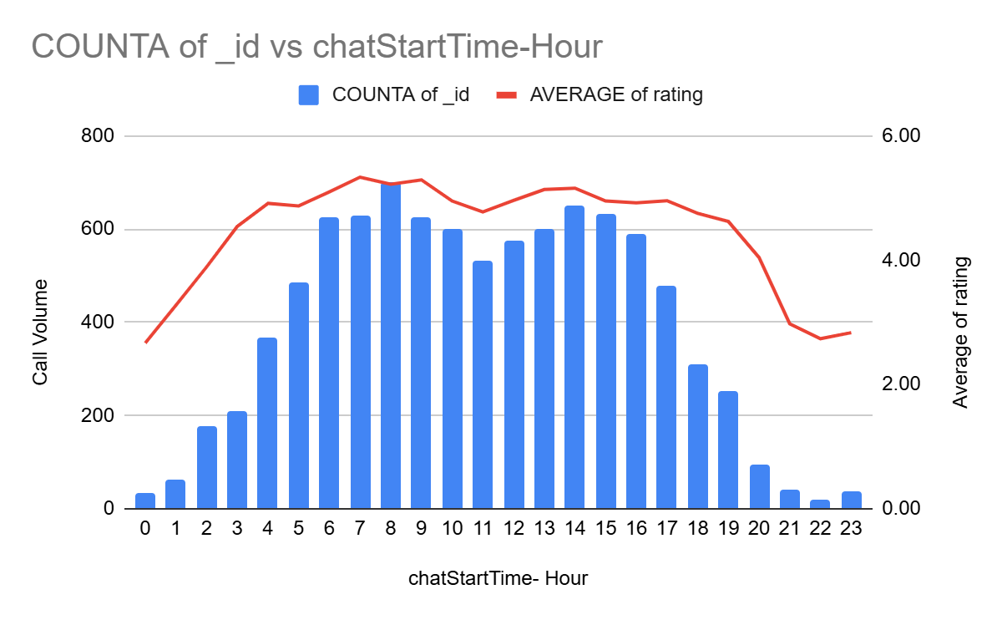
Customer Satisfaction During Peak Hours
Key Insights
The highest call volume was recorded at 8 AM with 699 calls, making it the peak hour for customer interactions.
Call volume increased steadily from early morning (0–8 AM), indicating growing customer activity during the morning hours.
High call traffic continued from 2 PM to 4 PM (651–591 calls), showing sustained demand throughout the afternoon.
Call volume declined significantly after 6 PM, with the fewest calls recorded during late-night hours (10 PM–11 PM).
Key Insights
Peak customer interactions occur between 6 AM and 4 PM, where hourly call volumes consistently exceed 500 calls
Customer ratings remain relatively high during peak hours, ranging approximately from 4.77 to 5.34, indicating that service quality is maintained despite higher workloads
Call volumes decline significantly after 8 PM, accompanied by lower customer ratings, suggesting that staffing and service quality should also be monitored during off-peak hours
Notes:
1.7.2013
9
‹#›

Slide 10
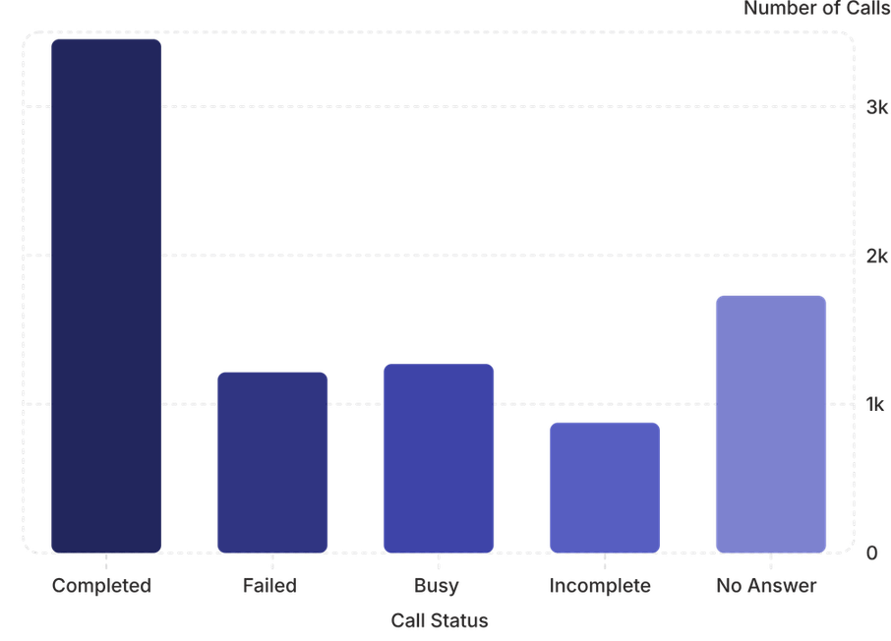
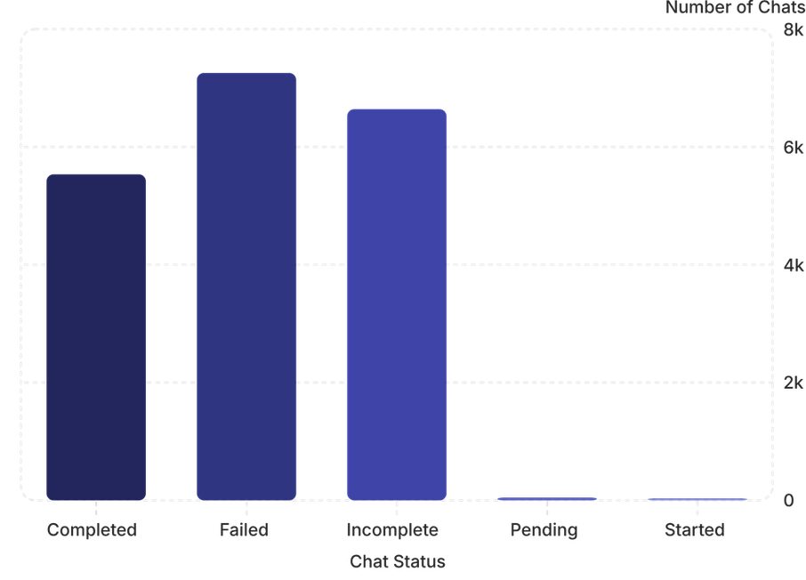
Interaction Status Analysis
Call Status Distribution
Chat Status Distribution
Key Insights
Only 3,453 out of 8,541 call interactions (40.43%) were successfully completed, while 5,088 interactions were unsuccessful due to busy, failed, incomplete, or no-answer statuses, indicating opportunities to improve call handling efficiency.
Chat interactions recorded 7,256 failed and 6,641 incomplete cases, which together account for more than 70% of all chat interactions, suggesting significant process and service quality challenges.
The gap between completed and unsuccessful interactions across both channels highlights the need for better workforce planning, agent training, and operational monitoring.
Recommendations
Prioritize reducing failed and incomplete interactions by improving agent training and implementing standardized call and chat handling procedures.
Monitor busy and no-answer call statuses during peak periods to optimize staffing and resource allocation.
Implement real-time operational dashboards to track completion rates and identify service bottlenecks across both call and chat channels.
Notes:
1.7.2013
10
‹#›

Slide 11
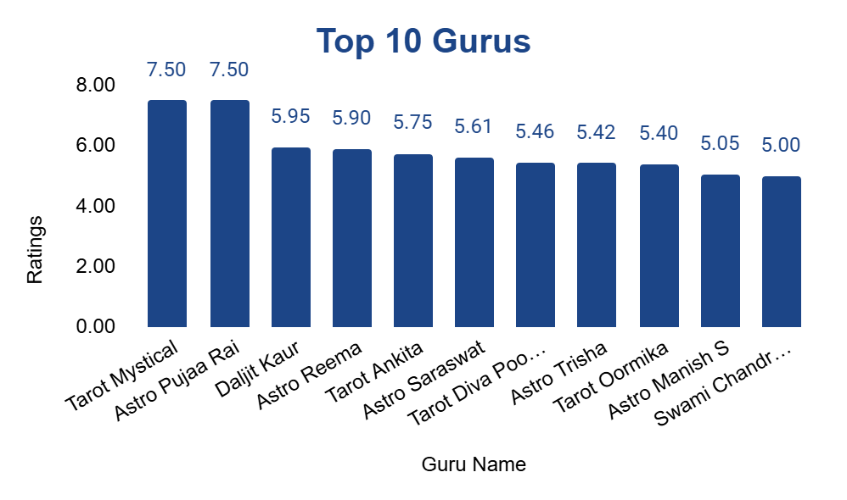
Guru Performance Analysis
Key Insights
Tarot Mystical and Astro Pujaa Rai achieved the highest average rating of 7.50, jointly ranking as the top-performing gurus.
The remaining top 10 gurus maintained average ratings between 5.00 and 5.95, indicating consistently positive customer feedback.
The difference between the highest-rated guru (7.50) and the tenth-ranked guru (5.00) is 2.50 rating points, showing a noticeable variation in customer satisfaction among the top performers.
All top 10 gurus received average ratings of 5.00 or above, reflecting a generally high level of customer satisfaction among the highest-ranked consultants.
Key Insights
The highest-rated gurus received customer ratings between 4.0 and 4.9, demonstrating consistently positive customer experiences and strong service quality.
Tarot Mystical achieved the highest customer rating (4.9), followed by Astro Pooja Rai (4.7) and Daljit Kaur (4.5), highlighting top-performing gurus within the organization.
Variations in customer ratings highlight differences in service quality and provide opportunities to identify best practices that can be replicated across the organization to improve overall customer satisfaction.
Recommendations
Recognize and reward consistently high-performing gurus to encourage service excellence.
Study the interaction patterns and service approaches of highly rated gurus to develop targeted training programs for other team members.
Monitor customer ratings regularly as a key performance indicator (KPI) to evaluate service quality, identify performance trends, and support data-driven operational decisions.
Notes:
1.7.2013
11
‹#›

Slide 12
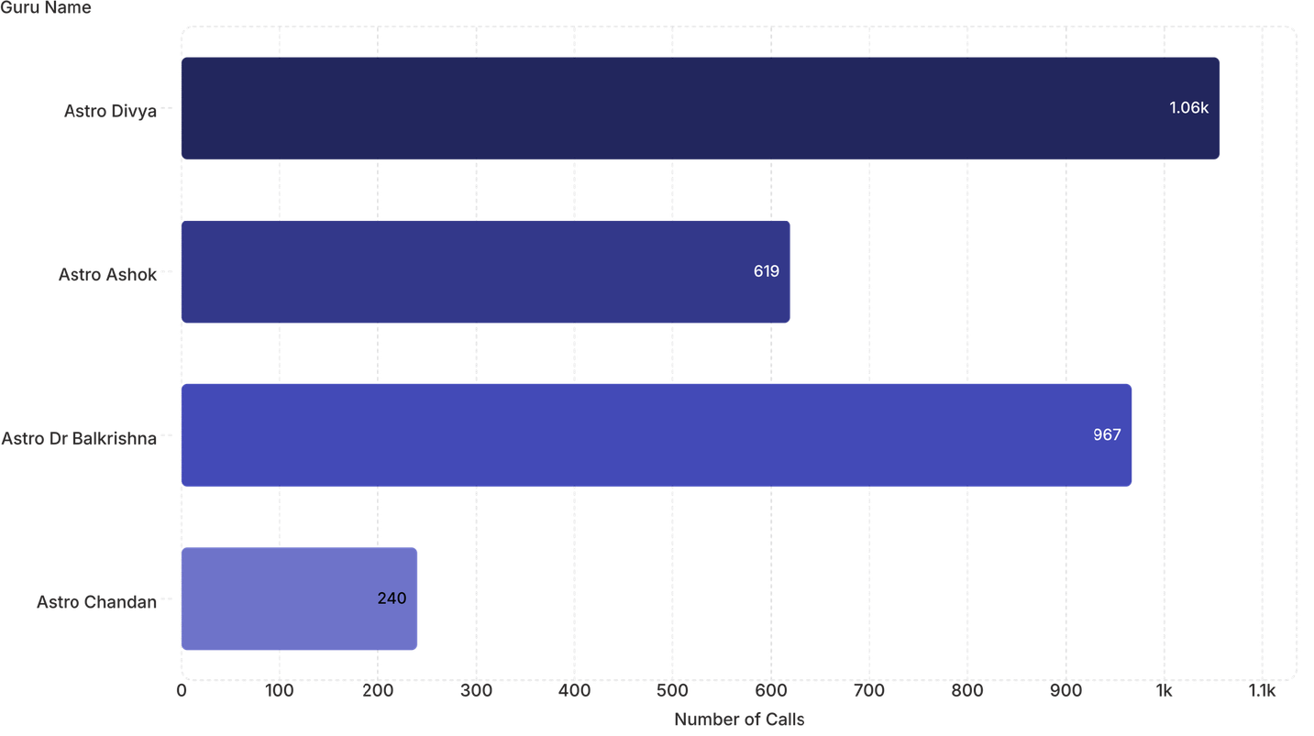
Guru Workload Analysis
Key Insights
Astro Divya handled the highest workload with approximately 1.06K calls, making them the busiest guru during the analyzed period.
Astro Dr. Balkrishna ranked second with 967 calls, indicating a consistently high consultation volume.
Astro Ashok handled 619 calls, while Astro Chandan managed 240 calls, showing a significant variation in workload across gurus.
The busiest guru (Astro Divya) handled over four times as many calls as Astro Chandan (1.06K vs. 240), highlighting an uneven distribution of customer interactions.
Key Insights
Guru workloads are unevenly distributed across the organization. Astro Divya handled the highest number of interactions (1,056), followed by Astro Dr Balkrishna (967), whereas Astro Chandan handled substantially fewer interactions (240).
The significant variation in interaction volumes suggests that some gurus may experience consistently higher workloads, which could affect operational efficiency and increase the risk of burnout if not managed appropriately.
Historical workload trends provide valuable insights for workforce planning and can help ensure a balanced distribution of customer interactions during peak demand periods.
Recommendations
Balance customer assignments across gurus to prevent excessive workloads and improve operational efficiency.
Regularly monitor guru-level workload metrics to identify capacity constraints and support better workforce planning.
Allocate additional staffing or schedule support during peak periods for gurus handling consistently high interaction volumes to maintain service quality and employee well-being.
Notes:
1.7.2013
13
‹#›

Slide 13
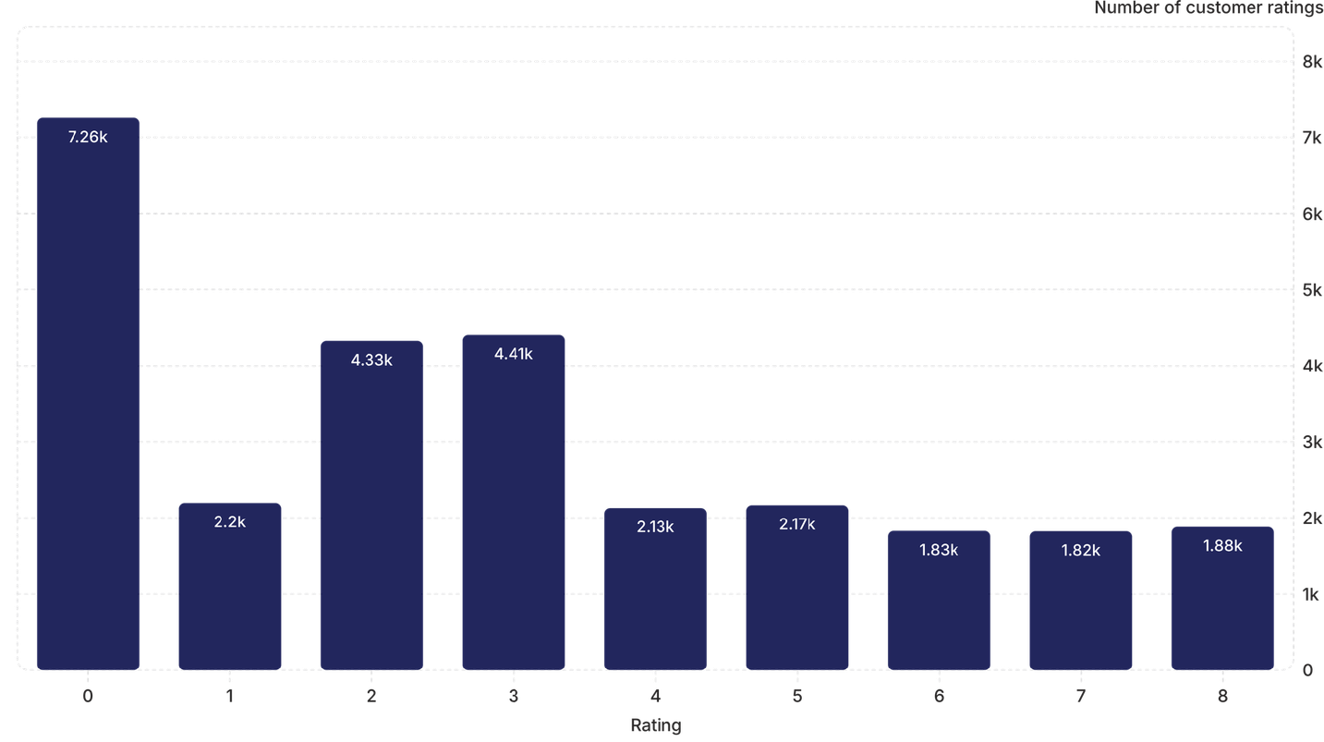
Customer Rating Distribution
Key Insights
Rating 0 was the most frequently recorded rating, with approximately 7.26K records, representing the largest share of customer ratings.
Ratings 2 and 3 were the next most common, with approximately 4.33K and 4.41K records respectively, indicating moderate customer satisfaction levels.
Higher ratings (6–8) were comparatively less frequent, with each category receiving fewer than 2K ratings.
The distribution is skewed toward lower rating values, suggesting that low to moderate ratings were more common than high ratings during the analyzed period.
Key Insights
Rating 0 has the highest frequency with 7,256 interactions, indicating significant opportunities for improving customer satisfaction and service quality.
Ratings 2 and 3 collectively account for 8,736 interactions, representing a significant proportion of customers with moderate satisfaction levels.
Higher ratings (6 to 8) collectively account for 5,535 interactions, indicating opportunities to further improve customer experiences and increase the proportion of highly satisfied customers.
Recommendations
Prioritize investigating the causes of zero and low ratings to identify operational bottlenecks and service quality issues.
Develop targeted training and quality improvement initiatives aimed at moving customers from moderate ratings (2 and 3) to higher satisfaction levels.
Continuously monitor customer rating trends using interactive dashboards to measure the impact of operational improvements over time.
Notes:
1.7.2013
14
‹#›

Slide 14







Technology Recommendations
AI Chatbots
Workforce Management Systems
CRM Integration
Intelligent chatbots for initial triage, FAQ handling, and after-hours support to reduce call volume and improve customer experience.
Real-time scheduling and forecasting to optimize staffing levels during peak hours and reduce operational costs.
Unified customer interaction history to enable personalized service, improve retention, and identify upsell opportunities.
Intelligent Call Routing
Speech Analytics
Real-time Reporting Dashboards
Automated call distribution based on guru expertise, availability, and customer preferences to reduce wait times and improve first-contact resolution.
Automated analysis of call recordings to identify service quality issues, training needs, and customer sentiment patterns.
Live KPI monitoring for managers and leadership to enable quick decision-making and performance optimization.
Customer Feedback Analytics
Automated sentiment analysis and feedback collection to identify service gaps and drive continuous improvement.
Notes:
1.7.2013
15
‹#›

Slide 15




Business Recommendations
Optimize Staffing During Peak Hours
Invest in Workforce Management Technologies
Allocate additional resources during peak demand periods (6 AM - 4 PM) to maintain service quality and reduce customer wait times.
Deploy scheduling and forecasting tools to optimize staffing levels and reduce operational costs while improving workforce utilization.
Implement AI-Powered Customer Support
Improve Customer Satisfaction Monitoring
Deploy AI chatbots for initial triage and FAQ handling to reduce call volume and improve first-contact resolution rates.
Implement real-time satisfaction tracking and feedback analytics to identify and address service quality issues promptly.
Reward High-Performing Gurus
Utilize Dashboard Analytics
Establish recognition programs and performance incentives to motivate consultants and reduce performance gaps across the team.
Leverage interactive dashboards for strategic decision-making and real-time performance monitoring across all operational metrics.
Historical Trend Monitoring
Track seasonal patterns and historical trends to improve workforce planning and resource allocation strategies.
Notes:
1.7.2013
16
‹#›

Slide 16
Dashboard Overview
KPI Cards: Total Calls (28,027), Total Sales (₹214,065.90), Operational Cost (₹99,146.57), Average Rating (2.93), Repeat Callers (4,737), Average Daily Calls (246.03)
User Rating Distribution: Pie chart showing customer satisfaction ratings
Daily Call Volume: Line chart tracking call trends
Revenue Generated by Consultation Type: Pie chart showing revenue distribution
Call Status Distribution: Pie chart showing call outcomes
Guru Rating Distribution: Bar chart showing consultant performance
Website Distribution: Pie chart showing channel distribution
Interactive Slicers: Filters for Date, Consultation Types, Gurus, Ratings, and Websites
Notes:
1.7.2013
17
‹#›

Slide 17
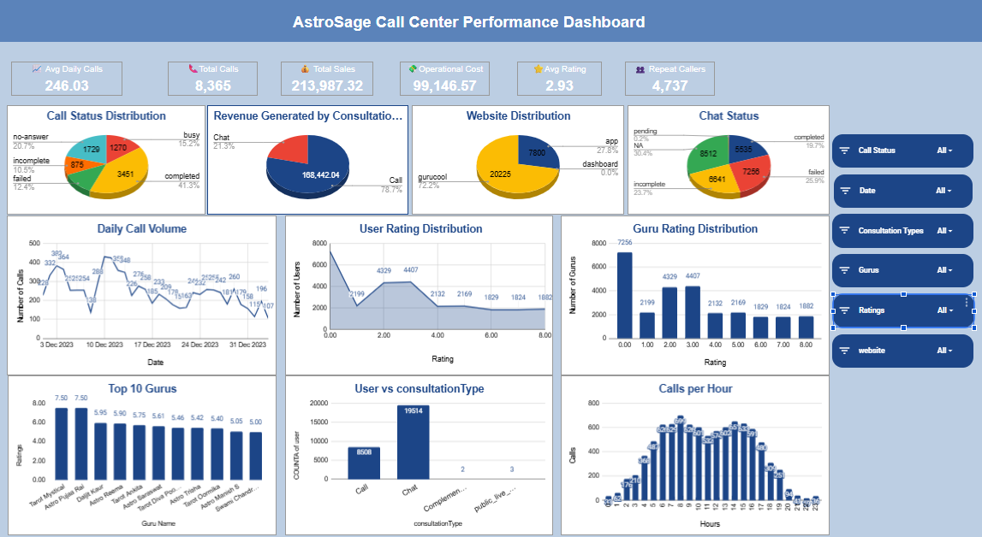

Notes:
1.7.2013
18
‹#›

Slide 18




Key Strategic Recommendations
To enhance operational efficiency, elevate customer satisfaction, and drive overall business growth, we recommend focusing on these strategic areas:
Staffing Optimization
Customer Satisfaction
Implement dynamic workforce management to balance guru workloads and ensure optimal coverage during peak demand periods (6 AM - 4 PM) through real-time scheduling and forecasting.
Prioritize investigation of low-rated interactions and deploy targeted training. Use real-time feedback and sentiment analytics to continuously monitor and improve service quality.
Technology Investment
Performance Management
Leverage AI chatbots for initial customer triage and FAQs, integrate CRM for personalized service, and utilize speech analytics for quality assurance and training needs identification.
Regularly monitor guru-level metrics, establish recognition programs, and provide performance incentives to motivate consultants and reduce gaps across the team.
Notes:
1.7.2013
19
‹#›

Slide 19
Dashboard Capabilities
Real-time KPI monitoring for operational performance tracking
Multi-dimensional drill-down analysis across time periods, consultants, and channels
Customer satisfaction trend monitoring and analysis
Revenue performance tracking by consultation type
Workforce performance evaluation and benchmarking
Interactive filtering for dynamic data exploration
Comprehensive reporting for strategic decision-making
Notes:
1.7.2013
20
‹#›

Slide 20
Key Insights
Total Calls: 28,027 interactions across all consultation categories demonstrate significant operational volume
Revenue Performance: Total sales of ₹214,065.90 with operational costs of ₹99,146.57 indicate healthy profit margins
Customer Satisfaction: Average rating of 2.93 suggests room for service quality improvements and training opportunities
Peak Hours: Daily call volume shows concentration during business hours (6 AM - 4 PM), requiring strategic staffing allocation
Consultation Mix: Revenue distribution across call and chat channels shows balanced channel utilization
Repeat Business: 4,737 repeat callers indicate customer retention and loyalty
Performance Variation: Guru rating distribution shows performance gaps requiring targeted coaching and support
Notes:
1.7.2013
21
‹#›

Slide 21


Conclusion
01
02
03
Comprehensive Business Analysis Completed
Peak-Hour Demand Patterns Identified
Customer Satisfaction Improvement Opportunities Identifiedfaction Opportunities Found
Peak-hour analysis identified 6 AM to 4 PM as the highest demand period, with hourly interactions reaching a maximum of 699, supporting better workforce planning and resource allocation.
Analyzed 28,027 customer interactions across operational, financial, customer satisfaction, and workforce performance dimensions to identify business improvement opportunities.
The overall customer rating of 2.93 highlights opportunities to improve service quality through targeted training, operational improvements, and customer experience initiatives.
04
05
Revenue & Cost Analysis
Strategic Recommendations Delivered
Total sales reached ₹214,065.90, while operational costs were ₹99,146.57, providing valuable insights for strategic investment and profitability analysis across consultation services.
Recommendations include workforce optimization, customer satisfaction monitoring, dashboard-driven KPI tracking, peak-hour staffing strategies, and technology investments to support sustainable business growth.
Transforming Customer Insights into Strategic Business Decisions
Thank You
Notes:
1.7.2013
22
‹#›

