Slide 1

PRIYADARSHINI COLLEGE OF ENGINEERING
Department Of Artificial Intelligence And Data Science
SENTIMENT ANALYSIS
Guided by :
DR. G. M Asutkar sir
Prof. Kaveri Deosarkar
Group members:
101. Anagha Borkar 102. Anjali Chaudhari 103. Bhumika Bagade 104. Divya Ikhar 105. Ekta Chopde

Slide 2
Sentiment Analysis:
Sentiment analysis, also known as opinion mining, is a computational technique used to determine the emotional tone behind a piece of text. It involves analyzing the sentiment expressed in a given text, such as positive, negative, or neutral feelings.

Slide 3
Use:
Customer Feedback Analysis
Social Media Monitoring
Product Development
Healthcare
Market Research

Slide 4
About the dataset:
Name: Covid19 vaccination tweets
Platform: Jupyter Notebook
Source: Kaggle.com
Size: 10k+ rows
16 columns

Slide 5
Polarity:
Polarity is one of the key aspects analyzed in sentiment analysis algorithms to determine the overall sentiment expressed in a piece of text. By assessing polarity, sentiment analysis algorithms can categorize text into positive, negative, or neutral sentiment categories, providing valuable insights into the emotional tone of the text.
Formula: Polarity = (Sum of positive word scores) - (Sum of negative word scores)

Slide 6
Polarity refers to the direction or orientation of a sentiment expressed in a piece of text. In sentiment analysis, polarity typically represents whether the sentiment conveyed in the text is positive, negative, or neutral.
Positive Polarity: Indicates a favorable sentiment expressed in the text, such as happiness, satisfaction, approval, or excitement.
Negative Polarity: Indicates an unfavorable sentiment expressed in the text, such as anger, disappointment, frustration, or dissatisfaction.
Neutral Polarity: Indicates a lack of strong sentiment in the text or a sentiment that is neither positive nor negative. Text with neutral polarity often includes factual information or statements without emotional connotations.

Slide 7
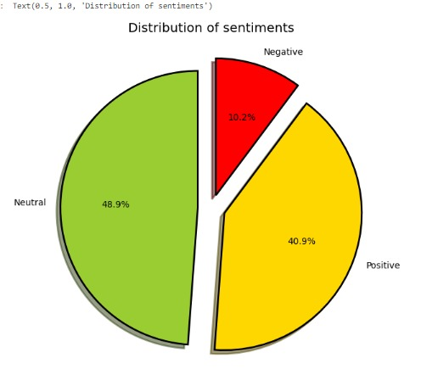
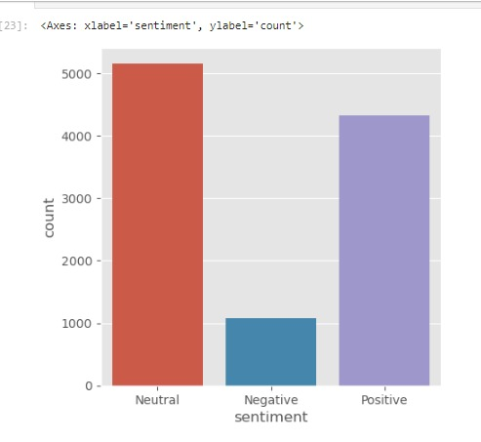
These plots show the ratio of neutral, negative and positive tweets.

Slide 8
Accuracy:
Our model correctly predicted the sentiment of 84% of the text samples in the evaluation dataset.
Prediction: The sentiment analysis model predicts the sentiment (positive, negative, or neutral) for each text sample in the evaluation dataset.

Slide 9
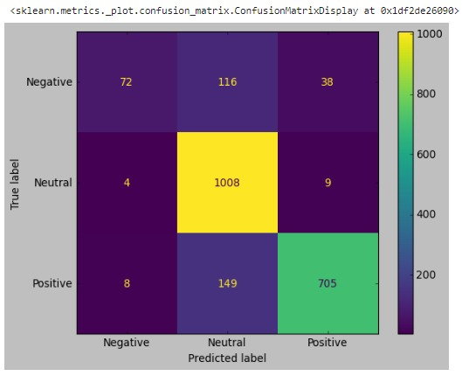
Confusion Matrix:
A confusion matrix is a table that is used to evaluate the performance of a sentiment analysis model. It allows for a more detailed analysis of the model's predictions by breaking down the predictions into different categories based on the actual and predicted classes.

Slide 10
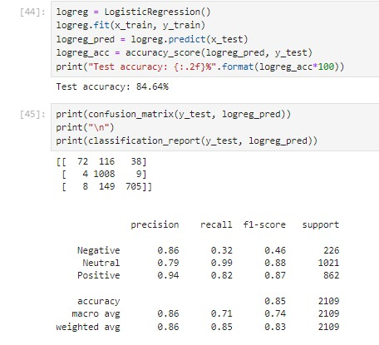

Slide 11
Outcomes:
Overall, drawing conclusions from a sentiment analysis model involves a comprehensive evaluation of its performance, relevance to the intended application, and potential for improvement.

Slide 12
Research papers:
PAPER DETAILS | AUTHORS | DATE PUBLISHED | WEBSITES
Sentiment Analysis of text using machine learning models | Ancy Grana | May 2022 | lrjmets.com
Sentiment Analysis using machine learning | Anjali Gupta | Sept 2021 | jetir.com
Using machine learning sentiment analysis to evaluate learning impact | Sean Humpherys | Feb 2022 | iscap.org
Sentiment analysis : Machine learning approach | Dipak Kawde | July 2019 | ijet

Slide 13
ThankYou

