Slide 1

Red Black Tree
Dr. Anant Ram
Associate Professor
Dept. of CEA, GLA University, Mathura

Slide 2
Red Black Tree

Slide 3
Red Black Tree
A red-black tree is a binary search tree with one extra bit of storage per node: its color, which can be either RED or BLACK.
By constraining the way nodes can be colored on any path from the root to a leaf, red-black trees ensure that no such path is more than twice as long as any other, so that the tree is approximately balanced.
Each node of the tree now contains the fields color, key, left, right, and p.
If a child or the parent of a node does not exist, the corresponding pointer field of the node contains the value NIL.

Slide 4
Properties of Red Black Tree
A binary search tree is a red-black tree if it satisfies the following red-black properties:
Every node is either red or black.
2. Every leaf (NIL) is black.
3. If a node is red, then both its children are black.
4. Every simple path from a node to a descendant leaf contains the same number of black nodes.

Slide 5
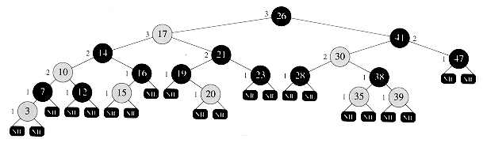
Red Black Tree

Slide 6
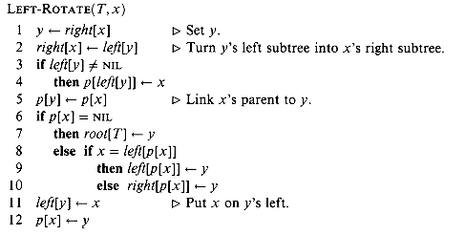

Rotation

Slide 7
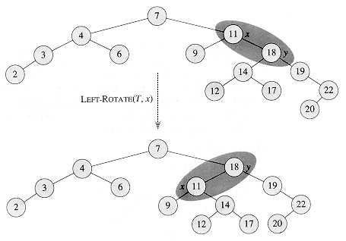

Slide 8
Red Black Insertion
Tree Insert (T, x)
temp = root[T]
y = NULL
while temp != NULL
y = temp
if key[x] < key[temp]
temp = left[temp]
else temp = right[temp]
parent[x] = y
if y==NULL
Root[T] = x
else if key[x] < key[y]
left[ y] = x
else right[y] = x

Slide 10
Red Black Tree

Slide 11
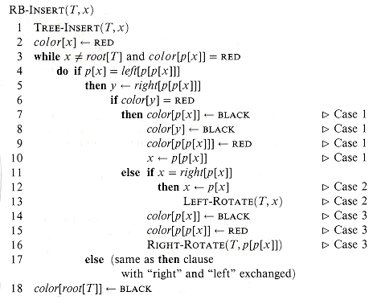
Red Black Insertion

Slide 12
RB Tree Deletion
TREE-DELETE(T, z)
if left[z] = =NIL or right[z] = = NIL
then y = z
else y =TREE-SUCCESSOR(z)
if left[y] != NIL
then x = left[y]
else x = right[y]
if x != NIL
then p[x] = p[y]
if p[y] = =NIL
then root[T] = x
else if y = left[p[y]]
then left[p[y]]=x
else right[p[y]] = x
if y != z
then key[z] = key[y]
if color[y] = BLACK
then RB-DELETE-FIXUP (T,x)
. return y

Slide 13
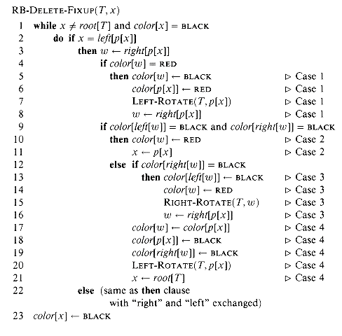
Red Black Deletion

Slide 14
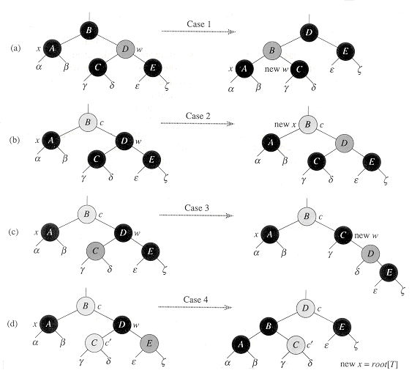
Red Black Deletion

Slide 16
Red Black Tree

Slide 17
Red Black Tree
A red-black tree with n internal nodes has height at most 21g(n + 1).
Proof: We first show that the subtree rooted at any node x contains at least 2^{bh(x)} -1 internal nodes.
If the height of x is 0, then x must be a leaf (NIL), and the subtree rooted at x indeed contains at least 2^{bh(x)}-1 = 2⁰ - 1 = 0 internal nodes.
Consider a node x that has positive height and is an internal node with two children. Each child has a black-height of either bh(x) or bh(x) - 1, depending on whether its color is red or black, respectively.

Slide 18
Red Black Tree
The inductive hypothesis to conclude that each child has at least 2^{bh(x) -1} -1 internal nodes. Thus, the subtree rooted at x contains at least (2^{bh(x)-1} -1) + (2^{bh(x)-1} -1) + 1 = 2^{bh(x)}- 1 internal nodes, which proves the claim.
n >=2^{h/2} - 1.
lg (n + 1) >= h/2
h<= 21g (n + 1)

