Slide 1

B Tree
Dr. Anant Ram
Associate Professor
Dept. of CEA, GLA University, Mathura

Slide 2
B Tree

Slide 3
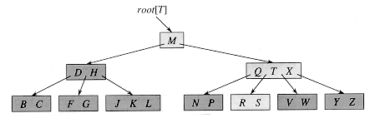
B Tree
B-trees are balanced search trees designed to work well on magnetic disks or other direct-access secondary storage devices.

Slide 4
Properties of B Tree
A B-tree T is a rooted tree (with root root[T]) having the following properties.
1. Every node x has the following fields:
a. n[x], the number of keys currently stored in node x,
b. the n[x] keys themselves, stored in nondecreasing order: key₁[x]<= key₂[x]<= ……….<= key_{n}[x]
c. leaf [x], a boolean value that is TRUE if x is a leaf and FALSE if x is an internal node.
2. If x is an internal node, it also contains n[x] + 1 pointers c₁ [x], c₂[x], . . . , c_{n}[x]+1[x] to its children. Leaf nodes have no children, so their c_{i} fields are undefined.
3. The keys key_{i}[x] separate the ranges of keys stored in each subtree: if k_{i} is any key stored in the subtree with root c_{i}[x], then
k₁ <=key₁[x]<= k₂ <=key₂[x]<= --------<= key_{n[x]}[x] <=k_{n}[x]+1 .

Slide 5
Properties of B Tree
4. Every leaf has the same depth, which is the tree's height h.
5. There are lower and upper bounds on the number of keys a node can contain. These bounds can be expressed in terms of a fixed integer t >= 2 called the minimum degree of the B-tree:
a. Every node other than the root must have at least t - 1 keys. Every internal node other than the root thus has at least t children. If the tree is nonempty, the root must have at least one key.
b. Every node can contain at most 2t - 1 keys. Therefore, an internal node can have at most 2t children. We say that a node is full if it contains exactly 2t - 1 keys.
.

Slide 6
B Tree

Slide 7
B Tree

Slide 8
B Tree Search
B-TREE-SEARCH(x, k)
1 i = 1
2 while i <=n[x] and k< key_{i}[x]
3 do i= i + 1
4 if i<= n[x] and k = key_{i}[x]
5 then return (x, i)
6 if leaf [x]
7 then return NIL
8 else DISK-READ(c_{i}[x])
9 return B-TREE-SEARCH(c_{i}[x], k)

Slide 9
Creating an empty B-tree
B-TREE-CREATE(T)
1 x = ALLOCATE-NODE()
2 leaf[x] = TRUE
3 n[x] = 0
4 DISK-WRITE(x)
5 root[T] = x

Slide 10
Splitting a node in a B-tree
B-TREE-SPLIT-CHILD(x,i,y)
1 z = ALLOCATE-NODE()
2 leaf[z] = leaf[y]
3 n[z] = t - 1
4 for j = 1 to t - 1
5 do key_{j}[z] = key_{j+t}[y]
6 if not leaf [y]
7 then for j = 1 to t
8 do c_{j}[z] = c_{j+t}[y]
9 n[y] = t - 1
10 for j = n[x] + 1 downto i + 1
11 do c_{j+1}[x] = c_{j}[x]

Slide 11
Splitting a node in a B-tree
12 c_{i+1}[x] = z
13 for j = n[x] downto i
14 do key_{j+1}[x] = key_{j}[x]
15 key_{i}[x] = key_{t}[y]
16 n[x] = n[x] + 1
17 DISK-WRITE(y)
18 DISK-WRITE(z)
19 DISK-WRITE(x)

Slide 12
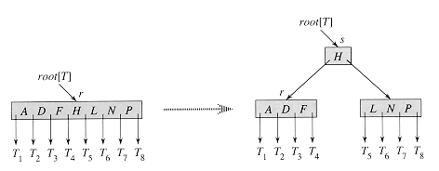
Inserting a key into a B-tree
B-TREE-INSERT(T,k)
1 r = root[T]
2 if n[r] = 2t - 1
3 then s = ALLOCATE-NODE()
4 root[T] = s
5 leaf[s] = FALSE
6 n[s] = 0
7 c₁[s] = r
8 B-TREE-SPLIT-CHILD(s,1,r)
9 B-TREE-INSERT-NONFULL(s,k)
10 else B-TREE-INSERT-NONFULL(r,k)

Slide 13
Inserting a key into a B-tree
B-TREE-INSERT-NONFULL(x,k)
1 i = n[x]
2 if leaf[x]
3 then while i =1 and k < key_{i}[x]
4 do key_{i+1} [x] = key_{i}[x]
5 i = i - 1
6 key_{i+1}[x] = k
7 n[x] = n[x] + 1
8 DISK-WRITE(x)
9 else while i >= 1 and k < key_{i}[x]
10 do i = i - 1
11 i = i + 1
12 DISK-READ(c_{i}[x])
13 if n[c_{i}[x]] = 2t - 1
14 then B-TREE-SPLIT-CHILD(x,i,c_{i}[x])
15 if k > key_{i}[x]
16 then i = i + 1
17 B-TREE-INSERT-NONFULL(c_{i}[x],k)

Slide 14
Deleting a key from a B-tree
If the key k is in node x and x is a leaf, delete the key k from x.
2. If the key k is in node x and x is an internal node, do the following.
If the child y that precedes k in node x has at least t keys, then find the predecessor k' of k in the subtree rooted at y. Recursively delete k', and replace k by k' in x. (Finding k' and deleting it can be performed in a single downward pass.)
b. Symmetrically, if the child z that follows k in node x has at least t keys, then find the successor k' of k in the subtree rooted at z. Recursively delete k', and replace k by k' in x. (Finding k' and deleting it can be performed in a single downward pass.)
c. Otherwise, if both y and z have only t- 1 keys, merge k and all of z into y, so that x loses both k and the pointer to z, and y now contains 2t - 1 keys. Then, free z and recursively delete k from y.

Slide 15
Deleting a key from a B-tree
3. If the key k is not present in internal node x, determine the root c_{i}[x] of the appropriate sub tree that must contain k, if k is in the tree at all. If c_{i}[x] has only t - 1 keys, execute step 3a or 3b as necessary to guarantee that we descend to a node containing at least t keys. Then, finish by recursing on the appropriate child of x.
If c_{i}[x] has only t - 1 keys but has a sibling with t keys, give c_{i}[x] an extra key by moving a key from x down into c_{i}[x], moving a key from c_{i}[x]'s immediate left or right sibling up into x, and moving the appropriate child from the sibling into c_{i}[x].
If c_{i}[x] and all of c_{i}[x]'s siblings have t - 1 keys, merge c_{i} with one sibling, which involves moving a key from x down into the new merged node to become the median key for that node.

Slide 16
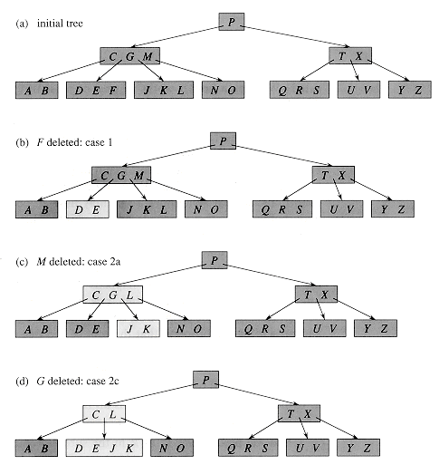
B Tree

Slide 17

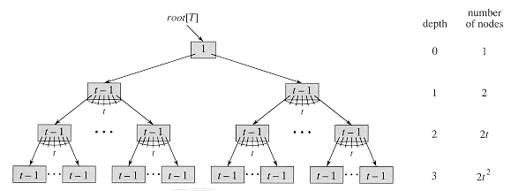
B Tree
If n 1, then for any n-key B-tree T of height h and minimum degree t 2,

Slide 18
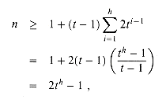
B-tree
Proof If a B-tree has height h, the number of its nodes is minimized when the root contains one key and all other nodes contain t - 1 keys. In this case, there are 2 nodes at depth 1, 2t nodes at depth 2, 2t² nodes at depth 3, and so on, until at depth h there are 2t^{h-}1 nodes.

Slide 19
B Tree

