Slide 1

Graph
Dr. Anant Ram
Associate Professor
Dept. of CEA, GLA University, Mathura

Slide 2
Graph
G = (V, E): is a collection of edges and vertices.
Types of Graph
Null Graph: A null graph is a graph in which there are no edges between its vertices. A null graph is also called empty graph.
Trivial Graph: A trivial graph is the graph which has only one vertex.
Simple Graph: A simple graph is the undirected graph with no parallel edges and no loops.
Undirected Graph: An undirected graph is a graph whose edges are not directed.
Directed Graph: A directed graph is a graph in which the edges are directed by arrows.
Weighted Graph: A weighted graph is a graph whose edges have been labeled with some weights or numbers.

Slide 3
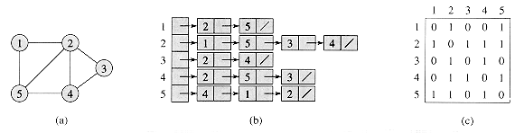
Representations of graphs
Adjacency-list representation
Adjacency-matrix representation: For the adjacency-matrix representation of a graph G = (V, E), we assume that the vertices are numbered 1, 2, . . . , |V| in some arbitrary manner. The adjacency-matrix representation of a graph G then consists of a |V|× |V| matrix A = (a_{ij}) such that

Slide 4
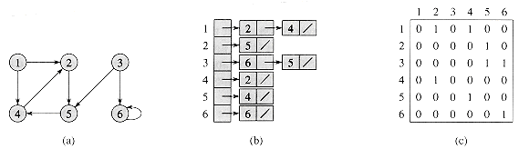
Representations of graphs
Adjacency-list representation
Adjacency-matrix representation

Slide 5
Breadth-first search
BFS(G,s)
1 for each vertex u ∈ V[G] - {s}
2 do color[u] = WHITE
3 d[u] =∞
4 π [u] = NIL
5 color[s] = GRAY
6 d[s] = 0
7 π [s] = NIL
8 Q ={s}
9 while Q != Φ
10 do u = head[Q]
11 for each v ∈ Adj[u]
12 do if color[v] = = WHITE
13 then color[v] = GRAY
14 d[v] = d[u] + 1
15 π [v] = u
16 ENQUEUE(Q,v)
17 DEQUEUE(Q)
18 color[u] = BLACK

Slide 6
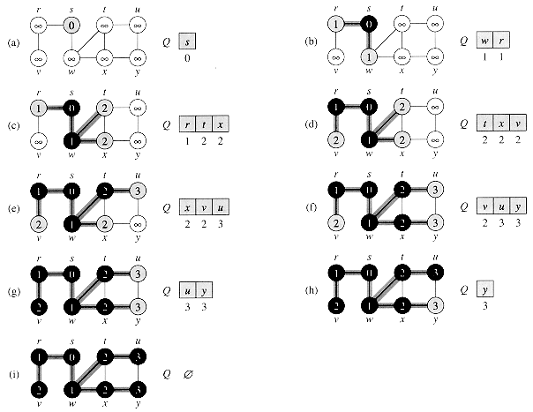
Breadth-first search

Slide 7
Depth-first search
DFS(G)
1 for each vertex u∈ V[G]
2 do color[u] = WHITE
3 π[u]= NIL
4 time= 0
5 for each vertex u ∈V[G]
6 do if color[u] = WHITE
7 then DFS-VISIT(u)

Slide 8
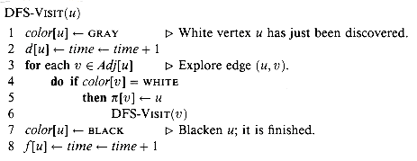
Depth-first search

Slide 9
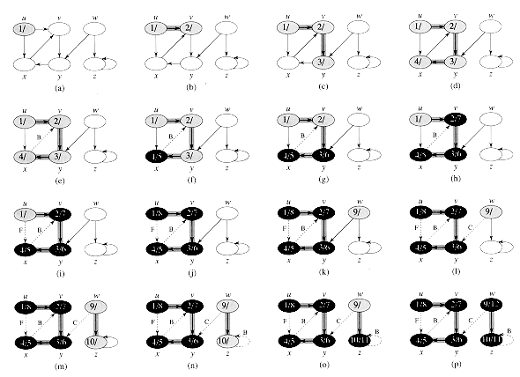
Depth-first search

