Slide 1

SINGLE-SOURCE SHORTEST PATHS
Dr. Anant Ram
Associate Professor
Dept. of CEA, GLA University, Mathura

Slide 2
Shortest Path
single-source shortest-paths problem: given a graph G = (V, E), we want to find a shortest path from a given source vertex s∈ V to every vertex v ∈ V. Many other problems can be solved by the algorithm for the single-source problem, including the following variants.
Single-destination shortest-paths problem: Find a shortest path to a given destination vertex t from every vertex v. By reversing the direction of each edge in the graph, we can reduce this problem to a single-source problem.
Single-pair shortest-path problem: Find a shortest path from u to v for given vertices u and v. If we solve the single-source problem with source vertex u, we solve this problem also. Moreover, no algorithms for this problem are known that run asymptotically faster than the best single-source algorithms in the worst case.
All-pairs shortest-paths problem: Find a shortest path from u to v for every pair of vertices u and v. This problem can be solved by running a single-source algorithm once from each vertex.

Slide 3
Relaxation
Relaxation. For each vertex v ∈V, we maintain an attribute d[v], which is an upper bound on the weight of a shortest path from source s to v. We call d[v] a shortest-path estimate. We initialize the shortest-path estimates and predecessors by the following procedure.
INITIALIZE-SINGLE-SOURCE(G,s)
1 for each vertex v ∈ V[G]
2 do d[v]=∞
3 π[v] =NIL
d[s]= 0
RELAX(u, v, w)
1 if d[v] > d[u] + w(u,v)
2 then d[v]= d[u] + w(u,v)
3 π[v]= u

Slide 4
Dijkstra's algorithm
DIJKSTRA(G,w,s)
INITIALIZE-SINGLE-SOURCE (G,s)
S=Φ
Q= V[G]
while Q!= Φ
do u= EXTRACT-MIN(Q)
S = S ∪ {u}
for each vertex v∈ Adj[u]
do RELAX (u,v,w)

Slide 5
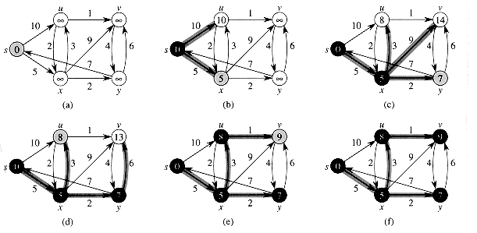

Slide 6
Bellman-Ford algorithm
BELLMAN-FORD(G, w, s)
INITIALIZE-SINGLE-SOURCE(G, s)
for i =1 to |V[G]| - 1
do for each edge (u, v) ∈ E[G]
do RELAX(u, v, w)
for each edge (u, v) ∈ E[G]
do if d[v] > d[u] + w(u, v)
then return FALSE
return TRUE

Slide 7
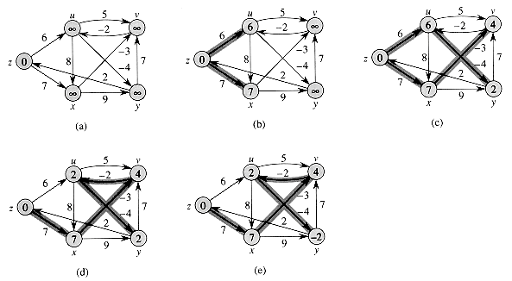
(u, v) (u, x) (u, y) (v, u) (x, v) (x, y) (y, v) (y, z)
(z, u) (z, x)

Slide 8
Fractional Knapsack Problem
Let there are n number of objects and each object is having a weight and contribution to profit. The knapsack of capacity M is given. The objective is to fill the knapsack in such a way that profit shall be maximum. We allow a fraction of item to be added to the knapsack.

Slide 9
AlgorithmFKNAPSACK (p, w, x, n, M)
Arrange the items in decreasing order of profit/weight ratio.
for (i = 1; i<= n; i ++)
x[i] = 0
cu = M
for (i =1; i<= n ; i ++)
{
if(w[i] >cu )
break;
else{
x[i] = 1 ;
cu = cu – w[i] ;
}
if( i<= n){
x[i] = cu/w[i] ;
Return x;
}

Slide 10
For example
Given n = 3, (p1, p2, p3) = {25, 24, 15}
( w1, w2, w3) = {18, 15, 10} M = 20
Sol: p₁/w₁ = 25/18 = 1.39
p₂/w₂ = 24/15 = 1.6
p₃/w₃ = 15/10 = 1.5
Optimal solution: x₁ = 0, x₂ = 1, x₃ = 1/2
total profit = 24 + 7.5 = 31.5

Slide 11
Activity Selection Problem
Algorithm ACTIVITY SELECTION (S, f)
{
n = LENGTH (S)
Arrange all the activity in increasing order of their finish time
A = {a₁}
i = 1
for (j = 2 ; j< = n ; j++)
{
if (s_{j} ≥ f_{i}) {
A = A∪ {a_{m}}
i = j
}

Slide 12
si 1 3 0 5 3 5 6 8 8 2 12
fi 4 5 6 7 8 9 10 11 72 13 14
si 1 3 0 5 3 5 6 8 2 12 8
fi 4 5 6 7 8 9 10 11 13 14 72

Slide 13
Job sequencing with deadlines
Problem: n jobs, S={1, 2, …, n}, each job i has a deadline d_{i} ≥ 0 and a profit p_{i} ≥ 0. We need one unit of time to process each job and we can do at most one job each time. We can earn the profit p_{i} if job i is completed by its deadline.
i | 1 | 2 | 3 | 4 | 5
p_{i} | 20 | 15 | 10 | 5 | 1
d_{i} | 2 | 2 | 1 | 3 | 3

Slide 14
Algorithm:
Step 1: Sort p_{i} into decreasing order. After sorting p₁ ≥ p₂ ≥ p₃ ≥ … ≥ p_{n}.
Step 2: Add the next job i to the solution set if i can be completed by its deadline. Assign i to time slot [r-1, r], where r is the largest integer such that 1 ≤ r ≤ d_{i} and [r-1, r] is free.
Step 3: Stop if all jobs are examined. Otherwise, go to step 2.
Time complexity: O(n²)

Slide 15
i | p_{i} | d_{i}
1 | 20 | 2 | assign to [1, 2]
2 | 15 | 2 | assign to [0, 1]
3 | 10 | 1 | reject
4 | 5 | 3 | assign to [2, 3]
5 | 1 | 3 | reject

