Slide 1

Asymptotic Notations
Presented by:-
Dr. Anant Ram
Associate Professor

Slide 2
Asymptotic Notations
Asymptotic notations are used to represent the complexities of algorithms for asymptotic analysis.
These notations are mathematical tools to represent the complexities. There are three notations that are commonly used.
Big ‘Oh’ Notation (O)
Omega Notation (Ω)
Theta Notation (Θ)

Slide 3
Asymptotic Notations

Slide 4
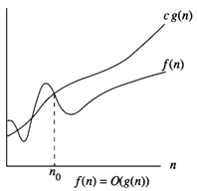
Asymptotic Notations
Big ‘Oh’ Notation (O)
O(g(n)) = { f(n) : there exist positive constants c and n₀ such that 0 ≤ f(n) ≤ cg(n) for all n ≥ n₀ }

Slide 5
Example
f(n) = 3n + 2
General form is f(n) ≤ cg(n)
When n ≥ 2, 3n + 2 ≤ 3n + n = 4n
Hence f(n) = O(n), here c = 4 and n₀ = 2

Slide 6
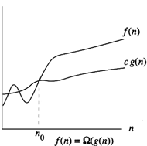
Contd…
Omega Notation (Ω)
Ω (g(n)) = { f(n) : there exist positive constants c and n₀ such that 0 ≤ cg(n) ≤ f(n) for all n ≥ n₀ }

Slide 7
Example
f(n) = 3n + 2
3n < 3n + 2 for all n.
Hence f(n) = Ω(n) here c = 3 and n₀ = 1

Slide 8
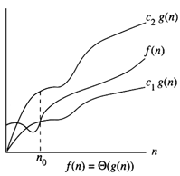
Contd..
Theta Notation (Θ)
Θ(g(n)) = {f(n) : there exist positive constants c₁,c₂ and n₀ such that c₁g(n) ≤f(n) ≤c₂g(n) for all n ≥ n₀ }

Slide 9
Example
f(n) = 3n + 2
C₁n≤ f(n) ≤ C₂n
3n ≤ 3n + 2 ≤ 4n for n ≥ 2
f(n) = Θ(n) for C₁ = 3, C₂ =4 and n ≥ 2.

Slide 10
Contd..
Little ‘Oh’ Notation (o)
o(g(n)) = { f(n) : for any positive constants c > 0, there exists n₀>0, such that 0 ≤ f(n) < cg(n) for all n ≥ n₀ }
Example: f(n) = 3n + 2
f(n) = o(n²)
Little Omega (ω)
ω(g(n)) = { f(n) : for any positive constants c>0 and n₀>0 such that 0 ≤ cg(n) < f(n) for all n ≥ n₀ }
Example: f(n) = 3n² + 2
f(n) = ω(n)

Slide 12
Mathematical Analysis
Big ‘Oh’ Notation (O)
Lim (n ∞) f(n)/g(n)= C where 0 ≤ C < ∞
Little ‘Oh’ Notation (o)
Lim (n ∞) f(n)/g(n)= C where C=0
Omega Notation (Ω)
Lim (n ∞) f(n)/g(n)= C where 0 < C ≤ ∞
Little Omega (ω)
Lim (n ∞) f(n)/g(n)= C where C = ∞
Theta Notation (Θ)
Lim (n ∞) f(n)/g(n)= C where 0 < C < ∞

