Slide 1

Dynamic Programming
Dr. Anant Ram
Associate Professor
Dept. of CEA, GLA University, Mathura

Slide 2
Knapsack 0-1 Algorithm
for j = 0 to M {
V[0,j] = 0
}
for i = 1 to n {
V[i,0] = 0
}
for i = 1 to n {
for j = 1 to M {
if j < w_{i}
V[i, j] = V[i-1,j]
else
V[i, j] = Max(V[i-1,j], V[i-1,j-w_{i}]+P_{i} )
}
}

Slide 3
M=10 | P | W
1 | 20 | 2
2 | 15 | 5
3 | 30 | 3
4 | 105 | 7
5 | 120 | 10
If j < w_{i}
V[i, j] = V[i-1,j]
else
V[i, j] = Max(V[i-1,j], V[i-1,j-w_{i}]+P_{i}
 | 0 | 1 | 2 | 3 | 4 | 5 | 6 | 7 | 8 | 9 | 10
0 | 0 | 0 | 0 | 0 | 0 | 0 | 0 | 0 | 0 | 0 | 0
1 | 0 | 0 | 20 | 20 | 20 | 20 | 20 | 20 | 20 | 20 | 20
2 | 0 | 0 | 20 | 20 | 20 | 20 | 20 | 35 | 35 | 35 | 35
3 | 0 | 0 | 20 | 30 | 30 | 50 | 50 | 50 | 50 | 50 | 65
4 | 0 | 0 | 20 | 30 | 30 | 50 | 50 | 105 | 105 | 125 | 135
5 | 0 | 0 | 20 | 30 | 30 | 50 | 50 | 105 | 105 | 125 | 135

Slide 4
If V[i, j]= V[i-1, j-w_{i}] + P_{i}

Slide 5
ALL-PAIRS SHORTEST PATHS
Finding shortest paths between all pairs of vertices in weighted graph.
Negative-weight edges are allowed, but we assume for the time being that the input graph contains no negative-weight cycles.
For developing a dynamic-programming algorithm.
1.Characterize the structure of an optimal solution.
2. Recursively define the value of an optimal solution.
3.Compute the value of an optimal solution in a bottom-up fashion.

Slide 6
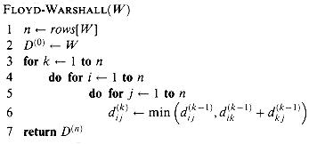

Slide 7
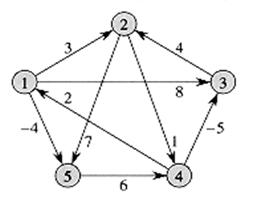
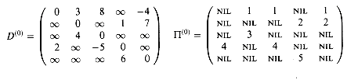
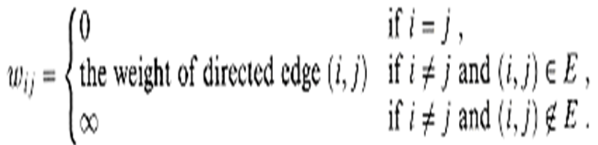

Slide 8
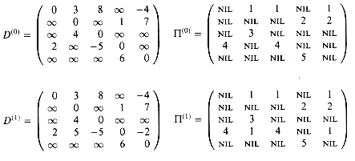

Slide 9
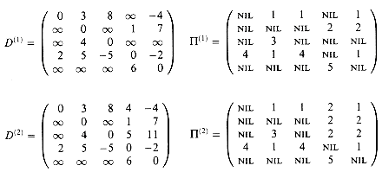

Slide 10
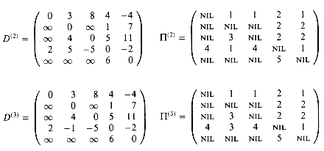

Slide 11
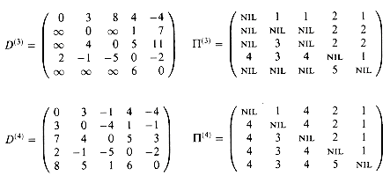

Slide 12
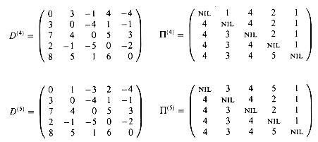

Slide 13
The resource allocation problem
m resources, n projects
profit p(i, j) : j resources are allocated to project i.
maximize the total profit.

Slide 14
Optimization function
Let x₁,x₂,x₃ and x₄ be the number of resources allocated to the project 1, 2, 3 and 4.
f₁(x₁), f₂(x₂), f₃(x₃) and f₄(x₄) are the resource allocation respective profit.
Maximized Z= f₁(x₁)+f₂(x₂)+f₃(x₃)+f₄(x₄)
subject to x₁+x₂+x₃+x₄ <=3

Slide 15
Project/Resources | 0 | 1 | 2 | 3
0 | 0 | 0 | 0 | 0
1 | 0 | 2 | 8 | 9
2 | 0 | 5 | 6 | 7
3 | 0 | 4 | 4 | 4
4 | 0 | 2 | 4 | 5

Slide 16
Project/Resources f₁(x₁) |  | 0 | 1 | 2 | 3
 |  | 0 | 2 | 8 | 9
 | f₂(x₂) | f₁(x₁) + f₂(x₂)
0 | 0 | 0 | 2 | 8 | 9
1 | 5 | 5 | 7 | 13
2 | 6 | 6 | 8
3 | 7 | 7
Project/Resources f₁(x₁)+f₂(x₂) |  | 0 | 1 | 2 | 3
 |  | 0(0+0) | 5(0+1) | 8(2+0) | 13(2+1)
 | f₃(x₃) | f₁(x₁) + f₂(x₂) +f₃(x₃)
0 | 0 | 0 | 5 | 8 | 13
1 | 4 | 4 | 9 | 12
2 | 4 | 4 | 9
3 | 4 | 4

Slide 17
Project/Resources f₁(x₁)+f₂(x₂)+f₃(x₃) |  | 0 | 1 | 2 | 3
 |  | 0(0+0+0) | 5(0+1+0) | 9(0+1+1) | 13(2+1 +0)
 | f₄(x₄) | f₁(x₁) + f₂(x₂) +f₃(x₃)+ f₄(x₄)
0 | 0 | 0 | 5 | 9 | 13
1 | 2 | 2 | 7 | 11
2 | 4 | 4 | 9
3 | 5 | 5
Project/Resources f₁(x₁)+f₂(x₂)+f₃(x₃) +f₄(x₄) | 0 | 1 | 2 | 3
 | 0(0+0+0+0) | 5(0+1+0+0) | 9(0+1+1+0) | 13(2+1 +0+0)

Slide 18
The multistage graph solution
The resource allocation problem can be described as a multistage graph.
(i, j) : i resources allocated to projects 1, 2, …, j
e.g. node H=(3, 2) : 3 resources allocated to projects 1, 2.

Slide 19
Find the longest path from S to T :
(S, C, H, L, T), 8+5+0+0=13
2 resources allocated to project 1.
1 resource allocated to project 2.
0 resource allocated to projects 3, 4.

