Slide 1

Branch and Bound
Dr. Anant Ram
Associate Professor
Dept. of CEA, GLA University, Mathura

Slide 2
Branch and Bound
Branch and bound (BB) is a general search method, especially in discrete optimization.
There is a way to split the solution space (branch)
There is a way to predict a lower bound for a class of solutions. There is also a way to find a upper bound of an optimal solution. If the lower bound of a solution exceeds the upper bound, this solution cannot be optimal and thus we should terminate the branching associated with this solution.
divide it into subproblems. The algorithm is applied recursively to the subproblems. The search proceeds until all nodes have been solved or pruned.
Backtracking uses a depth-first search with pruning, the branch and bound algorithm uses a breadth-first search with pruning
Branch and bound uses a queue as an auxiliary data structure
In many types of problems, branch and bound is faster than backtracking, due to the use of a breadth-first search instead of a depth-first search
The worst case scenario is the same, as it will still visit every node in the tree

Slide 3
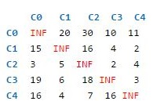
Travelling Salesman Problem
0
1
3
2
4

Slide 4
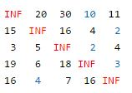
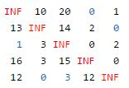
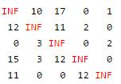

Slide 5
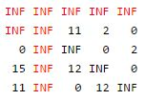
Let we Consider edge 0--1
Cost 1= Cost of node 0 + weight of edge (0—1) + Reduction Cost

Slide 6
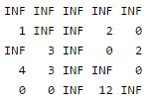
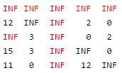
Let we Consider edge 0--2
Cost 2= Cost of node 0 + weight of edge (0—2) + Reduction Cost

Slide 7
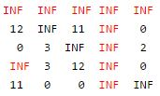
Let we Consider edge 0--3
Cost 3= Cost of node 0 + weight of edge (0—3) + Reduction Cost

Slide 8
Let we Consider edge 0--4
Cost 4= Cost of node 0 + weight of edge (0—4) + Reduction Cost

Slide 9
