Slide 1

Recurrence Relations
Presented by:-
Dr. Anant Ram
Associate Professor

Slide 2
Time Complexity Calculation
Linear Search ( Array A, Value x)
Step 1: Set i to 1 (1)
Step 2: if i > n then go to step 7 (n+1)
Step 3: if A[i] = x then go to step 6 (n)
Step 4: Set i to i + 1 (n)
Step 5: Go to Step 2 (n)
Step 6: Print Element x Found at index i and go to step 8 (1)
Step 7: Print element not found (1)
Step 8: Exit (1)
T(n)=C₁*1+C₂*(n+1)+C₃*n+C₄*n+C₅*n+C₆*1+C₇*1+C₈*1
T(n)= (C₂+C₃+C₄+C₅)*n+ (C₁+C₂+ C₆+C₇+C₈)
T(n)= an+b
T(n)= O(n)

Slide 3
Recurrence Relations
T(n)= an + b
Algorithm: Binary-Search(A[], x, l, r)
Step 1: if l = r then return l
Step 2: else m := ⌊(l + r) / 2⌋
Step3: if x==A[m] then return.
Step 4: else if x < A[m] then
return Binary-Search(A[], x, l, m)
else return Binary-Search(A[], x, m+1, r)
0 if n=1
T(n)= {
T(n/2)+1 otherwise

Slide 4
Methods for solving recurrences
Master method
Iteration method
Substitution method
Recursion tree method

Slide 5
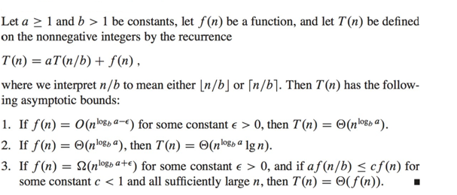
Master Method

Slide 6
Case 1
T(n)=8T(n/2) + n²
T(n)=aT(n/b) + f(n)
a=8, b=2, f(n)= n²
n^{log}_{b}ª = n^{log}₂⁸ = n^{3-ε} = f(n) where ε =1
then T(n) = θ (n^{log}_{b}ª)
T(n) = θ (n^{log}₂⁸)
T(n) = θ (n³)

Slide 7
Case 2
T(n)=4T(n/2) + n²
T(n)=aT(n/b) + f(n)
a=4, b=2, f(n)= n²
n^{log}_{b}ª = n^{log}₂⁴ = n² = f(n)
then T(n) = θ (n^{log}_{b}ª lg n)
T(n) = θ (n^{log}₂⁴ lg n)
T(n) = θ (n² lg n)

Slide 8
Case 3
T(n)=3T(n/2) + n²
T(n)=aT(n/b) + f(n)
a=3, b=2, f(n)= n²
n^{log}_{b}ª = n^{log}₂³ = n^{1.5+ε} = f(n) where ε =0.5
then T(n) = θ (f(n))
T(n) = θ (n²)

Slide 9
Extended Master Method
T(n)= aT(n/b) + θ (n^{k}log^{p}n) Here, a >= 1, b > 1, k >= 0 and p is a real number
Case-01:
If a > b^{k}, then T(n) = θ (n^{log}_{b}ª)
Case-02:
If a = b^{k} and
If p < -1, then T(n) = θ (n^{log}_{b}ª)
If p = -1, then T(n) = θ (n^{log}_{b}ª.log²n)
If p > -1, then T(n) = θ (n^{log}_{b}ª.log^{p+1}n)
Case-03:
If a < b^{k} and
If p < 0, then T(n) = O (n^{k})
If p >= 0, then T(n) = θ (n^{k}log^{p}n)

Slide 10
Case1
. T(n) = √2T(n/2) + logn
We compare the given recurrence relation with T(n) = aT(n/b) + θ (n^{k}log^{p}n).
Then, we have-
a = √2 b = 2 k = 0 p = 1
Now, a = √2 = 1.414 and b^{k} = 2⁰ = 1.
Clearly, a > b^{k}.
So, we follow case-01.
So, we have-
T(n) = θ (n^{log}_{b}ª)
T(n) = θ (n^{log}₂^{√2})
T(n) = θ (n^{1/2})
T(n) = θ (√n)

