Slide 1
Shell Sort
Presented by:-
Dr. Anant Ram
Associate Professor

Slide 2

Shell sort
Shell sort works by comparing elements that are distant rather than adjacent elements in an array or list where adjacent elements are compared.
Shell sort uses a sequence h₁, h₂, …, h_{t} called the increment sequence.
Shell sort makes multiple passes through a list and sorts a number of equally sized sets using the insertion sort.
Shell sort improves on the efficiency of insertion sort by quickly shifting values to their appropriate position.

Slide 3
Shell Sort
Shell sort( A, n)
Step1:- for (i= n/2; i >0; i= i/2)
Step2:- for(j=i; j<n; j++)
Step3:- for(k=j-i; k>=0; k=k-i)
If(A[k+i] >= A[k])
break;
else exchange( A[k], A[k+i] )
Step4:- End

Slide 4
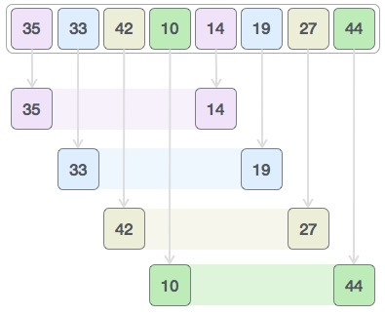


Slide 5
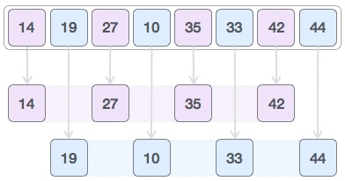


Slide 6
10 | 3 | 5 | 16 | 2 | 1 | 6 | 8
Shell sort( A, n)
Step1:- for (i= n/2; i >0; i= i/2)
Step2:- for(j=i; j<n; j++)
Step3:- for(k=j-i; k>=0; k=k-i)
If(A[k+i] >= A[k])
break;
else exchange( A[k], A[k+i] )
Step4:- End

Slide 7
2 | 1 | 5 | 8 | 10 | 3 | 6 | 16
Shell sort( A, n)
Step1:- for (i= n/2; i >0; i= i/2)
Step2:- for(j=i; j<n; j++)
Step3:- for(k=j-i; k>=0; k=k-i)
If(A[k+i] >= A[k])
break;
else exchange( A[k], A[k+i] )
Step4:- End

Slide 8
2 | 1 | 5 | 3 | 6 | 8 | 10 | 16
Shell sort( A, n)
Step1:- for (i= n/2; i >0; i= i/2)
Step2:- for(j=i; j<n; j++)
Step3:- for(k=j-i; k>=0; k=k-i)
If(A[k+i] >= A[k])
break;
else exchange( A[k], A[k+i] )
Step4:- End

Slide 9
1 | 2 | 3 | 5 | 6 | 8 | 10 | 16
Shell sort( A, n)
Step1:- for (i= n/2; i >0; i= i/2)
Step2:- for(j=i; j<n; j++)
Step3:- for(k=j-i; k>=0; k=k-i)
If(A[k+i] >= A[k])
break;
else exchange( A[k], A[k+i] )
Step4:- End

