Slide 1
Backtracking / Branch and Bound

Slide 2
Basic Idea
The exhaustive-search technique suggests generating all candidate solutions and then identifying the one (or the ones) with a desired property.
Backtracking is a more intelligent variation of this approach
Principal idea:-
construct solution’s one component at a time
If a partially constructed solution can be developed further without violating the problem’s constraints, it is done by taking the first remaining legitimate option for the next component.
If there is no legitimate option for the next component, no alternatives for any remaining component need to be considered.
In this case, the algorithm backtracks to replace the last component of the partially constructed solution with its next option.

Slide 3
Implemented by constructing a tree of choices being made, called the state-space tree
root : initial state before the search for a solution begins
nodes of the first level: choices made for the first component of a solution
And so on.
Leaves represent either non-promising dead ends or complete solutions found by the algorithm
depth-first search

Slide 4
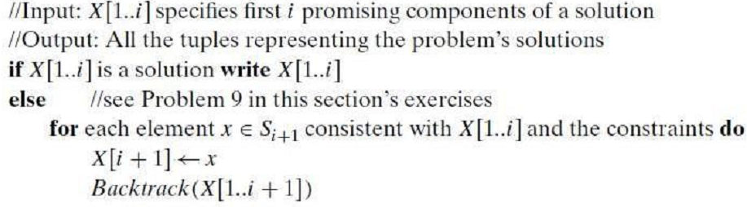
General solution: Backtracking

Slide 5
Problems ???
N-queen
Sum of subsets
Hamiltonian cycles
Graph coloring

Slide 6
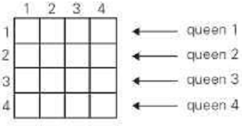
N- queen problem
Place n queens on an n × n chessboard so that no two queens attack each other
Let us consider the four-queens problem

Slide 7
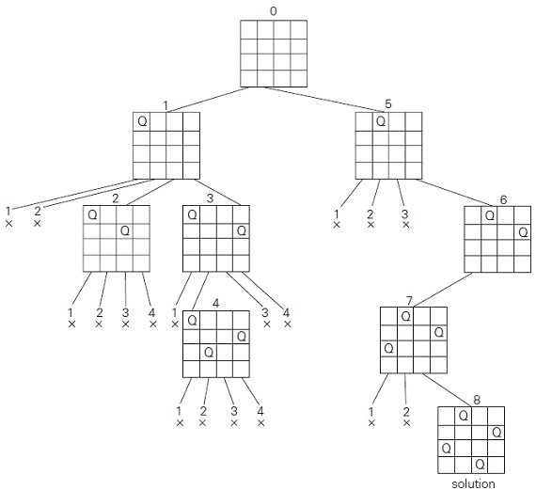
N- queen problem

Slide 8
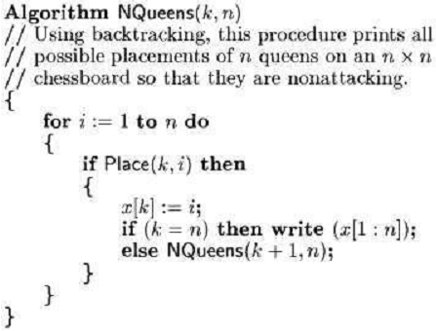
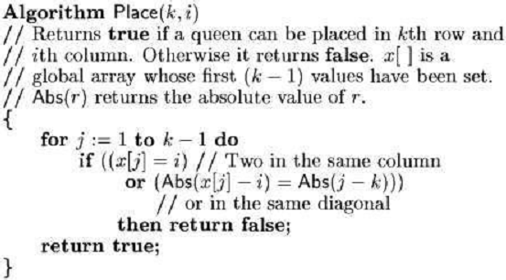
N- queen problem

Slide 9
Sum of subsets
Problem definition:
Find a subset of a given set A = {a₁, . . . , a_{n}} of n positive integers whose sum is equal to a given positive integer d.
we will assume that
a₁< a₂< . . . < a_{n}
For example,
A = {1, 2, 5, 6, 8} and d = 9,
there are two solutions: {1, 2, 6} and {1, 8}

Slide 10
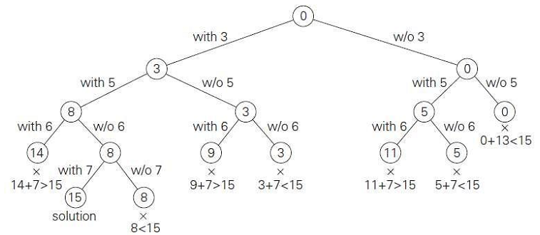
Sum of subsets

Slide 11
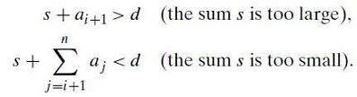
Sum of Subsets
We record the value of s, the sum of these numbers, in the node.
If s is equal to d, we have a solution to the problem.
We can either report this result and stop or,
if all the solutions need to be found, continue by backtracking to the node’s parent.
If s is not equal to d, we can terminate the node as non-promising if either of the following two inequalities holds:

Slide 12
Graph Coloring
Suppose we represent a graph by an adjacency matrix G[1…n, 1…n], where G[i,j] = 1 if (i,j) is an edge.
We want to discover whether the nodes of G can be colored in such a way that no two adjacent nodes have the same color, yet only m colors are used.
m-colorability decision problem.
The colors are represented by integers 1,2,..,m and solutions are given by the n-tuple(x1,x2,x3,…., x_{n})
The resulting state-space tree used is of n+1 levels.

Slide 13
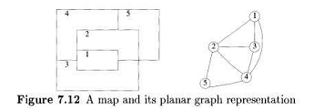
Graph Coloring
Example

Slide 14
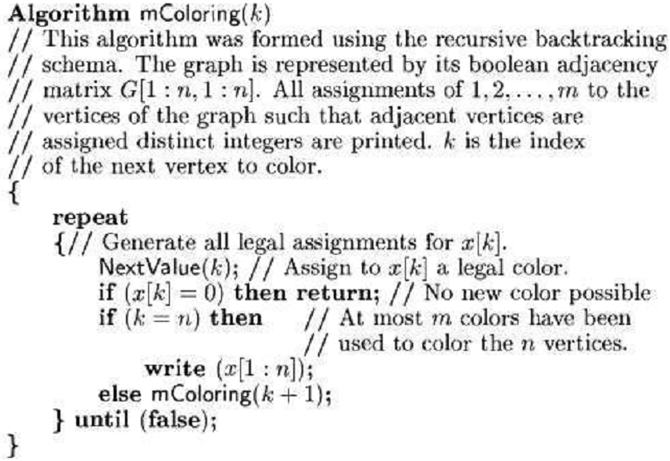
Graph Coloring

Slide 15
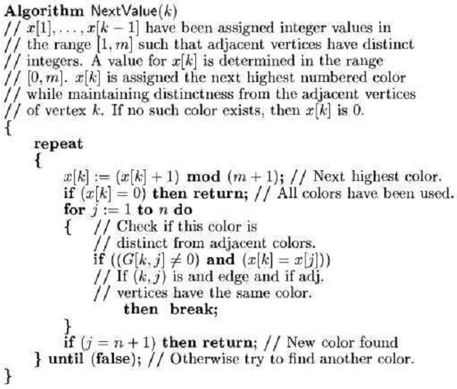
Graph Coloring

Slide 16
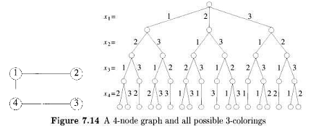

Graph Coloring

Slide 17


Hamiltonian Cycle

Slide 18


Hamiltonian Cycle

Slide 19
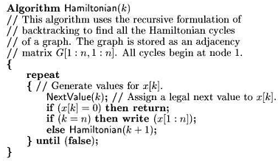
Hamiltonian Cycle

Slide 20
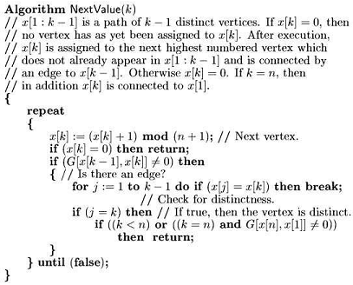
Hamiltonian Cycle

