Slide 1


dobox
This Photo by Unknown Author is licensed under CC BY-NC-ND
a website in which you can add your autobiography to others so that other will also get motivated from you).
LETS SHARE YOUR LIFE STRUGGLE WITH OTHERS
AND MAKE THEM MOTIVATED.
Live link:
https://shubhi1488.github.io/deBox/

Slide 2


Team members
Anjali Jain (201500094)
kajal Rathore ( 201500323 )
Naina Johri ( 201500422 )
Shubhi Agrawal ( 201500682)
Anjali Singh ( 201500096 )
Shivam Parashar( 201500652)
Anjali Kumari ( 201500095 )
Jashvant Kumar ( 201500311 )
Priya Sengar ( 2115990014 )

Slide 3
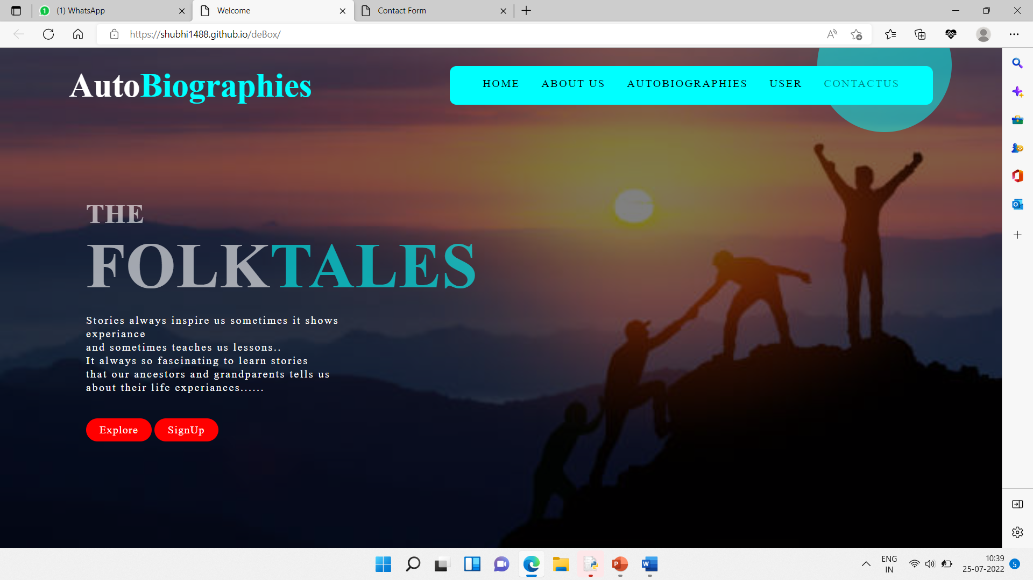
Main page:-

Slide 4


What is an autobiography??
the biography of oneself narrated by oneself. Autobiographical works can take many forms, from the intimate writings made during life that were not necessarily intended for publication (including letters, diaries, journals, memoirs, and reminiscences) to a formal book-length autobiography.

Slide 5

TYPES OF AUTOBIOGRAPHY:
An autobiography may be placed into one of four very broad types: thematic, religious, intellectual, and fictionalized.
An autobiography is a written literary work that is in the form of a novel or a short story. An autobiography is the story of the life of a person, written by that person himself, for example, Mahatma Gandhi’s My Experiments with Truth.
An autobiography can be identified easily, as its written in the first person point of viewpoint, the writers, I, me, and myself.

Slide 6
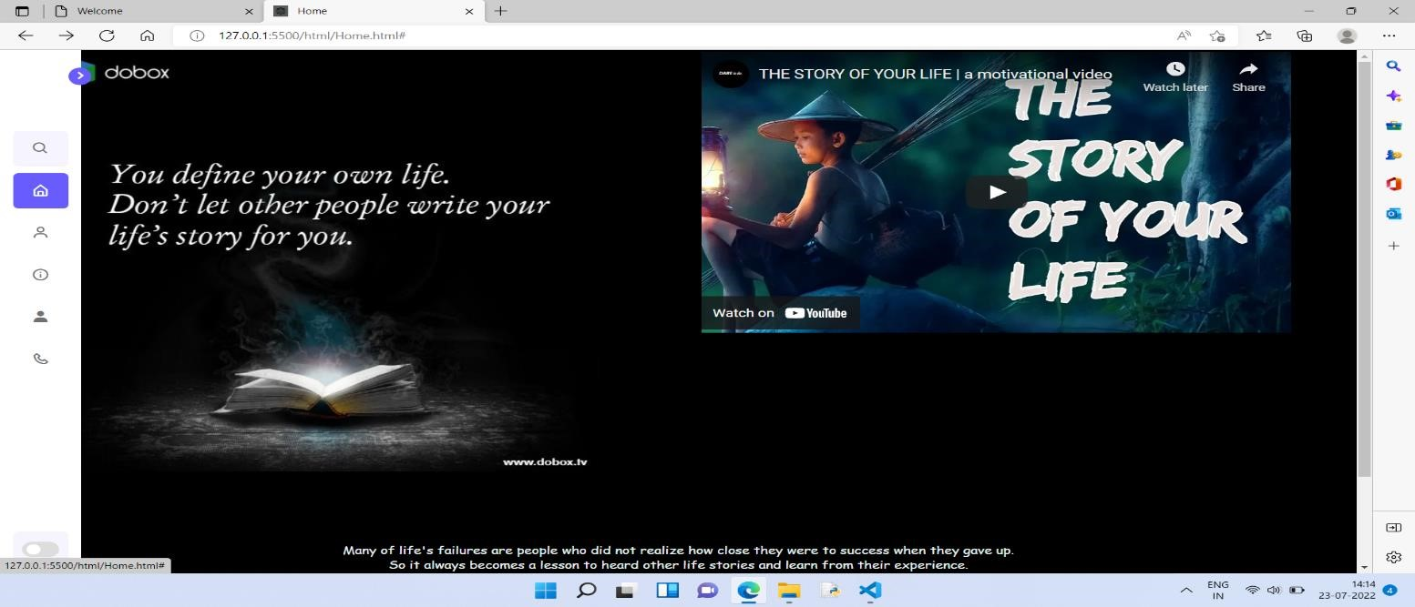

Home page:-
For a Web user, the home page is the first Web page
that is
displayed after starting a Web browser
.

Slide 7
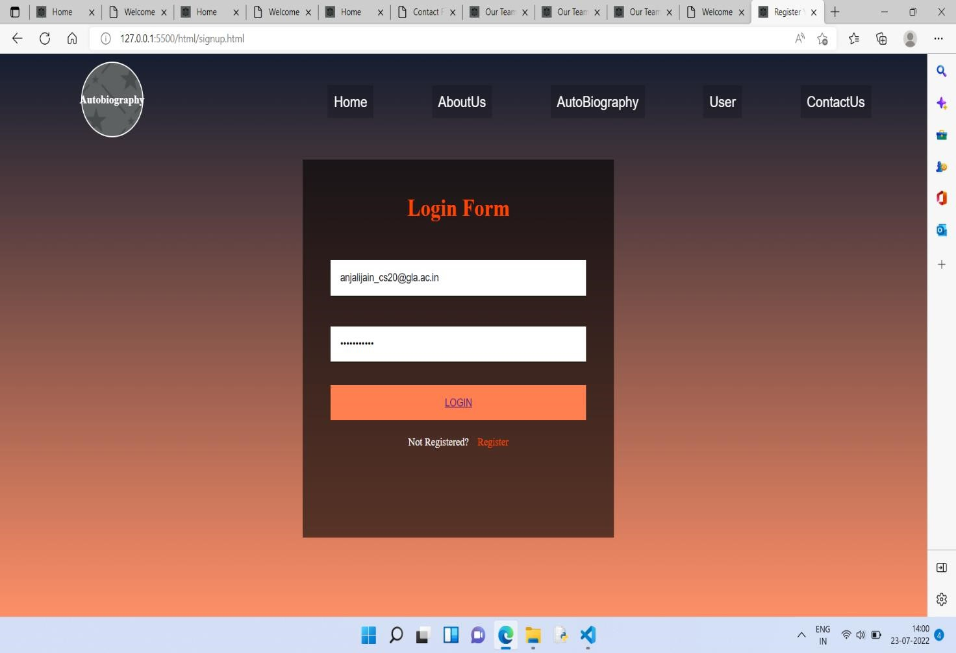
USER LOGIN PAGE:
A login page is a web page or an entry page to a website that requires user identification and authentication, regularly performed by entering a username and password combination.

Slide 8
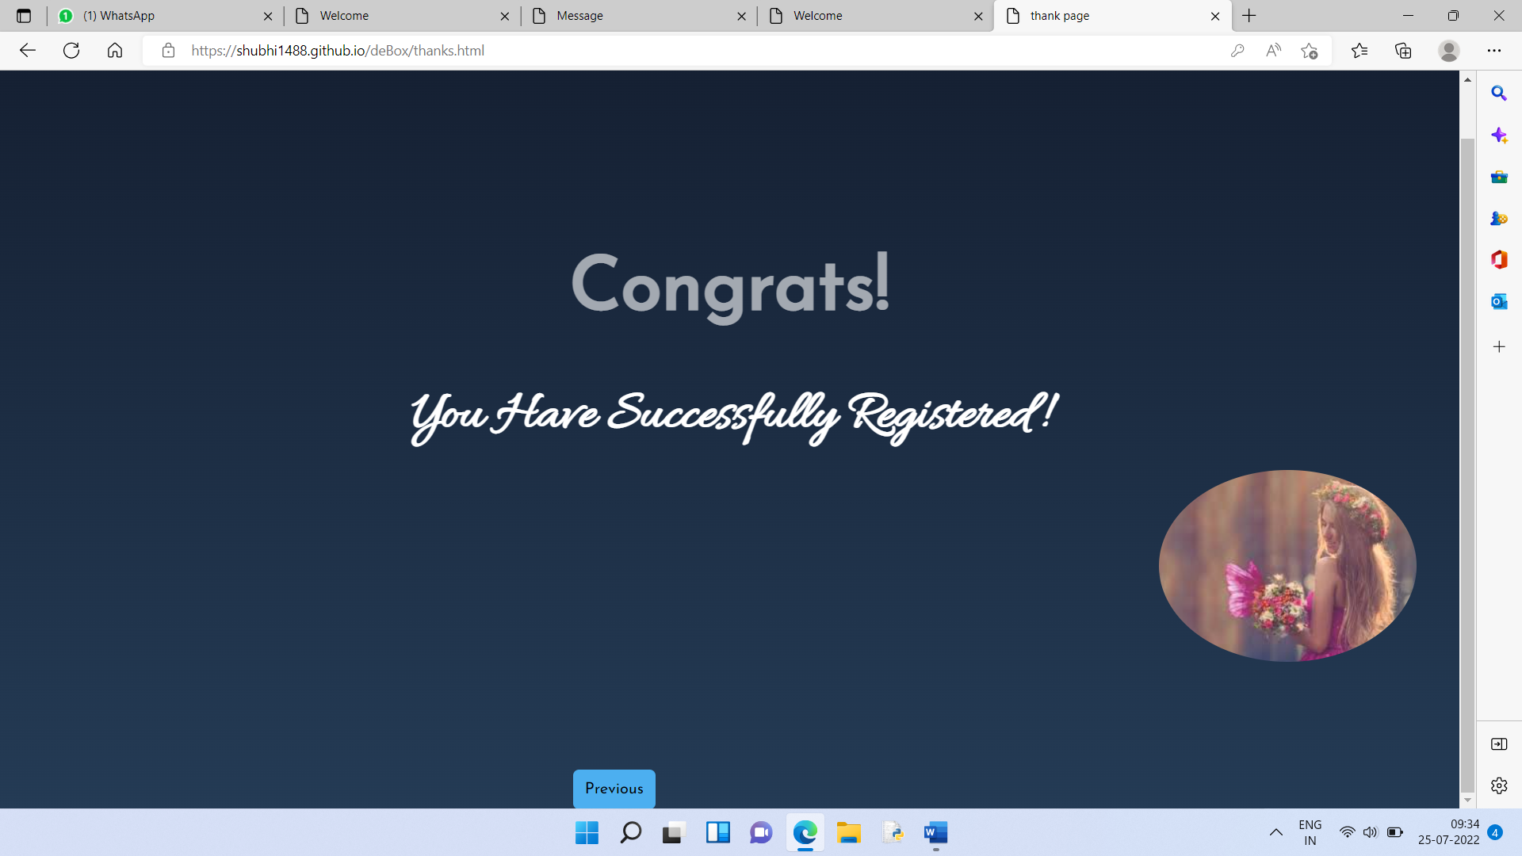
Now you are part of DEBOX
Lets explore !!

Slide 9

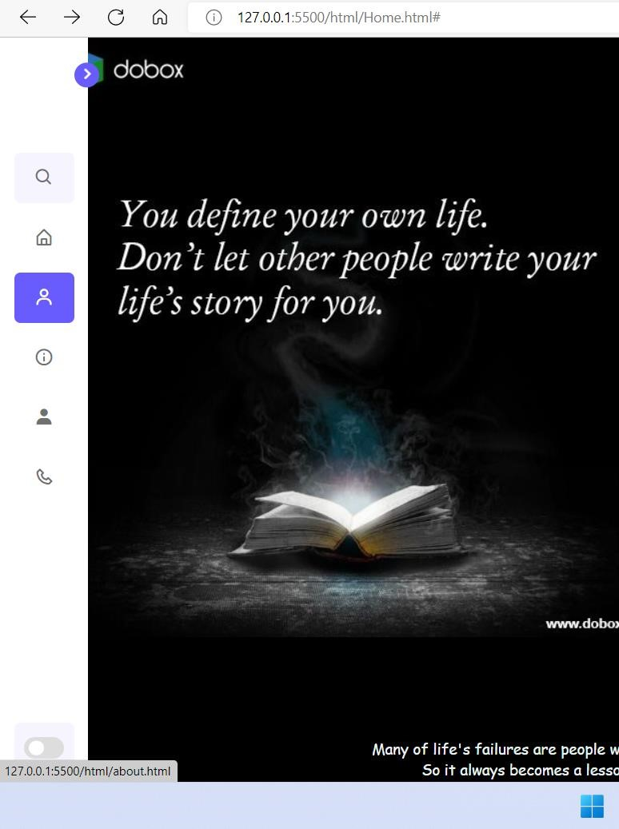
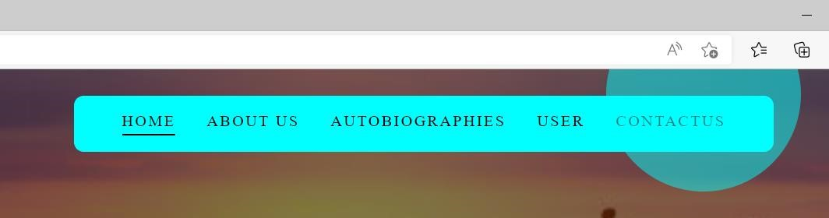
Navigation bar:
A navigation bar (or navigation system) is a section of a graphical user interface intended to aid visitors in accessing information.
Navigation bars are implemented in file browsers, web browsers and as a design element of some web sites.

Slide 10
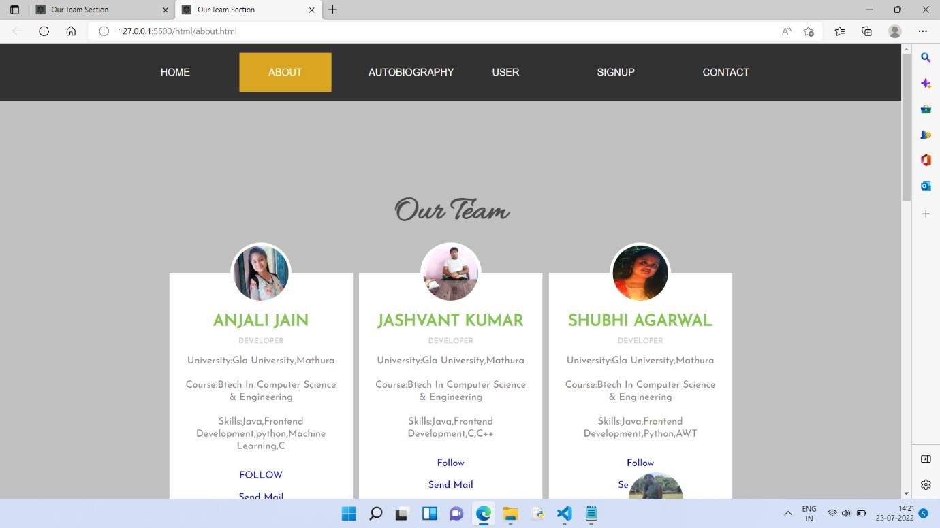
About us:-
The about us page helps online userto develop a relationship with customers and build trust by putting a face and a story to the name on the storefront.
About us pages serve much the same purpose for retailers who share less-common or unique ideas as well.
The About Us page of your website is an essential source of information for all who want to know more about your business.
About Us pages are where you showcase your history, what is unique about your work, your company’s values, and who you serve.

Slide 11
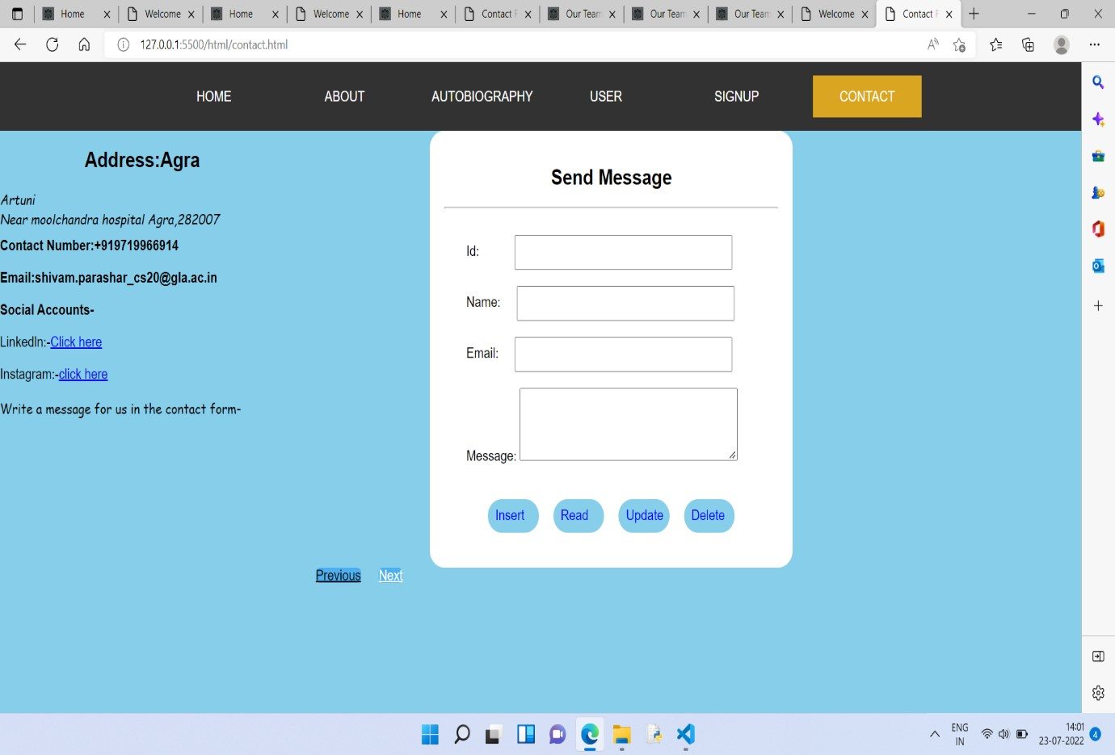
A contact page provides guidance for existing customers and offers an overview of your brand for new visitors.
If you ask customers to submit inquiries on your page,ensure you use the Contact Us form wisely.

Slide 12
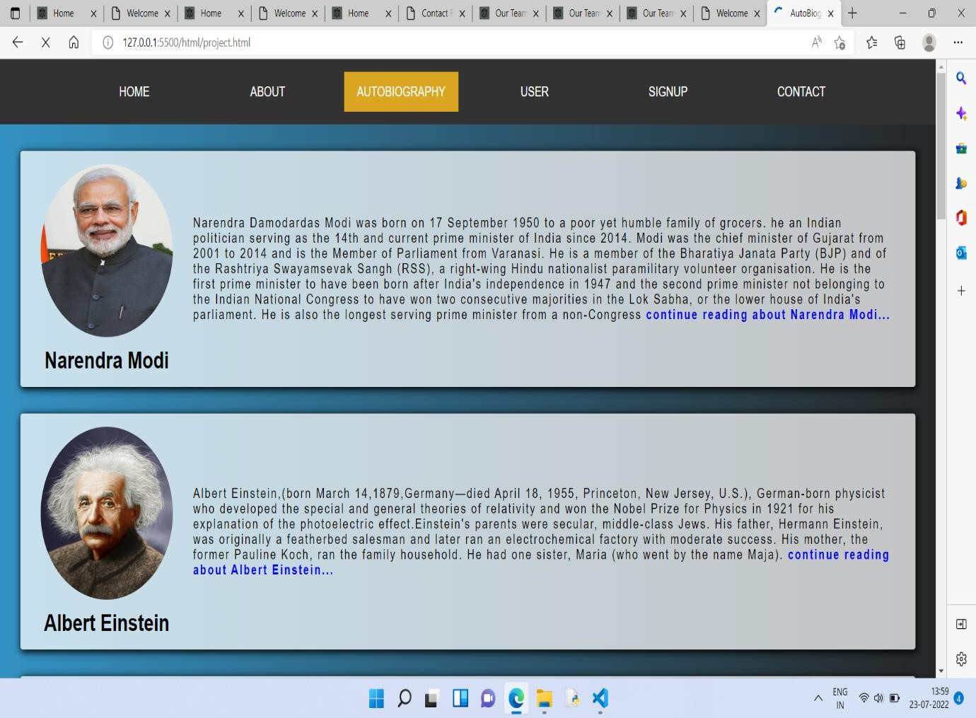
adding and searching your favorite autobiography:

Slide 13
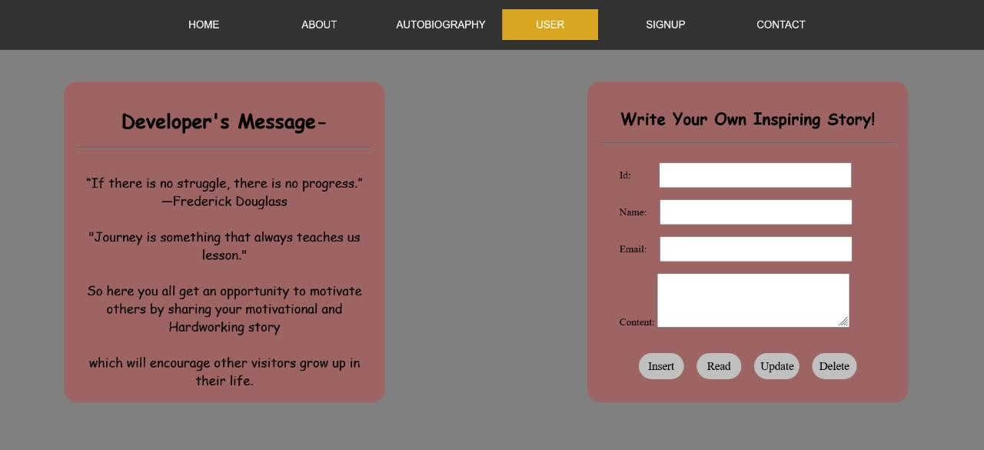
Add your autobiography:
If user want to share their own motivational journey so here is best opportunity to them
So let share your experience with others so that no one repeat those mistakes in their life and also get connected with others.
Stay connected with “do-box “!!

Slide 14

REFERENCES:
https://shubhi1488.github.io/deBox/
let share your beautiful journey
with others so that
every0ne can get motivation from it.
We are waiting for your valuable feedback.

