Slide 1
Principal Component Analysis (PCA)
BCSE 0105 MACHINE LEARNING

Slide 2


Statistics Mean
the mean of a sample is,

Slide 3

Mean
The mean doesn’t tell us a lot about the data except for a sort of middle point.
For example, these two data sets have exactly the same mean (10).
So what is different about these two sets? It is the spread of the data that is different.

Slide 4
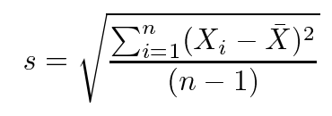
Standard Deviation (SD)
The Standard Deviation (SD) of a data set is a measure of how spread out the data is.
“The average distance from the mean of the data set to a point”.

Slide 5
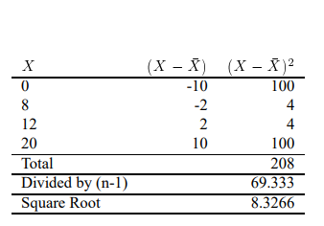

Slide 6
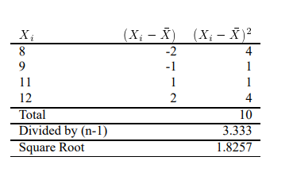

Slide 7
As expected, the first set has a much larger standard deviation due to the fact that the data is much more spread out from the mean.

Slide 8

This dataset has a mean of 10, but its standard deviation is 0, because all the numbers are same.

Slide 9

Variance
Variance is another measure of the spread of data
Standard deviation and variance only operate on 1 dimension

Slide 10
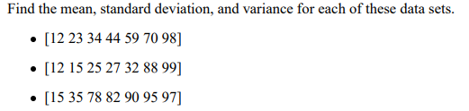
Exercise

Slide 11


Covariance
Covariance is always measured between 2 dimensions.
If you calculate the covariance between one dimension and itself, you get the variance.

Slide 12
Covariance
Positive value indicates that both dimensions increase together.
Negative value indicates that if one dimension increases, the other decreases.
If covariance is zero, it indicates that the two dimensions are independent of each other.

Slide 13

Both are similar

Slide 14
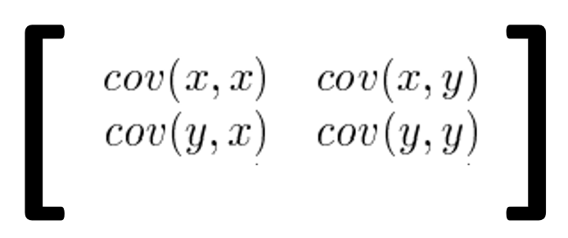
The covariance Matrix
For two dimensions

Slide 15
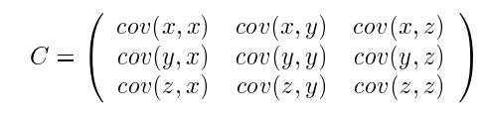
The covariance Matrix
For three dimensions

Slide 16
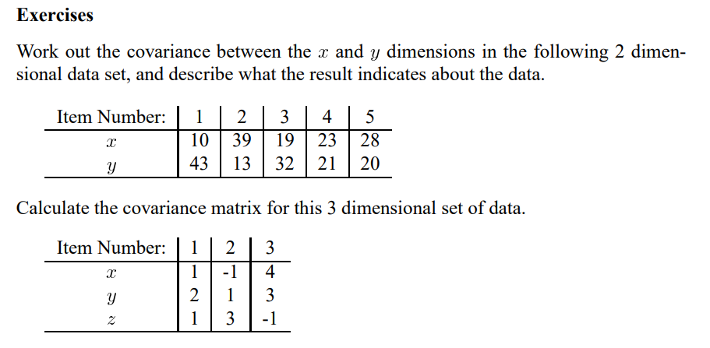

Slide 17
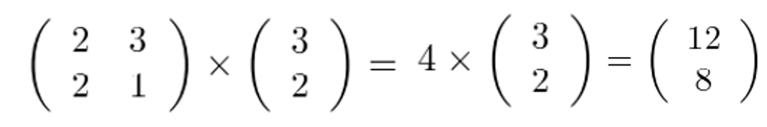
Eigen Vectors
Can only be found for square matrices
For nxn matrix, there are n eigen vectors
All the eigenvectors of a matrix are perpendicular(orthogonal).
We can express the data in terms of these perpendicular eigenvectors, instead of expressing them in terms of the x and y axes.

Slide 18
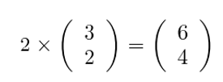
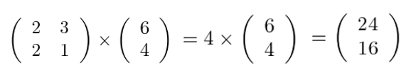
Scaled eigenvector is still an eigenvector

Slide 19
Eigenvalues
Eigenvalues are closely related to eigenvectors
Here, 4 is the eigenvalue associated with the eigenvector

Slide 20
Eigenvectors and Eigenvalues
always come in pairs

Slide 21

Ques
Find eigenvalues and eigenvectors of the following matrix
$\left[\begin{aligned}7 3 \\ 3 −1\end{aligned}\right]$

Slide 22
Covariance and correlation
Covariance shows you how the two variables differ, whereas correlation shows you how the two variables are related.

Slide 23
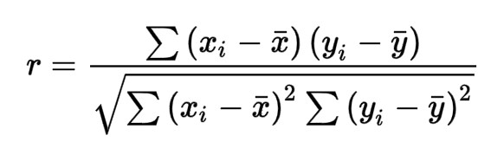
The correlation coefficient is calculated by first determining the covariance of the variables and then dividing that quantity by the product of those variables' standard deviations.

Slide 24
Correlation
The values range between -1.0 and 1.0.
A calculated number greater than 1.0 or less than -1.0 means that there was an error in the correlation measurement.

Slide 25
Feature Extraction and Feature Selection
Extraction by PCA

Slide 26
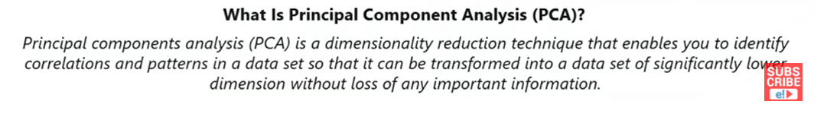
Principal Components Analysis (To overcome the problem of overfitting)
Principal Component Analysis (PCA) is one of the most commonly used unsupervised machine learning algorithms across a variety of applications: exploratory data analysis, dimensionality reduction, information compression, data de-noising, and plenty more

Slide 27
Method
Step 1: Get some data
Step 2: Subtract the mean
Step 3: Calculate the covariance matrix
Step 4: Calculate the eigenvectors and eigenvalues of the covariance matrix
Step 5: Choosing components and forming a feature vector
Step 5: Deriving the new data set

Slide 28
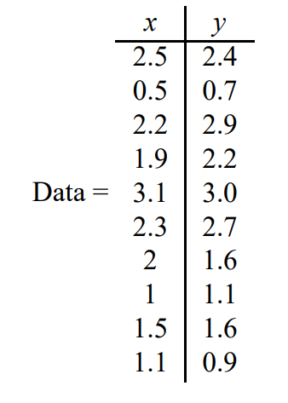
Step 1: Get some data

Slide 29
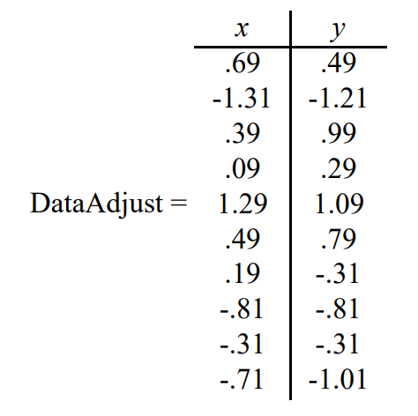
Step 2: Subtract the mean (This produces a data set whose mean is zero.)

Slide 30
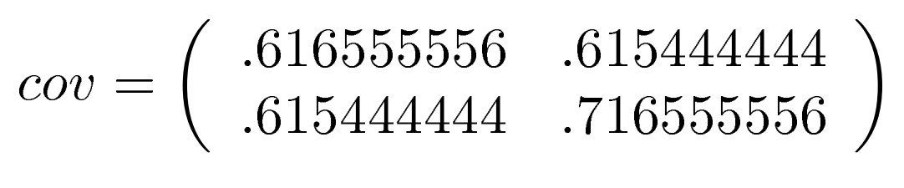
Step 3: Calculate the covariance matrix

Slide 31
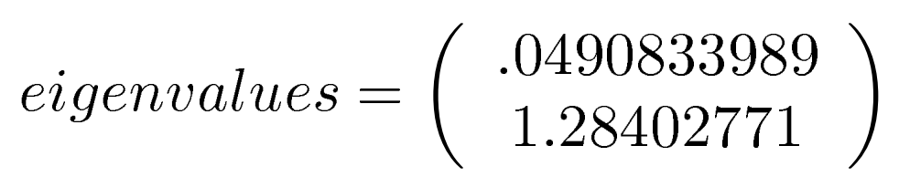
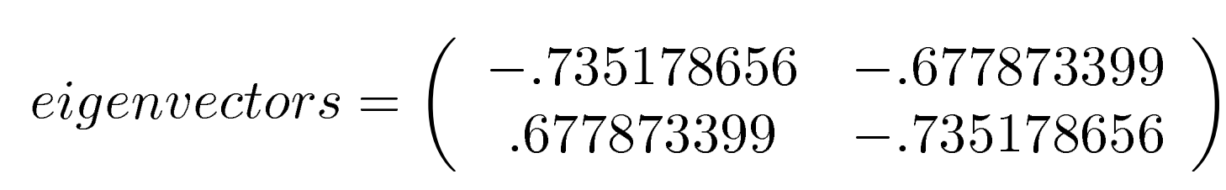
Step 4: Calculate the eigenvectors and eigenvalues of the covariance matrix

Slide 32
Step 5: Choosing components and forming a feature vector
Order the eigen vectors by eigenvalues, highest to lowest. This gives you the components in order of significance
For n dimensions, we calculate n eigenvectors and eigenvalues , and then choose only the first p eigenvectors, then the final data set has only p dimensions.
Form a feature vector

Slide 33


Slide 34
Step 5: Deriving the new data set

