Slide 1


Project Presentation
on
Travel And Tourism Management System
Under the Guidance
of
Priti .L. Yadav
Submitted By
Anjali Jha

Slide 2

Travel And Tourism Management System

Slide 3
Contents
Introduction
Literature Survey
Project Goals
Key Observations
Tools and Technology
Results & Discussion
ER-Diagram
Future Scope
Conclusion
References

Slide 4
Introduction
A travel and tourism management system is a software application that helps businesses in the tourism industry effectively manage their operations. It usually includes modules for managing bookings, bookings, inventory, customer relations and reporting. This system is important in this industry because it helps businesses to streamline their operations, reduce manual errors and improve customer service. It also provides real-time data insights, enabling businesses to make data-driven decisions and optimize their revenue. In addition, it can improve the customer experience by providing personalized services and tailor-made packages.

Slide 5
Literature Survey
A travel and tourism management system is an application software that helps manage various aspects of the tourism industry such as reservations, reservations and customer management. These systems can be developed using various technologies such as JDBC, JSP, Java, MySQL Workbench and Hibernate.
JDBC (Java Database Connectivity) is a Java API that enables connecting to databases and performing CRUD (Create, Read, Update, Delete) operations. JSP (Java Server Pages) is a technology that allows the creation of dynamic web pages using Java code. Java is a popular programming language used to build enterprise-level applications. MySQL Workbench is an integrated visual tool for database architects, developers, and DBAs. Hibernate is a popular object-relational mapping (ORM) framework for Java that simplifies database access and reduces the amount of boilerplate code required to interact with the database.

Slide 6
Project Goals
The objectives of a travel and tourism management system can vary depending on the specific needs of the user and the tourism industry. However, some common goals are:
Streamlining the booking process and booking for customers will be more efficient and user-friendly.
Provides real-time availability and pricing information for tourism products and services.
Manage customer data and preferences, provide personalized offers and targeted marketing.
Integrate with other systems, such as payment gateways and inventory management tools, to provide an end-to-end experience.
Analyze data and generate insights to inform business decisions and improve operational efficiency.
Ensure data security and compliance with relevant regulations.
Provide a mobile voice and accessible platform for customers and employees.
Continuously improve and update systems to maintain competitiveness and meet changing customer needs.

Slide 7
Key Observations
Depending on the goals of the project and the technologies used, some key considerations for a travel and tourism management system using JDBC, JSP, Java, MySQL Workbench, and Hibernate may include:
Improved data management and access: With the use of relational databases like MySQL and ORM frameworks like Hibernate, the system can efficiently manage and retrieve data, enabling faster and more accurate processing of bookings, reservations and customer information.
Enhanced User Experience: Using JSP and Java can help create a user-friendly interface for customers, enabling them to easily search and book travel products and services. The system can also provide personalized recommendations based on customer data and preferences.

Slide 8
Improve operational efficiency: By automating and streamlining various processes such as arrangement and booking management, the system can help reduce manual errors and increase operational efficiency.
Better data security: By using JDBC and Hibernate, the system can ensure secure data transfer and storage, protecting sensitive customer data and complying with relevant regulations.
Scalability and flexibility: The system can be easily expanded and configured by integrating with other systems and tools required to meet the changing needs of the travel business.
Improved analytics and reporting: The system can generate insights and reports based on customer data and behavior, helping tourism businesses make informed decisions and improve their marketing and sales strategies.
Continuous improvement and innovation: The system can be continuously improved and updated based on user feedback and changing industry trends, ensuring that it remains competitive and relevant in the tourism market.

Slide 9
Tools and Technology
Software/Hardware Requirement
Specification
Operating System:-Microsoft Windows 10
Application:- HTML & CSS ,ANGULAR FRAMEWORK,JSP,JDBC.
Database:-MYSQL SERVER & HIBERNATE
Software:-Eclipse/MYSQL Workbench
Minimum Hardware Requirement
Processor: Dual-core processor with a minimum speed of 2 GHz
Memory: 4 GB RAM
Operating System: Windows 10
Database: MySQL Server
Integrated Development Environment (IDE): Eclipse
Keyboard & Mouse

Slide 10
Results & Discussion
The tourism management system project is a software application that manages tour bookings. It includes various sections such as objectives, existing and proposed systems, functional requirements, and system configuration. The system is built using JDBC, JSP, Java, MySQL Workbench, and Hibernate. The frontend is developed using Angular, HTML & CSS, JSP, while the backend is developed using JDBC and Hibernate ORM framework. The database is built using MySQL Workbench. The system aims to improve data management, enhance user experience, increase operational efficiency, ensure data security, and provide scalability and flexibility. The minimum hardware requirements for this system include a dual-core processor with a minimum speed of 2 GHz, 4 GB RAM, 50 GB of available hard-disk space, and Windows 10.

Slide 11
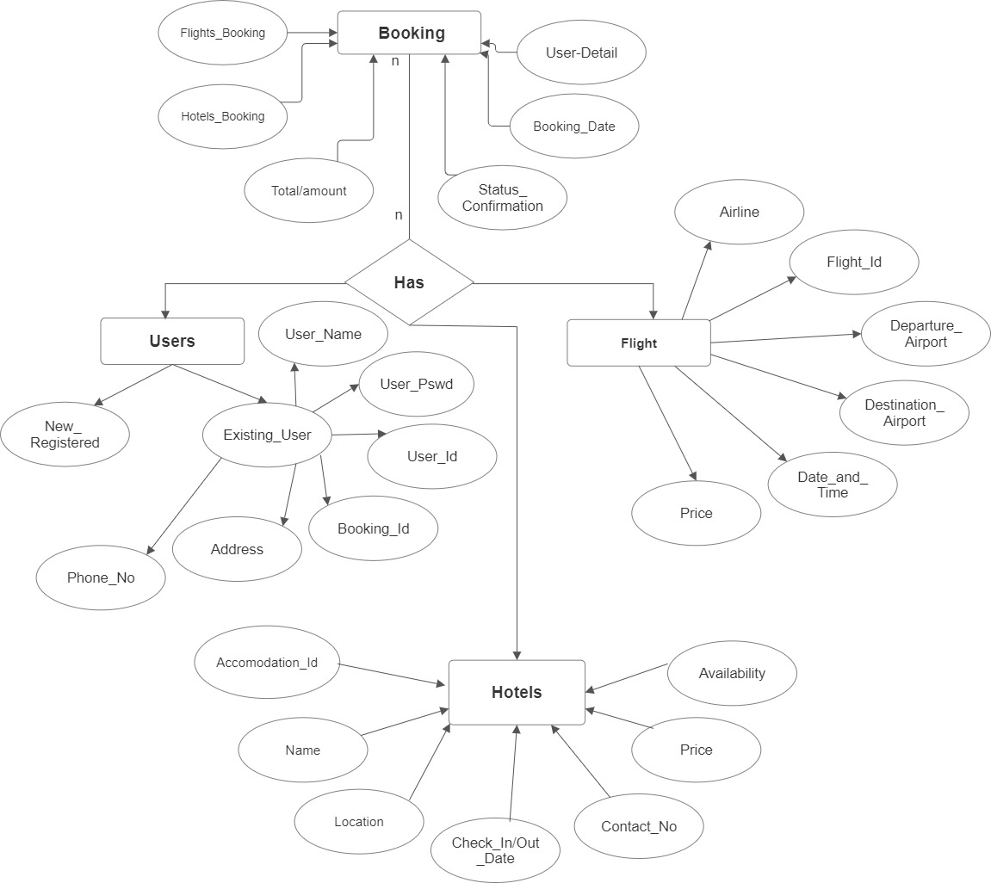
ER-Diagram

Slide 12
Future Scope
The travel and tourism management system has a promising future with several growth opportunities.
Personalization: As travellers seek more personalized experiences, travel and tourism management systems can use data analytics and AI to deliver customized offers and services, such as personalized itineraries, dining options and activities.
Sustainable Tourism: With the growing awareness of the environmental impact of tourism, there is a demand for sustainable travel options. Travel and tourism management systems can help promote sustainable development by providing environmentally friendly travel opportunities, reducing carbon footprints, and promoting local communities and cultures.
Virtual and Augmented Reality: Virtual and augmented reality technologies can offer immersive travel experiences that allow travellers to explore destinations before booking. Travel and tourism management systems can use this technology to offer virtual tours, immersive experiences, and interactive guides.

Slide 13
Mobile Integration: With the proliferation of mobile devices, travel and tourism management systems can offer mobile integration that allows travelers to access information, make reservations, and receive notifications on their mobile devices.
Multi-channel integration: Travel and tourism management systems can offer multi-channel integration that allows travellers to interact with the system through multiple channels, including websites, mobile apps, social media, and chat.

Slide 14
Conclusion
In conclusion, the travel and tourism management system developed using JDBC, JSP, Java, MySQL Workbench, and Hibernate, Angular has proven to be an efficient and effective solution for managing tour bookings. The system offers several benefits, including improved data management, enhanced user experience, increased operational efficiency, better data security, and scalability and flexibility. The system has also demonstrated the potential for future growth and innovation, particularly in areas such as personalization, sustainable tourism, virtual and augmented reality, mobile integration, and multi-channel integration. Overall, the travel and tourism management system has the potential to revolutionize the tourism industry and provide a better experience for travelers and tour operators alike.

Slide 15
References
Travel and Tourism Management System: A Case Study: https://www.researchgate.net/publication/330735633_Travel_and_Tourism_Management_System_A_Case_Study
Design and Implementation of a Travel and Tourism Management System: https://www.ijitee.org/files/Volume5Issue1/IJITEE05010111.pdf
A Study on Travel and Tourism Management System: https://www.researchgate.net/publication/330735633_Travel_and_Tourism_Management_System_A_Case_Study
Travel Agency Management System: A Review: https://www.ijarcs.org/archive/v5i3/ART20131859.pdf
Travel and Tourism Management System: A Comprehensive Review: https://www.researchgate.net/publication/330735633_Travel_and_Tourism_Management_System_A_Case_Study

Slide 16


