Slide 1

Data Science PROJECT TELECOM CHURN PREDICTION PROJECT TEAM ID - PTID-CDA-NOV-24-246 PRESENTED BY: ANUPRIYA S R ANJALI M K PRATHAM P M

Slide 2
Agenda
1. Introduction
2. Business Case
3. Dataset Overview
4. Data Preparation
5. Modeling and Results
6. Recommendations and Insights

Slide 3
INTRODUCTION
Objective
No-Churn Telecom aims to leverage Machine Learning to address the challenge of customer churn in a competitive telecom industry.
PROJECT GOALS:
1. Understanding the variables that are influencing the customers to migrate.
2. Creating Churn risk scores that can be indicative to drive retention campaigns.
3. Introduce new predicting variable “CHURN-FLAG” with values YES(1) or NO(0) so that email campaigns with lucrative offers can be targeted to Churn YES customers.

Slide 4

BUSINESS CASE
No-Churn Telecom is an established Telecom operator in Europe with more than a decade in Business. Due to new players in the market, telecom industry has become very competitive and retaining customers becoming a challenge.
In spite of No-Churn initiatives of reducing tariffs and promoting more offers, the churn rate ( percentage of customers migrating to competitors) is well above 10%.
No-Churn wants to explore possibility of Machine Learning to help with following use cases to retain competitive edge in the industry.

Slide 5
Dataset Overview
Source: SQL database with 4,617 records.
Features:
- Customer Demographics: State, Area Code, Phone Number.
- Service Usage: Day Mins, Night Calls, International Plan.
- Customer Support: Number of Customer Service Calls.
Target Variable:
- 'Churn' (Yes/No).

Slide 6


Slide 7
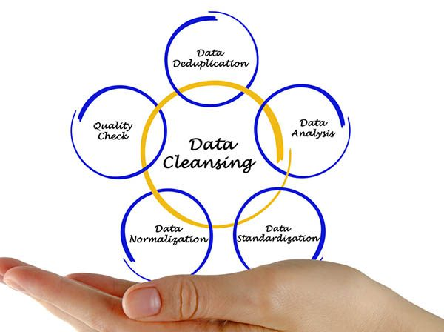
Data Preparation
Steps Taken:
1. Data Cleaning:
- Handled missing values and inconsistent data entries.
2. Feature Engineering:
- Created a new 'Churn-Flag' variable.
3. Data Transformation:
- Normalized numerical features.
- Encoded categorical variables.

Slide 8
Modeling and Results
Models Used:
- Logistic Regression
- Random Forest
- Gradient Boosting and etc…
Key Metrics:
- Accuracy, Precision, Recall, F1 Score.
Feature Importance:
- Highlighted top predictors of churn (e.g., Customer Support Calls).

Slide 9


Slide 10

Thank you

