Slide 1

University of Mysore Yuvaraja’s College[autonomous] Mysuru
Presentation on
Clean commute
Android app for encouraging low- carbon transportation
Under the guidance of
Dr . Annapurna H

Slide 2
AGENDA:
Introduction
Existing system
Proposed system
Modules
Snapshots
Conclusion

Slide 3
INTRODUCTION
Clean Commute is an innovative Android application designed to encourage and promote low-carbon transportation options among individuals. The app aims to reduce carbon emissions by motivating users to choose sustainable transportation methods such as walking, cycling, carpooling, and using public transportation. This is designed to make sustainable commuting choices convenient, rewarding, and socially engaging. By encouraging individuals to adopt low-carbon transportation methods, the app aims to contribute to a cleaner environment, reduce traffic congestion, and enhance the overall quality of life in urban areas.

Slide 4
EXISTING SYSTEM
The existing transportation system predominantly relies on fossil fuel-powered vehicles, leading to significant carbon emissions and environmental degradation. Private cars are the most common mode of transportation, resulting in traffic congestion, air pollution, and increased energy consumption. Limited emphasis is placed on promoting and incentivizing sustainable transportation alternatives, such as walking, cycling, carpooling, and public transportation. Existing apps and platforms often lack comprehensive features to track and encourage low-carbon commuting, and community engagement in promoting sustainable transportation is relatively limited.

Slide 5
DISADVANTAGES
Limited coverage.
Connectivity and technical issues
Lack of integration with all transportation options.
Limited carbon offsetting options.
Lack of user customization

Slide 6
PROPOSED SYSTEM
The proposed Clean Commute Android app to revolutionize the transportation Landscape by encouraging low-carbon commuting. It offers trip tracking, a carbon footprint calculator, route planning, and trip tracking. By providing users with incentives, information, and a sense of community, the app promotes sustainable transportation options, reduces carbon emissions, and improves the overall environmental impact of commuting. It also offers calculation of energy consumption on bills dependent on amount of people in house hold it allows users to enter starting and ending dates based on which further actions are taken by admin.

Slide 7
ADVANTAGES
Increased awareness.
Convenient access to information.
Personalized feedback and tracking.
Environmental impact reduction.

Slide 8
HARDWARE REQUIREMENTS
Hard disk : 40GB
RAM : 8GB
Device : Android mobile
SOFTWARE REQUIREMENTS
OS : windows 10
Language used : java ,XML,SQL
Development Environment : Android Studio
Database : SQLite
Software : JDK, Android SDK,DB Browser for SQLite

Slide 9
MODULES OF THE PROJECT
1. Profile Management: Users can set their preferences, commuting goals, and track their progress over time.
2. Trip Tracking and Logging: It records details such as distance, mode of transportation, and duration of each trip, providing valuable data for carbon footprint calculation and progress tracking.

Slide 10
MODULES OF THE PROJECT
3. Carbon Footprint Calculator: The carbon footprint calculator module estimates the carbon emissions saved by choosing sustainable transportation options. It considers factors such as distance, mode of transport, and vehicle efficiency to provide users with an understanding of their environmental impact
4. Updates and Notifications: This module delivers real-time updates on traffic congestion, public transportation schedules, and availability of shared mobility services. Users receive notifications and alerts to make informed decisions about their commute and choose the most sustainable options.

Slide 11
MODULES OF THE PROJECT
5. Progress Tracking and Analytics: The progress tracking module presents users with comprehensive data, including graphs and statistics, to visualize their commuting patterns and improvements over time. It helps users stay motivated and engaged in their sustainable transportation goals.

Slide 12
USE CASE DIAGRAM
A use case diagram is a graphical representation in the unified modelling languages (UML) that illustrates the interactions between actors (users or external systems) and a system under consideration. It provides a high –level view of system functionality by capturing the various use cases, actors and their relationships.

Slide 13
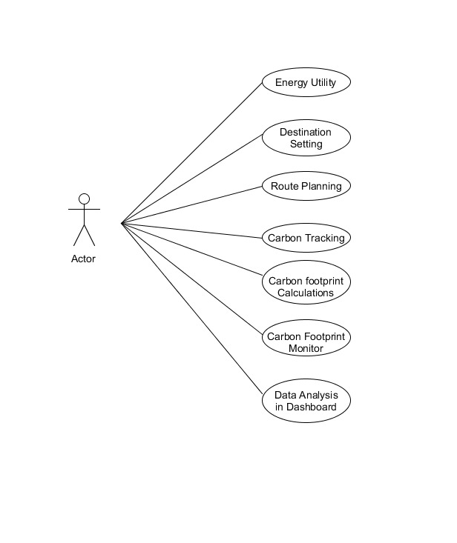
USE CASE DIAGRAM

Slide 14
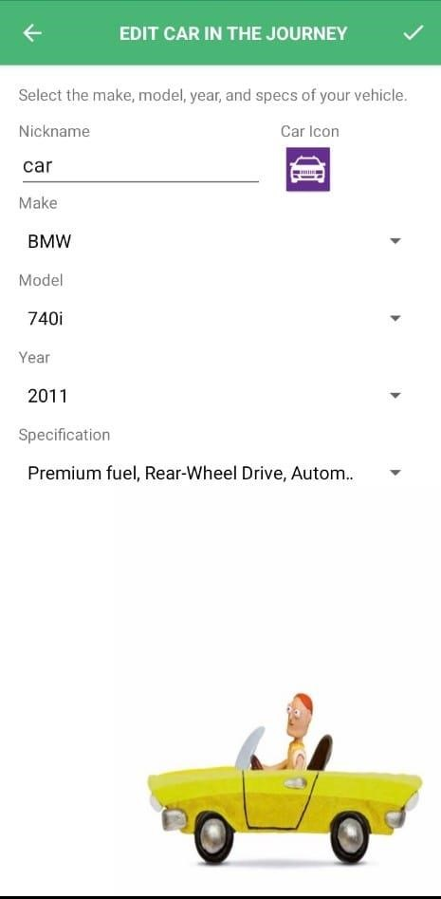
SNAPSHOTS - ADD A NEW CAR

Slide 15
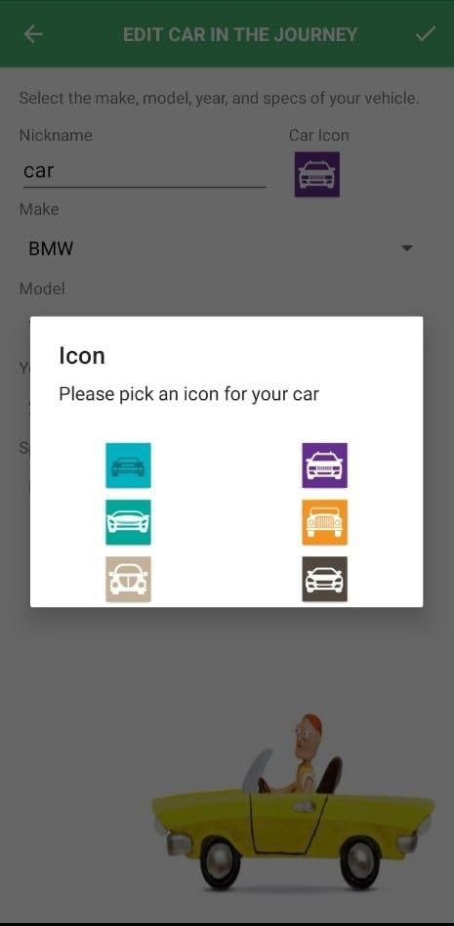
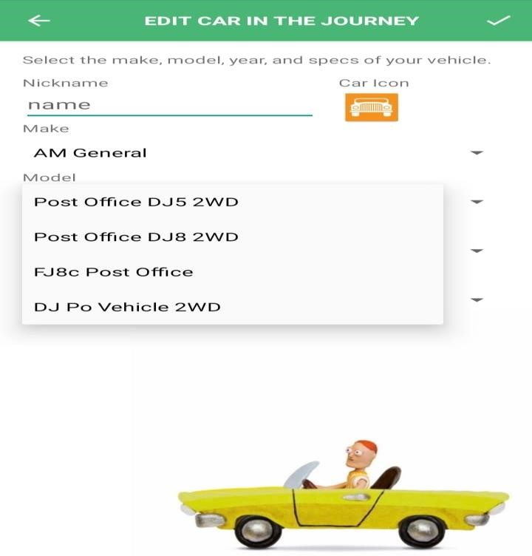
PICK CAR ICON ADD CAR MODEL

Slide 16
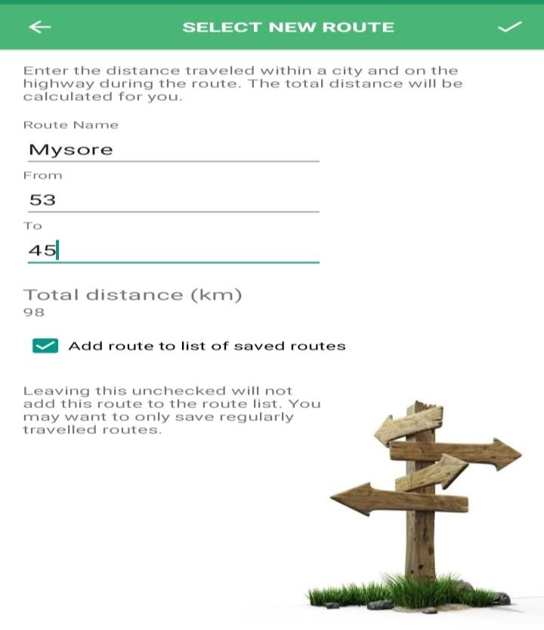
FILL DETAILS ABOUT ROUTES

Slide 17
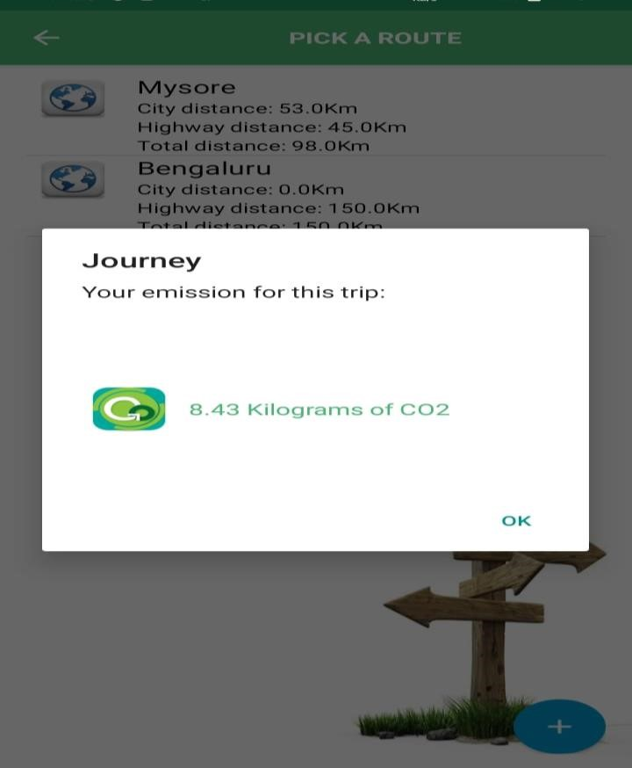
ADMIN SEND POP UP MESSAGE CARBON EMISSION CONSUMED

Slide 18
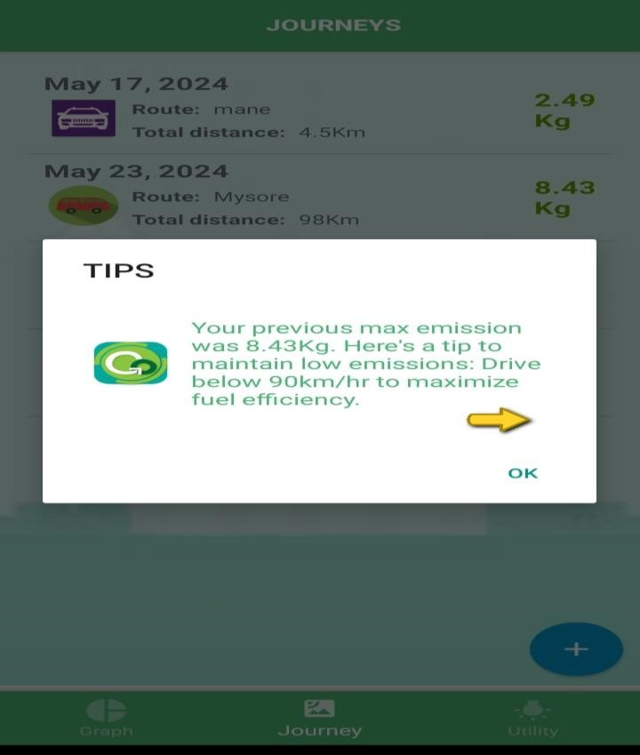
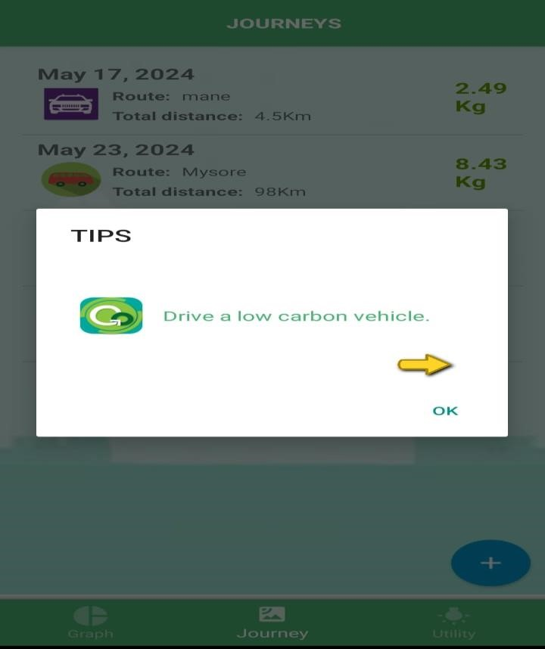
ADMIN GIVES TIPS TO USER

Slide 19
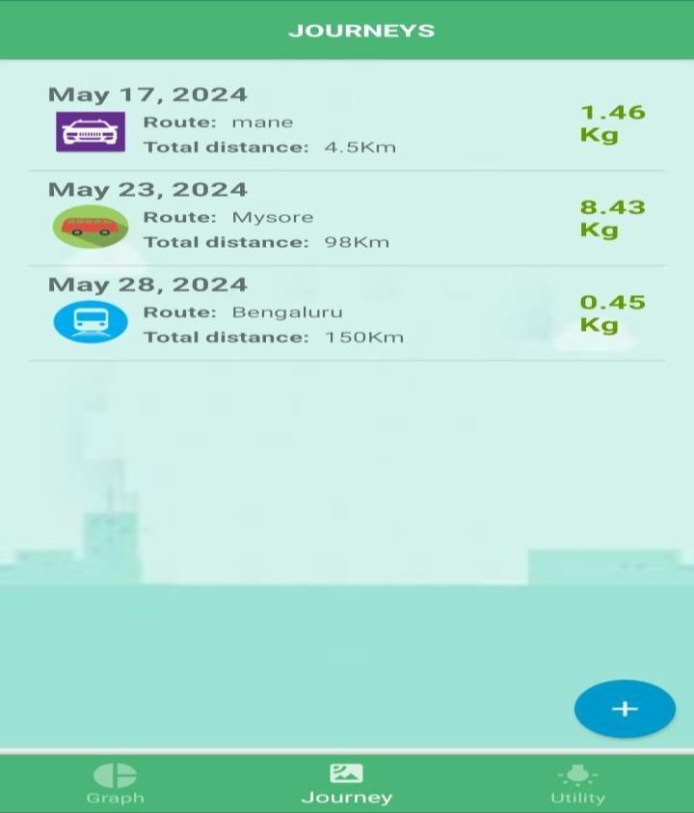
USER CAN VIEW ALL JOURNEYS

Slide 20
CONCLUSION
In conclusion, the Clean Commute Android app revolutionizes commuting habits by promoting low-carbon transportation options, providing incentives, community engagement, and comprehensive tracking features. By encouraging sustainable commuting choices, the app aims to reduce carbon emissions, alleviate traffic congestion, and improve the overall environmental impact of transportation

Slide 21

THANK YOU

