Slide 1
AI Language Translator App
Built using Python & Streamlit
Anjali J.

Slide 2
Problem Statement
Language barriers make communication difficult.
Need for a simple and interactive translation tool.
Goal: Build a real-time AI-powered language translator.

Slide 3
Tools & Technologies Used
Python
Streamlit
Googletrans Library
VS Code
GitHub

Slide 4
Implementation Steps
Created Streamlit user interface.
Integrated Google Translate API via googletrans.
Added source and target language selection.
Displayed translated output dynamically.

Slide 5
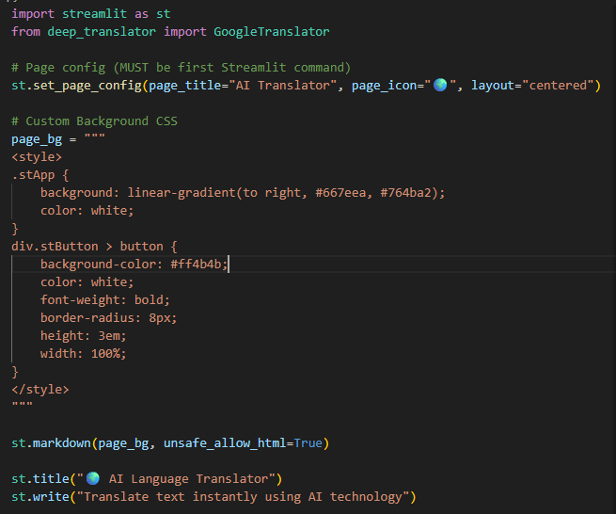
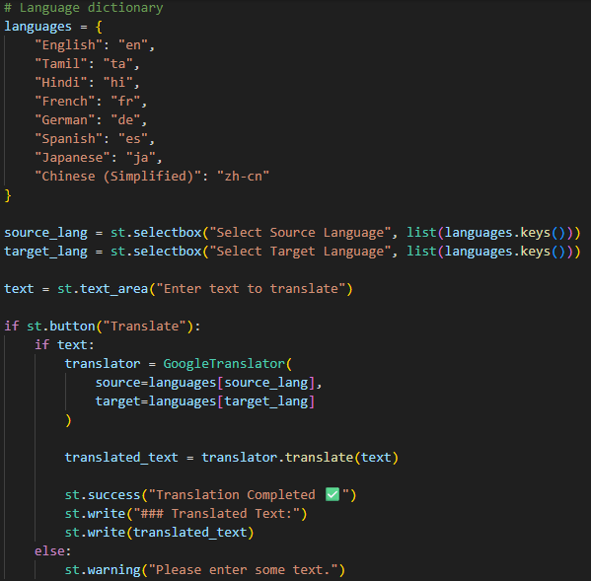
Code Implementation

Slide 6
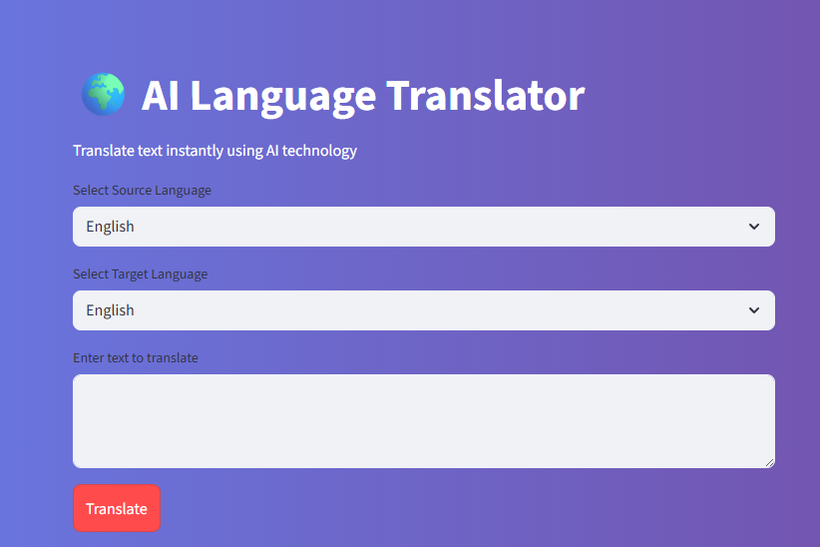
Key Features
User-friendly interface.
Supports multiple languages.
Real-time translation.
Clean UI with customized background.

Slide 7
What I Learned
Building AI applications using Python.
Working with external APIs.
Deploying apps with Streamlit.
Version control using GitHub.

Slide 8
Future Improvements
Add voice input feature.
Improve translation accuracy using advanced models.
Deploy on cloud platform.

Slide 9
Thank You
GitHub Repository: (https://github.com/Anjalisj4g/AI-Language-Translator-App/tree/main)

