Slide 1

Human Colorectal Histological Image
Classification Using Vision
Transformers (ViT)
By
Himanish Chowdhury
(B.Tech 4th Year, 12020002001032 )
Himangshu Chowdhury
(B.Tech 4th Year, 12020002001031)
Anjan Mahapatra
(B.Tech 4th Year, 12020002001157)
Under the Supervision of
Prof. (Dr.) Tapas Si
Dept. of Computer Science & Engineering
University of Engineering & Management, Jaipur

Slide 2
Outlines
Introduction
Literature Review
Objectives
Proposed Model
Experimental Setup
Result: Example
Result Analysis
Conclusion & Future Scope
Reference
Acknowledgement

Slide 3
Introduction
In this project we used a novel method employing Vision Transformers (ViTs) to classify colorectal cancer histology images. Its ranks among the top cancers globally.
The study utilizes deep learning techniques, CNN model and multiple ViT models, to achieve high accuracy in classifying histology images. And get the best model as ScalableVit.
This research significantly contributes to the field of medical image analysis.

Slide 4
Literature Review
The purpose of this work is to use convolutional neural networks (CNNs) on histological pictures to create a reliable and effective colorectal cancer classification system [1].
The diagnosis of colorectal cancer and the choice of treatment depend heavily on the histological classification of the tumor's tissue [2].
In this paper we studies about Vision transformers on colon Cnacer images [3].

Slide 5
Objectives
Data Acquisition and Preprocessing:
Obtain the dataset containing images for classification.
Preprocess the images if necessary (e.g., resizing, normalization, augmentation).
Splitting Dataset:
Divide the dataset into two subsets: training set and testing set.
Typically, you allocate a larger portion (e.g., 80%) to the training set and the rest to the testing set.
Create CNN Model:
Design and define a Convolutional Neural Network architecture suitable for image classification.
This could involve stacking convolutional layers, pooling layers, and fully connected layers.
Compile the model with an appropriate loss function and optimization algorithm.
Train CNN Model:
Feed the training images into the CNN model.
Adjust the model's weights iteratively through backpropagation to minimize the loss function.
Monitor the model's performance on the training set and optionally on a validation set.
Stop training based on predefined criteria (e.g., reaching a certain accuracy or after a certain number of epochs).

Slide 6
5. Create ViT Model:
Implement a Vision Transformer architecture for image classification.
This involves breaking down the input image into patches, passing them through multiple transformer layers, and producing classification results.
Compile the ViT model with appropriate settings.
6. Train ViT Model:
Feed the training images into the ViT model.
Similar to training the CNN model, adjust the ViT model's weights iteratively through backpropagation to minimize the loss function.
Monitor the model's performance on the training set and optionally on a validation set.
Stop training based on predefined criteria.
7. Create Different Advanced ViT Models:
Experiment with variations of the ViT architecture or incorporate advanced techniques to improve performance.
b. This could involve modifying the number of layers, patch sizes, attention mechanisms, or incorporating auxiliary tasks.
8. Train All Advanced ViT Models:
Feed the training images into each of the advanced ViT models.
Train each model by adjusting their weights iteratively through backpropagation to minimize the loss function.
Monitor the performance of each model and compare their results.
Select the best-performing model(s) based on predefined evaluation metrics.

Slide 7
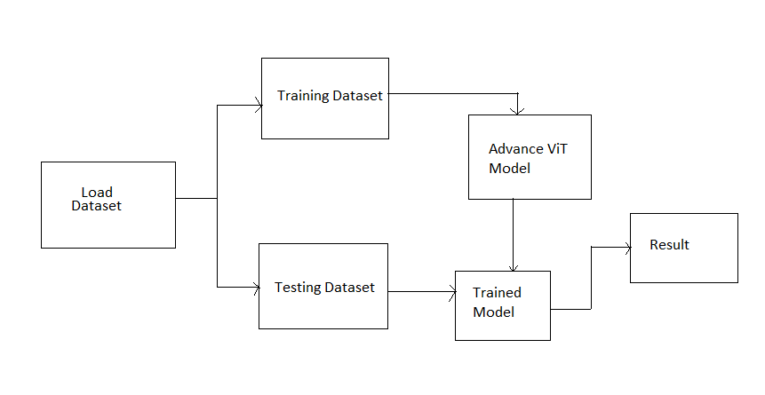
Proposed Model
Import Library (numpy, Pandas, tensorflows). After that load the full dataset and split the data into train and tast. Then we add CNN and train that model. After we build the ViT model. Then add 9 different ViT model and train that model.
9 different ViT model:-
DeepViT
MobileViT
CaiT
LeViT
RegionViT
ParallelViT
ScalableViT
NesTViT
AtsViT
Figure 2:-Proposed Model

Slide 8
Experimental Set-up
DATASET:-The textures found in histological pictures of human colorectal cancer are represented by this data set. There are two files in it:
The data includes 5000 histology pictures, Which is train Data
There have 200 histology pictures, which is test Data
IMPLEMENTATION DETAILS:- All the experiments are carried out in a Google colab: Python 3 Google Compute Engine
Backend:
RAM:12.67 GB
Disk: 107.72 GB
Figure 3:- Train Data
Figure 4:- Test data

Slide 9
Result: Example
We take a Colorectal Cancer Histological dataset and add CNN model, VIT model and 9 advanced VIT models then we calculate Accuracy, precision, recall, specificity, F1-Score etc. Here is the table
Models | Accuracy | Recall | Specificity | Precision | F1 | GM | FPR
CNN | 96.1 | 78.65 | 99.87 | 99.23 | 87.77 | 88.63 | 0.12
ViT | 96.1 | 78.65 | 99.87 | 99.29 | 87.77 | 88.63 | 0.12
DeepViT | 97 | 82.84 | 99.87 | 99.29 | 90.32 | 90.96 | 0.12
mobileViT | 97.8 | 87.42 | 99.76 | 98.58 | 92.66 | 93.38 | 0.23
CaiT | 97.4 | 84.84 | 99.88 | 99.29 | 91.5 | 92.05 | 0.11
LeViT | 99.1 | 95.2 | 99.76 | 98.58 | 96.86 | 97.45 | 0.28
RegionViT | 98.9 | 93.33 | 99.88 | 99.29 | 96.21 | 96.55 | 0.11
ParallelViT | 98.9 | 93.91 | 99.76 | 98.58 | 96.19 | 96.79 | 0.23
ScalableViT | 99.2 | 95.23 | 99.88 | 99.29 | 97.22 | 97.53 | 0.11
NesTViT | 98.8 | 94.48 | 99.53 | 97.16 | 95.8 | 96.97 | 0.46
AtSViT | 99 | 95.17 | 99.64 | 97.87 | 96.5 | 97.38 | 0.35

Slide 10
Result Analysis
In this project, we observe varying outputs from different models. ScalableViT exhibits higher accuracy with 99.2% compared to others. Meanwhile, ScalableViT demonstrated greater recall with 95.23%. ScalableViT, CaiT, and RegionViT excel in specificity with 99.88%, while ScalableViT, CaiT, RegionViT, and ViT showcase superior precision with 99.29%. Furthermore, ScalableViT displays higher F1-scores with 97.22% than other models, as well as greater geometric means (GM) with 97.53%. However, NestVit stands out with a higher false positive rate (FPR) with 0.46% relative to others.

Slide 11
Since there are multiple criteria they are giving different outputs from different models. So it is difficult to select the best model so we use the multi criteria decision making method as TOPSIS to find the best model.
According to the table the best model is the ScalaableViT for the current problem in our project.

Slide 12
Conclusions
The study employed CNNs, Vision Transformers, and a novel deep-learning methodology in computer vision to conduct multiclass tissue classification on a colorectal cancer histology dataset.
Using ViT models, the study fine-tuned multiple classes of histology images, with ScalableViT emerging as the top performer with high accuracy, recall, specificity, precision, F1-scores, and geometric means. And the less performance provided by NesTViT.

Slide 13
Future Scope
Future research should focus on validating these transformer models by using diverse datasets and conducting thorough comparisons with other models.
Also there have another model like Token to Token, CrossViT etc. In future we will implement these models for better accuracy.

Slide 14
References
[1] “Classification of Colorectal Cancer using ResNet and EfficientNet Models”, Abhishek , Abhishek Ranjan , Priyanshu Srivastva , B Prabadevi, R Sivakumar , Rahul Soangra and Shamala K. Subramaniam.
[2] "Detection of Colorectal Cancer with Vision Transformers", Emrah Hancer, Refik Samet, Zeynep Yıldırım, Mohamed Traore Mali, Nooshin Nemati .
[3] “Colon Cancer Detection using Vision Transformers and Explainable AI”, Aneesh Jayan Prabhu.
[4] Tensorflow ViT models : https://github.com/taki0112/vittensorflow/tree/main/vit_tensorflow.
[5] Dataset : https://zenodo.org/records/53169#.XGZemKwzbmG.

Slide 15
Acknowledgement
Endless gratitude to the Lord Almighty for blessings throughout the project journey, appreciation for extraordinary individuals who provided unwavering support.
Profound gratitude to project supervisor, Professor (Dr.) Tapas Si, for providing an engaging thesis topic and invaluable guidance.
Thank you to Professor Dr. Tapas Si for guidance during challenging times and encouragement throughout academic endeavors.

Slide 16

Dept. of CSE, University of Engineering & Management Jaipur

