Slide 1
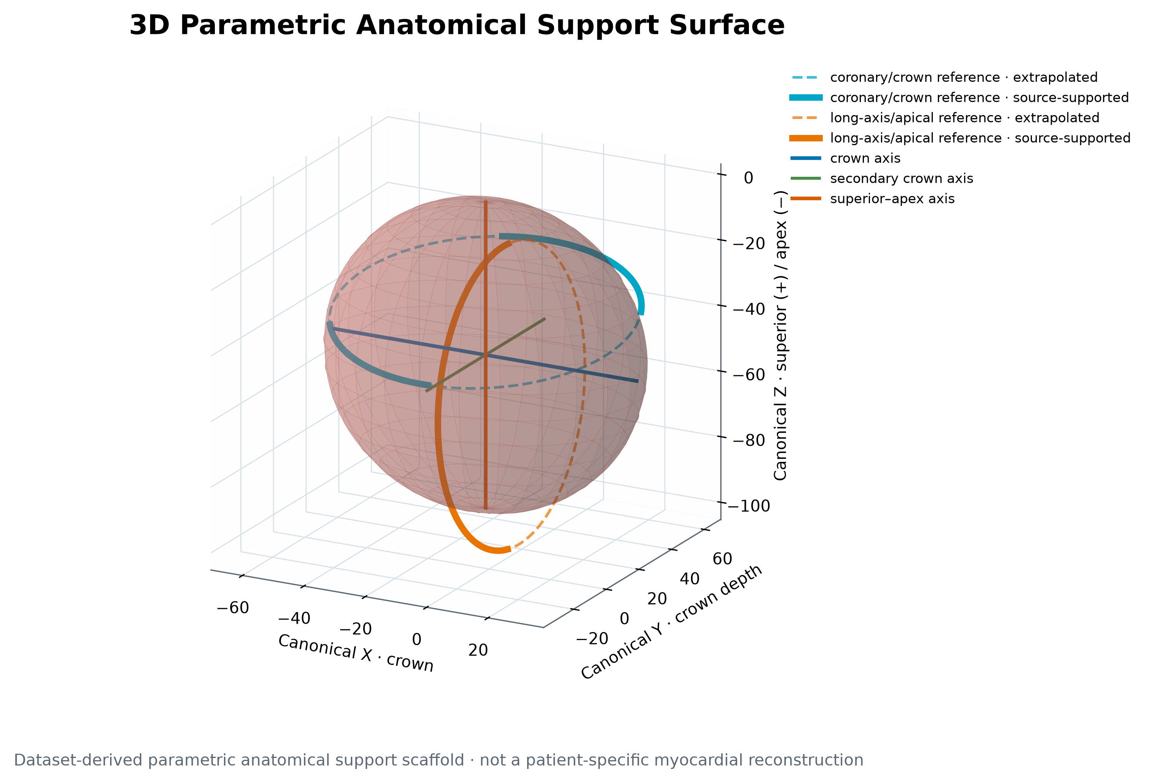
LCA / SSM · TECHNICAL MILESTONE
A dataset-derived heart scaffold is now generator-ready.
Stage‑1 · case 189.label · immutable source centerlines
Not a patient-specific myocardial reconstruction
Validated baseline · 07 AUG 2026

Slide 2
O B J E C T I V E
Stage‑1 turns saved measurements into support geometry—without touching the vessels.
SOURCE
MEASURE
SCAFFOLD
SURFACE
VALIDATE
Saved VTP + measurements
→
Centroid-SVD planes
→
Two anatomical references
→
Ellipsoid n = 2
→
Hashes + geometry guards
One global rigid canonical display transform · no projection · no deformation · no synthetic coronary geometry
189.label · Stage-1 anatomical scaffold
02

Slide 3
T R U S T C O N T R A C T
Stage‑1 is successful only if geometry, terminology, and scientific claims stay bounded.
PRESERVE
Source coordinates, segment lengths, file hashes
MEASURE
True centroid-SVD planes; measurement ≠ display
EXPLAIN
Solid observed intervals; dashed extrapolated reference
PARAMETERIZE
Surface dimensions from saved scaffold measurements
STOP
No vessel synthesis, radii, disease, motion, tubes, or meshes
This is a dataset-derived parametric anatomical support scaffold, not a patient-specific myocardial reconstruction.
189.label · Stage-1 anatomical scaffold
03

Slide 4
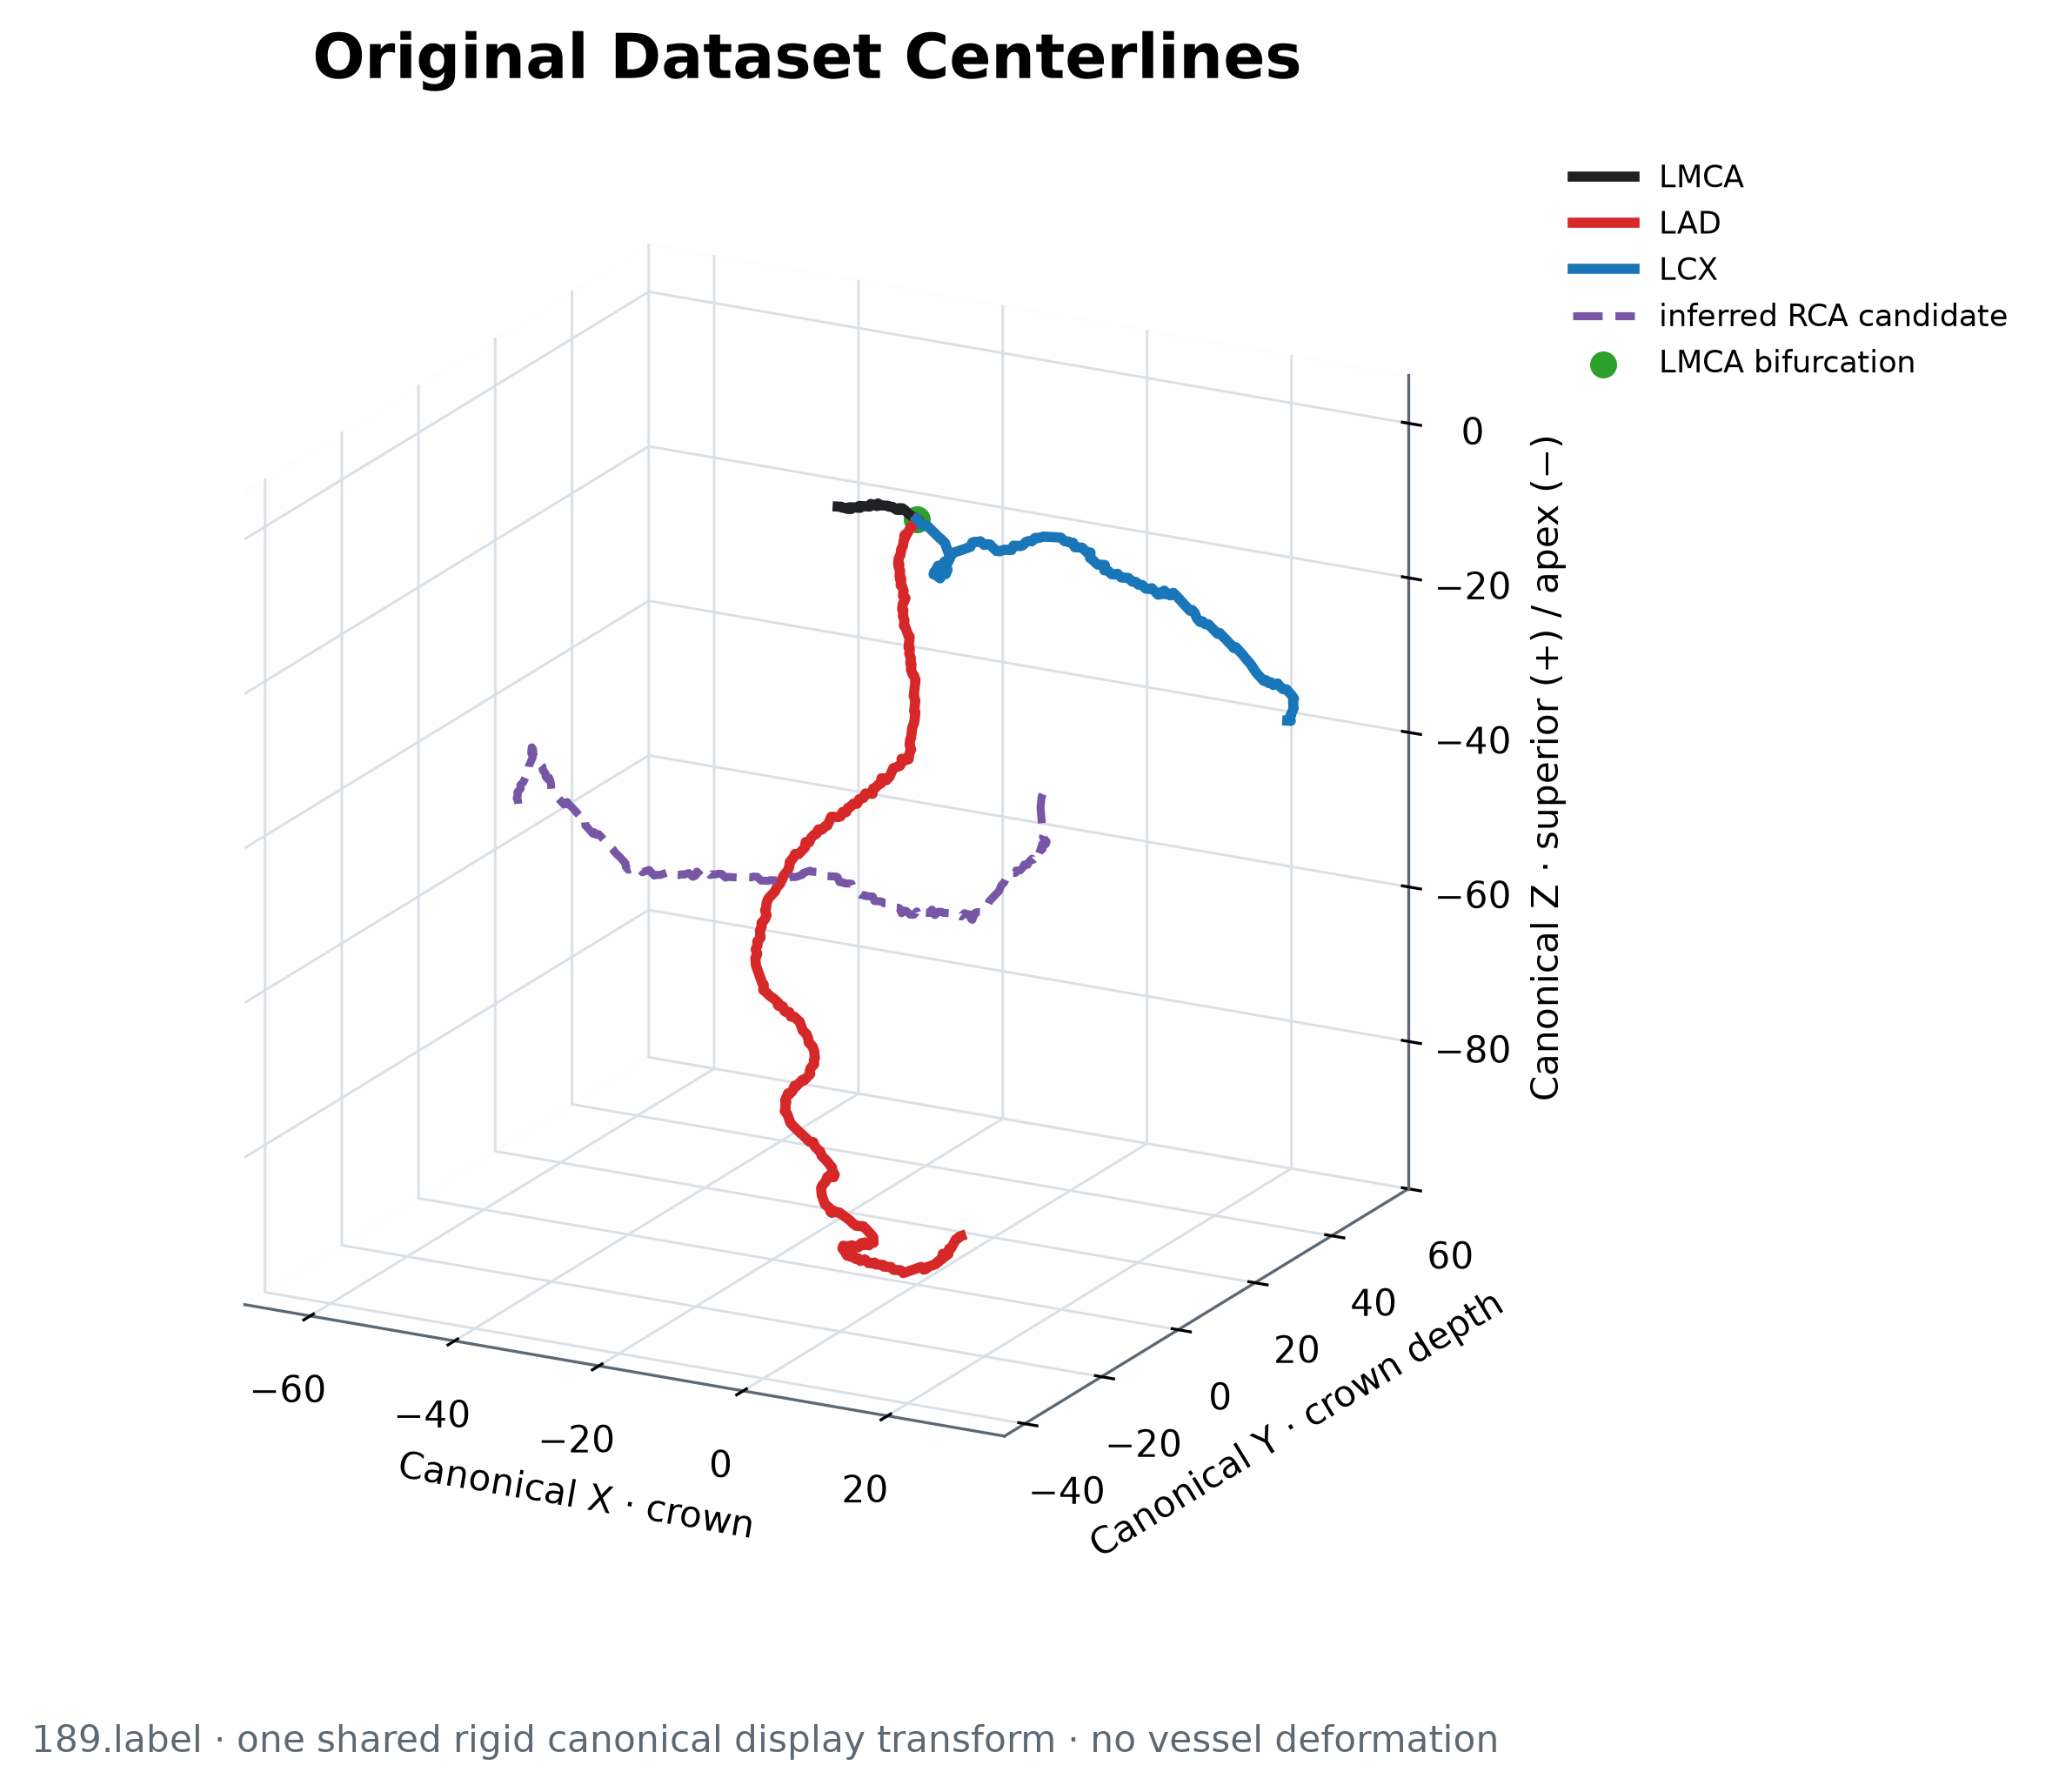
I M M U T A B L E S O U R C E
The anatomy shown here is the dataset evidence—not a regenerated coronary tree.
42
LMCA points
unchanged
352
LAD points
unchanged
187
LCX points
unchanged
249
inferred RCA candidate
not annotated ground truth
189.label · Stage-1 anatomical scaffold
04

Slide 5
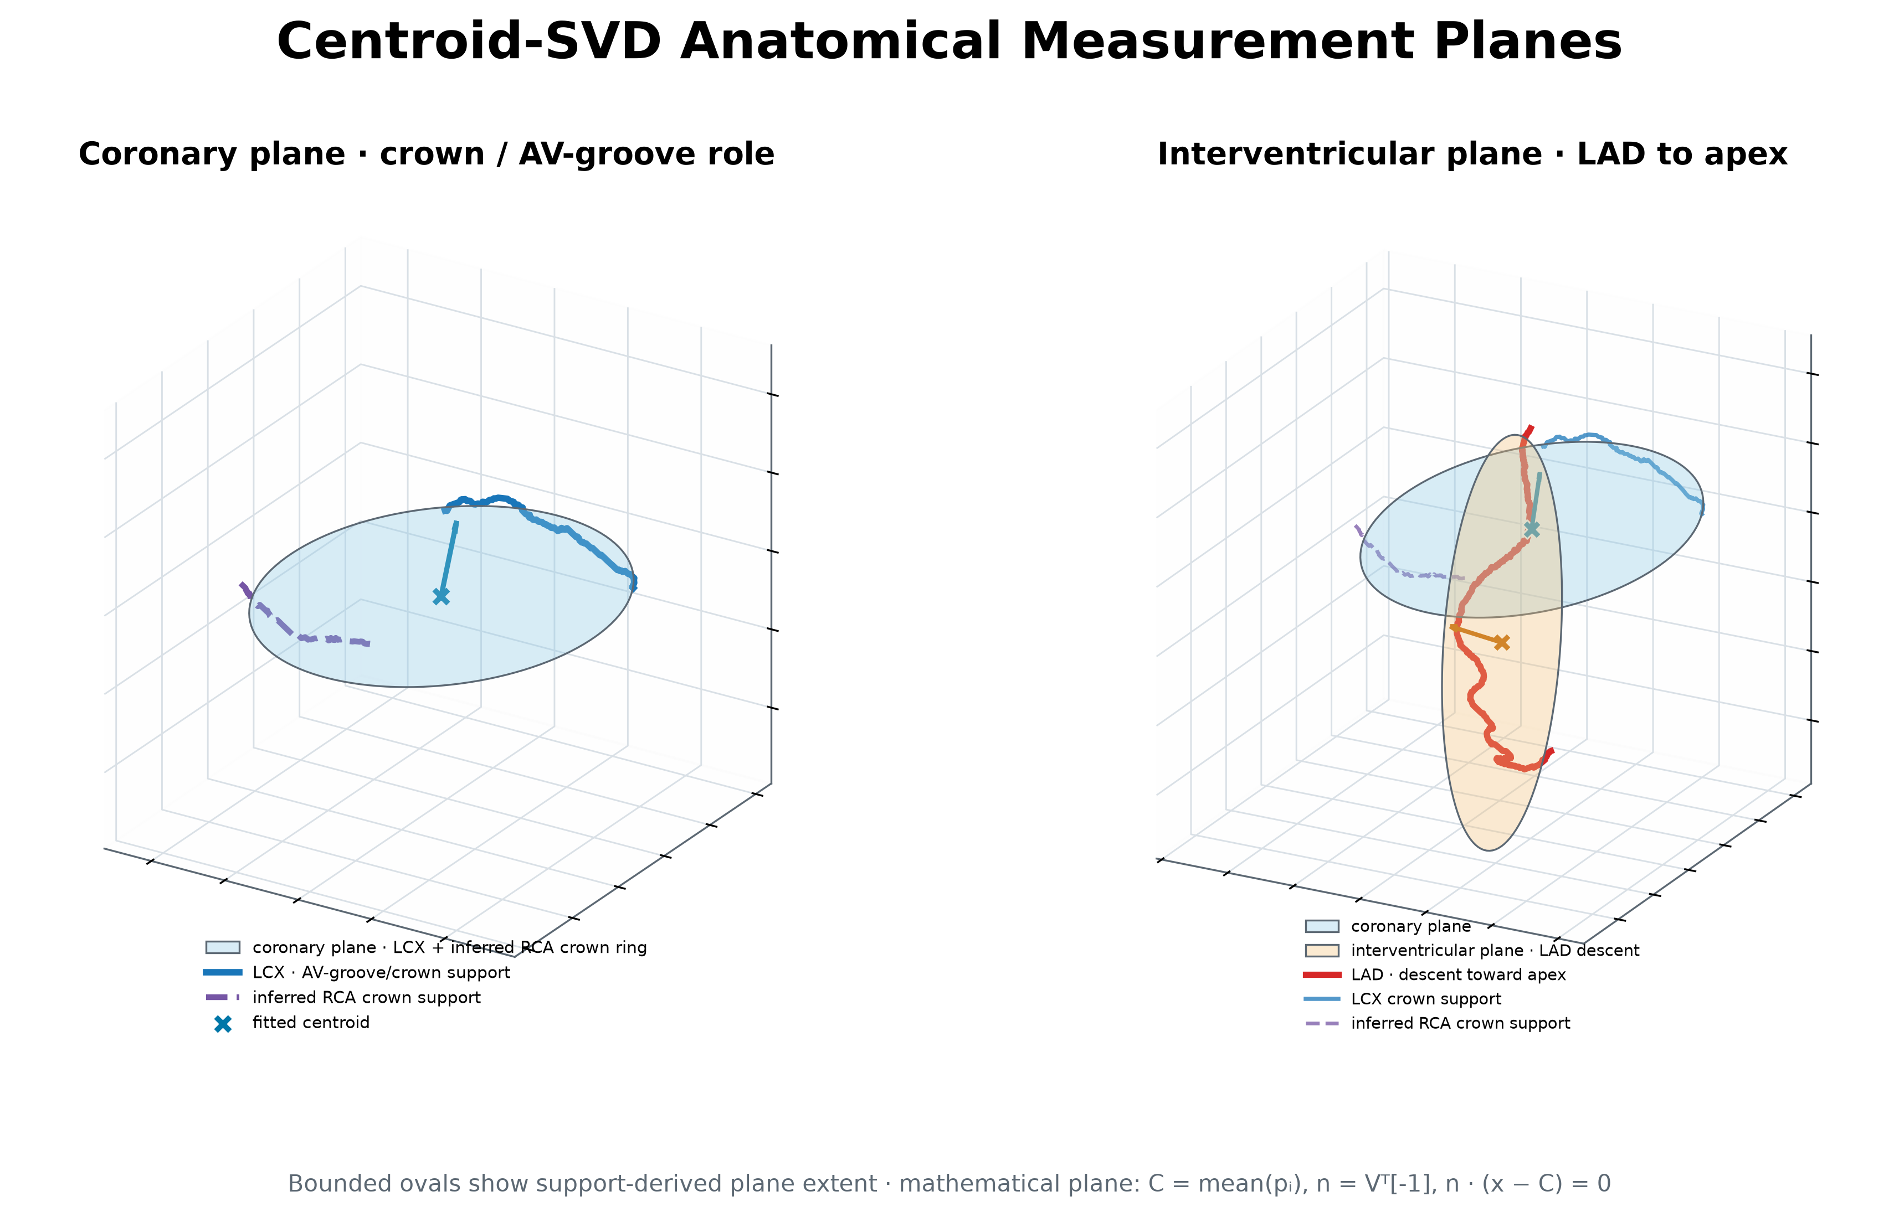
M E A S U R E M E N T
Centroid-SVD planes remain anchored to their true fitted centroids.
C = mean(pᵢ)
Q = pᵢ − C
UΣVᵀ = SVD(Q)
n = Vᵀ[−1]
Plane equation
n · (x − C) = 0
≤ 4.2e−15 mm
mesh-centroid agreement
numerical precision
189.label · Stage-1 anatomical scaffold
05

Slide 6
P L A N E R E L A T I O N S H I P
Two non-parallel measurements encode crown and apex roles separately.
1.631 mm
coronary plane RMSE
LCX + inferred RCA support
3.427 mm
LAD plane RMSE
descending trajectory support
65.56°
acute plane-normal separation
distinct anatomical roles
No plane is forced through the bifurcation. Display planes, if added later, must remain explicitly separate.
189.label · Stage-1 anatomical scaffold
06

Slide 7
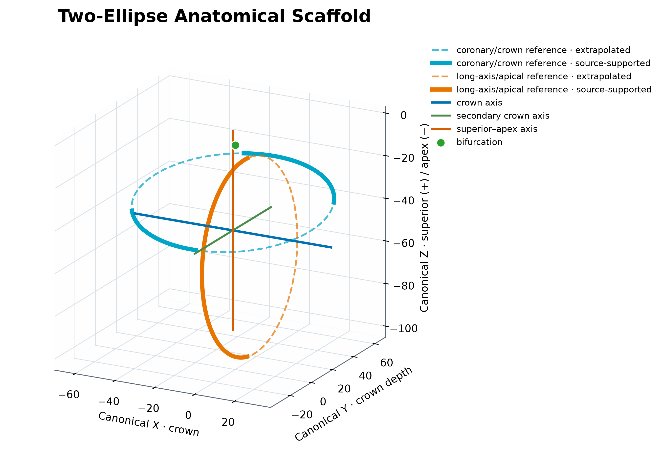
A N A T O M I C A L S C A F F O L D
Two measured reference ellipses establish crown and long-axis scale.
98.52 mm
scaffold crown span
2 × measured crown radius
93.19 mm
scaffold long-axis span
2 × measured apical radius
71.79 mm
scaffold crown depth
2 × measured minor radius
189.label · Stage-1 anatomical scaffold
07

Slide 8
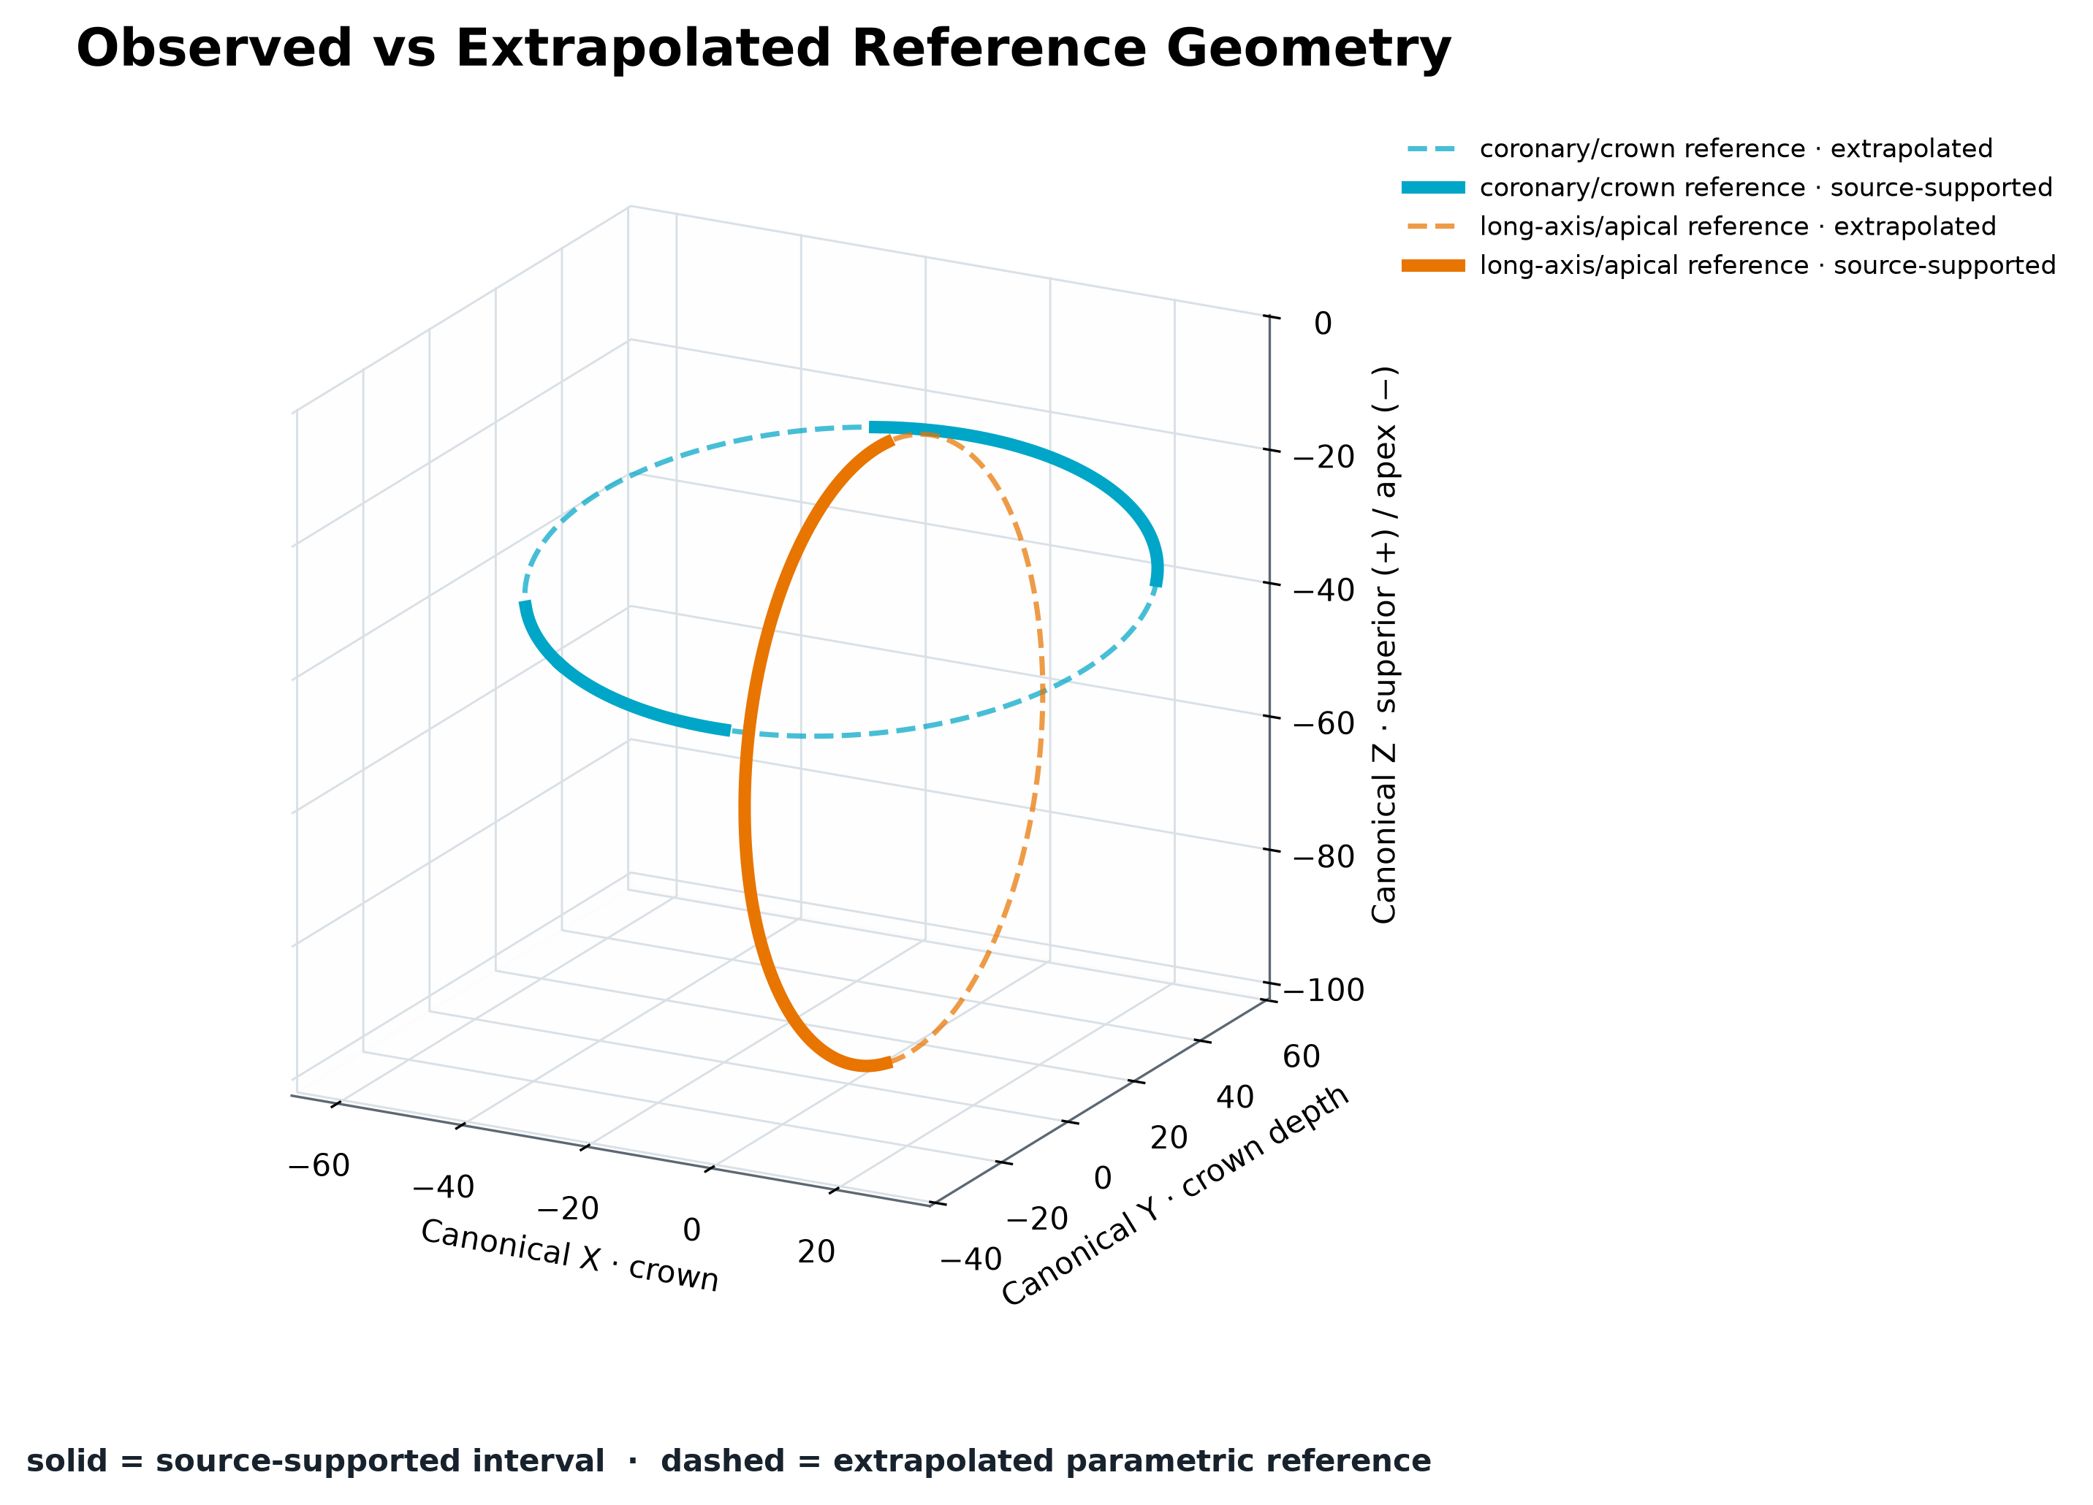
E V I D E N C E B O U N D A R Y
Line style makes observation and extrapolation impossible to confuse.
SOLID
source-supported interval
DASHED
extrapolated parametric reference
Extrapolated portions are scaffold geometry—not observed vessels.
189.label · Stage-1 anatomical scaffold
08

Slide 9
P A R A M E T R I C S U R F A C E
Saved scaffold spans parameterize a reusable ellipsoidal support surface.
(x/a)² + (y/b)² + (z/c)² = 1
49.26 mm
a · crown semi-axis
35.89 mm
b · crown-depth semi-axis
46.60 mm
c · long-axis semi-axis
baseline exponent n = 2
189.label · Stage-1 anatomical scaffold
09

Slide 10
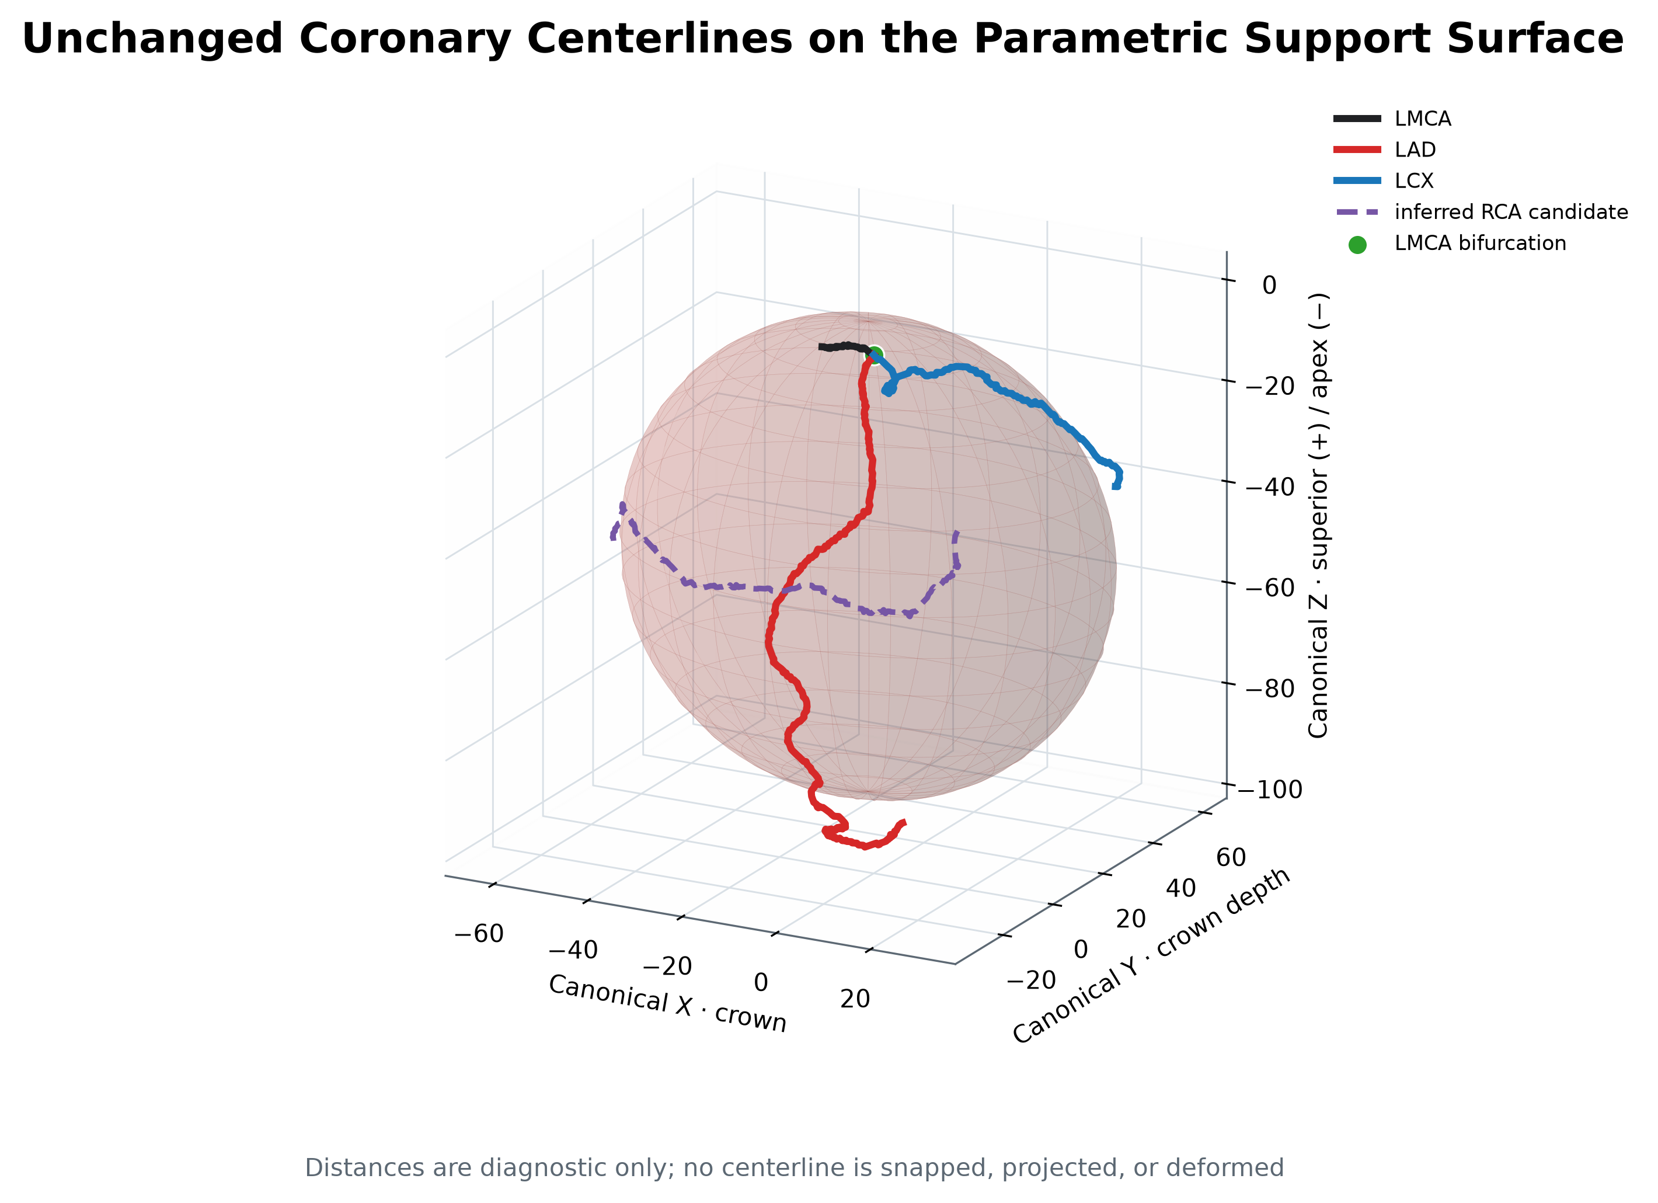
D I A G N O S T I C — N O T A L O S S
Surface distance quantifies mismatch; it never moves or rejects a source point.
SOURCE → SURFACE RMSE
LAD
23.05 mm
LMCA
13.55 mm
RCA*
10.52 mm
LCX
8.55 mm
LAD mismatch is deliberately visible: the baseline surface is anatomical support, not a close vessel-fit model.
189.label · Stage-1 anatomical scaffold
10

Slide 11
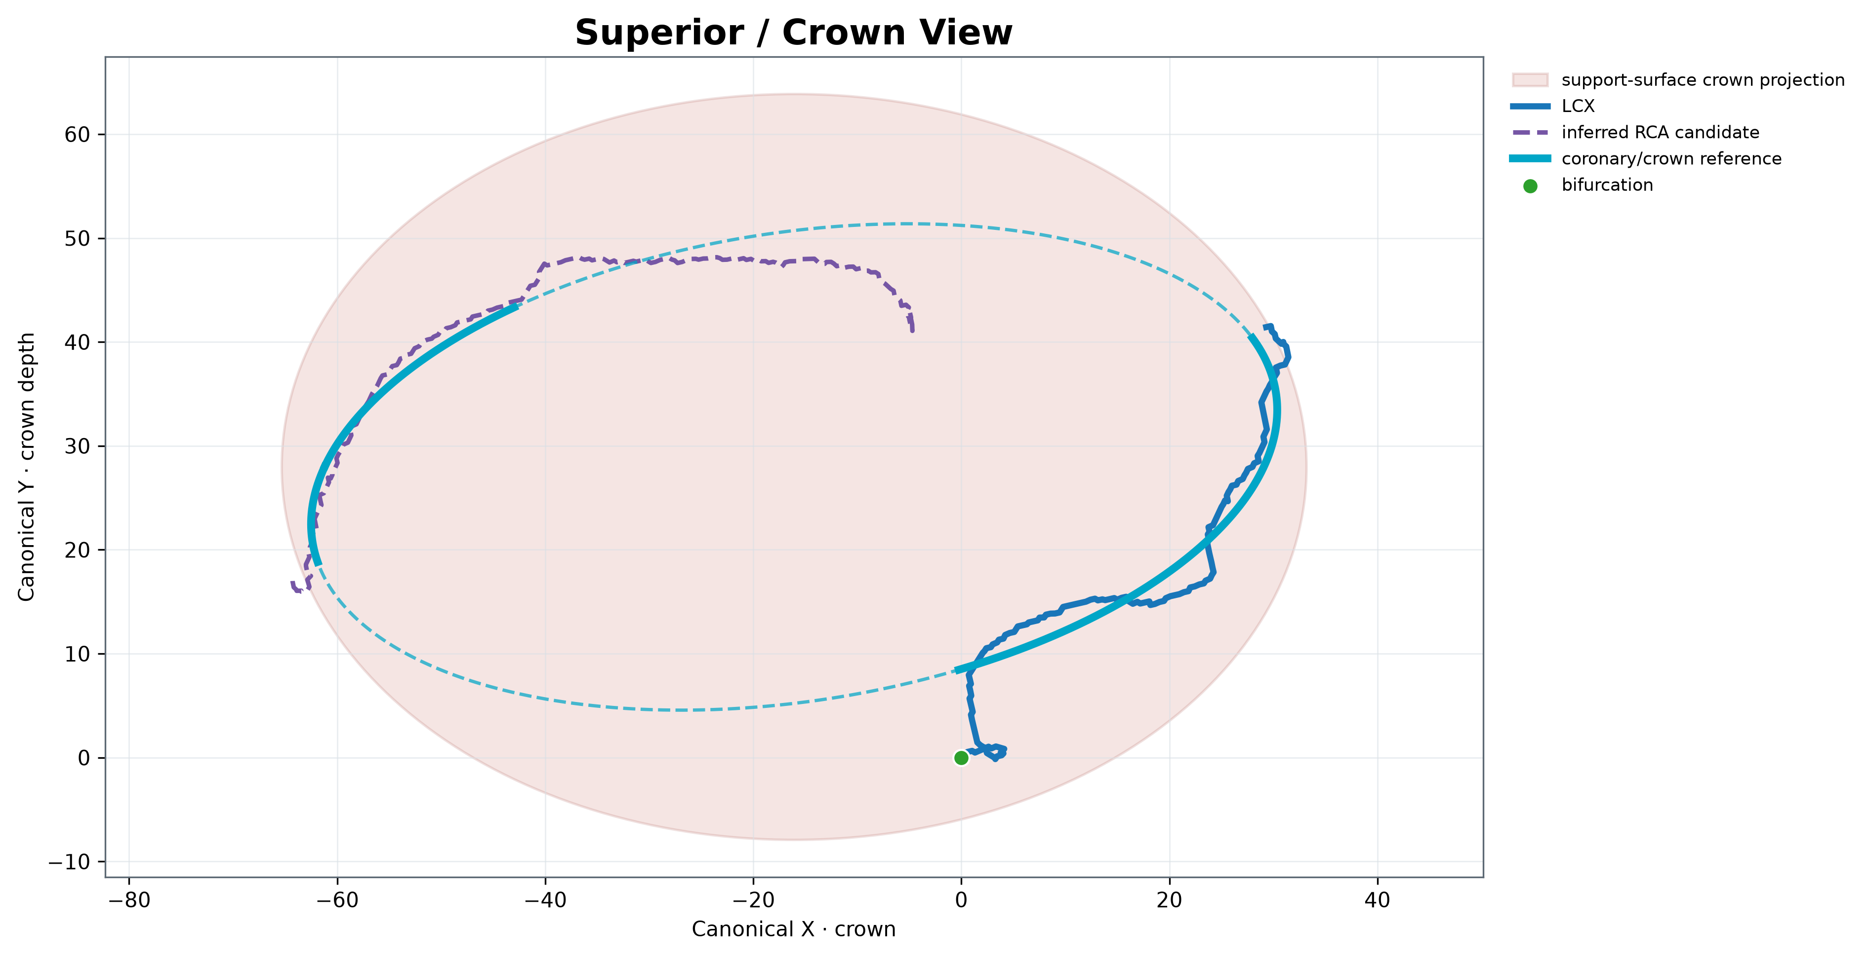
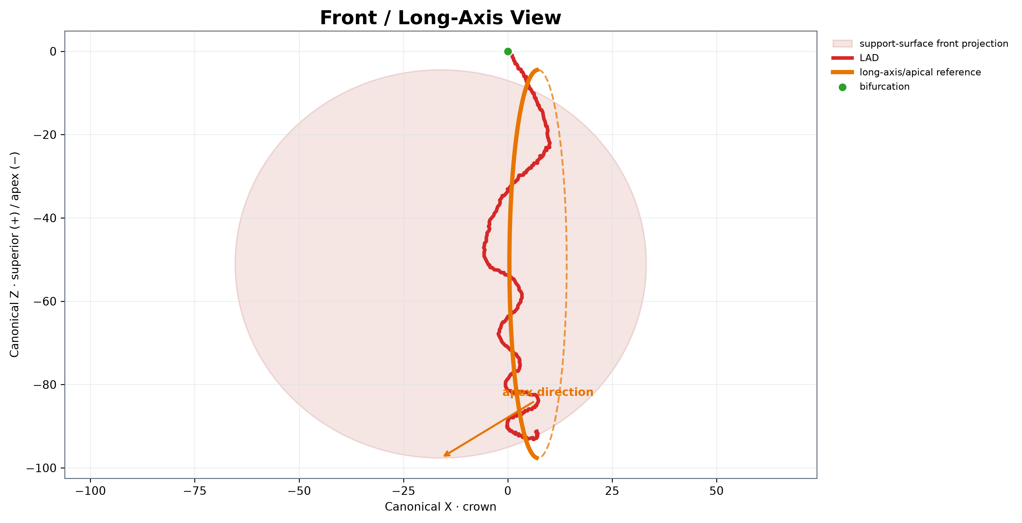
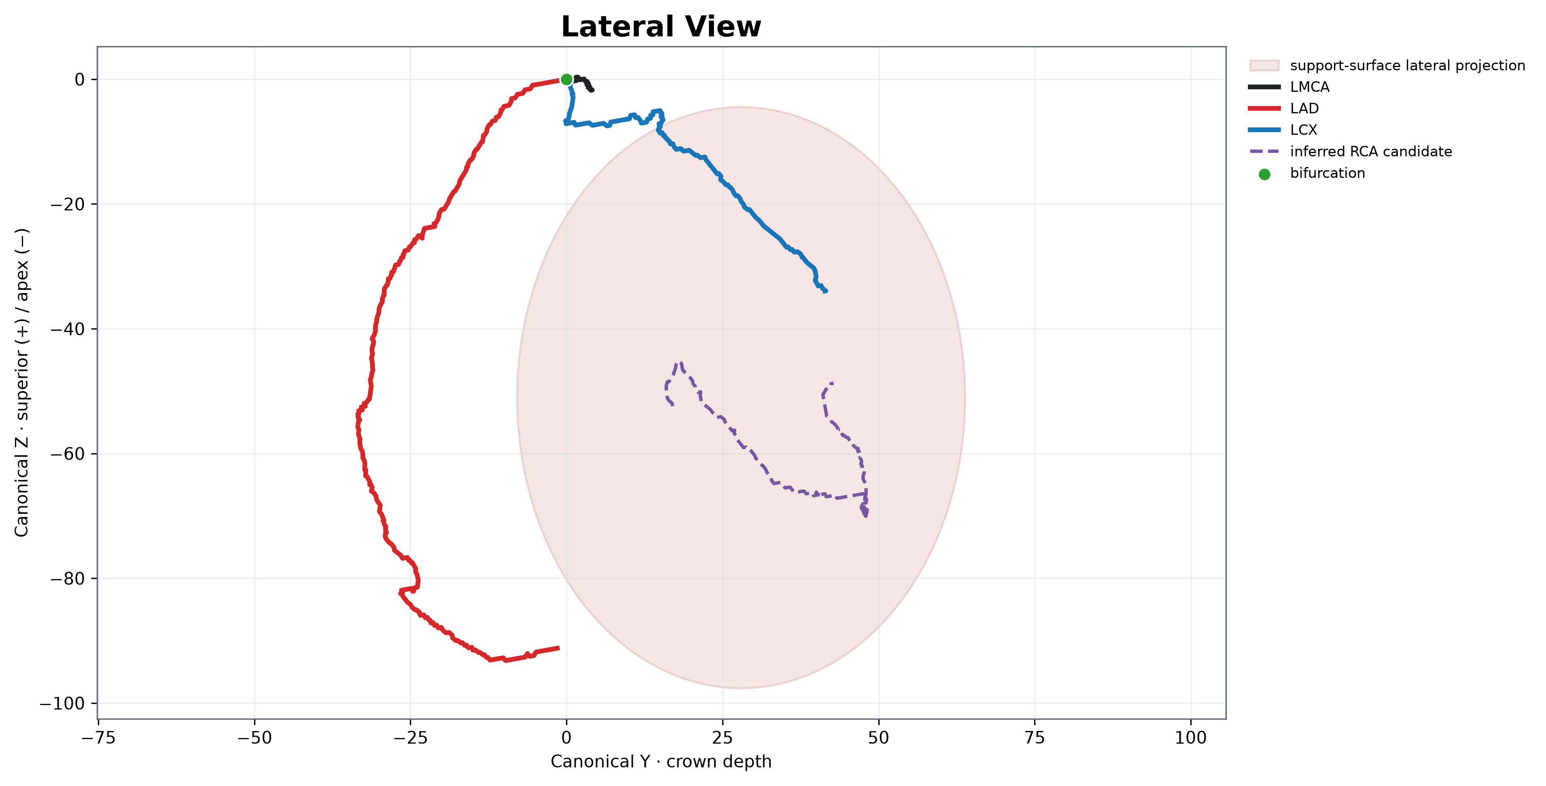
C A N O N I C A L R E V I E W
Three orthographic views expose anatomical role and residual mismatch.
SUPERIOR · crown
FRONT · long axis
LATERAL · depth
Canonical X = crown · Y = crown depth · Z = superior (+) / apex (−)
189.label · Stage-1 anatomical scaffold
11

Slide 12
F U T U R E A R C H I T E C T U R E
Stage‑C should generate trajectories in surface-relative coordinates—not Cartesian templates.
SCaffold
TRAJECTORY
BRANCH LOGIC
GEOMETRY
VALIDATE
u, v, normal
→
θ(s), φ(s), offset(s)
→
tree + continuity
→
centerline candidates
→
anatomy + integrity
A/B COMPLETE
C–H FUTURE
Surface API already exposes point, normal, coordinate conversion, nearest point, and distance.
189.label · Stage-1 anatomical scaffold
12

Slide 13
V T K O W N E R S H I P
Five multiblocks separate source, scaffold, surface, and complete-model concerns.
STAGE1 COMPLETE MODEL
13 named blocks
SOURCE CENTERLINES
LMCA · LAD · LCX · RCA* · bifurcation
5 blocks
MEASUREMENT PLANES
coronary centroid-SVD · LAD centroid-SVD
2 blocks
REFERENCE SCAFFOLD
two ellipses · three axes · bifurcation
7 blocks
PARAMETRIC SURFACE
triangular VTP · n=2 · normals
1 block
189.label · Stage-1 anatomical scaffold
13

Slide 14
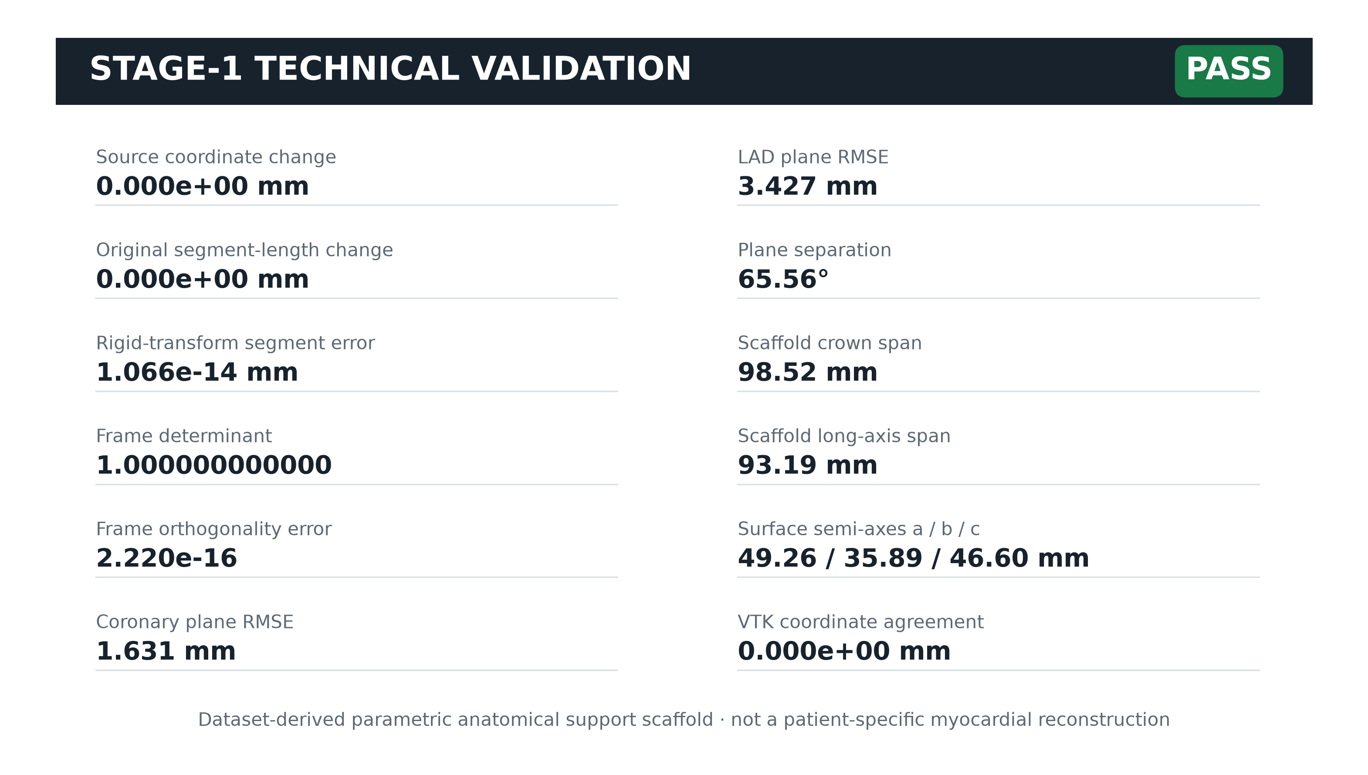
V A L I D A T I O N
Every scientific and file-integrity guard passes for 189.label.
0.000 mm
source coordinate change
0.000 mm
original segment change
1.07e−14 mm
rigid-transform error
PASS · source hashes unchanged · required VTK blocks present
189.label · Stage-1 anatomical scaffold
14

Slide 15
L I M I T A T I O N S
The baseline is deliberately useful—and deliberately incomplete.
RCA*
Inferred candidate; not annotated RCA ground truth
DIMENSIONS
Coronary-derived scaffold scale is not myocardial scale
ELLIPSE
Dashed portions are extrapolated parametric references
SURFACE
Ellipsoid n=2 is support geometry, not clinical reconstruction
GENERATION
No synthetic coronary trajectories exist in Stage‑1
Distance diagnostics describe model mismatch; they are not acceptance thresholds for source anatomy.
189.label · Stage-1 anatomical scaffold
15

Slide 16
DECISION
Stage‑1 is ready to support controlled Stage‑C trajectory research.
IMMUTABLE
MEASURED
MODULAR
HONEST
0.000 mm source change
98.52 × 93.19 mm scaffold
5 VTM assemblies
LAD surface RMSE 23.05 mm
Next: learn surface-relative coronary trajectories while preserving the same source-integrity contract.
Dataset-derived parametric anatomical support scaffold · not a patient-specific myocardial reconstruction

