Slide 1
PPT-PRIORITY COMPLETION
The original two-plane + two-ellipse measurement pipeline is complete.
Population measurements and statistics are finished across the available cohort. The generative model is intentionally deferred.
200
191
77,337
0.0 mm
PRE-GENERATION BOUNDARY
NIfTI labels
complete cases
point residuals
source change
No synthetic vessels
were created.
programmatically discovered
two planes + two ellipses
source vs ellipse records
coordinates and segments
Source: measured PPT-priority outputs • generator deferred
01

Slide 2
SOURCE OF TRUTH
One pipeline governs the work — and this increment stops at statistics.
200 NIfTI
labels
centerlines +
landmarks
2 SVD
planes
2 fitted
ellipses
population
statistics
STOP
→
→
→
→
before
generation
Original PPT work = primary
This deck reports measured evidence only. Parameter sampling, synthetic control points, noise sampling, generated bifurcations, B-splines and real-vs-generated comparisons remain outside this increment.
Heart-support surface = preserved extension
Source: measured PPT-priority outputs • generator deferred
02

Slide 3
REUSE, NOT RESTART
Good extraction and geometry code was reused; the PPT gaps were filled independently.
REUSED
ADDED FOR PPT DEFINITION
• NIfTI discovery and label adapter
• LMCA/LAD/LCX extraction
• multi-signal RAS daughter assignment
• inferred RCA candidate logic
• centroid-SVD plane utility
• exact source landmark/endpoints
• deterministic population RAS plane basis
• all-support actual 2-D ellipse fit
• fixed theta and axial tilt conventions
• branch angular extents on ellipse
• signed per-point residual table
• robust, circular and correlation statistics
Protected outputs were hash-checked before and after the run: Stage-1 VTK scaffold and parametric heart surface remained unchanged.
Source: measured PPT-priority outputs • generator deferred
03

Slide 4
METHOD SEPARATION
SVD answers “which plane?”; ellipse fitting answers “which a, b and tilt?”.
A — SVD PLANE
B — ACTUAL ELLIPSE
source XYZ → centroid → SVD
plane (u,v) → nonlinear 2-D fit
Outputs
→
Outputs
centroid
normal
plane basis
point-to-plane residual
center
semi-major a
semi-minor b
axial tilt + fit residual
does not output a, b or tilt
lifts back to 3-D only for reference/visualization
The source coordinate array is copied, measured and hash-verified. It is never snapped to either object.
Source: measured PPT-priority outputs • generator deferred
04

Slide 5
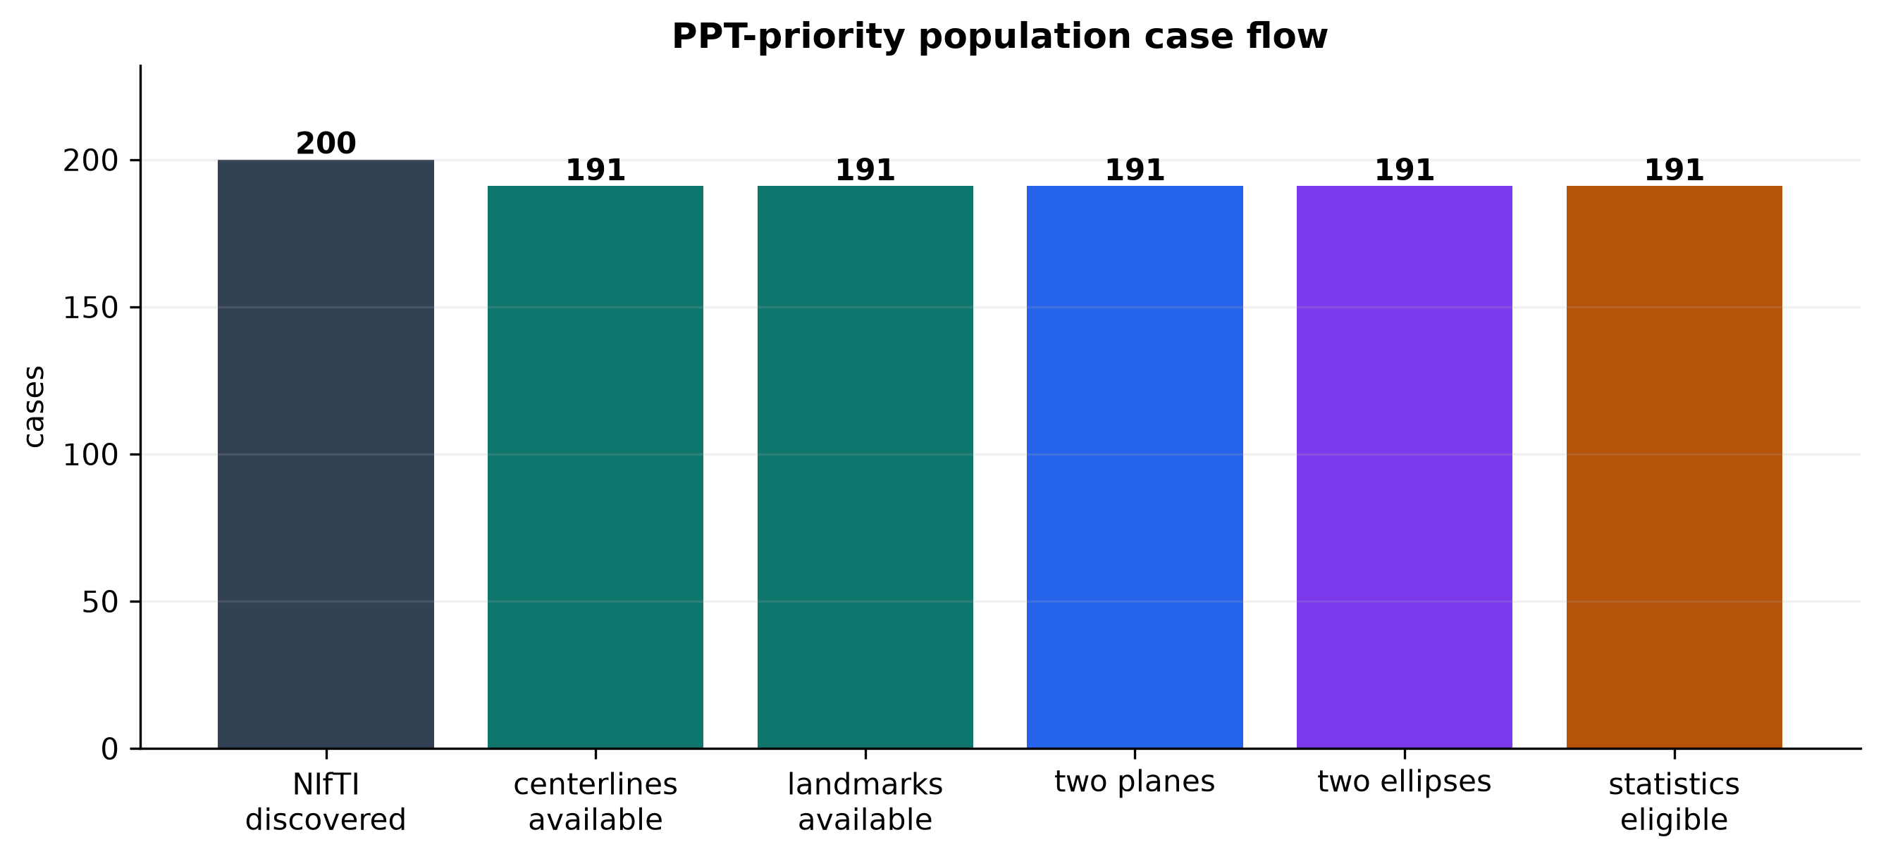
COHORT RESULT
191 of 200 label volumes complete both planes and both ellipses.
Nine cases retain the existing documented failure: no bifurcation satisfied Stage-2 LCA selection thresholds.
191
eligible cases
95.5% of discovered
Source: measured PPT-priority outputs • generator deferred
05

Slide 6
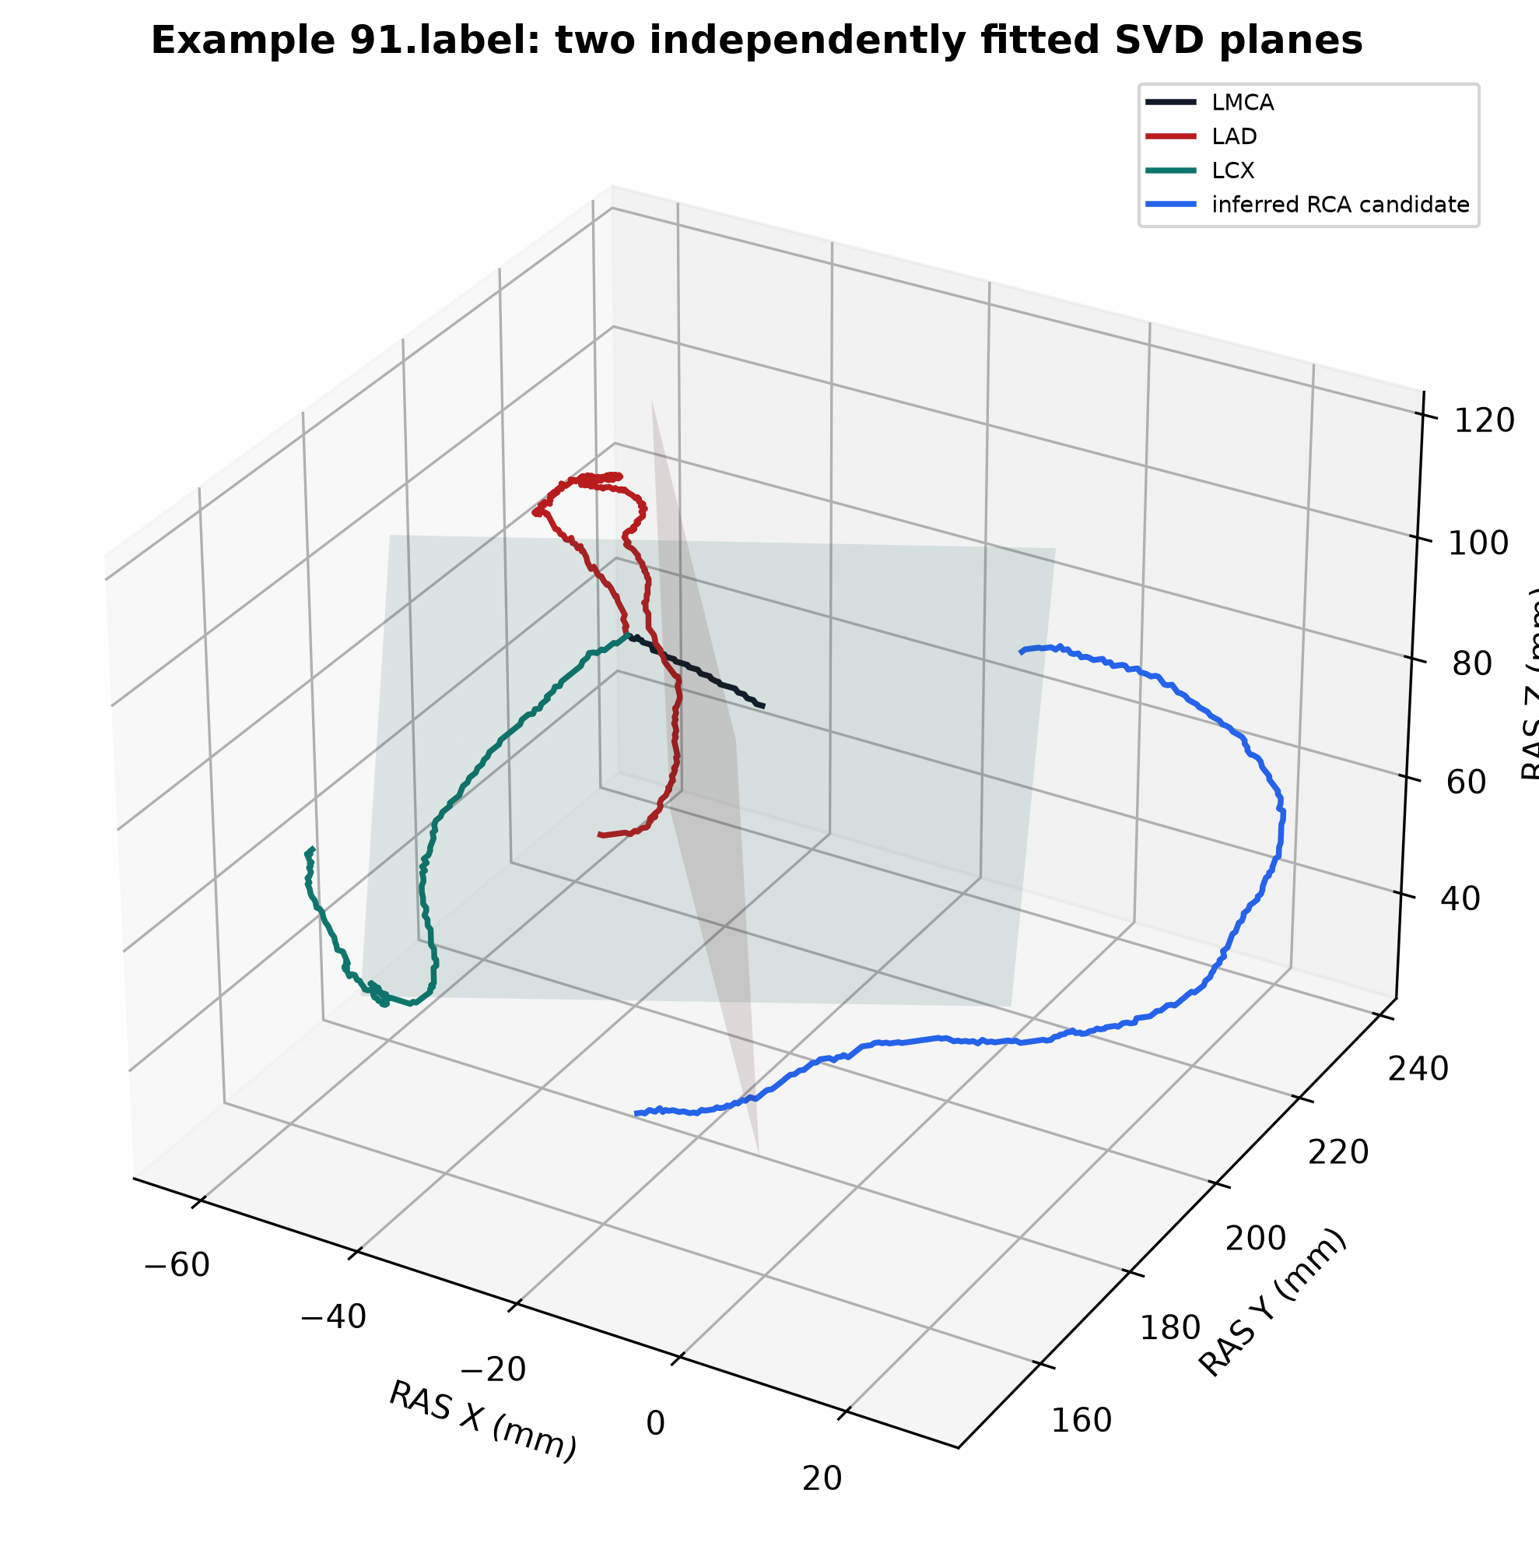
TWO PLANES / PATIENT
The crown and LAD planes retain distinct anatomical roles.
Crown support: LCX + inferred RCA candidate where available. LAD plane: unchanged LAD descent. RCA remains candidate—not annotated ground truth.
189
inferred RCA support
2 LCX-only approximations
Source: measured PPT-priority outputs • generator deferred
06

Slide 7
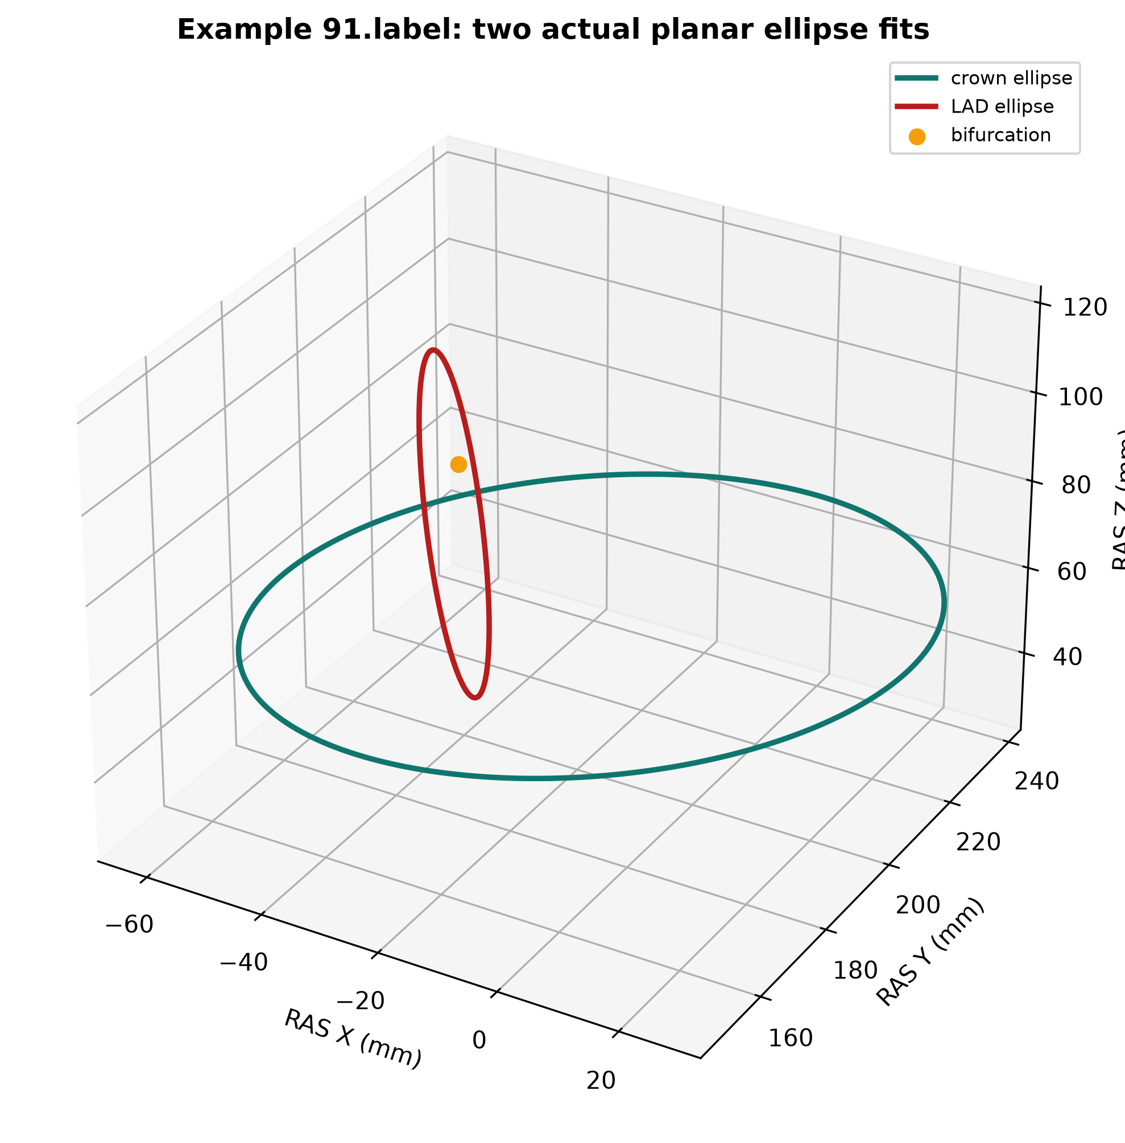
TWO ACTUAL ELLIPSES
Each projected support set is fit by a genuine planar ellipse — never by the SVD display patch.
The source arteries remain unchanged. Ellipse curves are statistical references measured in their fitted planes.
2 × 191
actual ellipse fits
all unchanged source support
Source: measured PPT-priority outputs • generator deferred
07

Slide 8
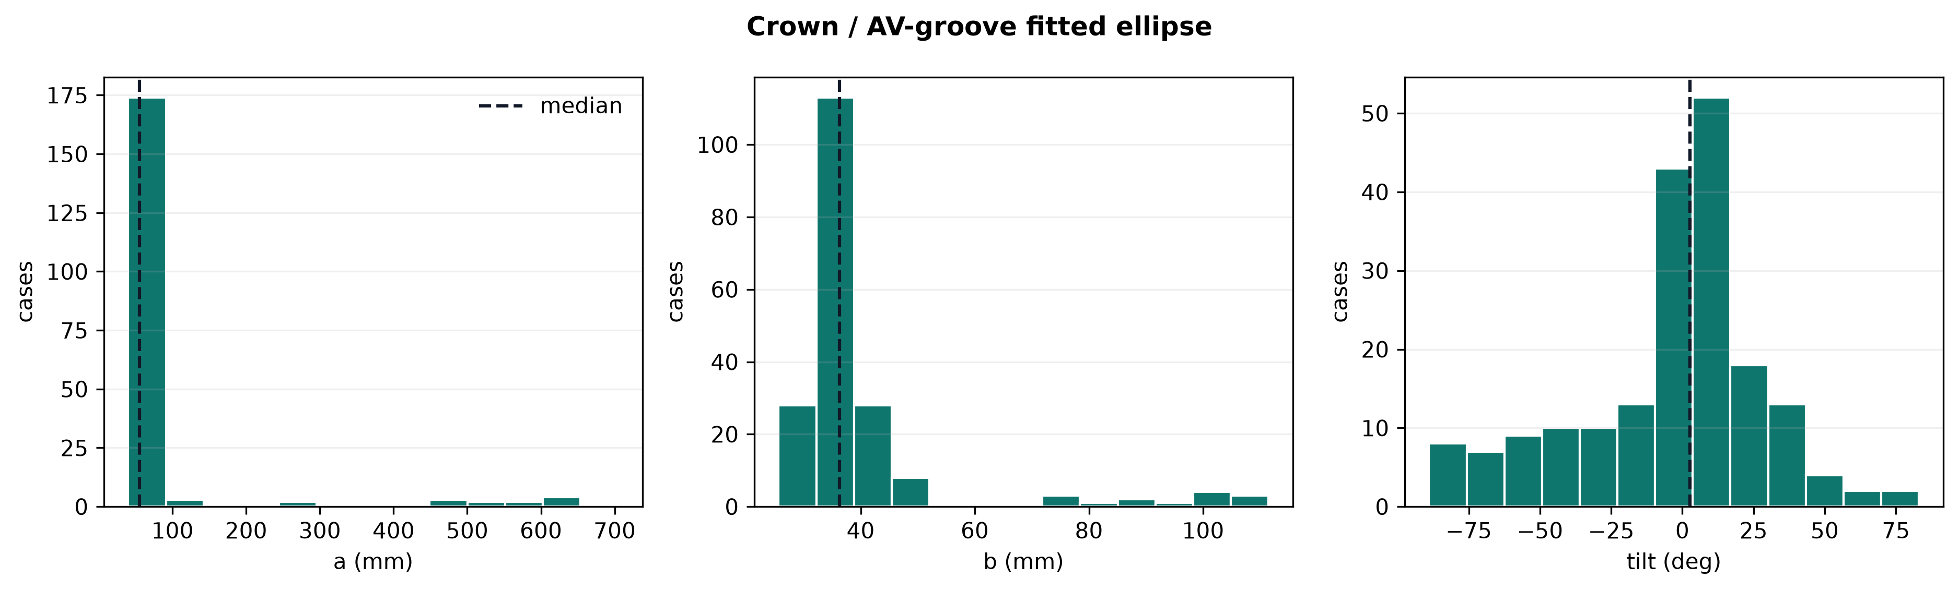
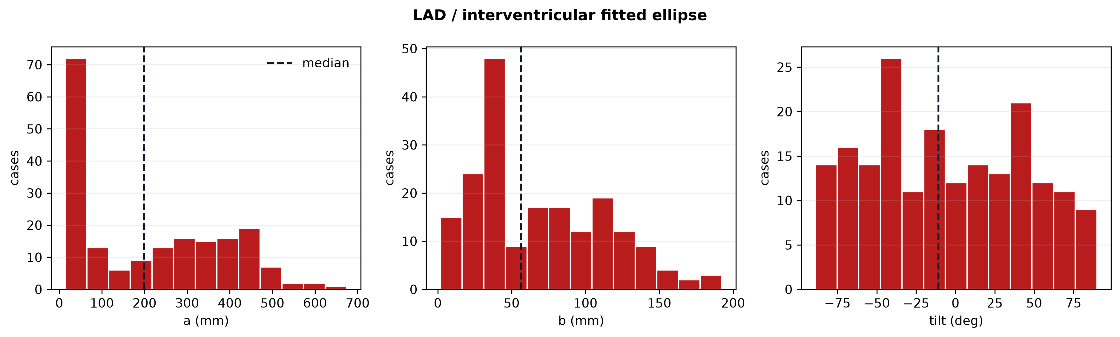
ELLIPSE PARAMETERS
Partial arterial arcs create long-tailed full-ellipse parameters — the tails stay visible.
55.2 mm
198.5 mm
Scientific handling
No cases were removed simply to lower RMSE. Mean, median, IQR, P5 and P95 expose fit instability transparently.
crown a median
LAD a median
mean 90.8 • long upper tail
mean 215.0 • partial-arc fit
Source: measured PPT-priority outputs • generator deferred
08

Slide 9
ANGLE CONVENTION
A deterministic RAS-tied frame removes arbitrary axis signs from population theta.
1
Plane u comes from projected RAS +X; +Y/+Z are deterministic fallbacks.
+ minor axis
2
Normal sign uses fixed RAS Z/Y/X priority, producing a right-handed frame.
θ = 0
major axis e₁
3
Ellipse major axis is axial: tilt lives in [−90°, 90°); theta increases toward +minor axis.
This convention prevents 180° sign flips from corrupting population statistics.
Source: measured PPT-priority outputs • generator deferred
09

Slide 10
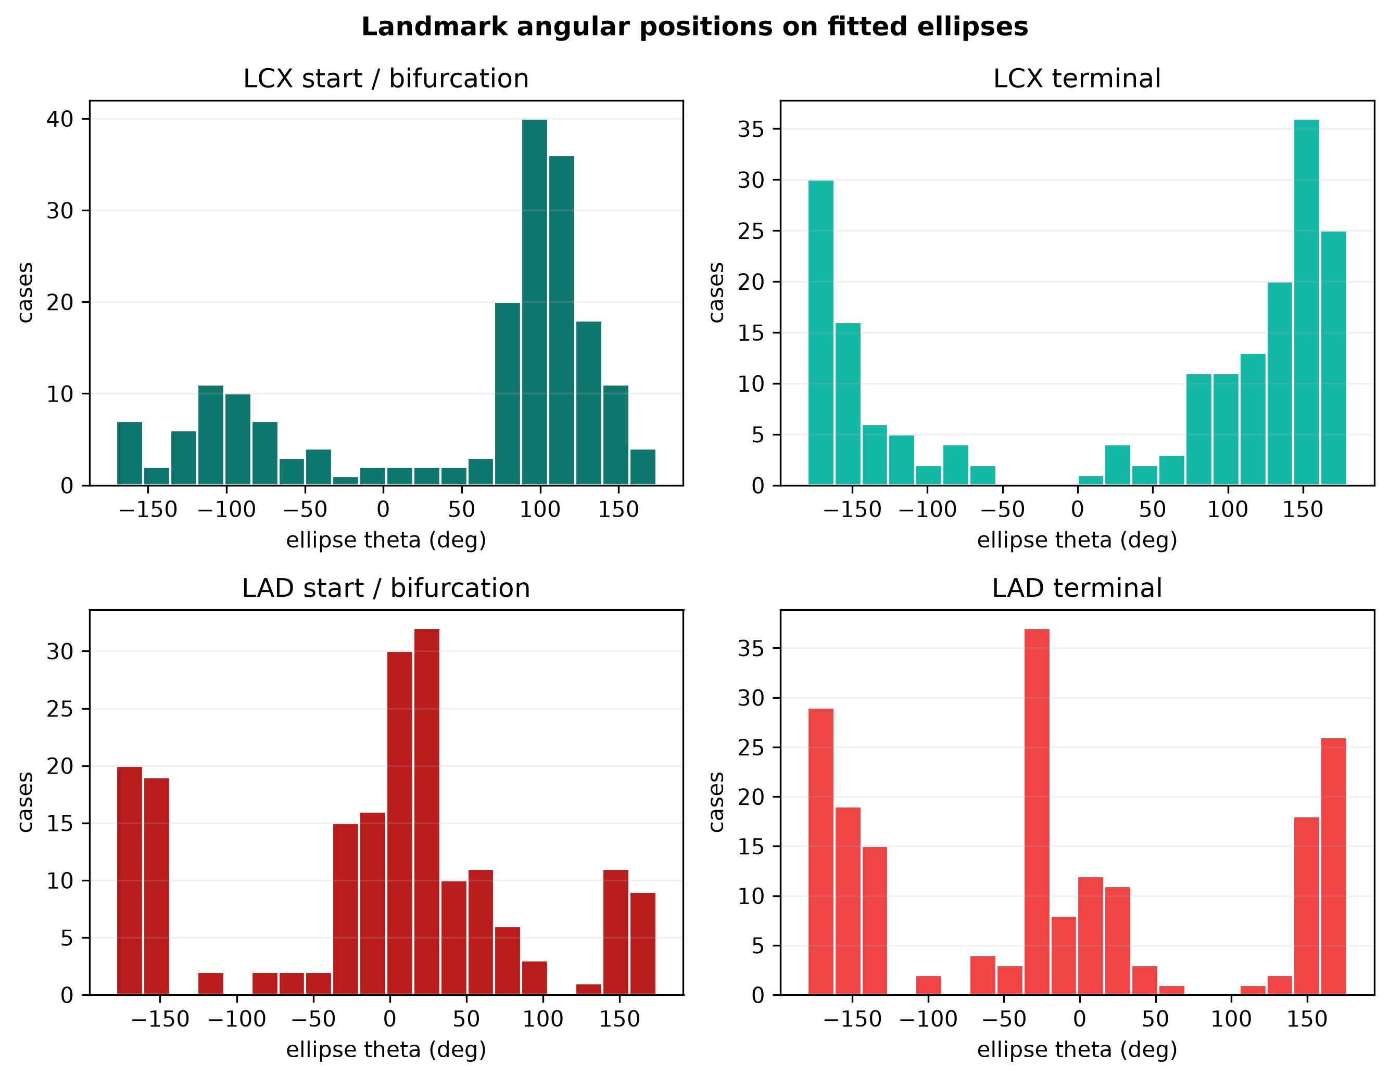
LANDMARK THETA
Bifurcation and terminal positions are circular variables, not ordinary means.
Landmark theta has a 360° period. Circular mean, circular standard deviation and resultant length are exported.
360°
theta period
directional circular
Source: measured PPT-priority outputs • generator deferred
10

Slide 11
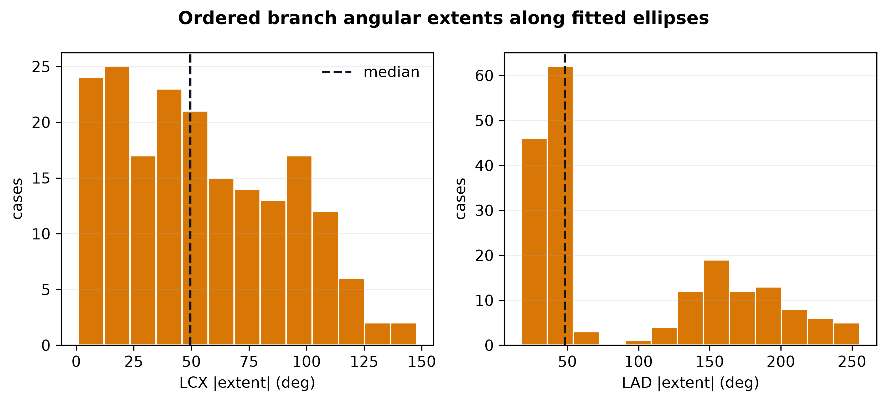
BRANCH EXTENT
LAD and LCX extent is measured along the fitted ellipse, in source order.
LCX |extent| mean 54.1°. LAD |extent| mean 95.4°. Extent is unwrapped terminal theta minus initial theta—not a Euclidean bifurcation angle.
95.4°
mean LAD extent
LCX mean 54.1°
Source: measured PPT-priority outputs • generator deferred
11

Slide 12
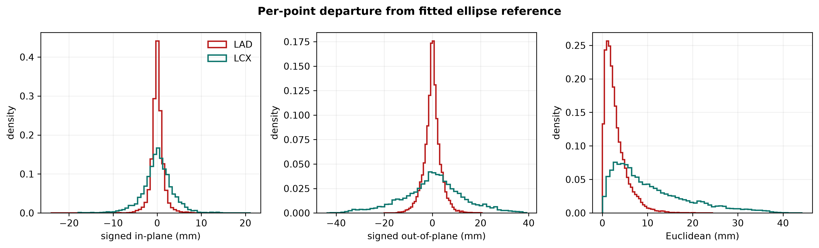
PER-POINT DEVIATION
77,337 point records preserve how vessels depart from ideal ellipses.
Each row stores normalized branch position, theta, source XYZ, reference XYZ, signed in-plane residual, signed out-of-plane residual and Euclidean residual.
10.66 mm
LCX mean point residual
LAD mean 2.99 mm
Source: measured PPT-priority outputs • generator deferred
12

Slide 13
POPULATION STATISTICS
Every model variable carries robust summaries; angles also carry circular summaries.
CROWN
LAD
RELATION
RESIDUAL
a 90.8 ± 127.8 mm
a 215.0 ± 168.8 mm
plane angle 70.4 ± 15.3°
LCX mean 10.66 mm
b 40.4 ± 15.9 mm
b 69.0 ± 44.7 mm
LCX extent 54.1 ± 35.7°
LAD mean 2.99 mm
tilt μc 1.7° • σc 31.5°
tilt μc −29.0° • σc 68.0°
LAD extent 95.4 ± 71.5°
signed + Euclidean pooled
Each variable exports N • mean • sample SD • median • IQR • min/max • P5/P95 — plus circular mean, circular SD and resultant length where appropriate.
Source: measured PPT-priority outputs • generator deferred
13

Slide 14
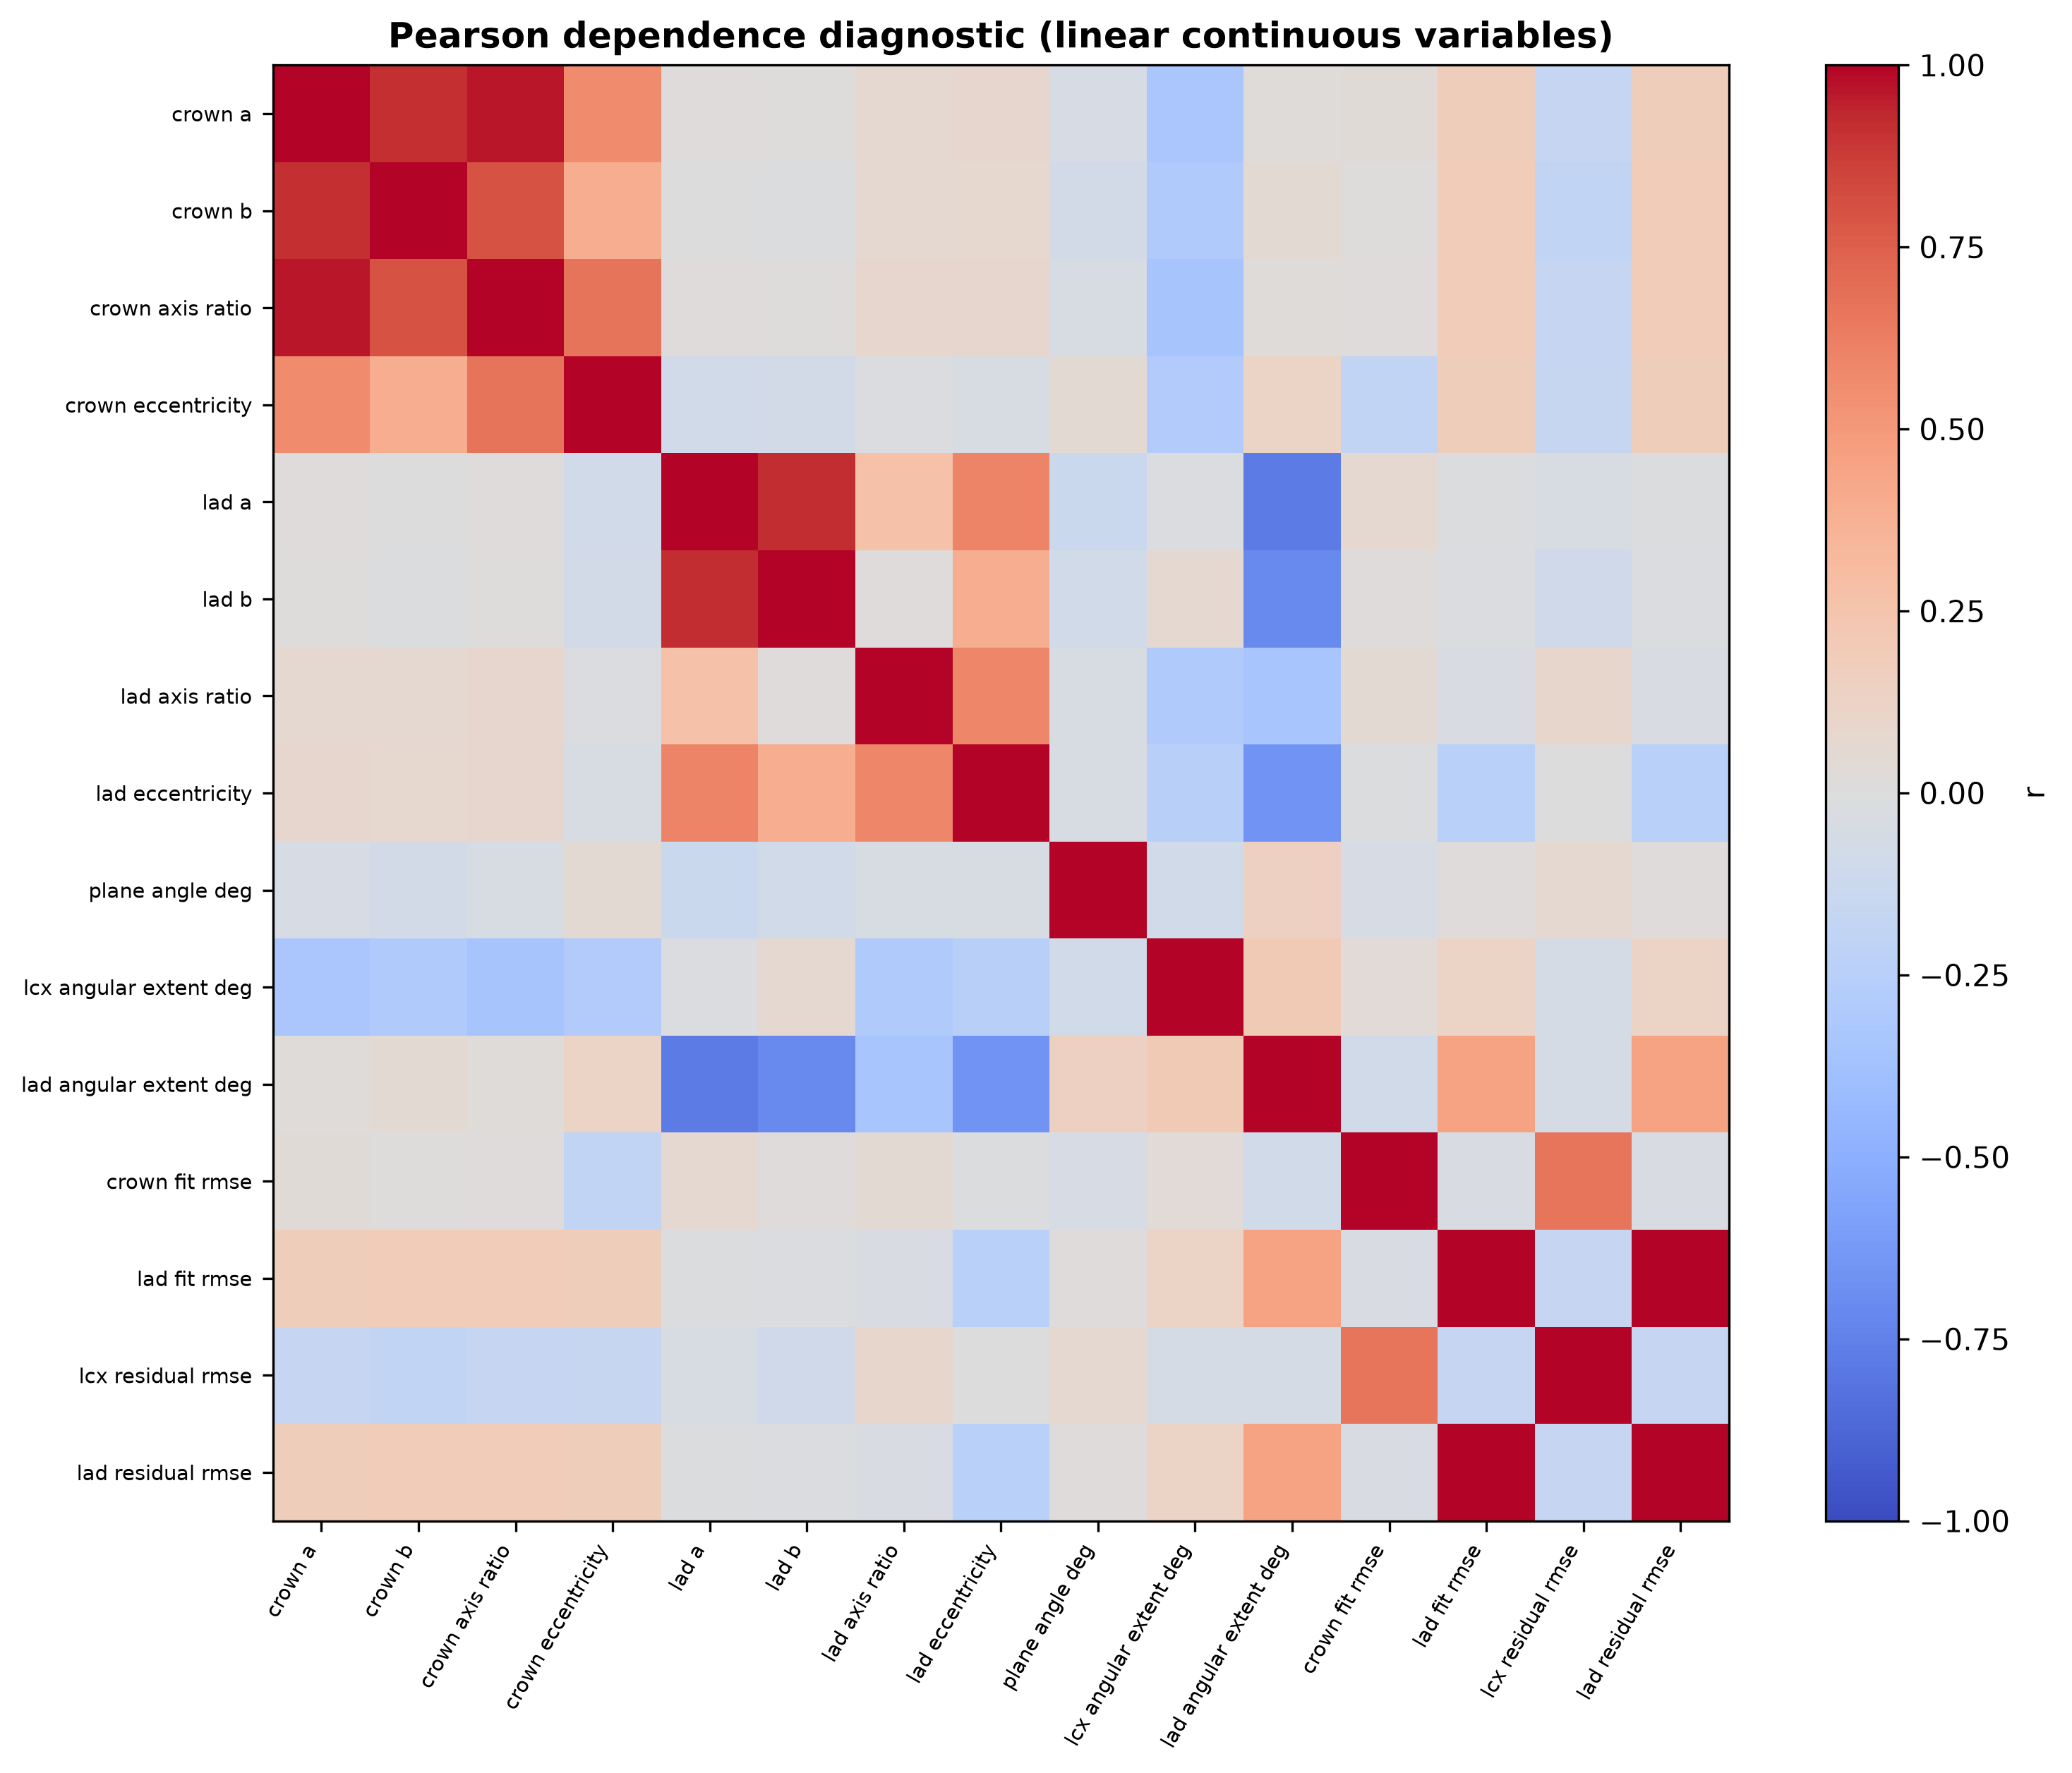
DEPENDENCE
Correlation is measured now so later sampling does not assume independence blindly.
Pearson r is a diagnostic for selected continuous linear quantities. Circular-linear dependence remains a later modeling decision.
Pearson r
diagnostic only
selected linear variables
Source: measured PPT-priority outputs • generator deferred
14

Slide 15
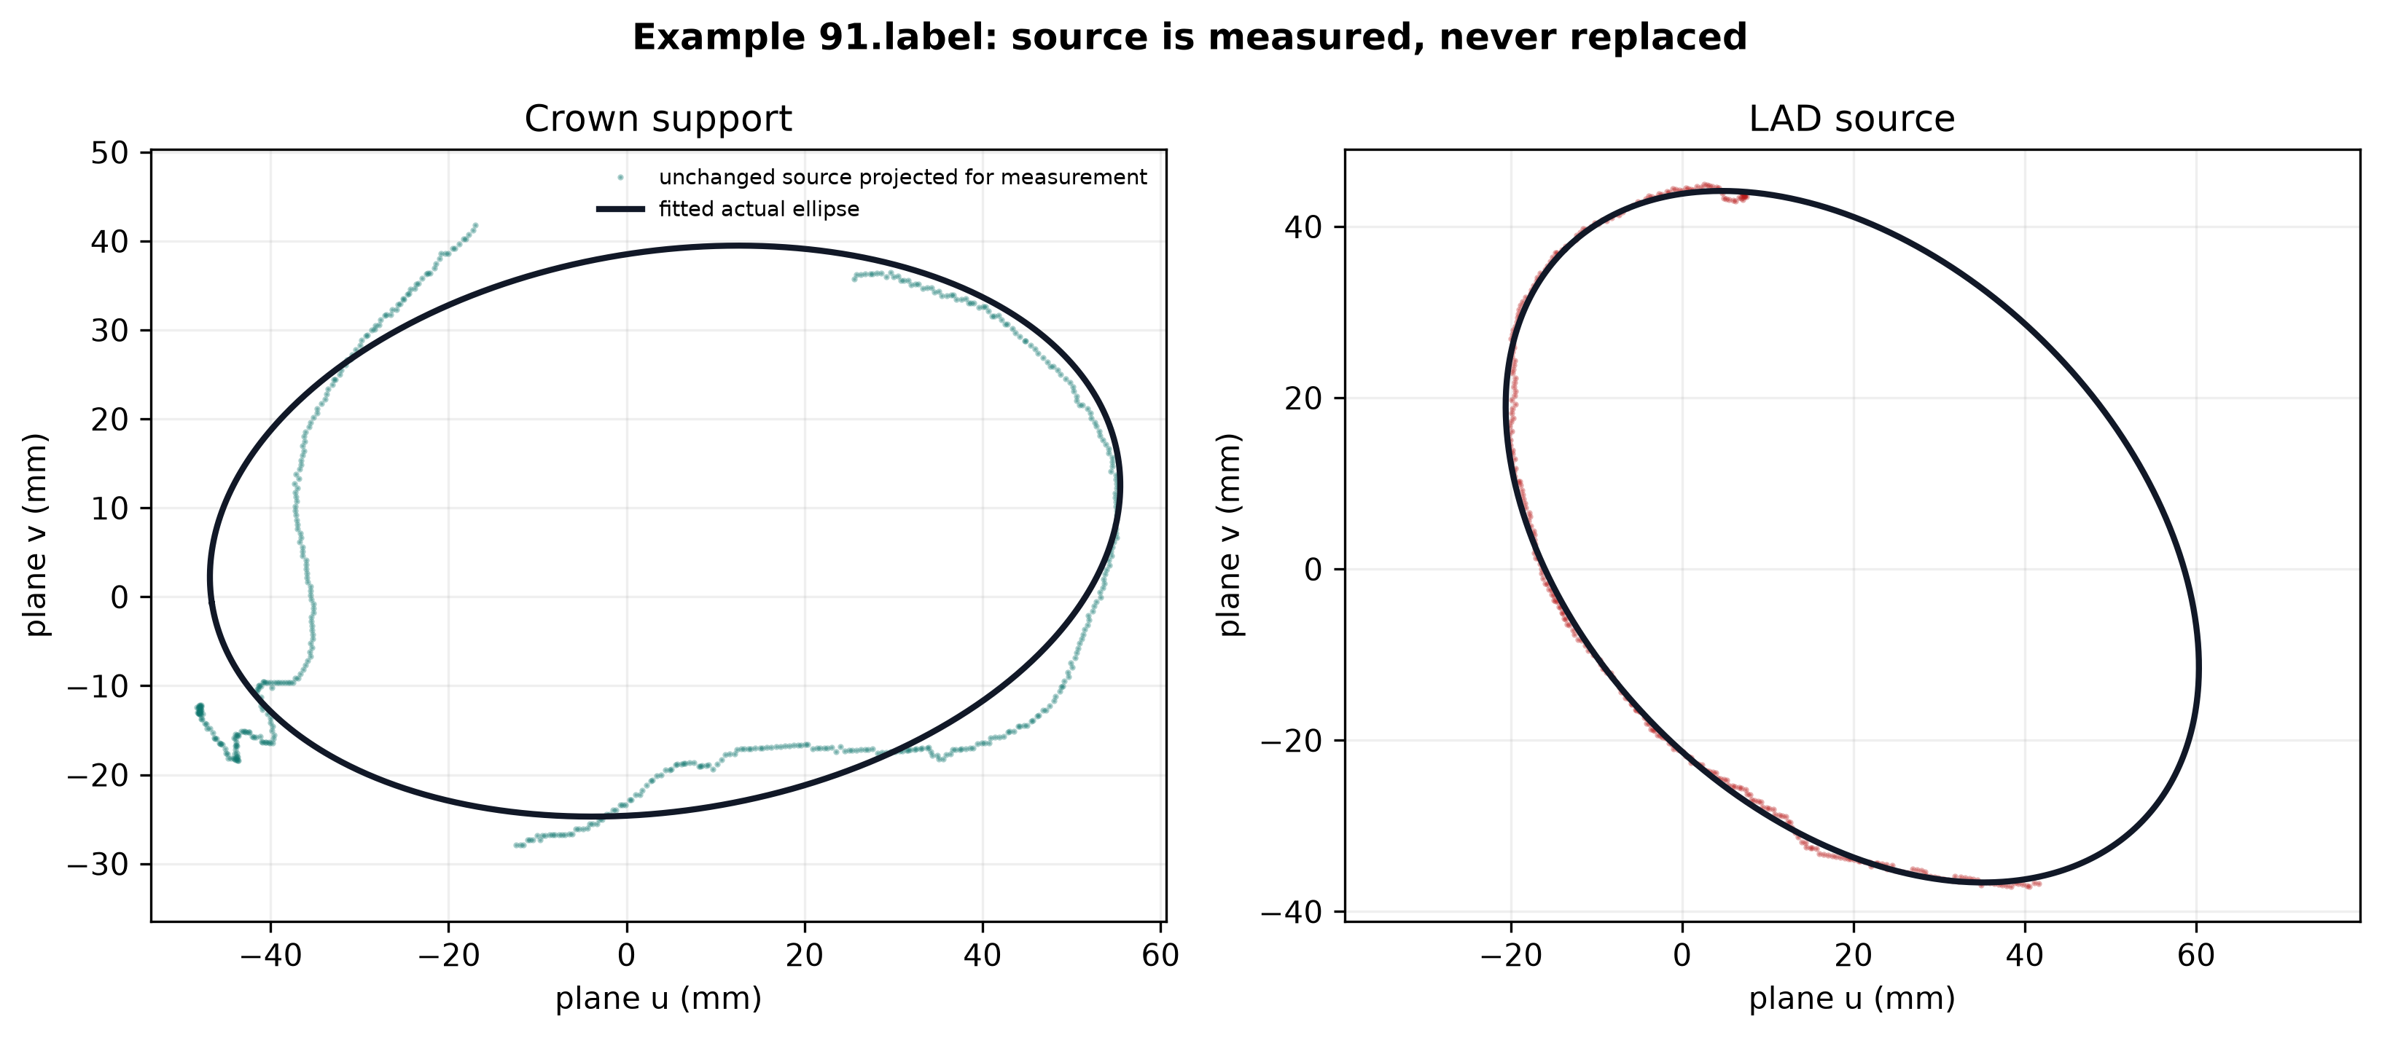
SOURCE INTEGRITY
Measurement changed no source coordinate and no source segment length.
Max coordinate change: 0.0 mm. Max segment-length change: 0.0 mm. Per-array and per-archive SHA-256 hashes are stored.
0.0 mm
maximum change
coordinates + segments
Source: measured PPT-priority outputs • generator deferred
15

Slide 16
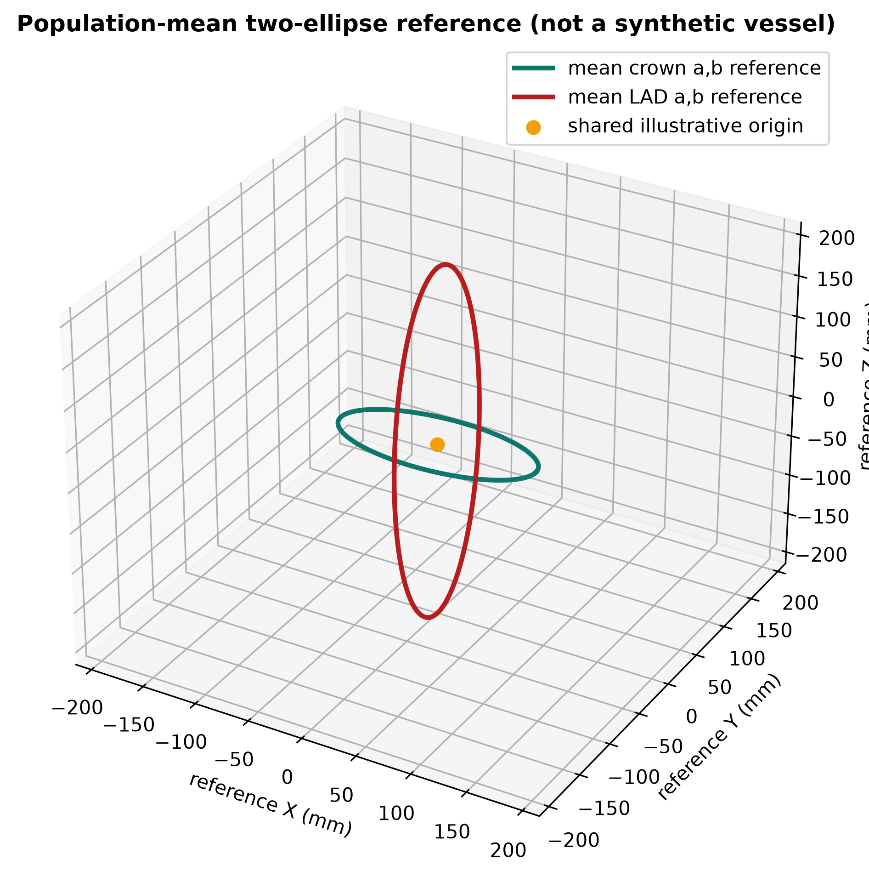
EXTENSION SEPARATION
The later heart-support surface is preserved as an extension — not a substitute.
ORIGINAL PPT MODEL
two patient planes
two fitted planar ellipses
landmark theta + branch extent
per-point residuals
population statistics
PRESERVED EXTENSION
parametric 3-D heart support surface
Stage-1 VTK/VTM scaffold
Future combination is possible—but neither definition is rewritten to imitate the other.
Source: measured PPT-priority outputs • generator deferred
16

Slide 17
NEXT INCREMENT
Generation begins with joint sampling; none of these future steps run today.
joint ellipse
parameter sampling
circular landmark
sampling
arc-length
control points
smooth empirical
residuals
shared LMCA
bifurcation
reuse B-spline +
validate
→
→
→
→
→
DEFERRED — no sampler, synthetic noise, generated vessel, B-spline output, VTK sample or real-vs-generated comparison exists in this increment.
The measured CSV/JSON files are the validated hand-off for this future work.
Source: measured PPT-priority outputs • generator deferred
17

Slide 18
COMPLETION STATUS
The measured PPT model is ready for a later, separately validated generator.
200
191
191
191
labels discovered
two-plane fits
two-ellipse fits
population cases
9 documented extraction failures
centroid-SVD in RAS
all support points measured
robust + circular statistics
Delivered now
Next decision
case status • per-patient parameters • pointwise residuals • statistics • circular summaries • correlation matrix • 12 modular figures • method/audit reports • this presentation
Choose the joint/circular statistical sampling design, then implement and validate the generative model as a separate increment.
Generator status: NOT IMPLEMENTED BY DESIGN
Source: measured PPT-priority outputs • generator deferred
18

