Slide 1
The Impact of the CHIPS Act on Stock Returns for Semiconductor Developers
Nameera Ali, Anjana Azhuvath, and Kenny Evans

Slide 2
INTRODUCTION
Creating Helpful Incentives to Produce Semiconductors (CHIPS) for America Act
  Passed on August 9th, 2022
  Aims to incentivize greater U.S. production of semiconductors
Objective Statement
  To assess immediate impact of CHIPS Act on companies’ stock prices
  To determine which companies benefit most from CHIPS Act

Slide 3
RESEARCH QUESTIONS
  How do stock market prices react to CHIPS Act grants?
  Do pre-grant stock trends change after announcement?
  Does CHIPS Act help larger or smaller companies more?
Hypothesis: Grants from the CHIPS Act will positively affect company stock Returns, particularly for smaller companies

Slide 4
LITERATURE REVIEW
Dixon and Nassios (2018)
  Subsidies increase domestic and foreign investment in an industry
Criscuolo et al. (2019)
  Subsidies help companies and region, benefit small companies more than large
Chen et al. (2020)
  Information asymmetry hurts subsidies usefulness, small companies benefit more
Veronesi and Pastor (2012)
  Stock prices drop when new policies are introduced, reaction to uncertainty

Slide 5
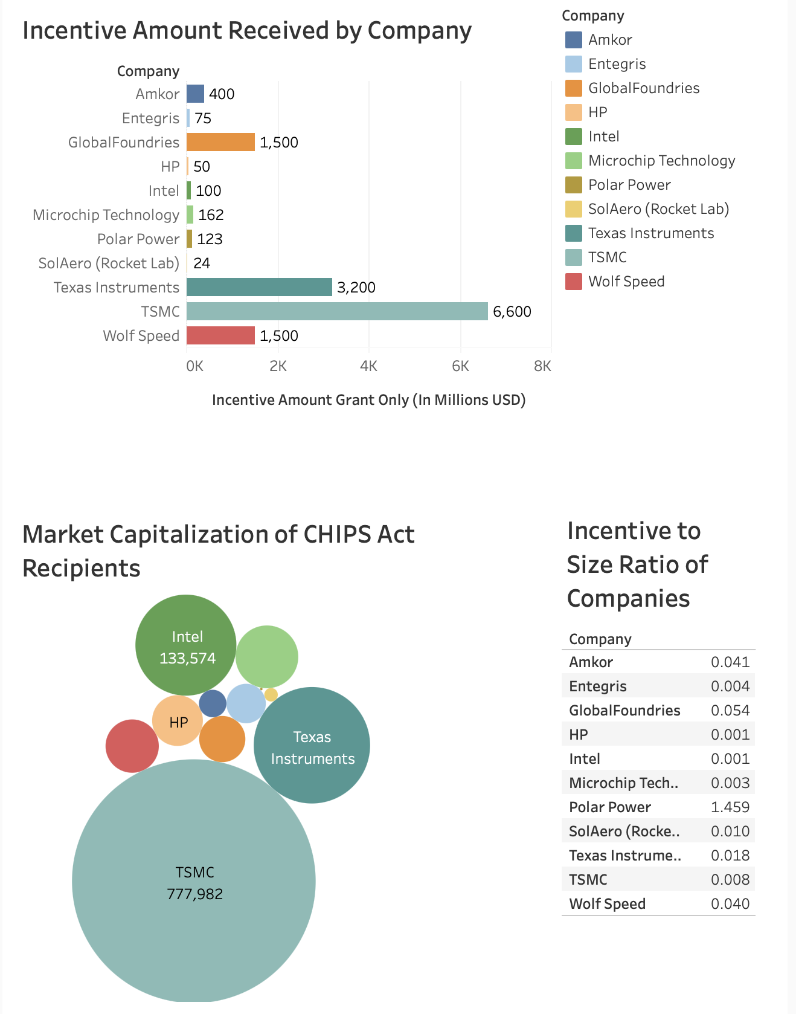
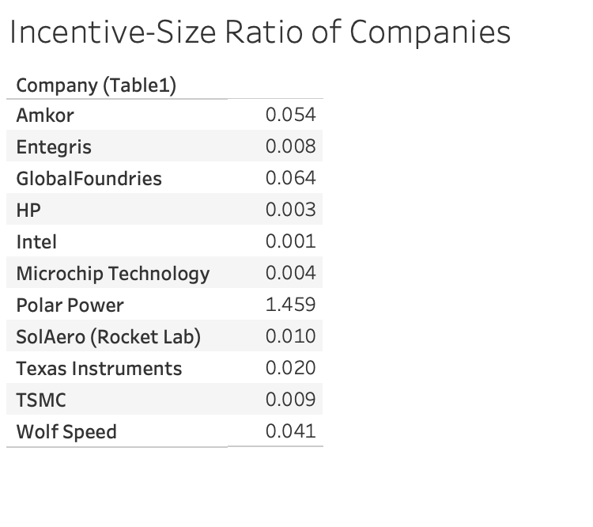
Incentive Recipients
Source: Data retrieved from Semiconductor Industry Association and Nasdaq, Visualized on Tableau

Slide 6
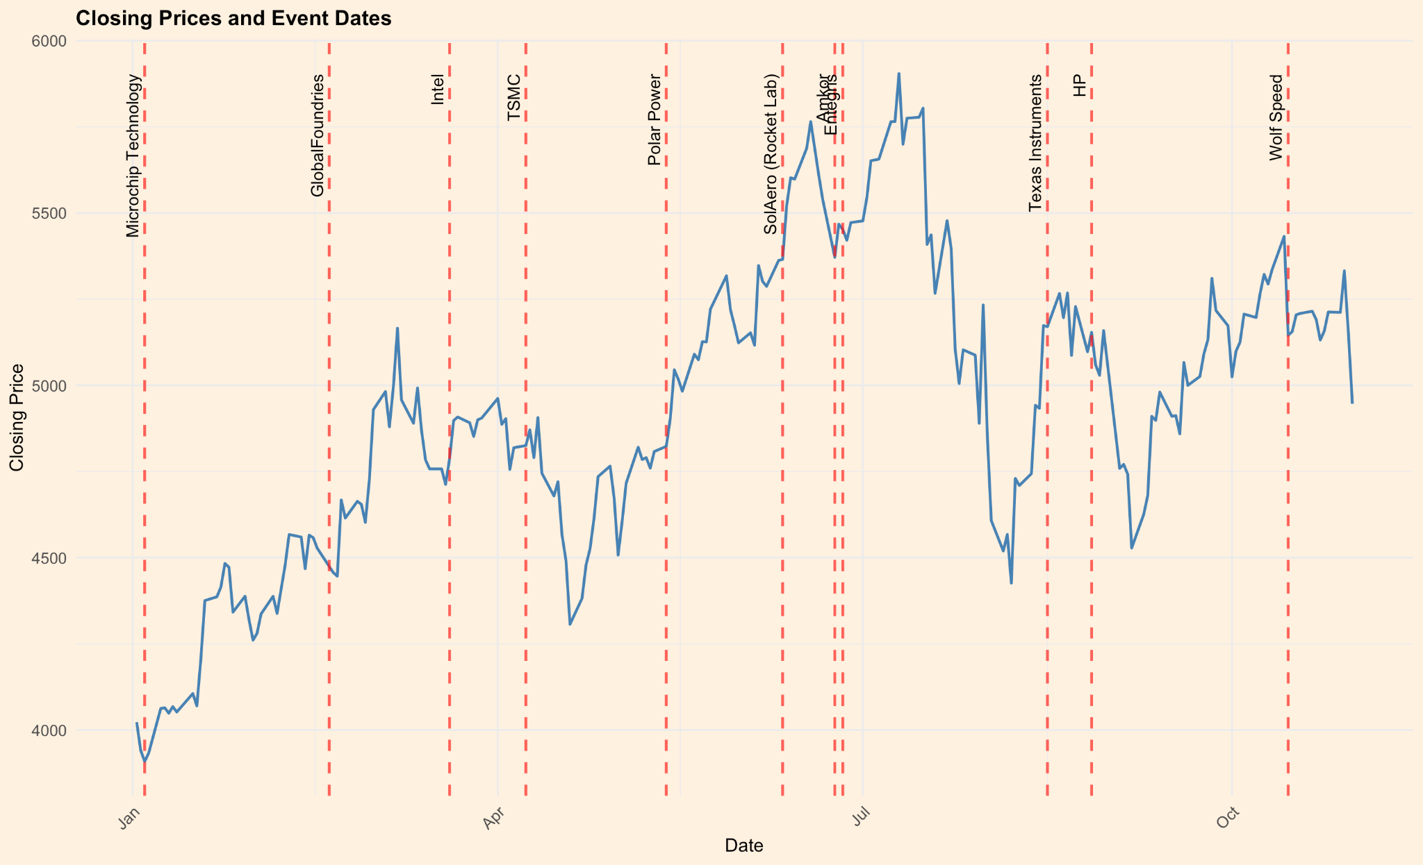
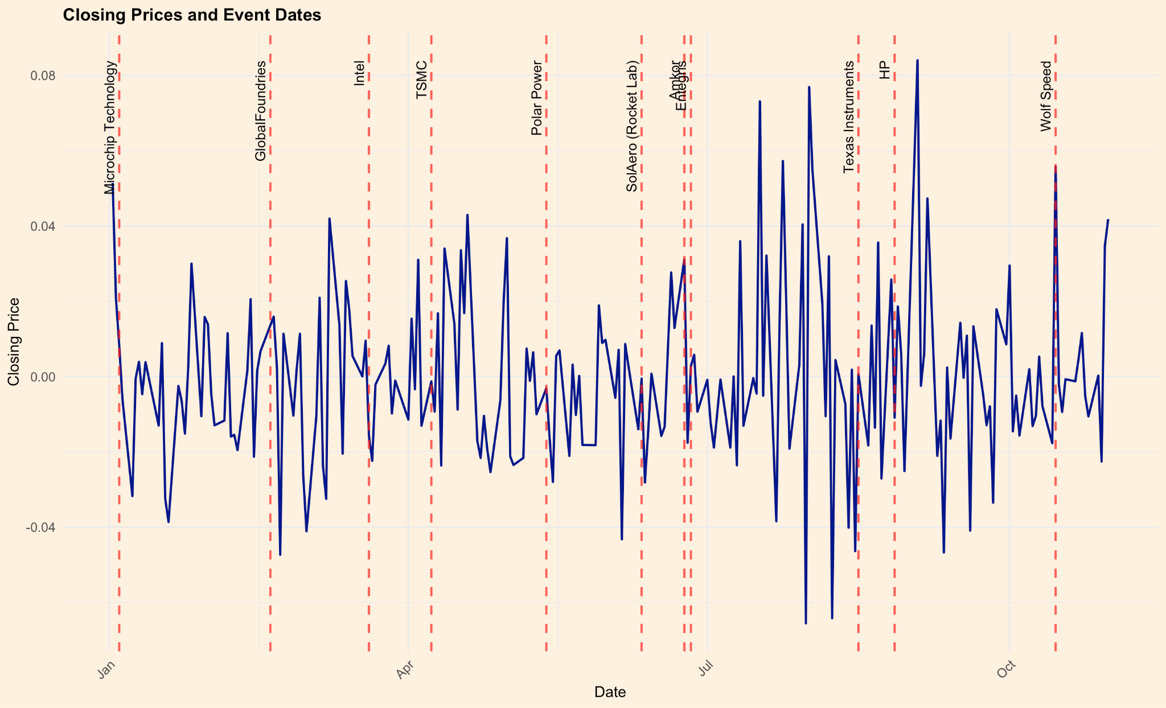
PHLX
Figure: Plots Representing the PHLX Closing Prices and Returns through Event Announcements
Source: Data retrieved from Nasdaq, Visualized on R
Notes:
Data Source: Semiconductor Industry Association (CHIPS Act grants)
Exclusions: Non-US-listed companies removed
Sample: 11 US-listed semiconductor companies
Data Collected: Daily closing prices (245 days pre- to 5 days post-announcement) via NASDAQ
Market Cap Defined: Micro, Midsize, Large, Mega
Impact Analysis: CHIPS Act effects across cap groups
Market Proxy: PHLX Semiconductor Index (due to 2024 CRSP data gap)
Summary Stats: Basic analysis for 250-day event window

Slide 7
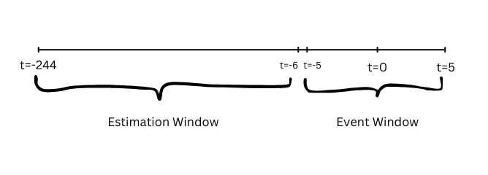
METHODOLOGY
Event Definition
  The event is the grant announcement under the CHIPS Act.
  This date is set as Day 0 in our event study timeline.
The Estimation and Event Windows
A 250-day event study window is created to analyze stock performance.
    Estimation Window: 239 days window (t=-244 through t=-6)
    Event Window: 11 days window ( t= -5 through t= +5)

Slide 8
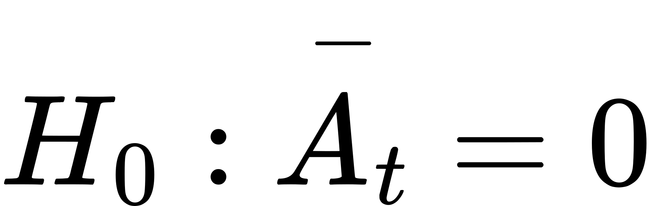
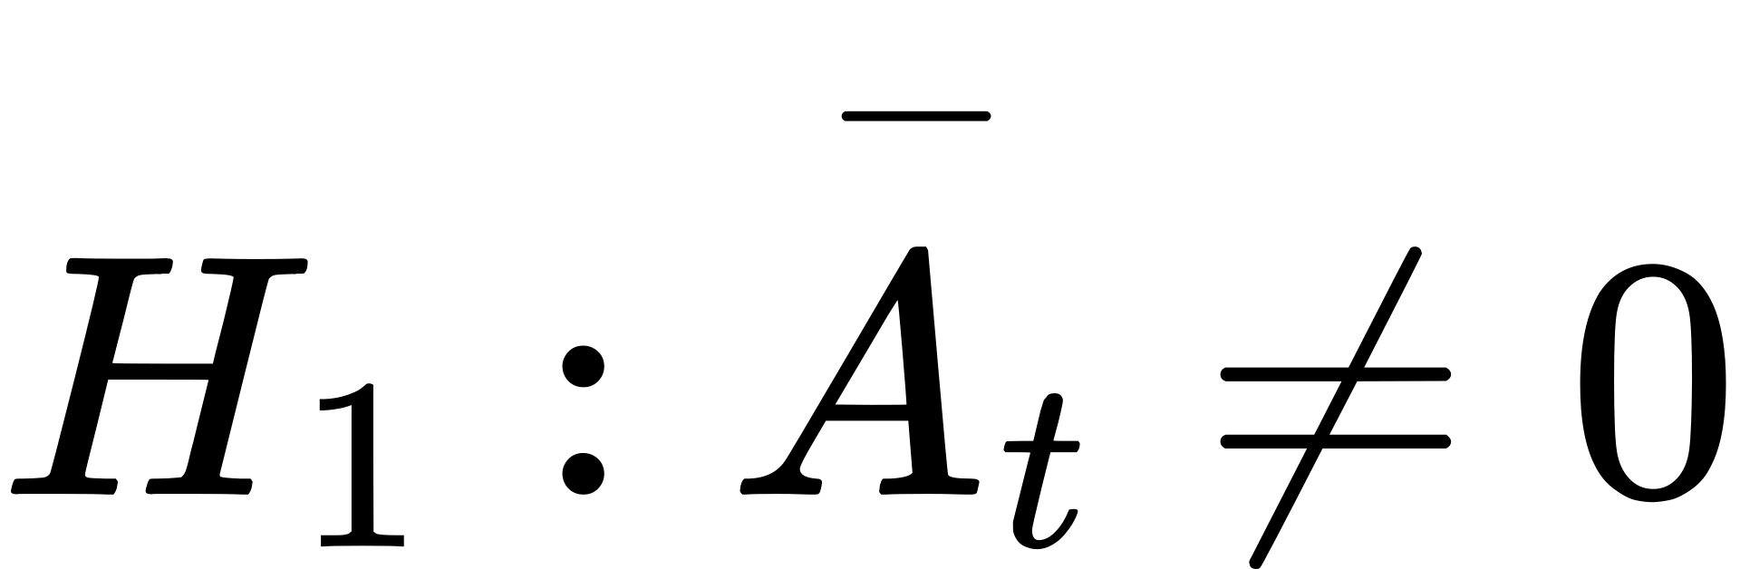
METHODOLOGY
Test For Normality and Stationarity
  Shapiro-Wilks normality test
  Augmented Dickey-Fuller test
The OLS Market Model
  Ordinary Least Squares (OLS) regression model to compute two key parameters for Intel's stock:
    α (alpha): Average daily returns.
    β (beta): Systemic risk based on NASDAQ market performance.
Test statistics under the null hypothesis
Ho: The mean day ‘0’ i.e. t=0 excess return (e.g., the simple average of market model excess
returns) is equal to zero

Slide 9
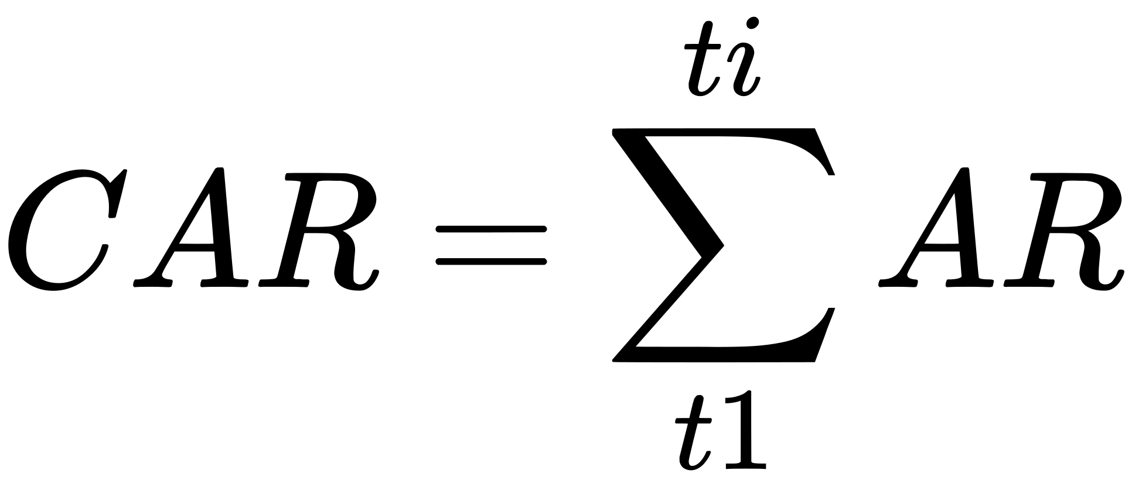
METHODOLOGY
Abnormal and Cumulative Abnormal Returns (CAR)
  Abnormal Returns (AR):
  Cumulative Abnormal Returns (CAR): The sum of abnormal returns over the event window to determine if the CHIPS Act announcement significantly impacted Intel’s stock

Slide 10
STATIONARITY TEST
Company | ADF Statistic | P-Value
SolAero (Rocket Lab) | -12.2972 | 0.01
HP | -11.8437 | 0.01
Entegris | 11.5146 | 0.01
Intel | -10.4025 | 0.01
Polar Power | -12.707 | 0.01
Microchip Technology | -11.7747 | 0.01
Amkor | -10.987 | 0.01
GlobalFoundries | -10.7816 | 0.01
Wolf Speed | -10.6045 | 0.01
Texas Instruments | -10.265 | 0.01
TSMC | -11.1843 | 0.01

Slide 11
NORMALITY TEST
Company | W Statistic | P-value
SolAero (Rocket Lab) | 0.9311 | 2.08E-09
HP | 0.8219 | 3.10E-16
Entegris | 0.9942 | 4.45E-01
Intel | 0.96141 | 2.99E-06
Polar Power | 0.8575 | 8.58E-01
Microchip Technology | 0.99585 | 0.7454
Amkor | 0.89238 | 2.37E-12
GlobalFoundries | 0.99157 | 0.1615
Wolf Speed | 0.97147 | 6.57E-05
Texas Instruments | 0.9528 | 3.05E-07
TSMC | 0.9145 | 8.94E-11

Slide 12
Regression Results
Source: Data retrieved from Nasdaq, Computed on R
Table: Regression Results of the Large Cap Companies for the Estimation Period
Company Size | Company | Coefficients |  | P-Value | T Statistic | Standard Error
Large Cap | HP | Intercept | 0.000188638 | 0.867213989 | 0.167379749 | 0.001127003
 |  | Slope | 0.318949724 | 1.70E-08 | 5.84164306 | 0.054599317
Large Cap | Entegris | Intercept | -0.0009891 | 0.222 | -1.223 | 0.0008085
 |  | Slope | 1.0793575 | <2e-16 | 23.338 | 0.0462492
Large Cap | Intel | Intercept | 0.0003073 | 0.817 | 0.232 | 0.0013238
 |  | Slope | 0.7956477 | <2e-16 | 10.589 | 0.0751384
Large Cap | Microchip Technology | Intercept | -0.00075 | 3.43E-01 | -0.95085 | 0.000787
 |  | Slope | 0.943346 | 6.40E-58 | 21.59966 | 0.043674
Large Cap | GlobalFoundries | Intercept | -0.00241 | 1.37E-02 | -2.48346 | 0.000972
 |  | Slope | 1.035158 | 1.80E-47 | 18.37274 | 0.056342
Large Cap | Wolf Speed | Intercept | -0.00635 | 0.03495 | -2.12113 | 0.002994
 |  | Slope | 1.345928 | 1.21E-19 | 9.926852 | 0.135585
Large Cap | Texas Instruments | Intercept | 0.00012150 | 0.86 | 0.177 | 0.0006864
 |  | Slope | 0.5468219 | <2e-16 | 16.153 | 0.0338517
Notes:
Alpha:
HP, Intel,TI positive and statistically insignificant alpha
WS,MT, GF significant negative daily returns on average, assuming market market return to be zero
Beta:
WS largest beta: most volatile
HP and TI least volatile

Slide 13
Regression Results Contd
Source: Data retrieved from Nasdaq, Computed on R
Table: Regression Results of the Micro, Mid and Mega Cap Companies for the Estimation Period
Company Size | Company | Coefficients |  | P-Value | T Statistic | Standard Error
Micro Cap | Polar Power | Intercept | -0.003375 | 0.346 | -0.945 | 0.003573
 |  | Slope | 0.120212 | 0.536 | 0.62 | 0.193775
Mid Cap | Amkor | Intercept | -0.906357 | 2.00E-16 | 0.010333 | 0.001219
 |  | Slope | 0.096659 | 2.00E-16 | 15.45024 | 0.070184
Mid Cap | SolAero (Rocket Lab) | Intercept | -0.001685 | 0.494 | -0.684 | 0.002462
 |  | Slope | 0.680554 | 2.81E-06 | 4.8 | 0.141779
Mega Cap | TSMC | Intercept | 0.0001922 | 0.832 | 0.213 | 0.0009038
 |  | Slope | 0.8677216 | <2e-16 | 17.038 | 0.0509273
Notes:
Alpha:
Ak significant negative avg return
Beta:
All less than zero and significant

Slide 14
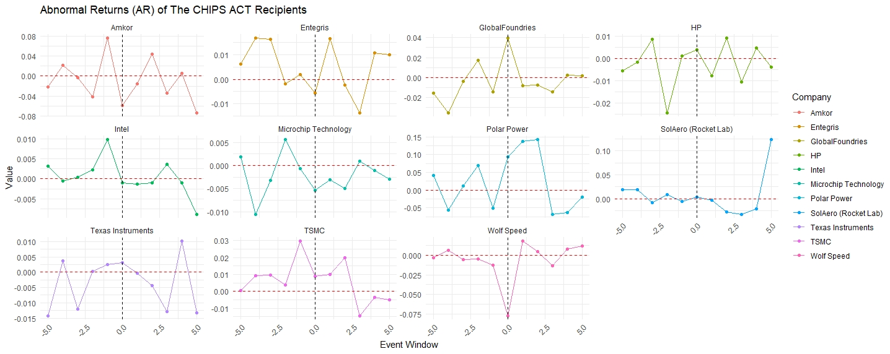
Abnormal Returns for Event Window
Source: Data retrieved from Nasdaq, Computed and visualized on R

Slide 15
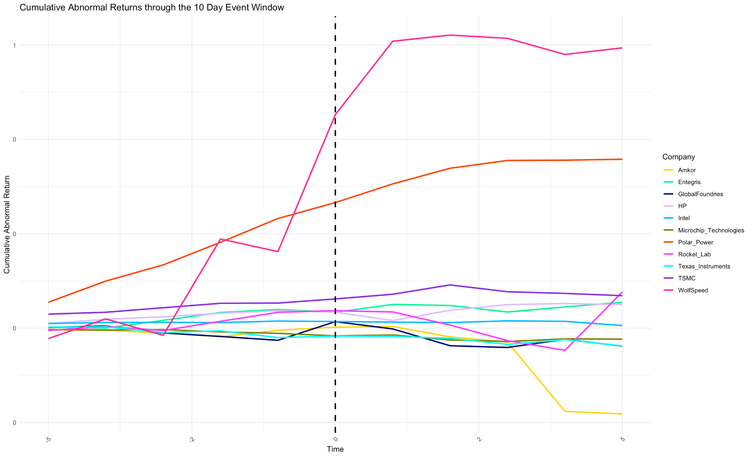
Figure: Representation of Cumulative Abnormal Returns of Recipients across the Event Window
Source: Data retrieved from Nasdaq, Computed and visualized on R
Notes:
Wolfspeed, PP [ large post announcement trend] Also large ratio
TSMC positive despite small ratio
AMK negative despite a sizable incentive-size ratio
Every other company return appears to be stable post announcement

Slide 16
Source: Data retrieved from Nasdaq, Computed on R
Table: T Test Results of Cumulative Abnormal Returns
Company Name | Mean CAR | t_statistic | p_value | Incentive-size Ratio
HP | 0.03286909 | 7.57552692 | 1.89E-05 | 0.003683762729
Microchip Technologies | -0.0144589 | -5.1067288 | 0.00045949 | 0.003141926977
GlobalFoundries | -0.0158974 | -2.7855207 | 0.01926728 | 0.05376754824
Amkor | -0.0401819 | -1.92235 | 0.08348403 | 0.0405261304
WolfSpeed | 0.34579453 | 4.1197054 | 0.00207807 | 0.0201779072
Entegris | 0.03250238 | 5.75801355 | 0.00018315 | 0.003683762729
Polar Power | 0.24395047 | 7.26903004 | 2.70E-05 | 1.459148511
TSMC | 0.05979437 | 10.3171862 | 1.19E-06 | 0.008483486794
Intel | 0.01228195 | 14.6339211 | 4.43E-08 | 0.06363532437
Rocket Lab | 0.01115652 | 1.09425264 | 0.2995006 | 0.01002851592
Texas Instruments | -0.0165194 | -4.1289066 | 0.00204776 | 0.009016446668
Notes:
Excluding our mid cap, all companies avg. returns were statistically significant at 5%. We can reject the null hypothesis of mean CAR= 0
Negative CAR:
TI-GF-MT-AMK
AMK: lowest CAR: insignificant
wf-TSMC-PP positive CAR

Slide 17
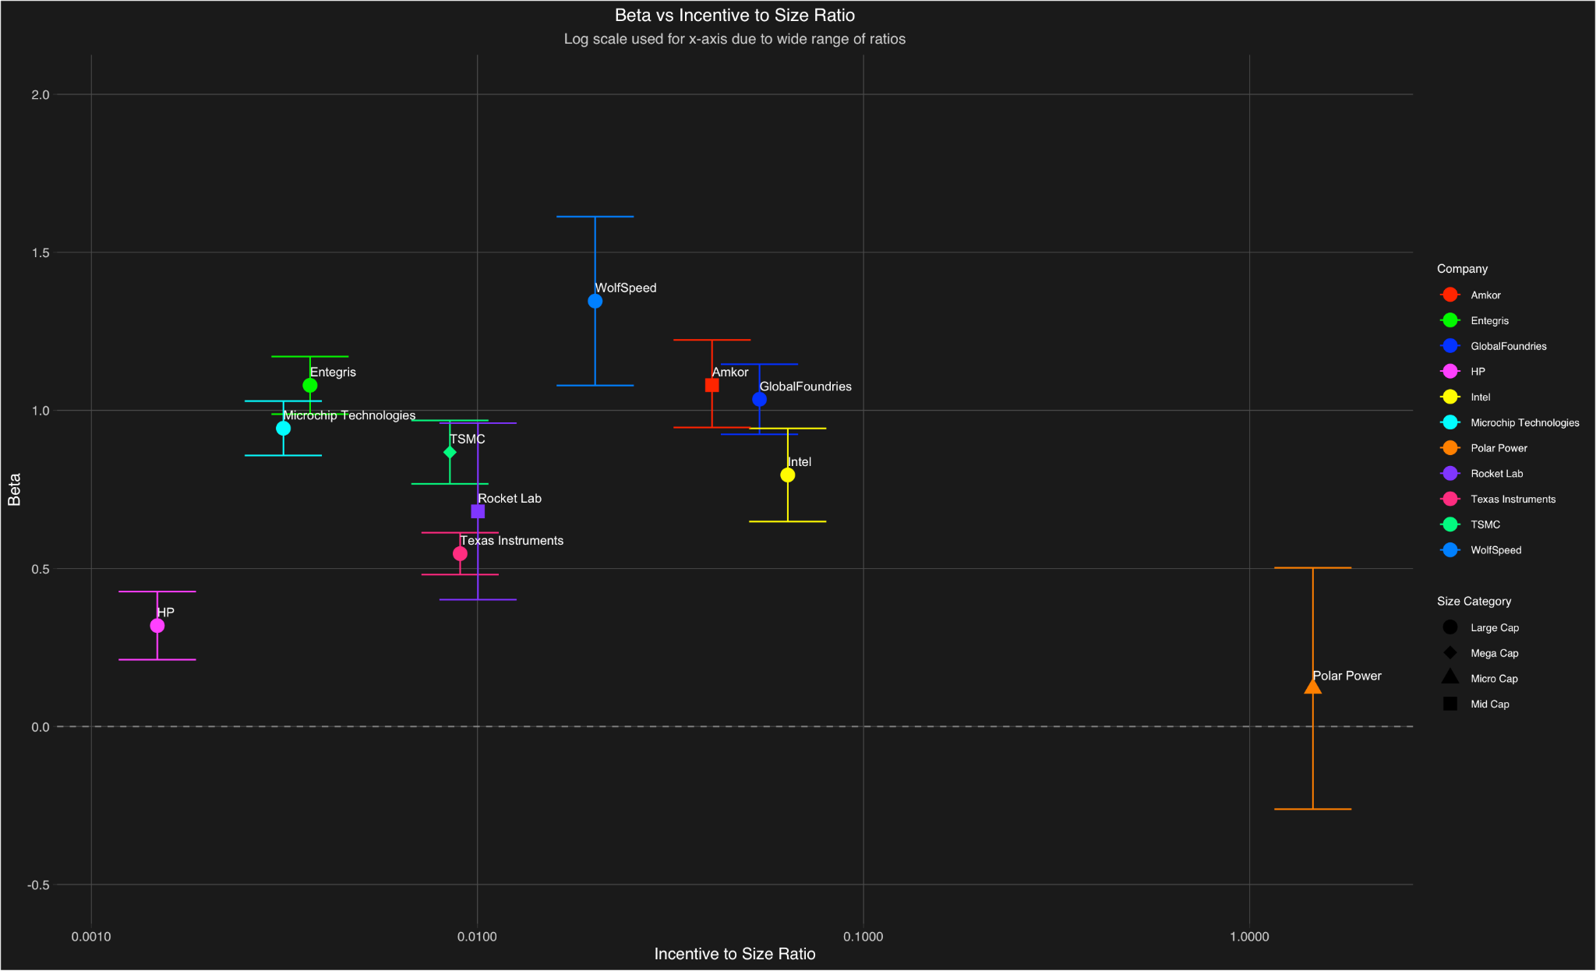
Risk-Incentive/Size Relationship
Figure: Representation of Beta Against Incentive-to-Market-Cap Ratio for CHIPS ACT Recipients
Source: Data retrieved from Semiconductor Industry Association and Nasdaq, Computed and Visualized on R

Slide 18
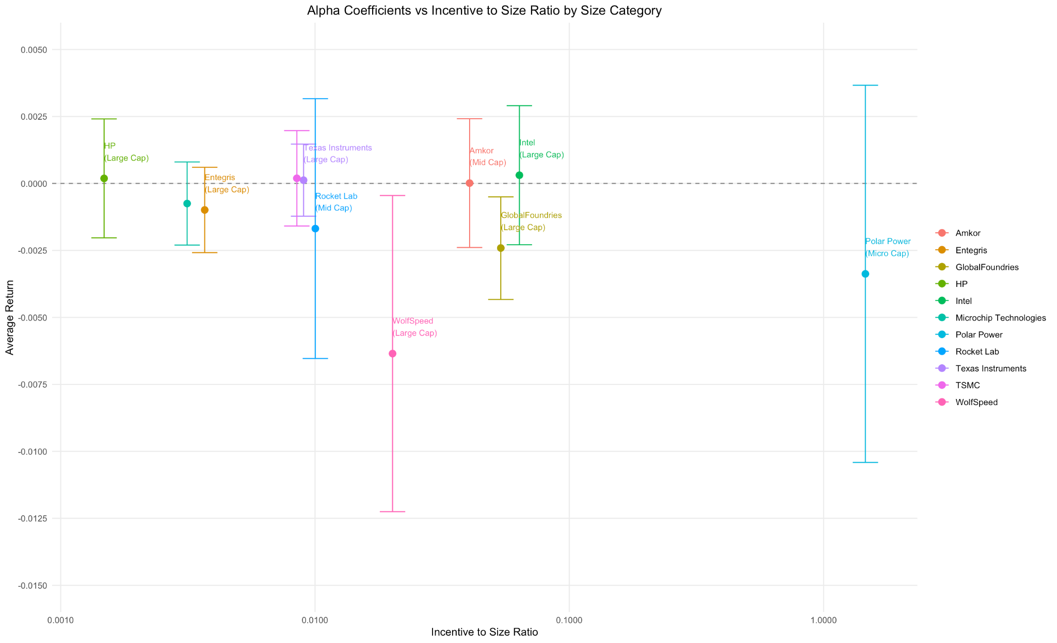
Average Return-Incentive/Size Relationship
Figure: Representation of Estimated Alpha Against Incentive-to-Market Cap Ratio for CHIPS ACT Recipients
Source: Data retrieved from Semiconductor Industry Association and Nasdaq, Computed and Visualized on R

Slide 19
CONCLUSION
No statistically significant change in daily returns for most companies
  Variation between positive and negative CAR’s across companies
  Potential positive correlation between grant size and risk factor
No direct evidence of small companies benefiting more from grants
  ⅔ small companies saw jump from negative to positive returns after grants
Future work: study effects of CHIPS Act on economic growth and innovation once government funds fully disperse after 2026

Slide 20
WORKS CITED
Adilov, N., Haber, L.J., & Fiechter, N. (2009). Policy Announcements and Stock Market Response.
Beechey, M.J., Gruen, D.W., & Vickery, J.I. (2000).The Efficient Market Hypothesis: A Survey.
Brown, S. J., & Warner, J. B. (1985). Using daily stock returns: The case of event studies.Journal of Financial Economics, 14(1), 3-31. https://doi.org/10.1016/0304-405X(85)90042-X.
Casarin, A. A., Dorobantu, S., & Saz-Carranza, A. (2021). NATIONALISM, FIRM VALUE AND RELOCATION. Academy of Management.
Chen, Y., Wang, Y., Hu, D., & Zhou, Z. (2020). Government R&D subsidies, information asymmetry, and the role of foreign investors: Evidence from a quasi-natural experiment on the shanghai-hong kong stock connect. Technological Forecasting and Social Change, 158, 120162.
Criscuolo, C., Martin, R., Overman, H.G., & Reenen, J.V. (2019). Some Causal Effects of an Industrial Policy.American Economic Review.
Dixon, J.M., & Nassios, J. (2018). The Effectiveness of Investment Stimulus Policies in Australia.
Driffield, N. (2001). THE IMPACT ON DOMESTIC PRODUCTIVITY OF INWARD INVESTMENT IN THE UK. The Manchester School, 69(1).
Gui-ru, H., Shuli, Z., Zhiyuan, L., & Guang-hui, J. (2021). Industrial Policies, Investor Sentiment and Enterprise Resource Allocation Efficiency. Journal of Finance and Economics, 47, 77-93.
H.R.4346 - 117th Congress (2021-2022): Supreme Court Security Funding Act of 2022 | congress.govlibrary of Congress. https://www.congress.gov/bill/117th-congress/house-bill/4346.
Intelligence, fDi.The world’s top semiconductor investors. fDi Intelligence – Your source for foreign direct investment information - https://www.fdiintelligence.com/content/data-trends/the-worlds-top-semiconductor-investors-82433.
Katitas, A., & Pandya, S. (2024). Investment incentives attract foreign direct investment: Evidence from the great recession. Public Choice. https://doi.org/10.1007/s11127-024-01158-0.
Kim, H. M., & Han, S. S. (2014). Inward foreign direct investment in Korea: Location Patterns and local impacts. Habitat International, 44, 146–157. https://doi.org/10.1016/j.habitatint.2014.05.011.
Liu, X., Megginson, W.L., & Xia, J. (2022). Industrial Policy and Asset Prices: Evidence from the Made in China 2025 Policy. Journal of Banking & Finance.
Malkiel, B.G. (2003). The Efficient Market Hypothesis and Its Critics. Journal of Economic Perspectives, 17(1), 59-82.
Mazewski, M., & Flores, C. (2022, May). Economic impacts of the Chips for America Act. Data for Progress. https://www.filesforprogress.org/memos/USICA_Semiconductors.pdf.
Raimondo, G. (2023, September 19). Testimony of Secretary of Commerce Gina Raimondo before the House Committee on Science, Space, and Technology. U.S. House of Representatives. https://docs.house.gov/meetings/SY/SY00/20230919/116375/HHRG-118-SY00-Wstate-RaimondoG-20230919.pdf
Ravi, S. (2023, July 27). The state of the industry report highlights challenges and opportunities facing U.S. chip industry. Semiconductor Industry Association. https://www.semiconductors.org/the-state-of-the-industry-report-highlights-challenges-and-opportunities-facing-u-s-chip-industry/.
Shi, F., Xu, H., Hsu, W.-L., Lee, Y.-C., & Zhu, J. (2021). Spatial pattern and influencing factors of outward foreign direct investment enterprises in the Yangtze River Economic Belt of China. Information, 12(9), 381. https://doi.org/10.3390/info12090381.
Stephen J. Brown, Jerold B. Warner, Using daily stock returns: The case of event studies, Journal of Financial Economics, Volume 14, Issue 1, 1985, Pages 3-31, ISSN 0304-405X, https://doi.org/10.1016/0304-405X(85)90042-X.
The Economist Newspaper. (n.d.). “Chip war” traces the evolution of the semiconductor industry. The Economist. https://www.economist.com/culture/2022/10/13/chip-war-traces-the-evolution-of-the-semiconductor-industry.
VERONESI, P., & PÁSTOR, L. (2012). Uncertainty about Government Policy and Stock Prices. The Journal of American Finance Association, 67(4).
Xinle, T., Zhen, W., & Xinting, L. (2021). The influence of government subsidy on enterprise innovation: based on Chinese high-tech enterprises. Economic Research-Ekonomska Istraživanja, 35(1), 1481–1499. https://doi.org/10.1080/1331677X.2021.1972818.

