Slide 1
Web user profiling
Anjana Ashokkumar

Slide 2
introduction
How does search work on the web?
Is this optimal ?
What can be done ?

Slide 3
The project is divided into three phases,
1)Data Collection
2)Feature Extraction
3)Machine learning

Slide 4
Phase – 1
The initial stage of creating the dataset, by collecting 100 web documents.
This could be done using a web crawler. (WebSPHINX)
This consists of attributes taken from the web documents.
The dataset is created using the contents from the web document, including the document name and a document class indicating the likes and dislikes of the user.

Slide 5
Phase - 2
We do the feature extraction in this step.
The dataset is converted into the ARFF format.
Now the ARFF file could be changed into various formats.
Here it is converted into Boolean, numeric and TF-IDF formats

Slide 6
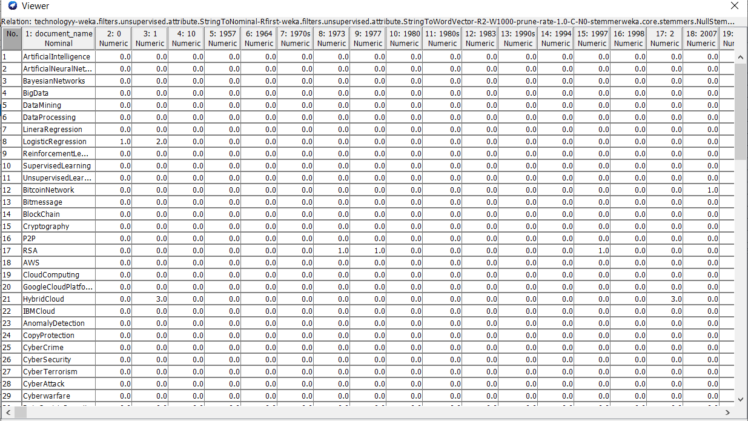
Numeric DATASET

Slide 7
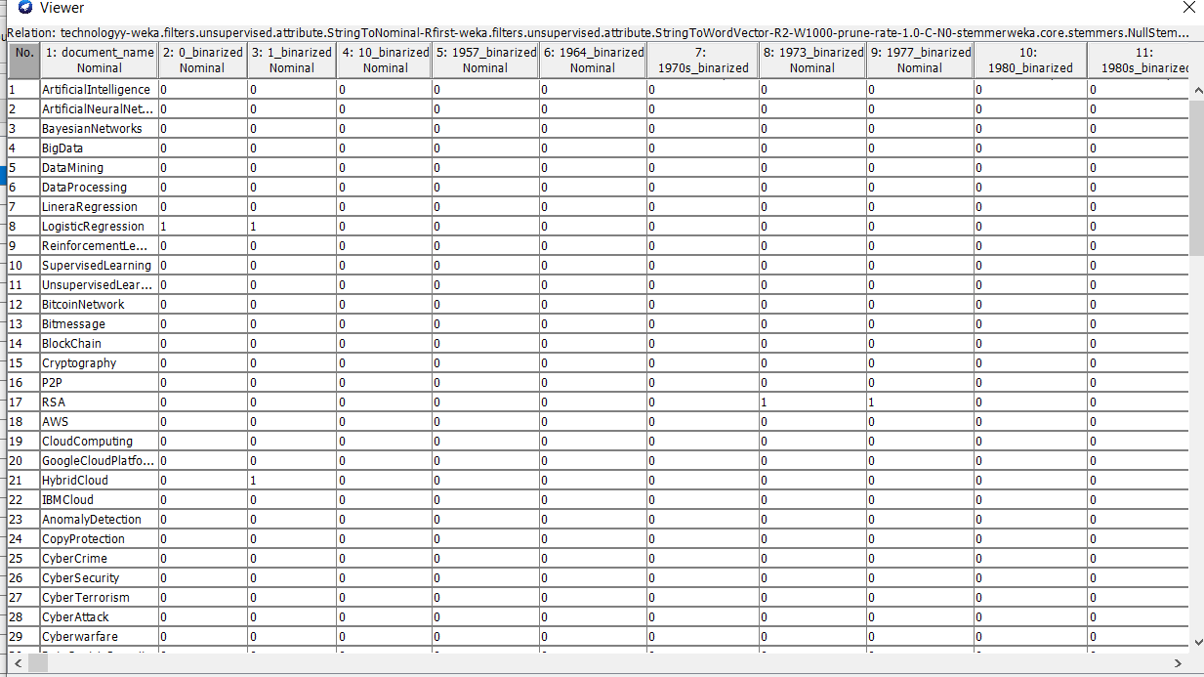
Boolean DATASET

Slide 8
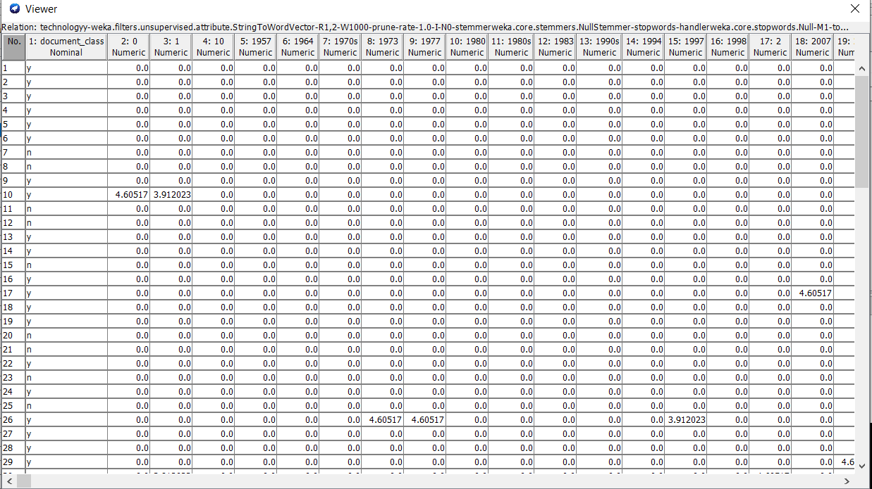
TF-IDF FORMAT

Slide 9
PHASE - 3
This is the machine learning stage.
Here web document filtering takes place.
That is according to the likes and dislikes, the documents which come under the dislikes are discarded.
Now the Decision Tree Algorithm is used to run the numeric dataset.
And the 10 fold cross-validation result and confusion matrix results are obtained.

Slide 10
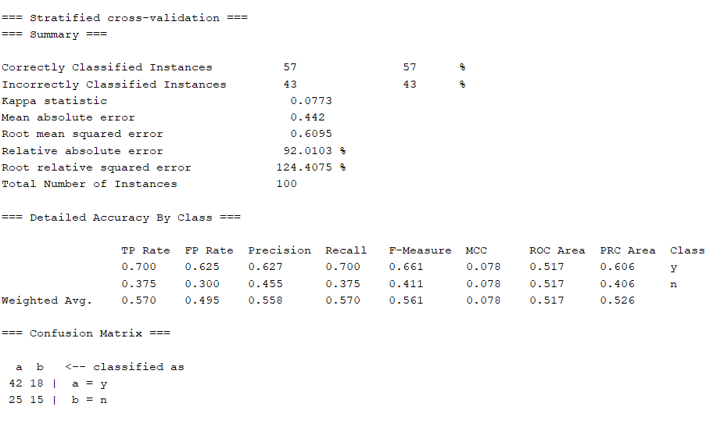
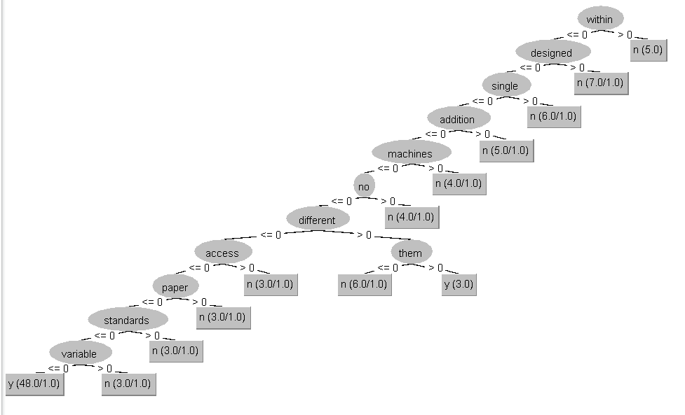

Slide 11
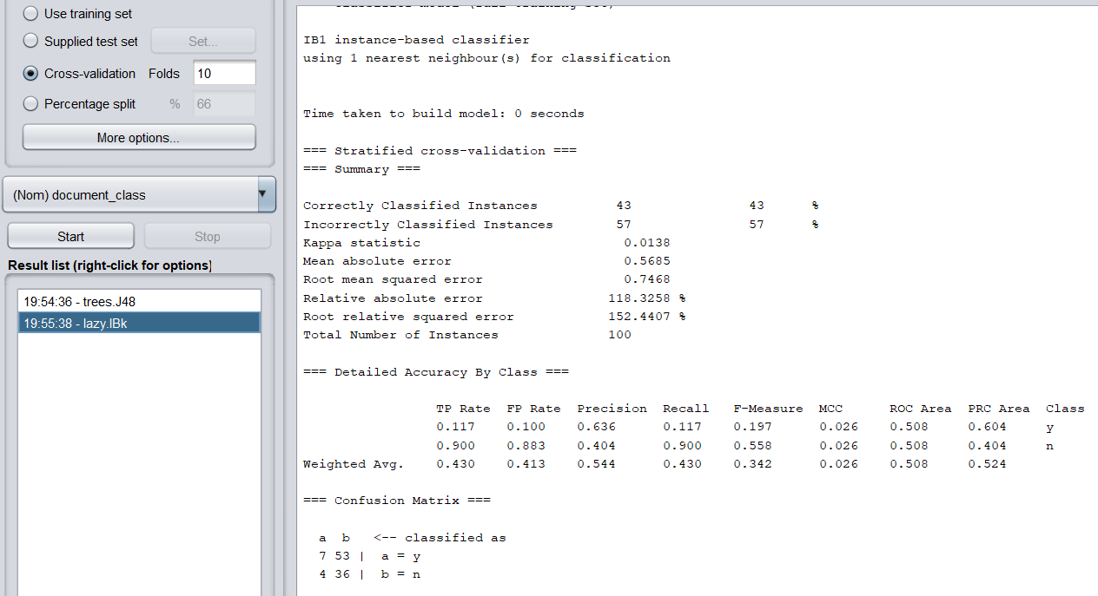
We could also run the dataset using the K-Nearest Neighbour Algorithm.
The results from both the Decision tree algorithm and KNN Algorithm are compared, and the results from the Decision Tree Algorithm seem to be better.

Slide 12

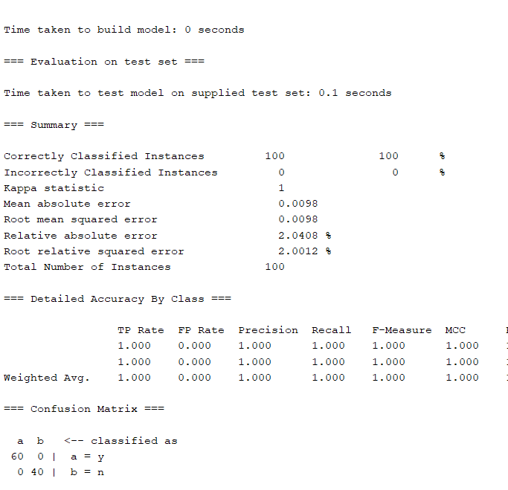
The testing dataset is built using the original ARFF file.
The testing dataset and training dataset are run in 10 fold cross-validation, and the results are obtained.
The testing and training dataset are spilt up into 34% and 66% respectively.

Slide 13
The last step is creating user data models.
Five user models are created along with a test dataset
These user models have different preferences and they are recorded each time using the 10 fold cross validations.
This will be helpful in recording the preferences and will be trained more and more so that it becomes easier for new users.

Slide 14
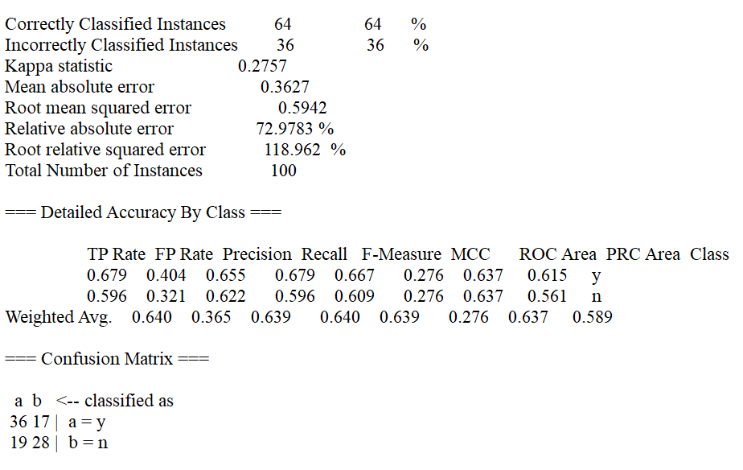

User 1
User 2

Slide 15
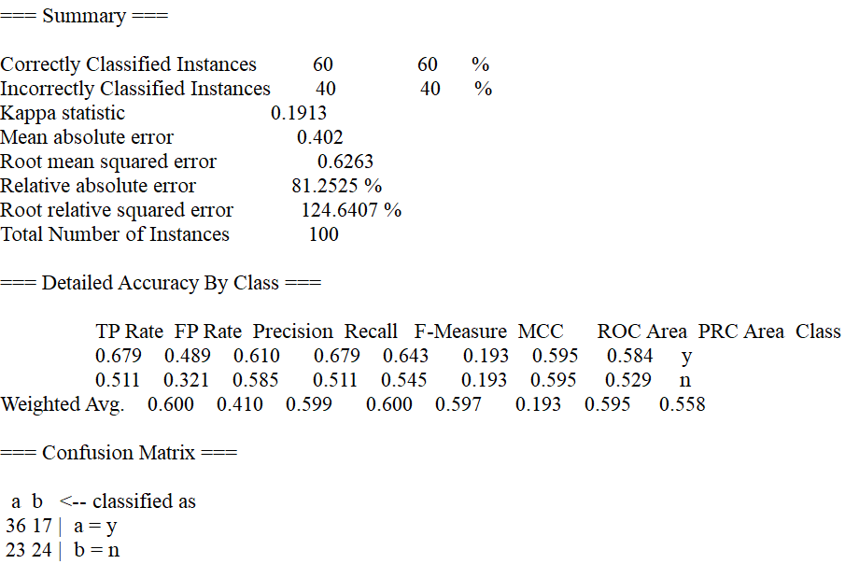
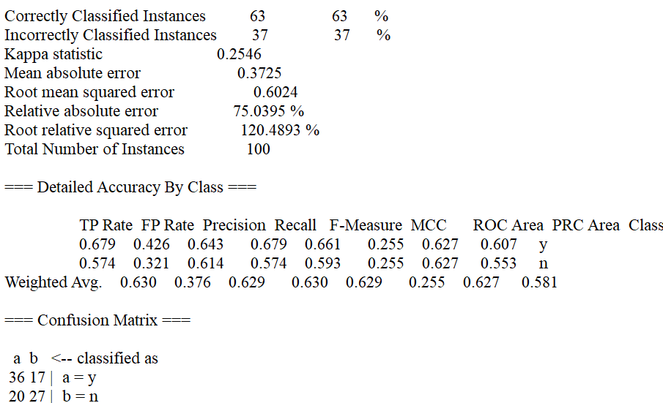
User 3
User 4

Slide 16
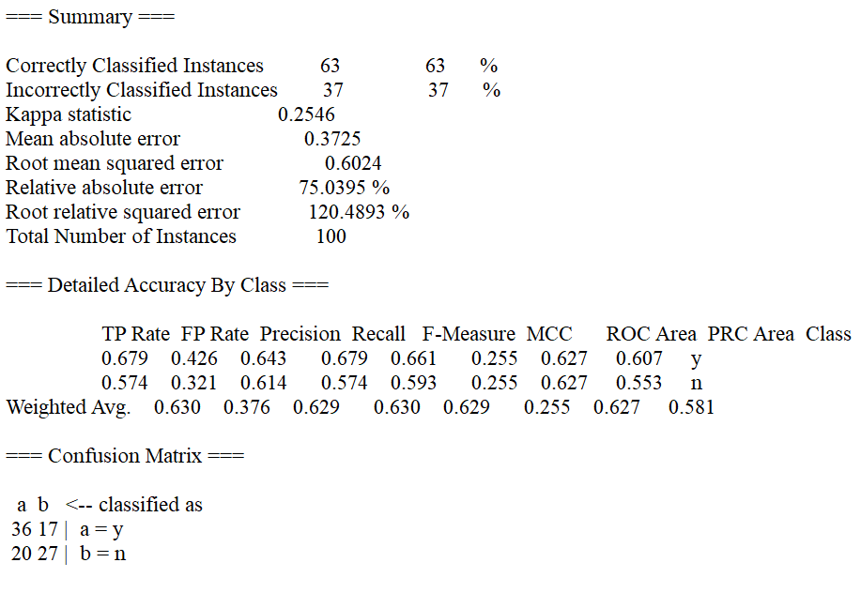
User 5

Slide 17
Conclusion
These models help in classifying the user according the preferences and the user models for every other user could be created in the real-time world, so that it becomes easy for searches to take place.
Hence this project could be used to find out the user preference for the old user and also the new user using the old user preference.
This enhances the searching techniques and makes it easy for the user. This could give us well-structured web, to search for the web documents.

Slide 18
Thank You
Questions ?

