Slide 1
WORLD HAPPINESS
Project
The

Slide 2




OUR TEAM
David Ruppel
Anjana Delhi
Morgan Tighe
Becky Ruth

Slide 3
Table of Contents
Overview
Process
Demo
Choosing Data and Creating the Vision
Set Up and Coding
Demonstration of our Application

Slide 4
Sources for Data and Mapping
The World Happiness Report
Kaggle
GeoJSON
Main source of data was 2019 numbers from The World Happiness Report
Kaggle data for Latitude and Longitude for the center markers of each country
GeoJSON was utilized to create vector maps

Slide 5
Uploading Data into Sqlite
Utilizing Pandas
Reading in CSV
Renaming Columns
Exporting to new CSV
SQLAlchemy
Read in CSV using Pandas
Creating engine and SQLite file to create db.py
Notes:
david

Slide 6
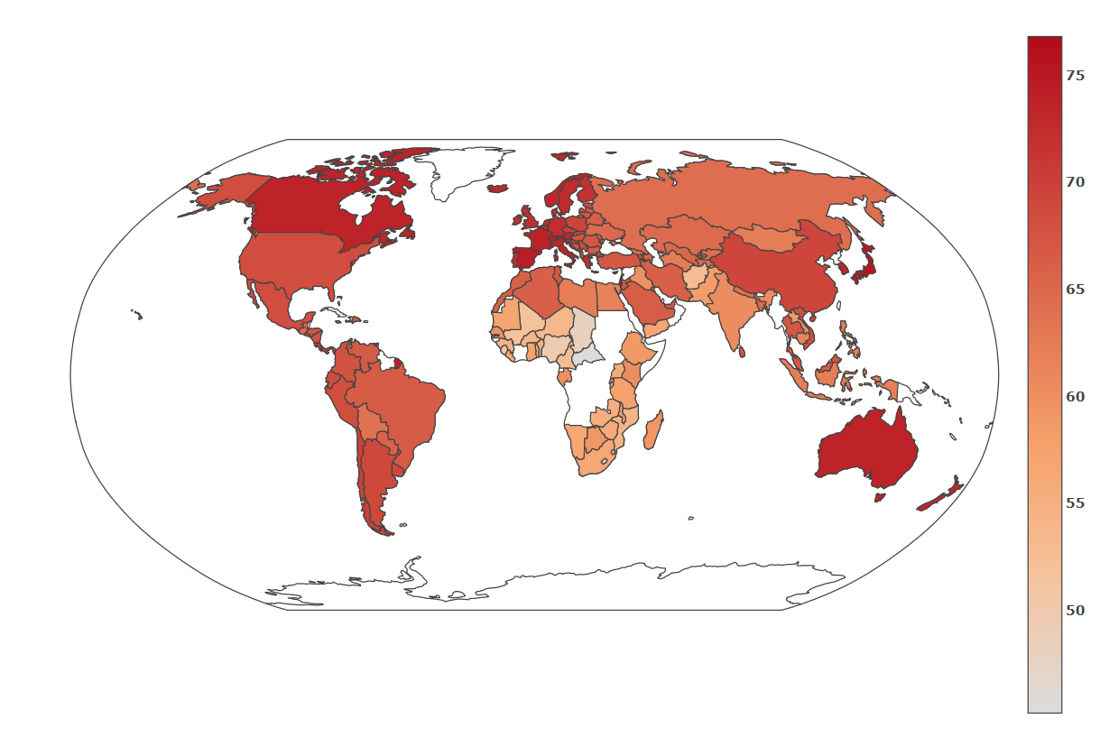
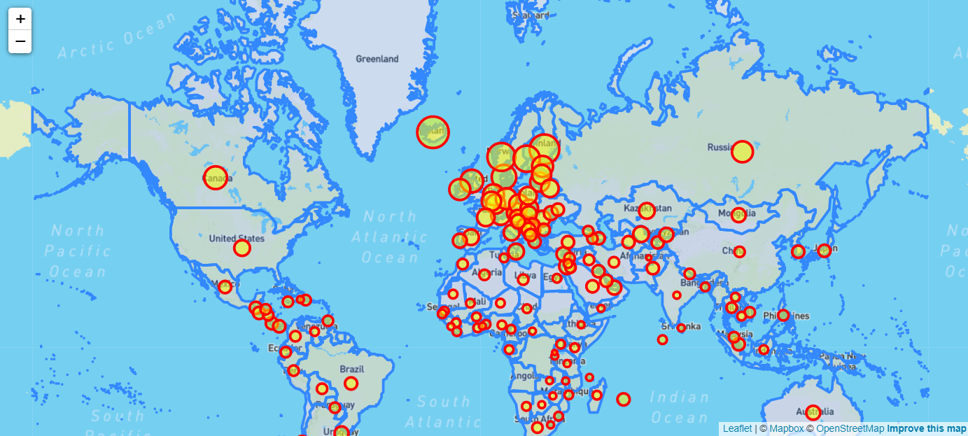
Visualizations
World Happiness Map
Life Expectancy Choropleth

Slide 7
Choropleth: a map that uses differences in shading, coloring, or the placing of symbols within predefined areas to indicate the average values of a property or quantity in those areas.
Creating the Choropleth
Creation
Life Expectancy data pulled in through Sqlite
Layout is formatted in Robinson Projection
Findings
Highest Life Expectancy Singapore: 76.8
Lowest Life Expectancy Central African Republic: 45.2
Notes:
Becky

Slide 8
Cantril Ladder Score: Asks respondents to think of a ladder, with the best possible life for them being a 10, and the worst possible life being a 0. They are then asked to rate their own current lives on that 0 to 10 scale.
Creating the Ladder Score Map
Geo json was used for maps
Leaflet was used to create a layer
Coded in JavaScript to create a map showing bubbles that correspond to the happiness score
Popup marker gives the country name and the score.
Notes:
Anjana

Slide 9
Formatting
Our Website
CSS
Flask
Main formatting of pages
Web server gateway interface
HTML
Javascript
Creation of web pages
Introducing interactive features
Notes:
David

Slide 10
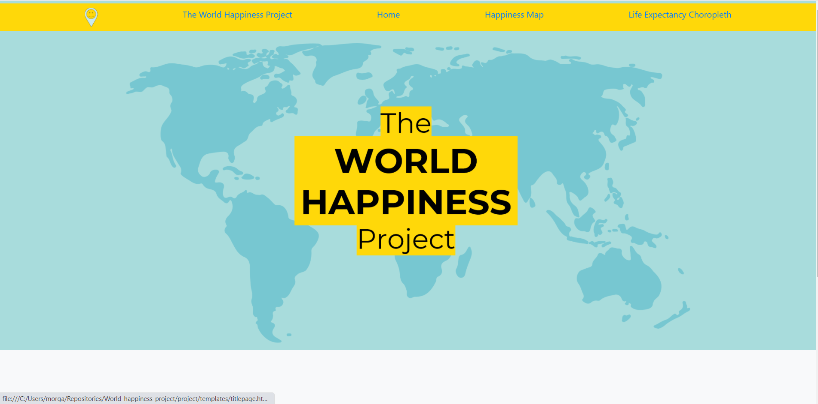
Our Webpage
Quick Demonstration of our Webpage
Notes:
Morgan

Slide 11
Any Questions?
Notes:
David

Slide 12
THANK YOU

